Slide 1
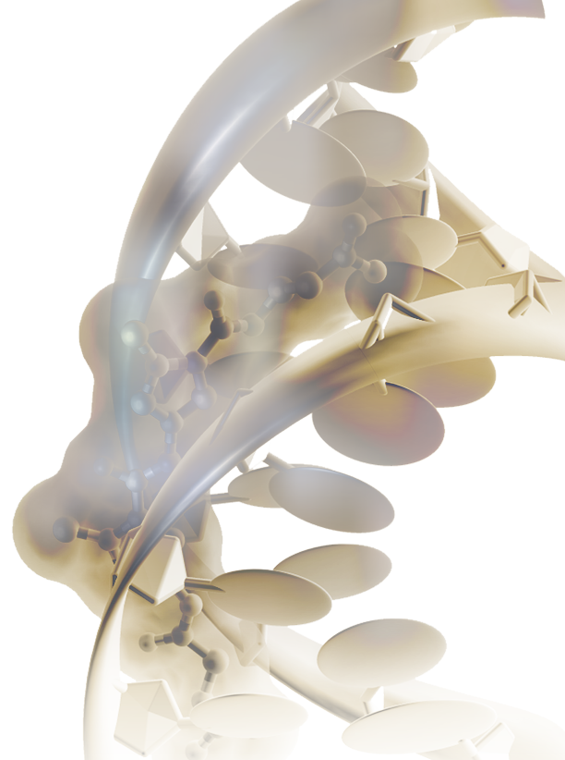


The Huntsman Cancer Institute (HCI) and Scientific Computing and Imaging (SCI) Institute Center for Cancer Data Science
Today, fundamental problems in cancer research are being solved with the help of data science and artificial intelligence.

Slide 4
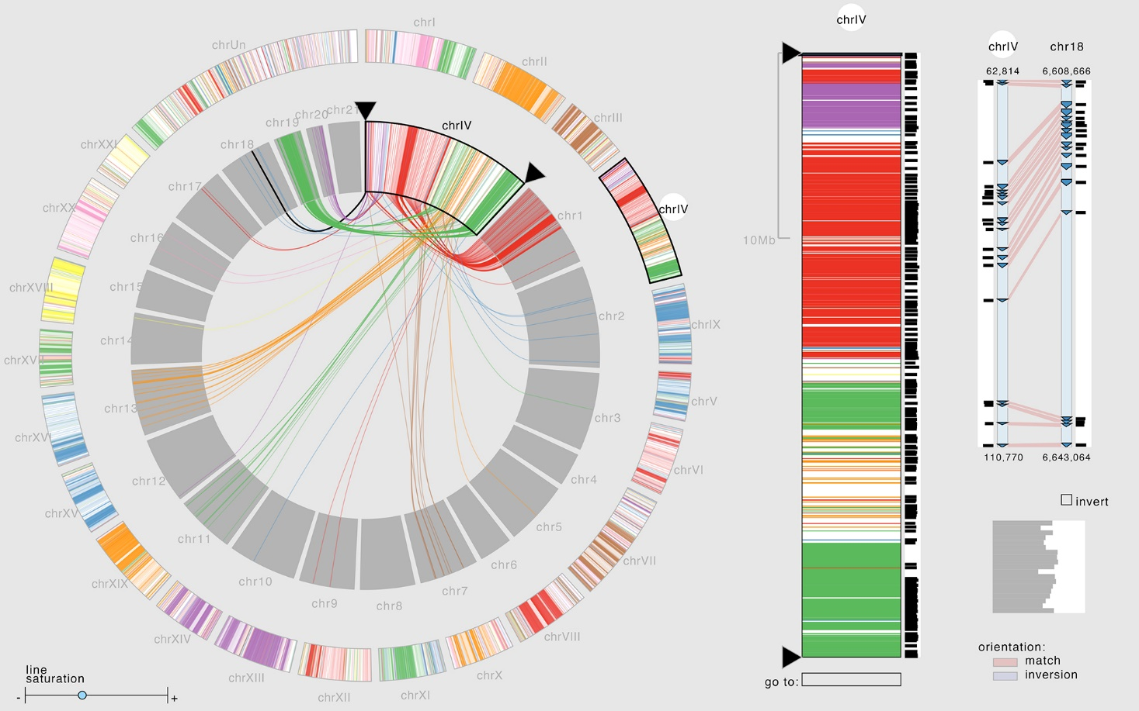
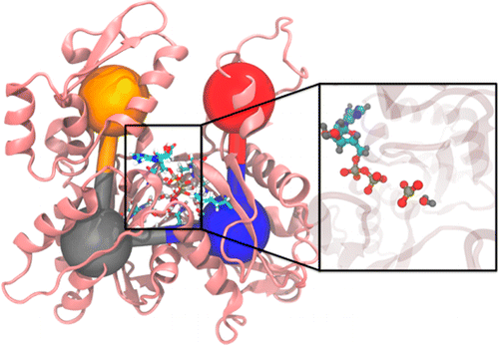
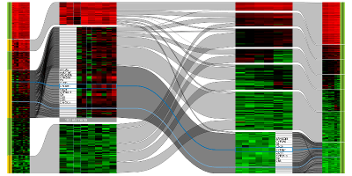
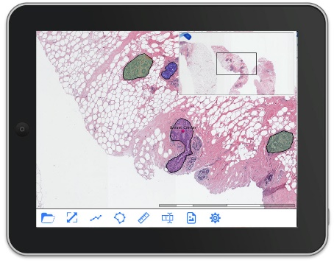
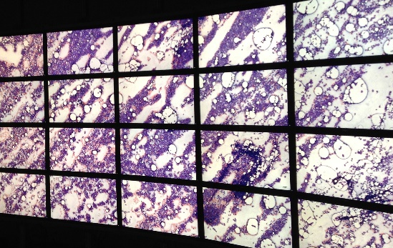
Fundamental Problems
in Cancer Research
1. Prevention
2. Detection
3. Prognosis and Diagnosis
4. Treatment
5. Drug Development
Data Science (or AI) Algorithms
1. Tensor Decompositions (Orly’s U01, Heidi’s K07, Rosalie’s F99)
2. Deep Learning in Image Analysis
(S. Joshi, R. Whitaker, and T. Tasdizen)
3. Visualization (A. Lex, M. Meyer, B. Wang)
      4. Large-Scale Simulation (M. Berzins, T. Bidone)
Cancer Data
1. Patients Information
(e.g., UPDB)
2. Tumor Samples
3. ’Omics (e.g., ORIEN)
4. Imaging
5. Model Organisms and
Systems
Data Science Data Management
1. Large-Scale Databases (F. Li)
2. Remote Access and Streaming (V. Pascucci)

Slide 5

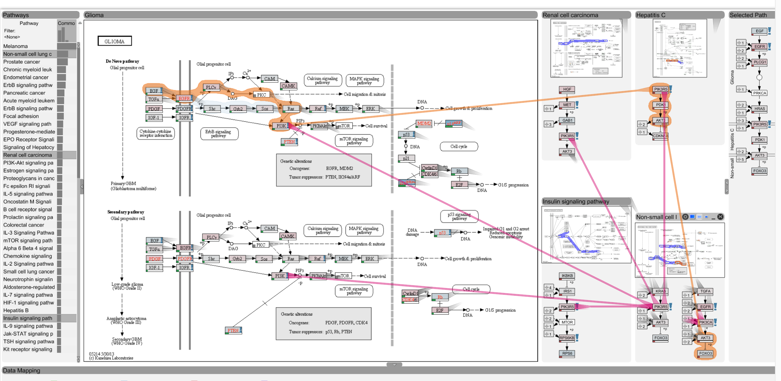
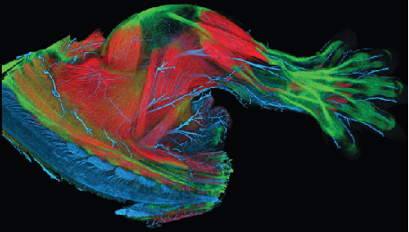
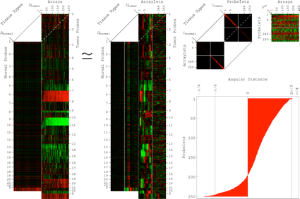
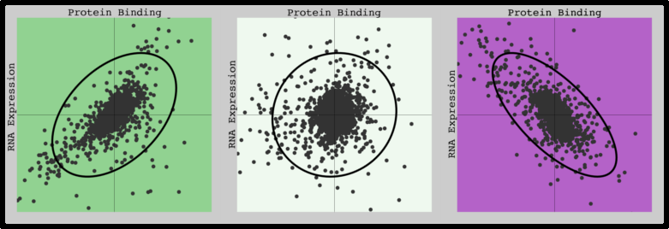
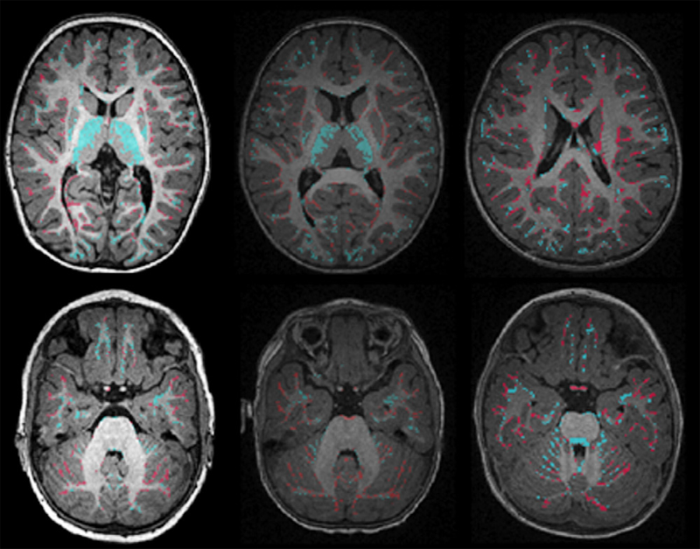
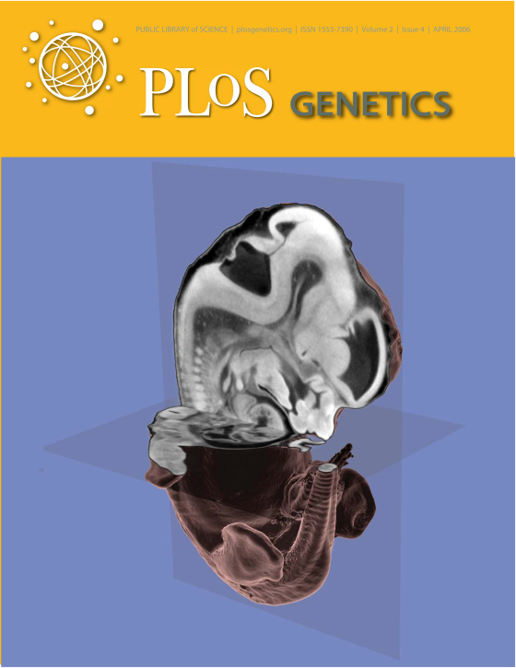
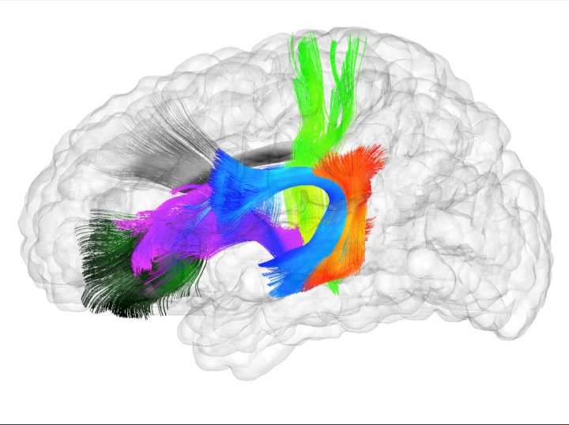
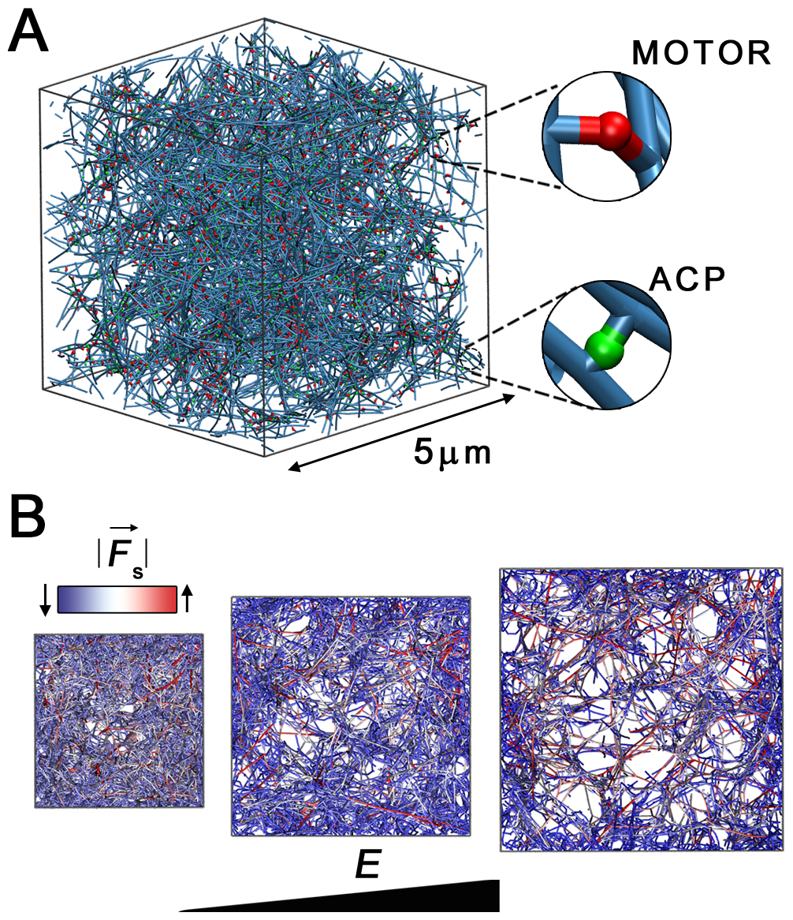
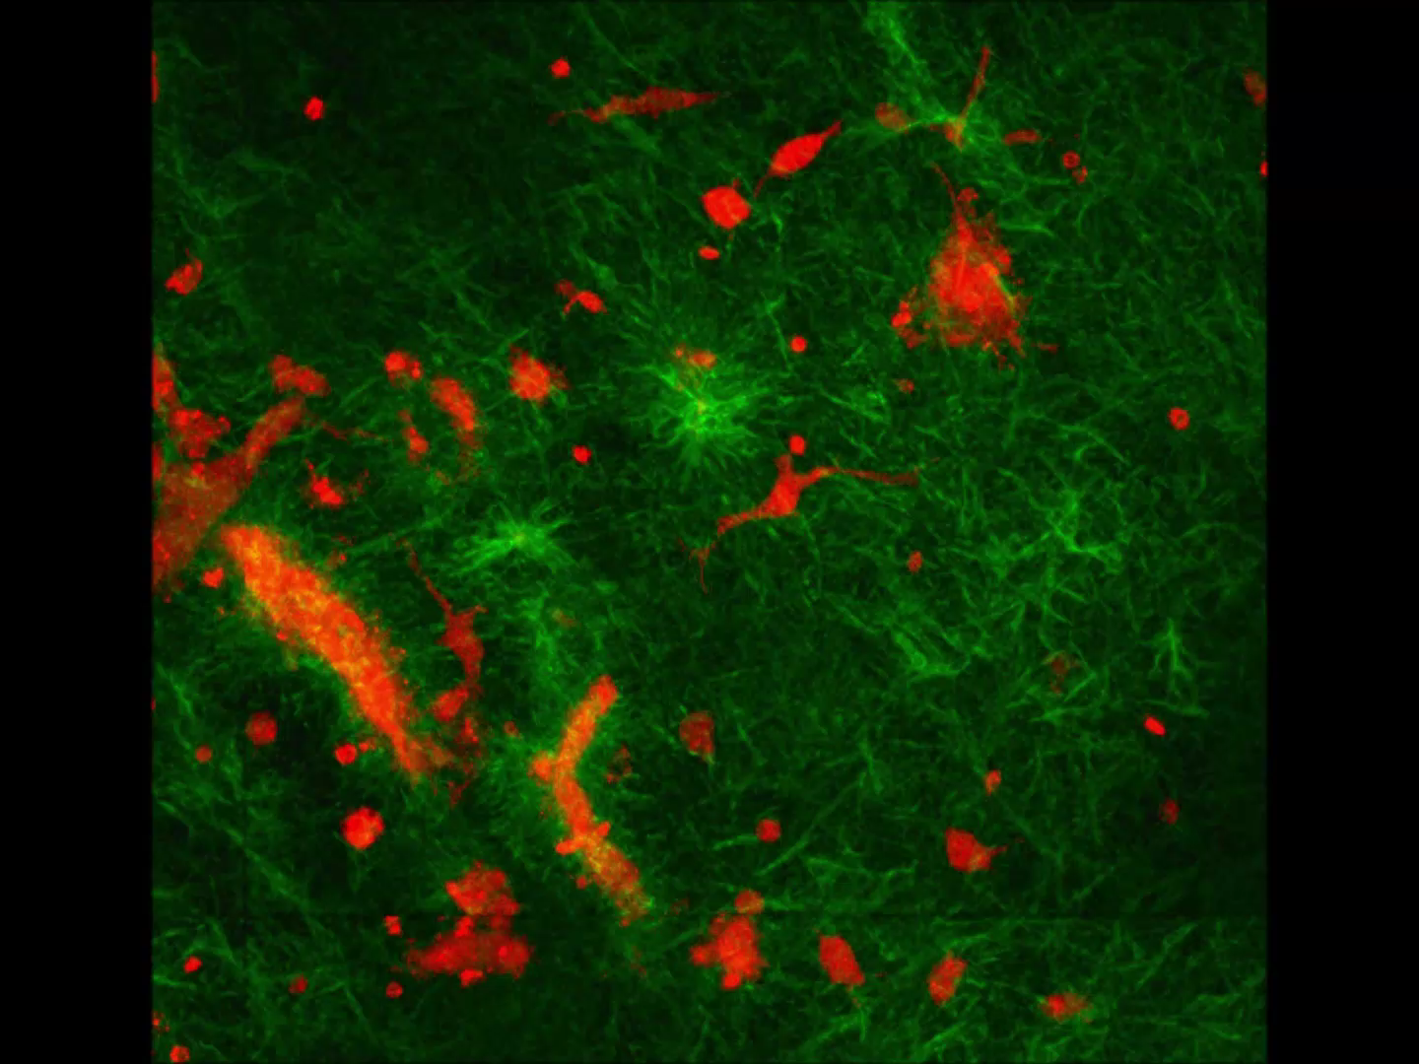
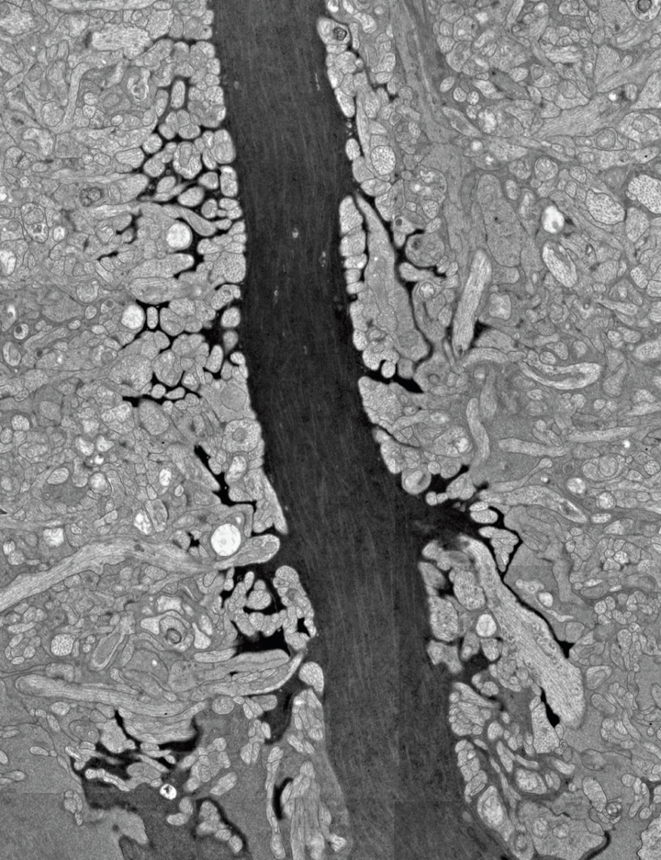
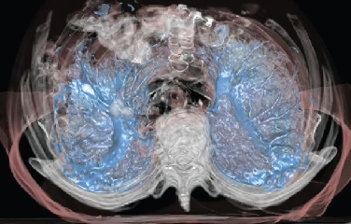
Research Cores
Visualization
+
HCI
Cancer Research
Computing
Image
Analysis

Slide 6




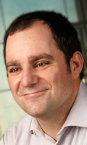
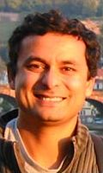
We will build upon the HCI and SCI expertises to become the best Center for Cancer Data Science (or AI) in the Western US (e.g., Broad Institute, Cornell in the Eastern US, Cancer Research UK initiative in Europe)
NIH releases strategic plan for data science, June 8, 2018
Advisory Board
Mary C. Beckerle
Chris R. Johnson
SCI UCDSC Core Faculty
Orly Alter
Tamara Biodone
Alex Lex
Sarang Joshi
New BMI Faculty

Slide 7
2018-2019
Start the Utah Cancer Data Science Initiative (UCDSI)
Start with 10 Core Faculty (5 from SCI and 5 from HCI)
Move Orly Alter’s faculty appointment from Bioengineering to Oncological Sciences (SCI 9 month FTE)
Search for a new junior SCI – BMI – HCI faculty member (SCI 9 month FTE) to start July 1, 2019. Start-up/Summer Salary from HCI.
Identify multiple funding opportunities, including a Center proposal
Identify 4 UCDSC Scholars (Orly and Sarang plus two from HCI)
2019 - 2020
New SCI FTE with an appropriate Department. Start-up/Summer Salary from HCI.
Formal proposal to create the UCDSC within the University
Start adding affiliate faculty
First UCDSC Hosted Workshop
Stress collaboration
2020 - 2021
New SCI FTE with an appropriate Department. Start-up/Summer Salary from HCI.
Review UCDSC Progress

Slide 8
Current SCI Cancer Projects – Alex Lex
Visual Analysis of Genomic and Clinical Data from Large Patient Cohorts (U01 CA198935) PI: Peter J. Park (Harvard Medical School)
Co-Investigators: Alexander Lex (University of Utah), Nils Gehlenborg, Hanspeter Pfister
Lineage: Integrating Clinical and Genetic Data with Genealogical Records (Utah Genome Project Seed Grant). PI: Lex Alexander; Co-Investigator: Hilary Coon.
SCI Cancer Publications
Carolina Nobre, Nils Gehlenborg, Hilary Coon, Alexander Lex
Lineage: Visualizing Multivariate Clinical Data in Genealogy Graphs
IEEE Transactions on Visualization and Computer Graphics, to appear, 2018
Michael Kern, Alexander Lex, Nils Gehlenborg, Chris R. Johnson. Interactive Visual Exploration And Refinement Of Cluster Assignments. BMC Bioinformatics, 2017
Hendrik Strobelt, Bilal Alsallakh, Joseph Botors, Brant Peterson, Mark Borowsky, Hanspeter Pfister, Alexander Lex. Vials: Visualizing Alternative Splicing of Genes. IEEE Transactions on Visualization and Computer Graphics (InfoVis ’15), 2016
Marc Streit, Alexander Lex, Samuel Gratzl, Christian Partl, Dieter Schmalstieg, Hanspeter Pfister, Peter Park, Nils Gehlenborg. Guided Visual Exploration of Genomic Stratifications in Cancer. Nature Methods, 2014

Slide 9
SCI Cancer Publications – Tamara Bidone
Integrin receptors are crucial to the initiation, progression and metastasis of solid tumors and are an appealing target for cancer therapies.
Studies about developing simulations approaches of integrin and integrin-based adhesion.
Tamara C Bidone , Anirban Polley , Jaehyeok Jin , Tristan Driscoll , Daniel Iwamoto , David Calderwood, Martin Schwartz, Gregory A Voth. Coarse-grained simulation of full-length integrin activation. Biophys J, 2018, Under review
Patrick W. Oakes, Tamara C. Bidone, Yvonne Beckham, Austin V. Skeeters, Guillermina R. Ramirez-San Juan, Stephen P. Winter, Gregory A. Voth, and Margaret L. Gardel. Lamellipodium is a myosin-independent mechanosensor. PNAS February 27, 2018.
Actomyosin tension and mechanosensing are critical in cancer growth and metastasis.
Computational models elucidating the general principles of actomyosin contractility and mechanosensing
Bidone TC, Jung W, Maruri D, Borau C, Kamm RD, Kim T. Morphological transformation and force generation of active cytoskeletal networks. PLoS Comput Biol. 2017 Jan 23;13(1):e1005277.
Borau C, Kim T, Bidone TC, García-Aznar JM, Kamm RD. Dynamic mechanisms of cell rigidity sensing: insights from a computational model of actomyosin network. PLoS One. 2012;7(11):e49174

Slide 10
Current SCI Cancer Projects - Sarang Joshi
Personalized Motion Management for Truly 4D Lung Stereotactic Body Radiotherapy (NCI R01CA169102: U of Maryland prime Utah PI: Joshi)
Validation and translation of a non-invasive, MR-guided breast cancer therapy (NCI 1R01CA224141 PI: Payne, Joshi)
Quantitative CT imaging biomarkers in lung cancer to assess prognosis and predict response to therapy on initial and longitudinal CT imaging: Pilot project with (Joshi, Schroeder and Akerley)
J. Hinkle, M. Szegedi, B. Wang, B. Salter, and S. Joshi. 4D CT image reconstruction with diffeomorphic motion model. Medical image analysis vol. 16(6) (2012), pp.1307–1316.
V. Sarkar, B. Wang, J. Hinkle, V. J. Gonzalez, Y. J. Hitchcock, P. Rassiah-Szegedi, S. Joshi, and B. J. Salter. Dosimetric evaluation of a virtual image-guidance alternative to explicit 6 degree of freedom robotic couch correction. Practical radiation oncology vol. 2(2) (2012), pp.122–137.
S. E. Geneser, J. Hinkle, R. M. Kirby, B. Wang, B. Salter, and S. Joshi. Quantifying variability in radiation dose due to respiratory-induced tumor motion. Medical image analysis vol. 15(4) (2011), pp.640–649.
Previous Collaborations with HCI

Slide 11
Current SCI Cancer Projects – Orly Alter
Principal Investigator:
$2,970,389 in NCI U01 CA-202144, 9/23/2015–8/31/2020: Multi-Tensor Decompositions for Personalized Cancer Diagnostics and Prognostics, to PI O. Alter with co-investigators H. A. Hanson, R. L. Jensen, C. A. Palmer, and C. T. Wittwer, and consultant R. A. Horn (University of Utah); http://physics.cancer.gov/network/UniversityofUtah.aspx
$113,751 in NCI U01 CA-202144 S1, Year 2: Clinical Translation of a Platform-Independent Genomic Predictor of GBM, to PI O. Alter.
$147,865 in NCI U01 CA-202144 S2, Year 3: Subtyping Prostate Cancer using a Familial Multi-Omics Analysis, to PI O. Alter, with co-investigator H. A. Hanson (University of Utah).
$7,500 in Cancer Research (CR) UK Project, 3/27/2007– : Global Effects of DNA Replication and DNA Replication Origin Activity on Eukaryotic Gene Expression, to PI O. Alter (University of Utah) with co-investigator J. F. X. Diffley (CR UK).
Co-Mentor:
$747,520 in NCI K07 CA230150, 7/6/2018–6/30/2023: Subtyping Bladder Cancer: A Multi-omic, Exposure-informed, Genealogical Approach (MErGE), to PI H. A. Hanson with mentor N. J. Camp and co-mentors O. Alter and K. R. Smith (University of Utah).

Slide 12
Current SCI Cancer Projects – Orly Alter
Co-Mentor (continued):
$360,000 in HCI IRG 129785 American Cancer Society (ACS) grant, 1/1/2017–12/31/2019, to PI D. E. Ayer, with review board members N. Agarwal, O. Alter, D. E. Ayer, M. E. Engel, D. Grossman, A. C. Kirchhoff, K. B. Mooney, P. J. Moos, T. G. Oliver, E. A. Raetz, J. P. Rutter, C. M. Ulrich, K. E. Varley, B. E. Welm, T. L. Werner, and J. T. Yap (University of Utah).
$1,043,208 in NIDDK T32 DK-110966, 7/1/2016–6/30/2021: The University of Utah Interdisciplinary Training Program in Bioinformatics and Diabetes, Obesity and Metabolic Disease, to PIs W. W. Chapman and S. J. Fisher, with with computational mentors F. R. Adler, O. Alter, B. R. Cairns, L. A. Cannon-Albright, T. E. Cheatham, M. B. Cummins, J. M. Dean, G. Del Fiol, K. Eilbeck, J. C. Faceli, A. L. Fogelson, B. S. Gibson, T. H. Greene, J. F. Hurdle, L. B. Jorde, S. Joshi, K. Kawamoto, J. P. Keener, A. Lex, G. Luo, G. T. Marth, R. S. MacLeod, C. McAdam-Marx, A. R. Quinlan, M. D. Yandell, and biological mentors B. K. Ambati, S. Beddhu, S. Boudina, A. K. Cheung, D. H. C. Chou, M. J. Drummond, T. E. Graham, C. T. Gregg, M. E. R. Harnett, R. Hess, A. L. Hughes, D. E. Kohan, L. A. Lesniewski, D. Y. Li, T. G. Liou, C. L. Murtaugh, R. M. O’Connell, K. L. Raphael, J. L. Round, J. P. Rutter, A. Schlegel, A. G. Smith, C. S. Thummel, C. J. Villanueva, C. K. Welt, A. S. Weyrich, D. R. Winge, and T. Yang (University of Utah).

Slide 13
Current SCI Cancer Projects – Orly Alter
Co-Mentor (continued):
$1,366,000 in NHGRI T32 HG-008962, 6/1/2016–5/31/2021: The University of Utah Health Sciences (UUHS) Training Program in Genomic Medicine, to PI L. B. Jorde (University of Utah), with external advisory committee members E. R. Mardis (Washington University in St. Louis and Nationwide Children’s Hospital), J. A. Phillips, III (Vanderbilt University), and L. J. Ptacek (University of California at San Francisco), internal steering committee members and mentors B. R. Cairns, N. J. Camp, D. Y. Li, D. W. Neklason, K. R. Smith, S. H. Tavtigian, M. W. Varner, D. H. Viskochil, K. V. Voelkerding, R. B. Weiss, M. D. Yandell, and J. H. Yost, steering committee member and emerging mentor L. C. Murtaugh, steering committee members S. B. Bleyl, J. L. Contreras, and W. H. Dere, mentors O. Alter, J. L. Bonkowsky, J. R. Botkin, D. I. Brixner, L. A. Cannon-Albright, H. H. Coon, K. Eilbeck, J. Gertz, S. L. Guthery, K. A. Kaphingst, G. T. Marth, A. R. Quinlan, J. D. Schiffman, M. Tristani-Firouzi, C. K. Welt, and A. S. Weyrich, and emerging mentors L. Brunelli, A. Kumanovics, and K. E. Varley (University of Utah).

Slide 14
Selected Cancer Publications – HCI Investigator Orly Alter
https://www.alterlab.org/orly/genetics.html
Book in Preparation
O. Alter, Genomic Signal Processing: Discovery of Principles of Nature from Matrix and Tensor Modeling of Large-Scale Molecular Biological Data. New York, NY: Wiley-Interscience (in preparation).
Journal Papers
K. A. Aiello and O. Alter, "Platform-Independent Genome-Wide Pattern of DNA Copy-Number Alterations Predicting Astrocytoma Survival and Response to Treatment Revealed by the GSVD Formulated as a Comparative Spectral Decomposition," Public Library of Science (PLoS) One 11 (10), article e0164546 (October 2016); doi: 10.1371/journal.pone.0164546.
P. Sankaranarayanan,* T. E. Schomay,* K. A. Aiello and O. Alter, "Tensor GSVD of Patient- and Platform-Matched Tumor and Normal DNA Copy-Number Profiles Uncovers Chromosome Arm-Wide Patterns of Tumor-Exclusive Platform-Consistent Alterations Encoding for Cell Transformation and Predicting Ovarian Cancer Survival," Public Library of Science (PLoS) One 10 (4), article e0121396 (April 2015); doi: 10.1371/journal.pone.0121396.
Press Release: J. Kiefer, "New Method Increases Accuracy of Ovarian Cancer Prognosis and Diagnosis," American Association for the Advancement of Science (AAAS) EurekAlert! (April 15, 2015).
Feature: R. Atkins, "Calculating Cancer Cures," National Academy of Engineering (NAE) Innovation Podcast and Radio Series (April 19, 2015).
Feature: F. Pavlou, "Big Data, Hidden Knowledge," The Pathologist (June 15, 2015).

Slide 15
Cancer Publications – HCI Investigator Orly Alter
Journal Papers (continued):
N. M. Bertagnolli, J. A. Drake, J. M. Tennessen and O. Alter, "SVD Identifies Transcript Length Distribution Functions from DNA Microarray Data and Reveals Evolutionary Forces Globally Affecting GBM Metabolism," Public Library of Science (PLoS) One 8 (11), article e78913 (November 2013); doi: 10.1371/journal.pone.0078913.
C. H. Lee,* B. O. Alpert,* P. Sankaranarayanan and O. Alter, "GSVD Comparison of Patient-Matched Normal and Tumor aCGH Profiles Reveals Global Copy-Number Alterations Predicting Glioblastoma Multiforme Survival," Public Library of Science (PLoS) One 7 (1), article e30098 (January 2012); doi: 10.1371/journal.pone.0030098.
S. P. Ponnapalli, M. A. Saunders, C. F. Van Loan and O. Alter, "A Higher-Order Generalized Singular Value Decomposition for Comparison of Global mRNA Expression from Multiple Organisms," Public Library of Science (PLoS) One 6 (12), article e28072 (December 2011); doi: 10.1371/journal.pone.0028072.
Mention: Among 10% Most Cited in PLoS One.
C. Muralidhara, A. M. Gross, R. R. Gutell and O. Alter, "Tensor Decomposition Reveals Concurrent Evolutionary Convergences and Divergences and Correlations with Structural Motifs in Ribosomal RNA," Public Library of Science (PLoS) One 6 (4), article e18768 (April 2011); doi: 10.1371/journal.pone.0018768.
L. Omberg, J. R. Meyerson, K. Kobayashi, L. S. Drury, J. F. X. Diffley and O. Alter, "Global Effects of DNA Replication and DNA Replication Origin Activity on Eukaryotic Gene Expression," Molecular Systems Biology (MSB) 5, article 312 (October 2009); doi: 10.1038/msb.2009.70.
Review: M. Méchali, Faculty of 1000 evaluation 1728974 (February 2010).
L. Omberg, G. H. Golub and O. Alter, "A Tensor Higher-Order Singular Value Decomposition for Integrative Analysis of DNA Microarray Data from Different Studies," Proceedings of the National Academy of Sciences (PNAS) USA 104 (47), pp. 18371–18376 (November 2007); doi: 10.1073/pnas.0709146104.

