Slide 1
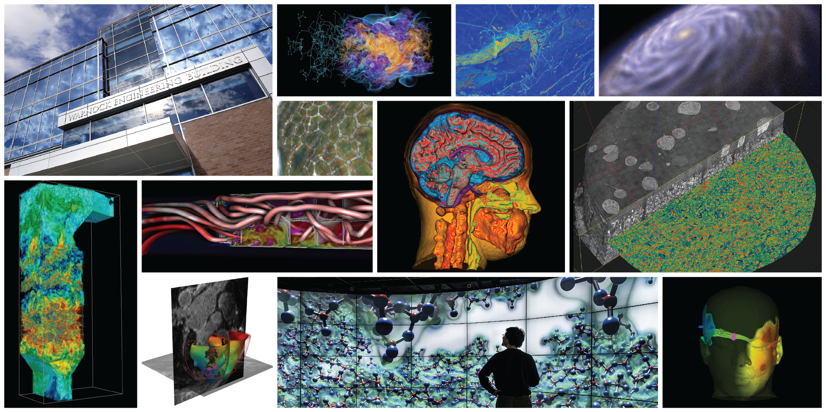
Uncertainty Visualization

Slide 2
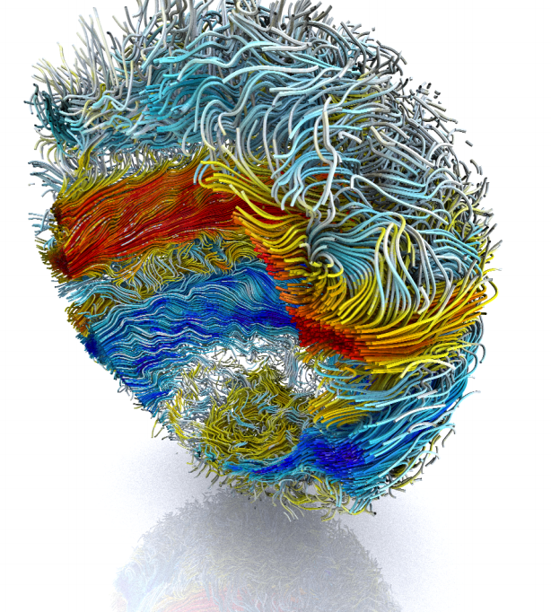
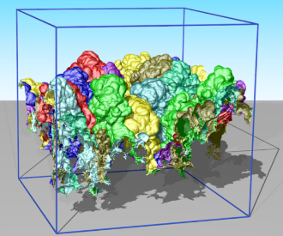
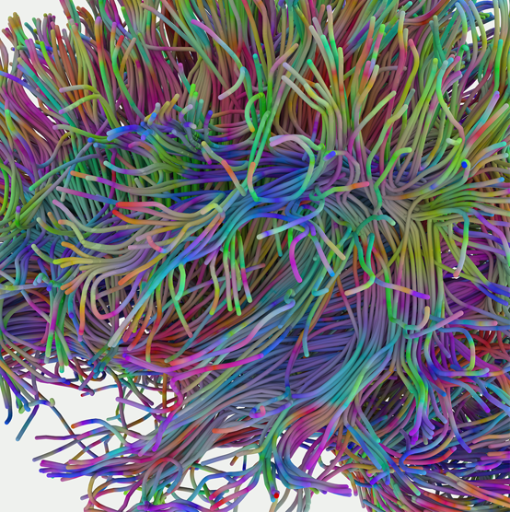
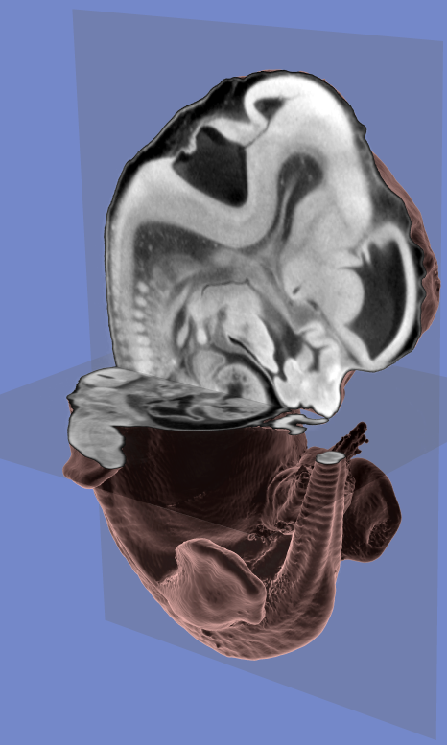
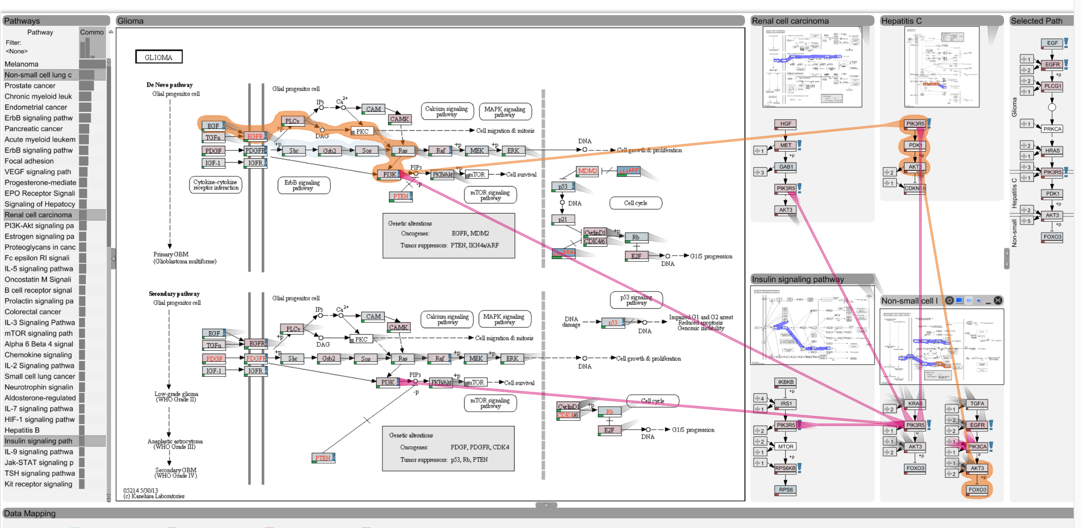
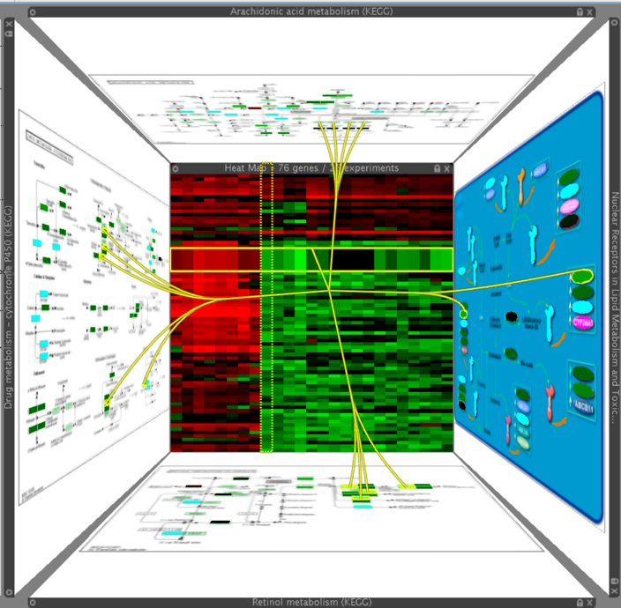

Slide 3
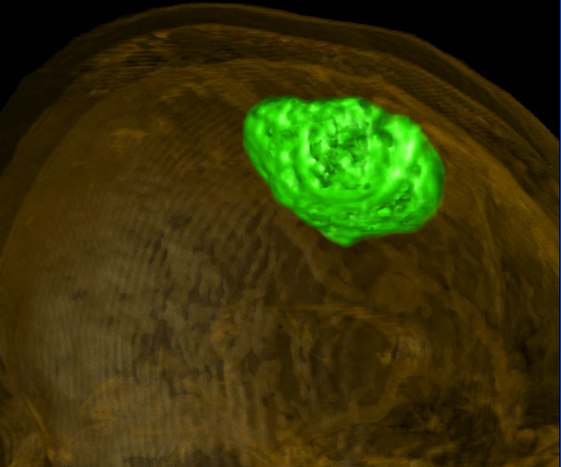
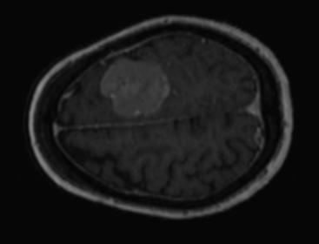
Decision Making Under Uncertainty
Surfaces imply certainty
Scientific Computing and Imaging Institute, University of Utah

Slide 4
Uncertainty Quotes
Richard Feynman: What is not surrounded by uncertainty cannot be the truth.
Richard Feynman: If you thought that science was certain, well, that is just an error on your part.
George Box: All models are wrong. Some models are useful.
John W. Tukey: Far better an approximate answer to the right question, which is often vague, than an exact answer to the wrong question, which can always be made precise.
Francis Bacon - If we begin with certainties, we shall end in doubts; but if we begin with doubts, and are patient in them, we shall end in certainties
Winston Churchill: True genius resides in the capacity for evaluation of uncertain, hazardous, and conflicting information.
Scientific Computing and Imaging Institute, University of Utah

Slide 5
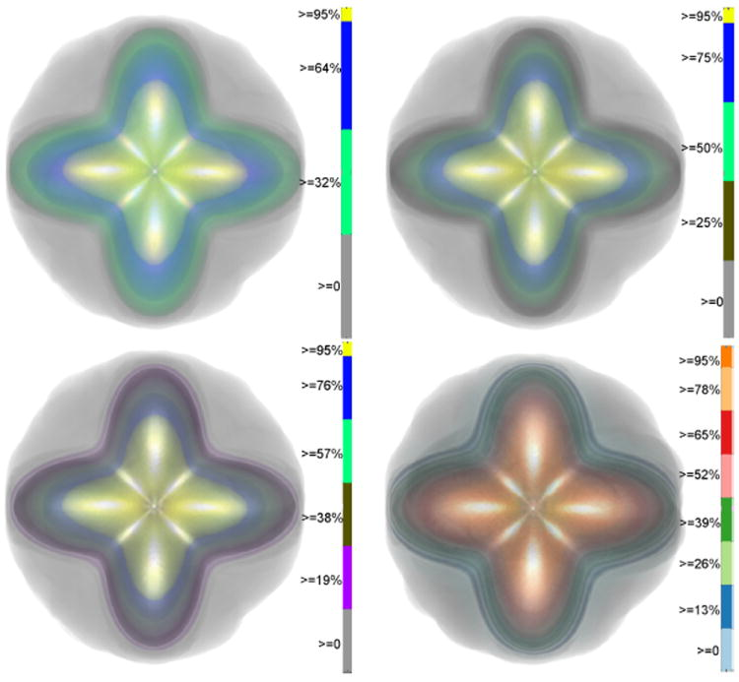
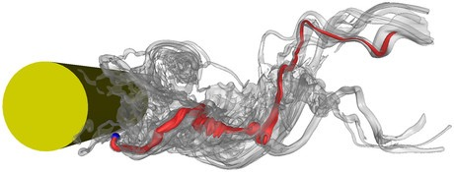
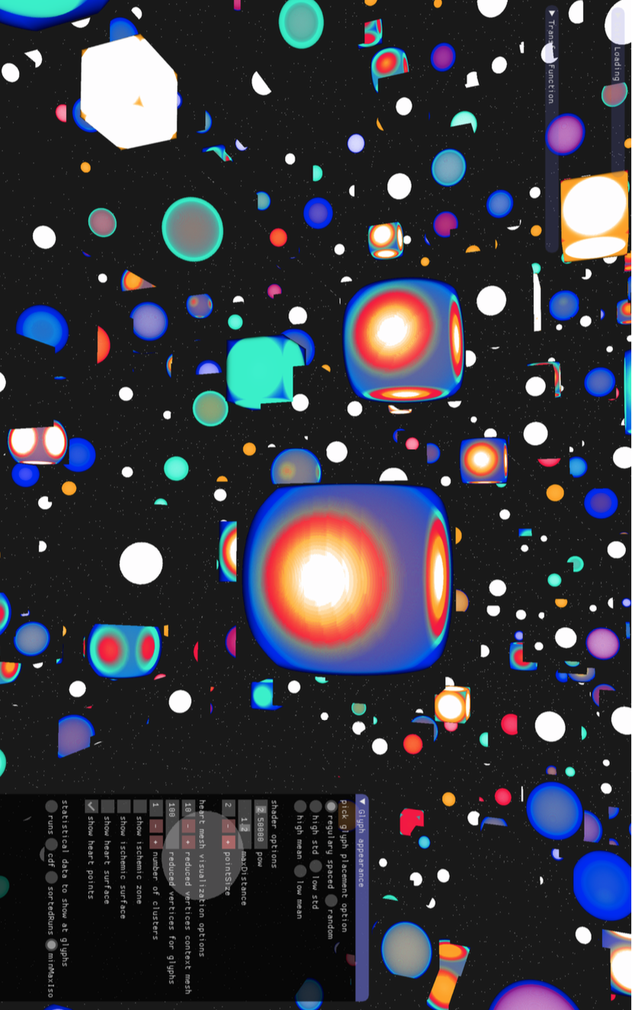
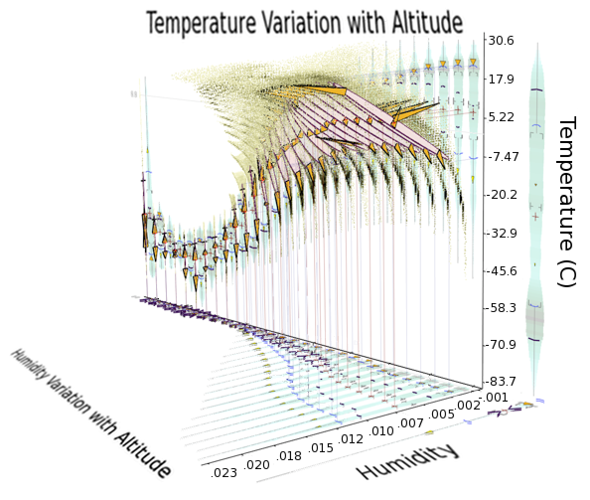
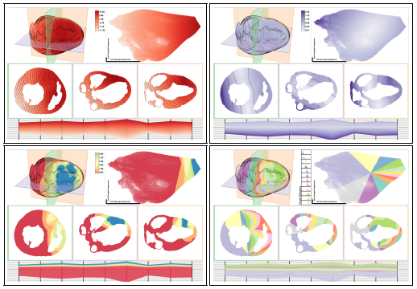
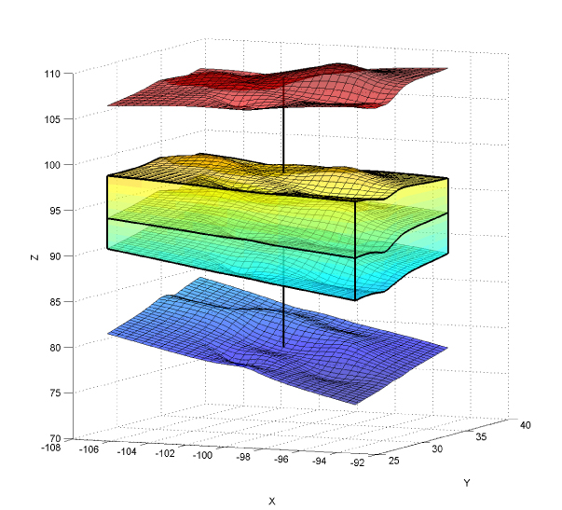
Uncertainty Visualization
G.P. Bonneau, H.C. Hege, C.R. Johnson, M.M. Oliveira, K. Potter, P. Rheingans, T. Schultz. “Overview and State-of-the-Art of Uncertainty Visualization,” In Scientific Visualization: Uncertainty, Multifield, Biomedical, and Scalable Visualization, Edited by M. Chen and H. Hagen and C.D. Hansen and C.R. Johnson and A. Kauffman, Springer-Verlag, pp. 3-27. 2014.
M.G. Genton, C.R. Johnson, K. Potter, G. Stenchikov, Y. Sun. “Surface boxplots,” In Stat Journal, Vol. 3, No. 1, pp. 1-11. 2014.
K. Potter, P. Rosen, C.R. Johnson. “From Quantification to Visualization: A Taxonomy of Uncertainty Visualization Approaches,” In Uncertainty Quantification in Scientific Computing, IFIP Series, Vol. 377, Springer, pp. 226-249. 2012.
K. Potter, A. Wilson, P.-T. Bremer, D. Williams, C. Doutriaux, V. Pascucci, C.R. Johnson. “Ensemble-Vis: A Framework for the Statistical Visualization of Ensemble Data,” In Proceedings of the 2009 IEEE International Conference on Data Mining Workshops, pp. 233-240. 2009.
C.R. Johnson, A.R. Sanderson. “A Next Step: Visualizing Errors and Uncertainty,” In IEEE Computer Graphics and Applications, Vol. 23, No. 5, pp. 6-10. September/October, 2003.
When is the last time you’ve seen an error
bar in a visualization of complex data ?

Slide 6
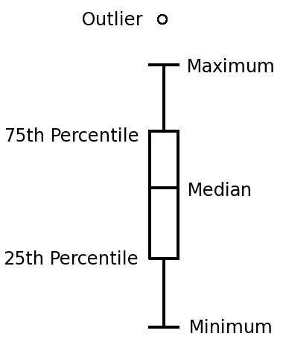
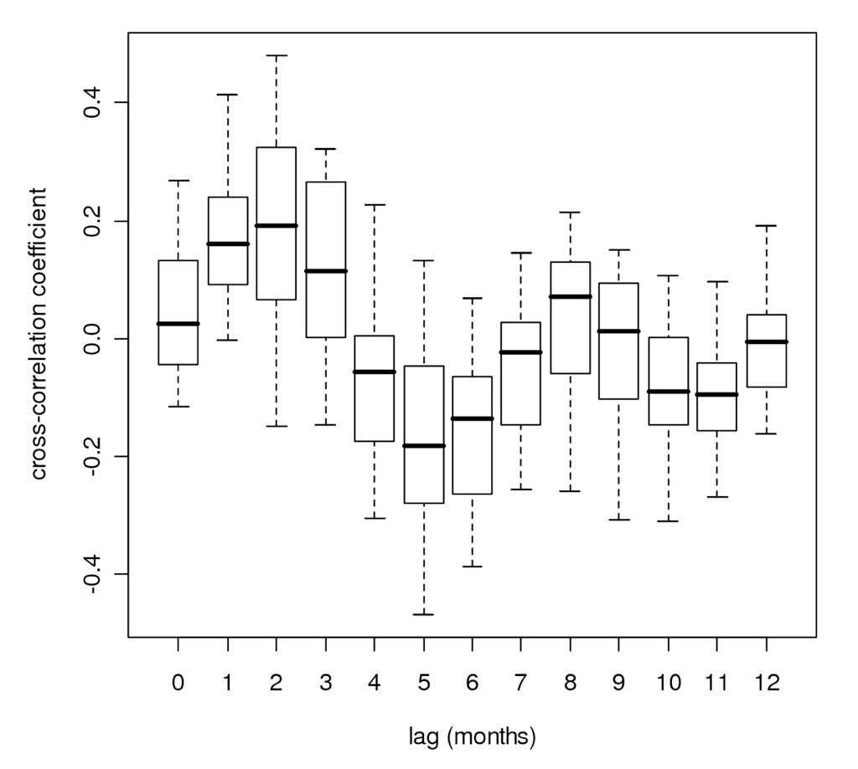
Traditional Display of Uncertainty
Boxplots (Tukey, 1977)
Quartile range including median
Outliers
Assume Gaussian
Scientific Computing and Imaging Institute, University of Utah

Slide 7
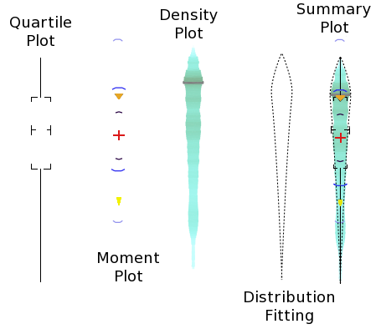
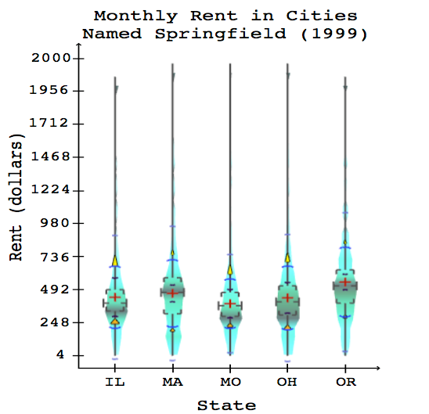
The Summary Plot
Augment boxplot with numerous display techniques
Emphasize characteristics other than mean/variance
Indicate quantity & location of uncertainty
K. Potter, J. Kniss, R. Riesenfeld, C.R. Johnson.
"Visualizing Summary Statistics and Uncertainty".
In Proc Eurovis 2010, 29(3), 2010.
Scientific Computing and Imaging Institute, University of Utah

Slide 8
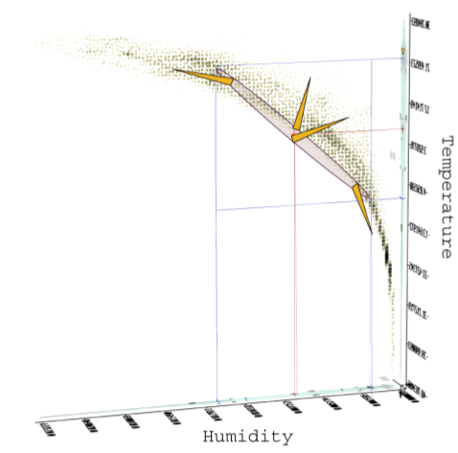
Summary Plot in Higher Dimensions
Statistics similar to summary plot
Highlight correlations
K. Potter, J. Kniss, R. Riesenfeld, C.R. Johnson.
"Visualizing Summary Statistics and Uncertainty".
In Proc Eurovis 2010, 29(3), 2010.
Scientific Computing and Imaging Institute, University of Utah

Slide 9
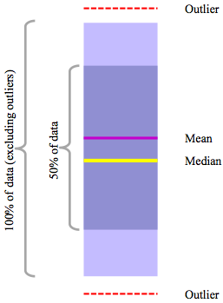
Contour Box Plots
Whitaker, Mirzargar, Kirby, IEEE Transactions on Visualization and Computer Graphics, Vol. 19, No. 12, pp. 2713--2722, 2013.
M.G. Genton, C.R. Johnson, K. Potter, G. Stenchikov, Y. Sun. “Surface boxplots,” In Stat Journal, Vol. 3, No. 1, pp. 1-11. 2014.

Slide 10
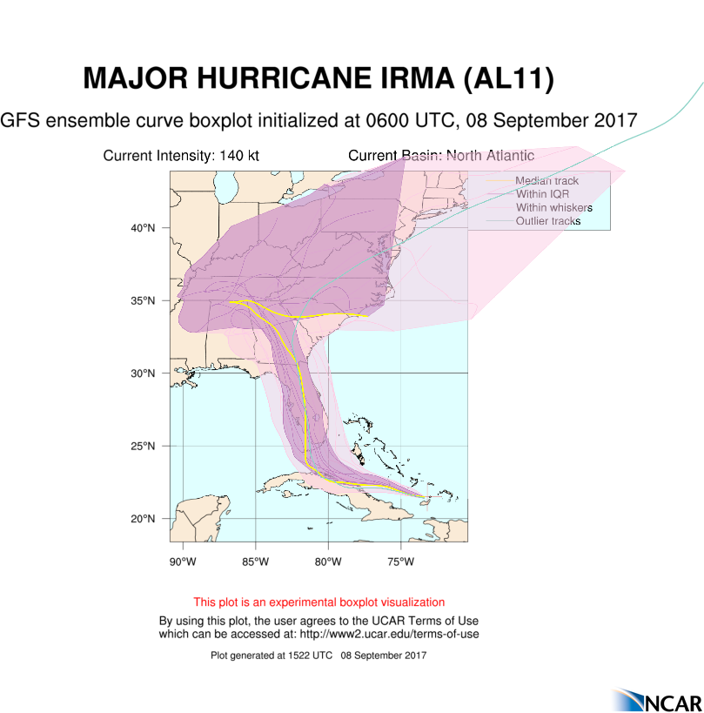
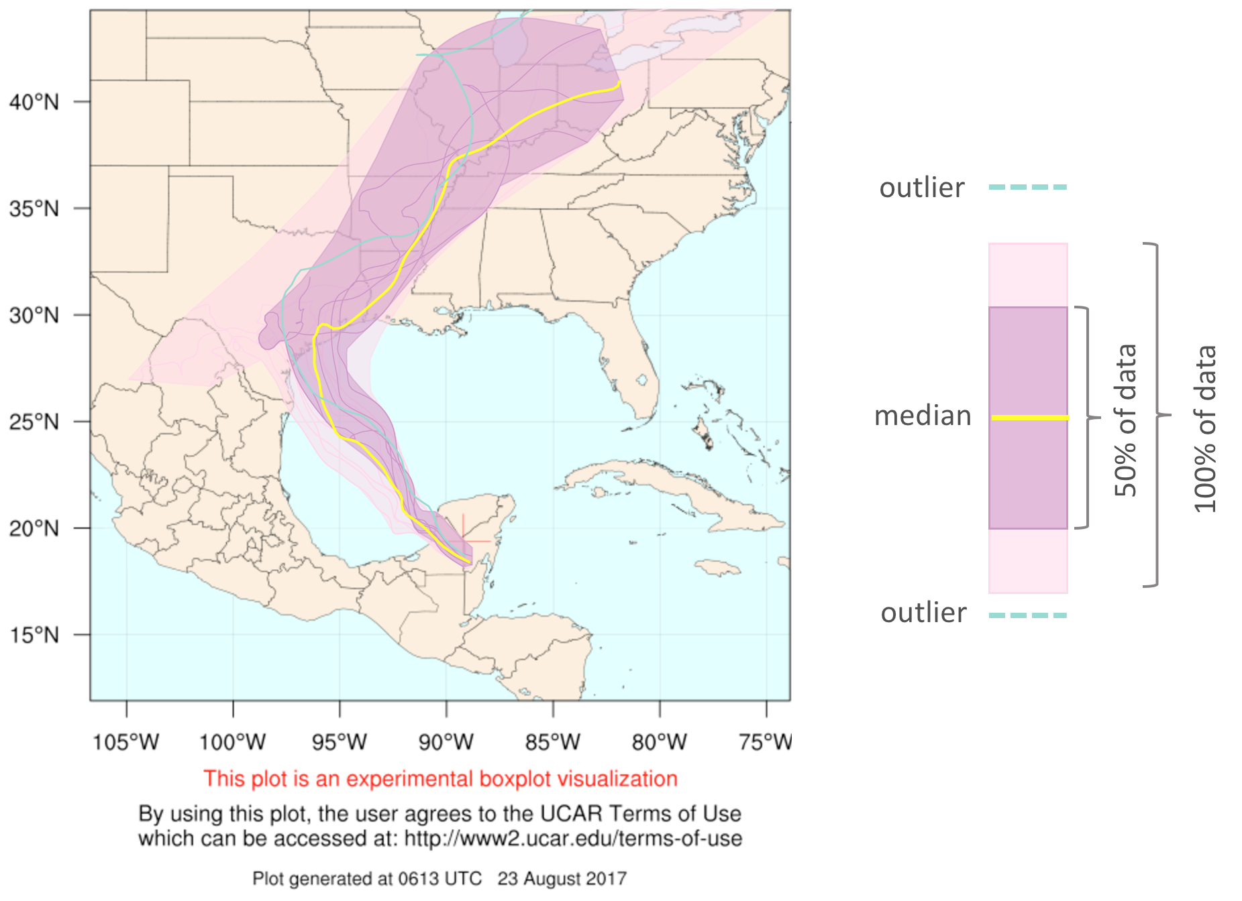
Ensemble Curved Boxplot
M. Mirzargar, R. Whitaker, R. M. Kirby. “Curve Boxplot: Generalization of Boxplot for Ensembles of Curves,”
IEEE Transactions on Visualization and Computer Graphics, Vol. 20, No. 12, IEEE, pp. 2654-63. December, 2014.

Slide 11
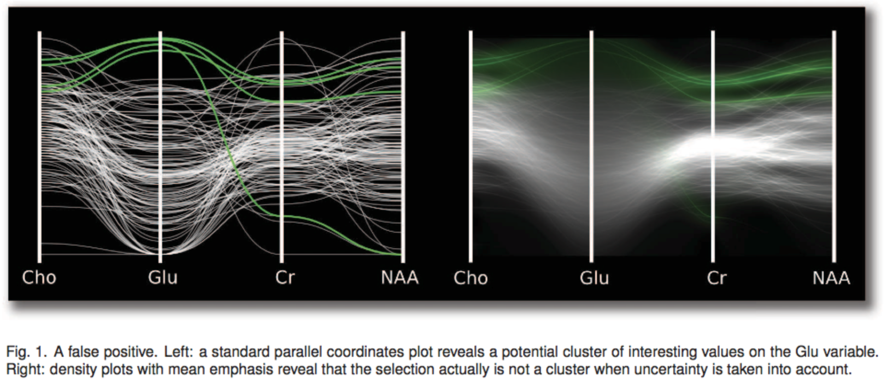
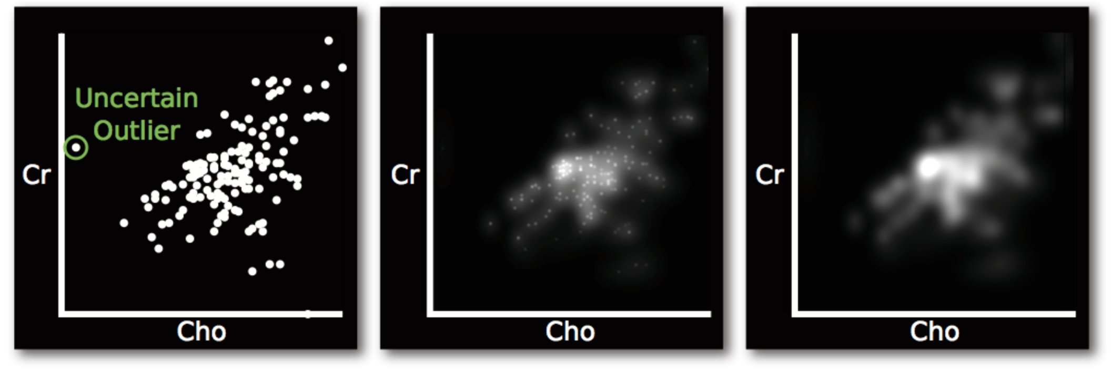
Feng, D., Kwock, L., Lee, Y., & Taylor, R. M., 2nd (2010). Matching visual saliency to confidence in plots of uncertain data. IEEE transactions on visualization and computer graphics, 16(6), 980–989. doi:10.1109/TVCG.2010.176

Slide 12
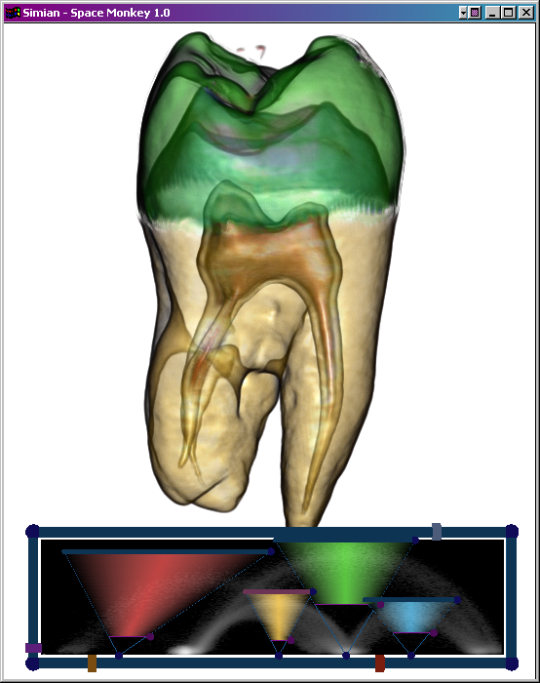
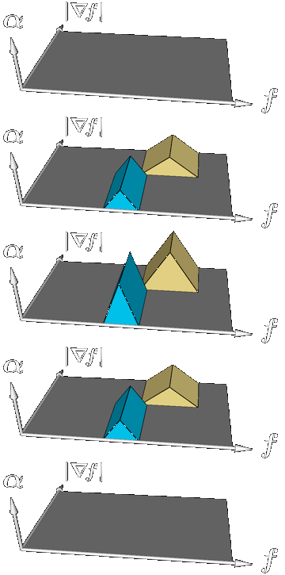
3D Transfer Function
+
0
-
Scientific Computing and Imaging Institute, University of Utah

Slide 13
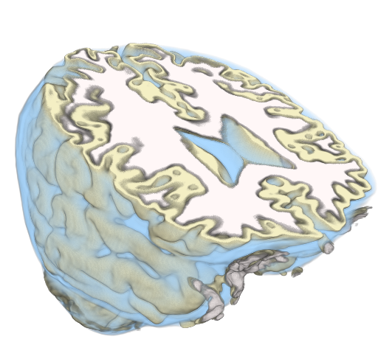
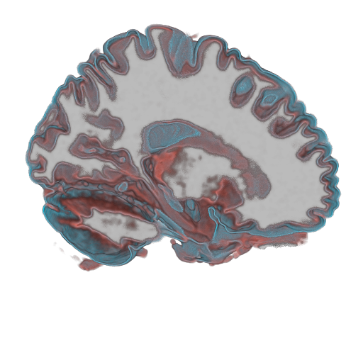
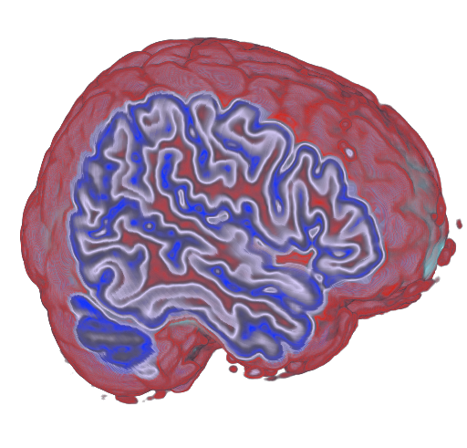
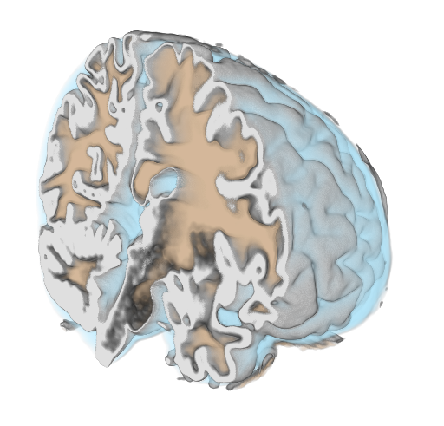
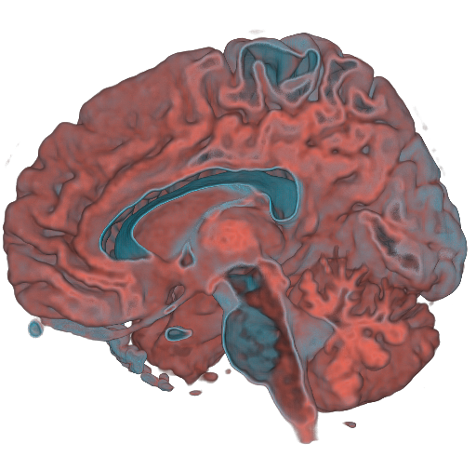
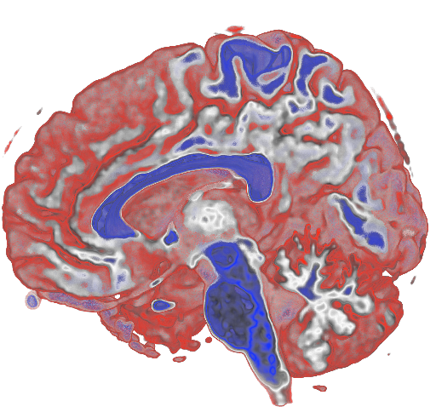
Visualizing Uncertainty Using Volume Rendering
Fuzzy
Sensitivity
Confidence
Scientific Computing and Imaging Institute, University of Utah
Notes:
More of a different kind. Make sure we have a demo here….

Slide 14
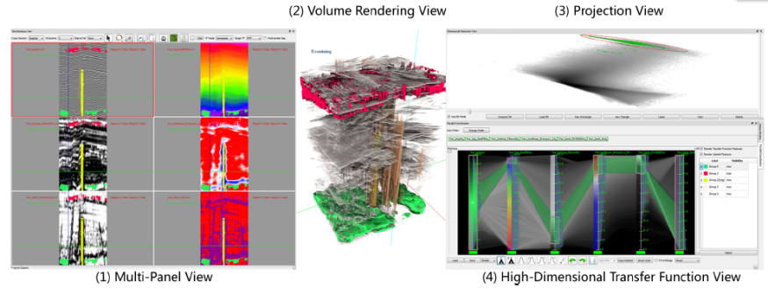
High Dimensional Transfer Functions
Create Transfer Functions (TFs) from user selected samples in spatial domain and error/uncertainty.
Multiple linked views.
Notes:
We propose to create TFs from …
A system with three stages and four linked views is proposed: … explain
Use the animation

Slide 15
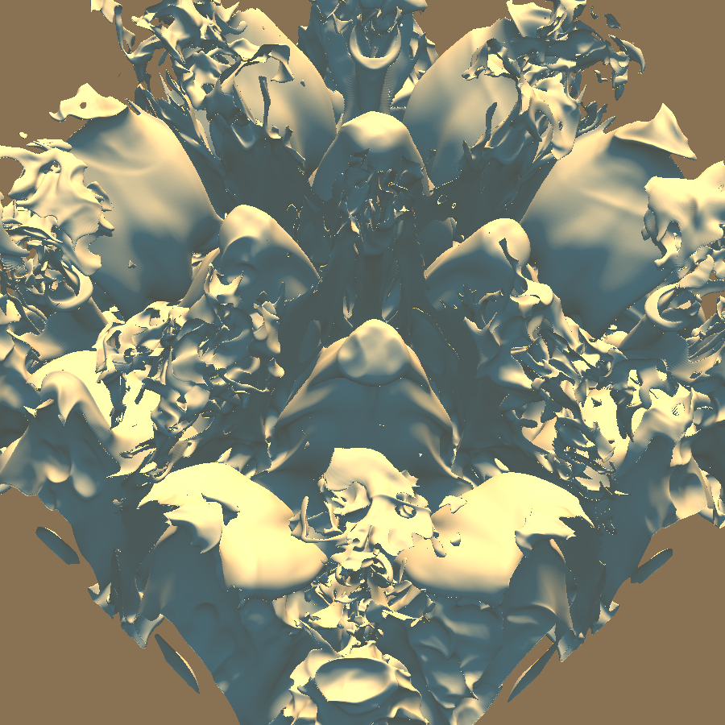
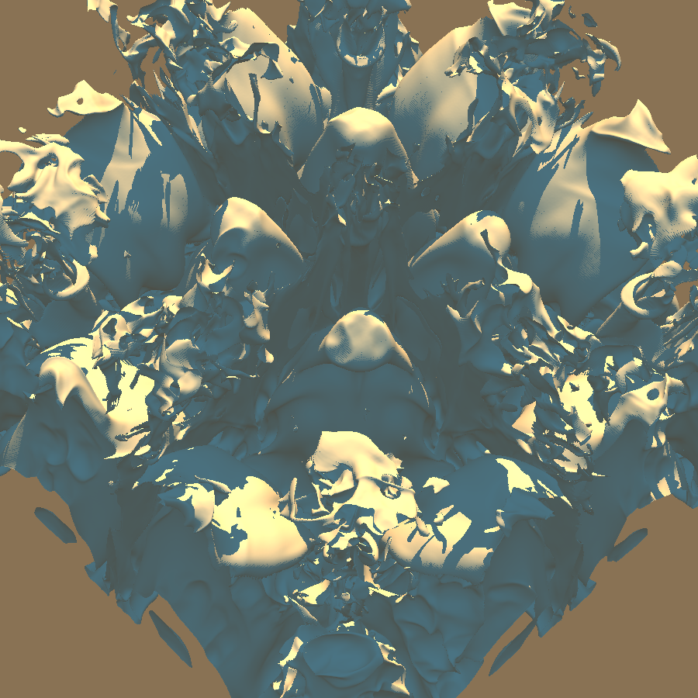
Perceptual Uncertainty
Scientific Computing and Imaging Institute, University of Utah

Slide 16
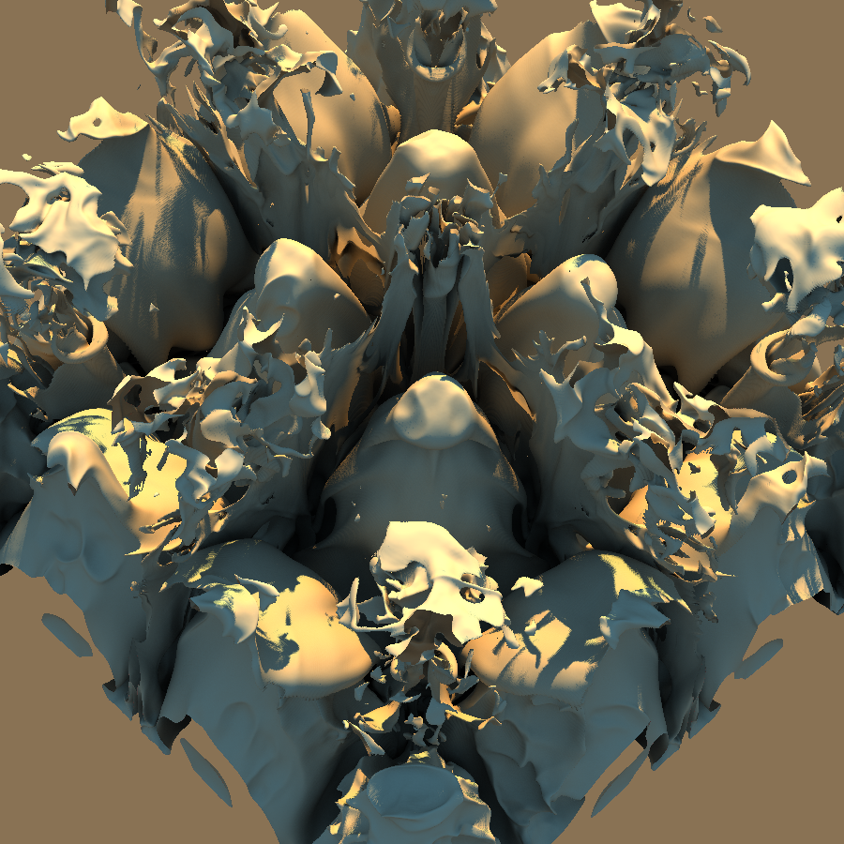
Perceptual Uncertainty
Scientific Computing and Imaging Institute, University of Utah

Slide 17
Path of water through a karst limestone structure of a ground sample analysis visualizing stone porosity and the spatial arrangement of the flow traces.

Slide 18
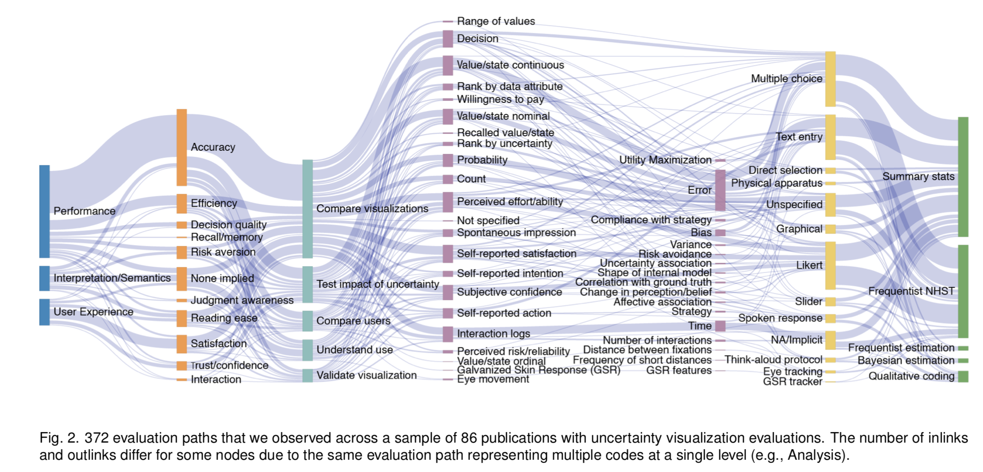
In Pursuit of Error: A Survey of Uncertainty Visualization Evaluation
Jessica Hullman, Xiaoli Qiao, Michael Correll, Alex Kale, Matthew Kay
IEEE Trans. Visualization & Comp. Graphics (Proc. InfoVis), 2019

Slide 19
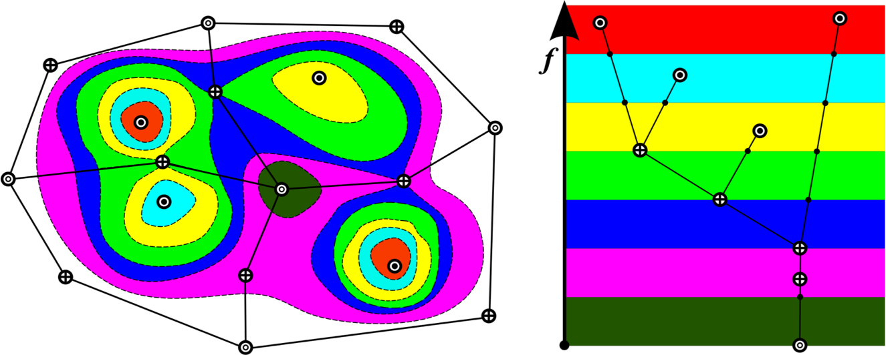
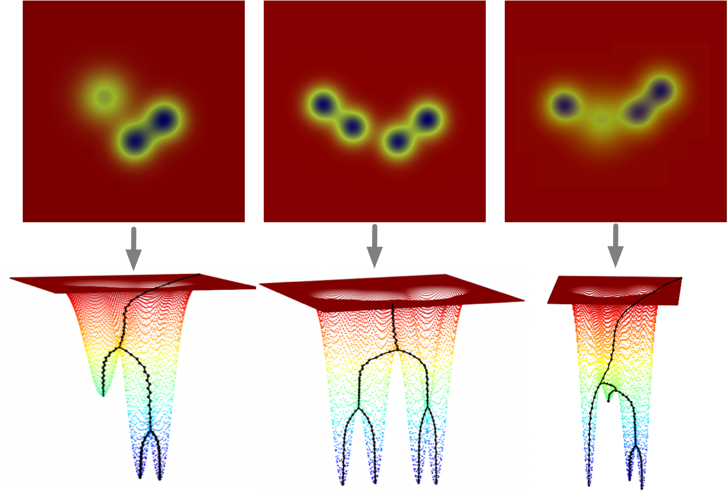
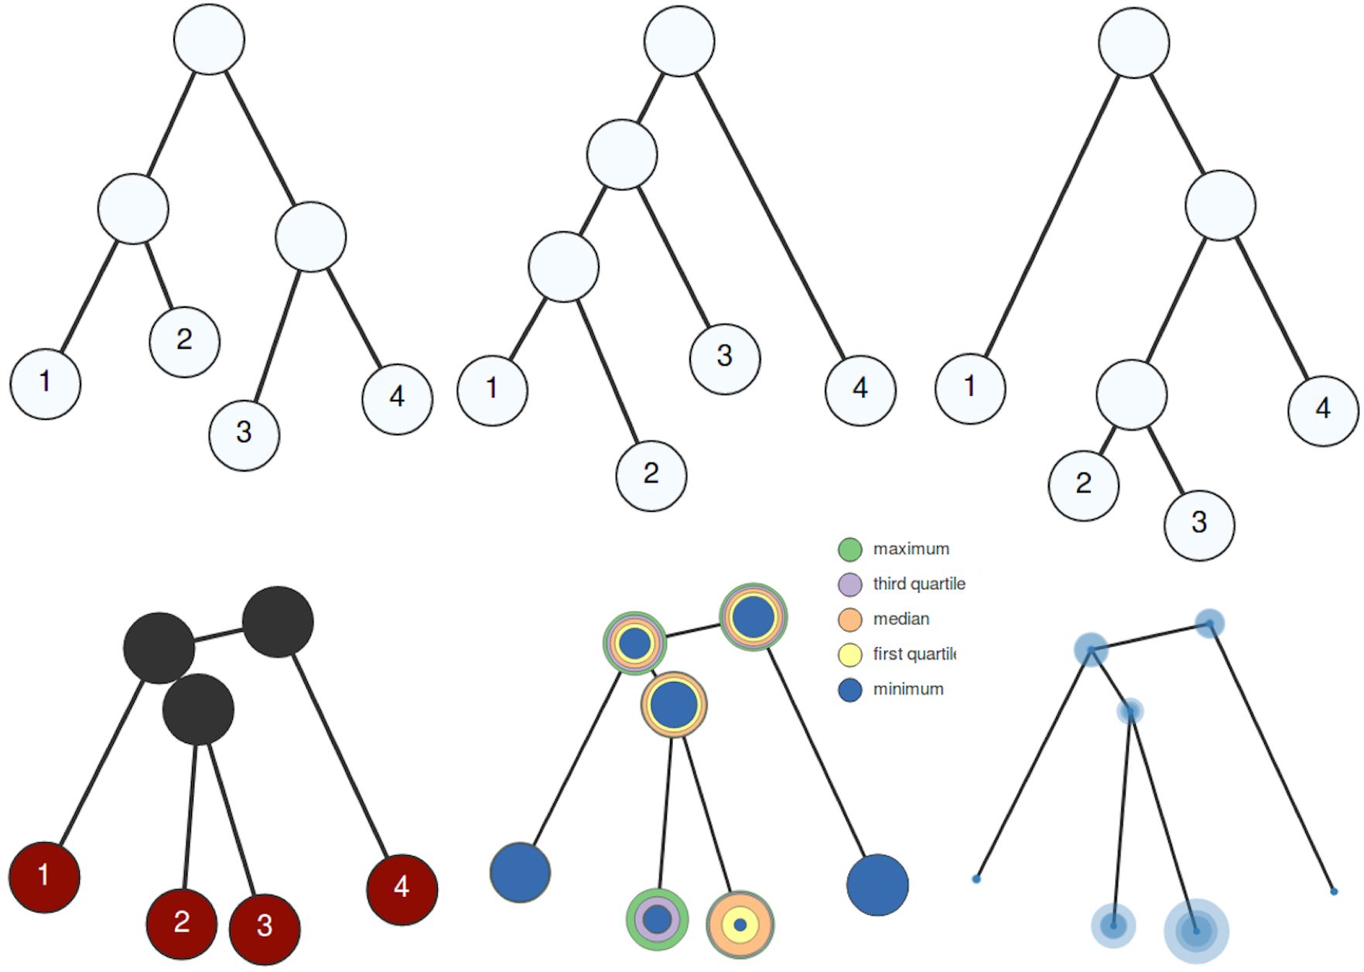
Visualizing uncertainty in topological structures
Merge Tree: a topological summary of scalar fields
Merge trees that arise from an ensemble of scalar fields
Compute an average merge tree from an ensemble
Uncertainty visualization of the average tree captures structural variations among the ensembles
Lin Yan, Yusu Wang, Elizabeth Munch, Ellen Gasparovic, Bei Wang. A Structural Average of Labeled Merge Trees for Uncertainty Visualization, IEEE VIS, 2019. arXiv: 1908.00113.

Slide 20
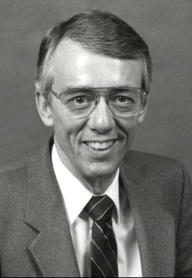
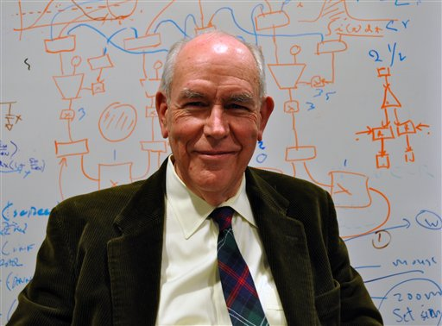
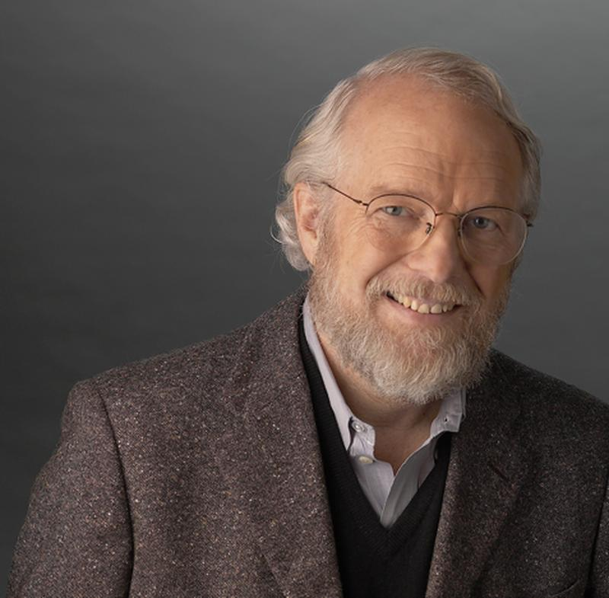
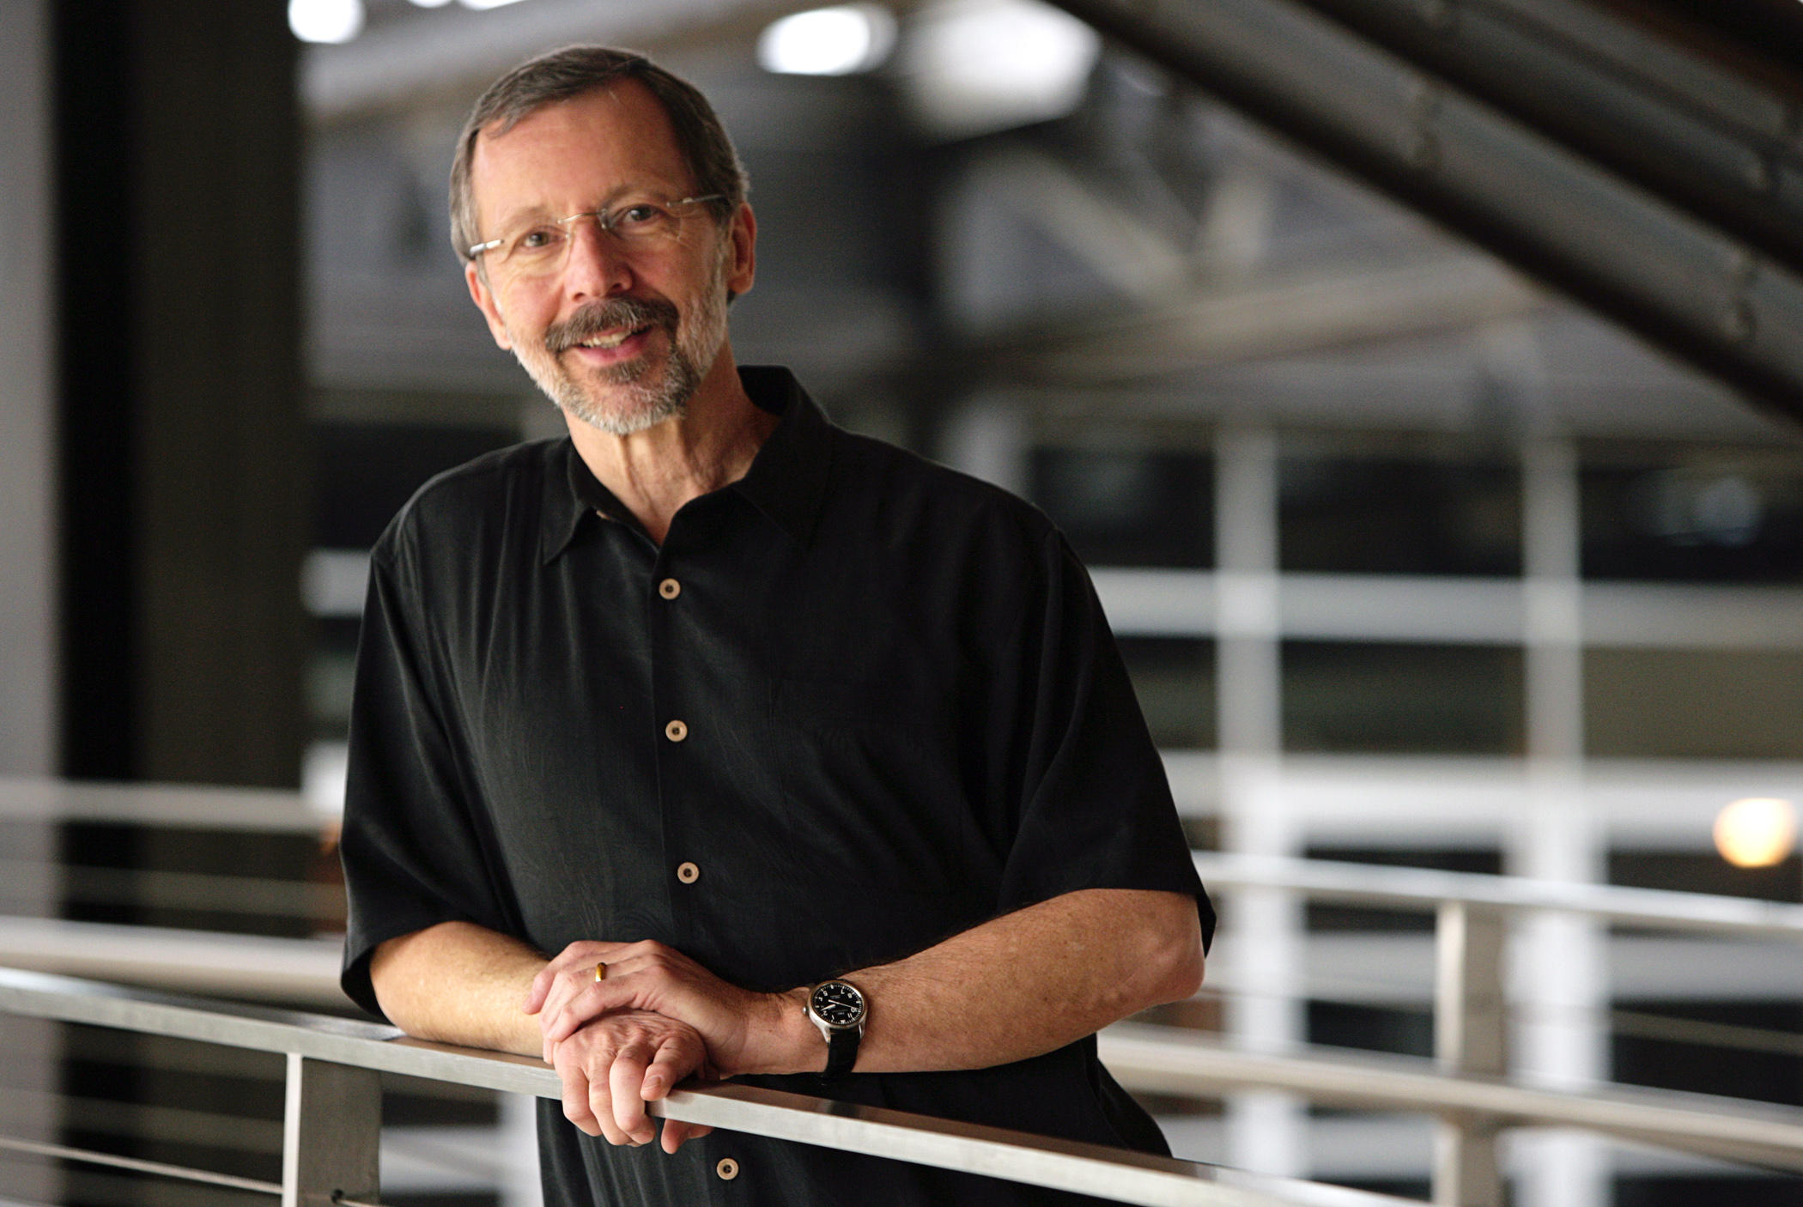
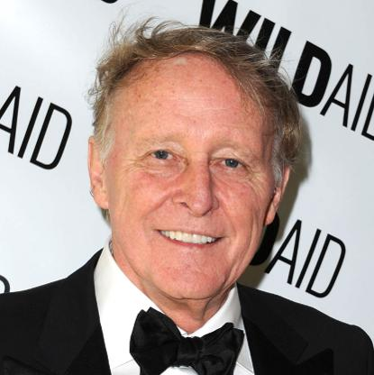
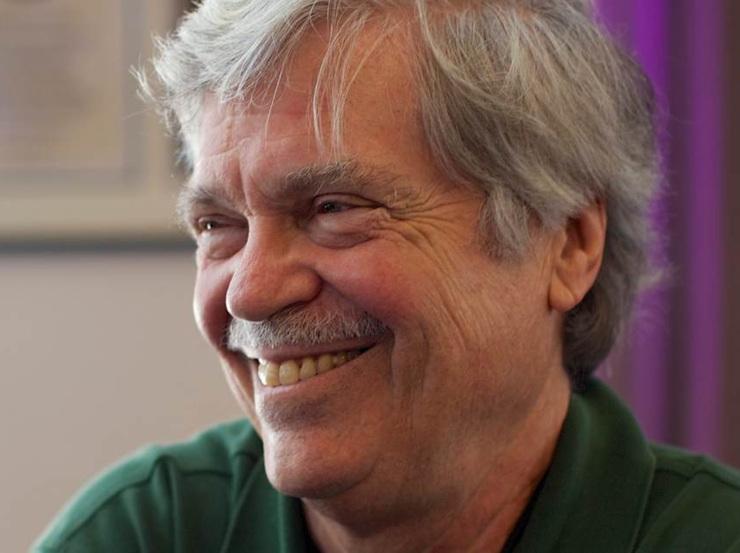
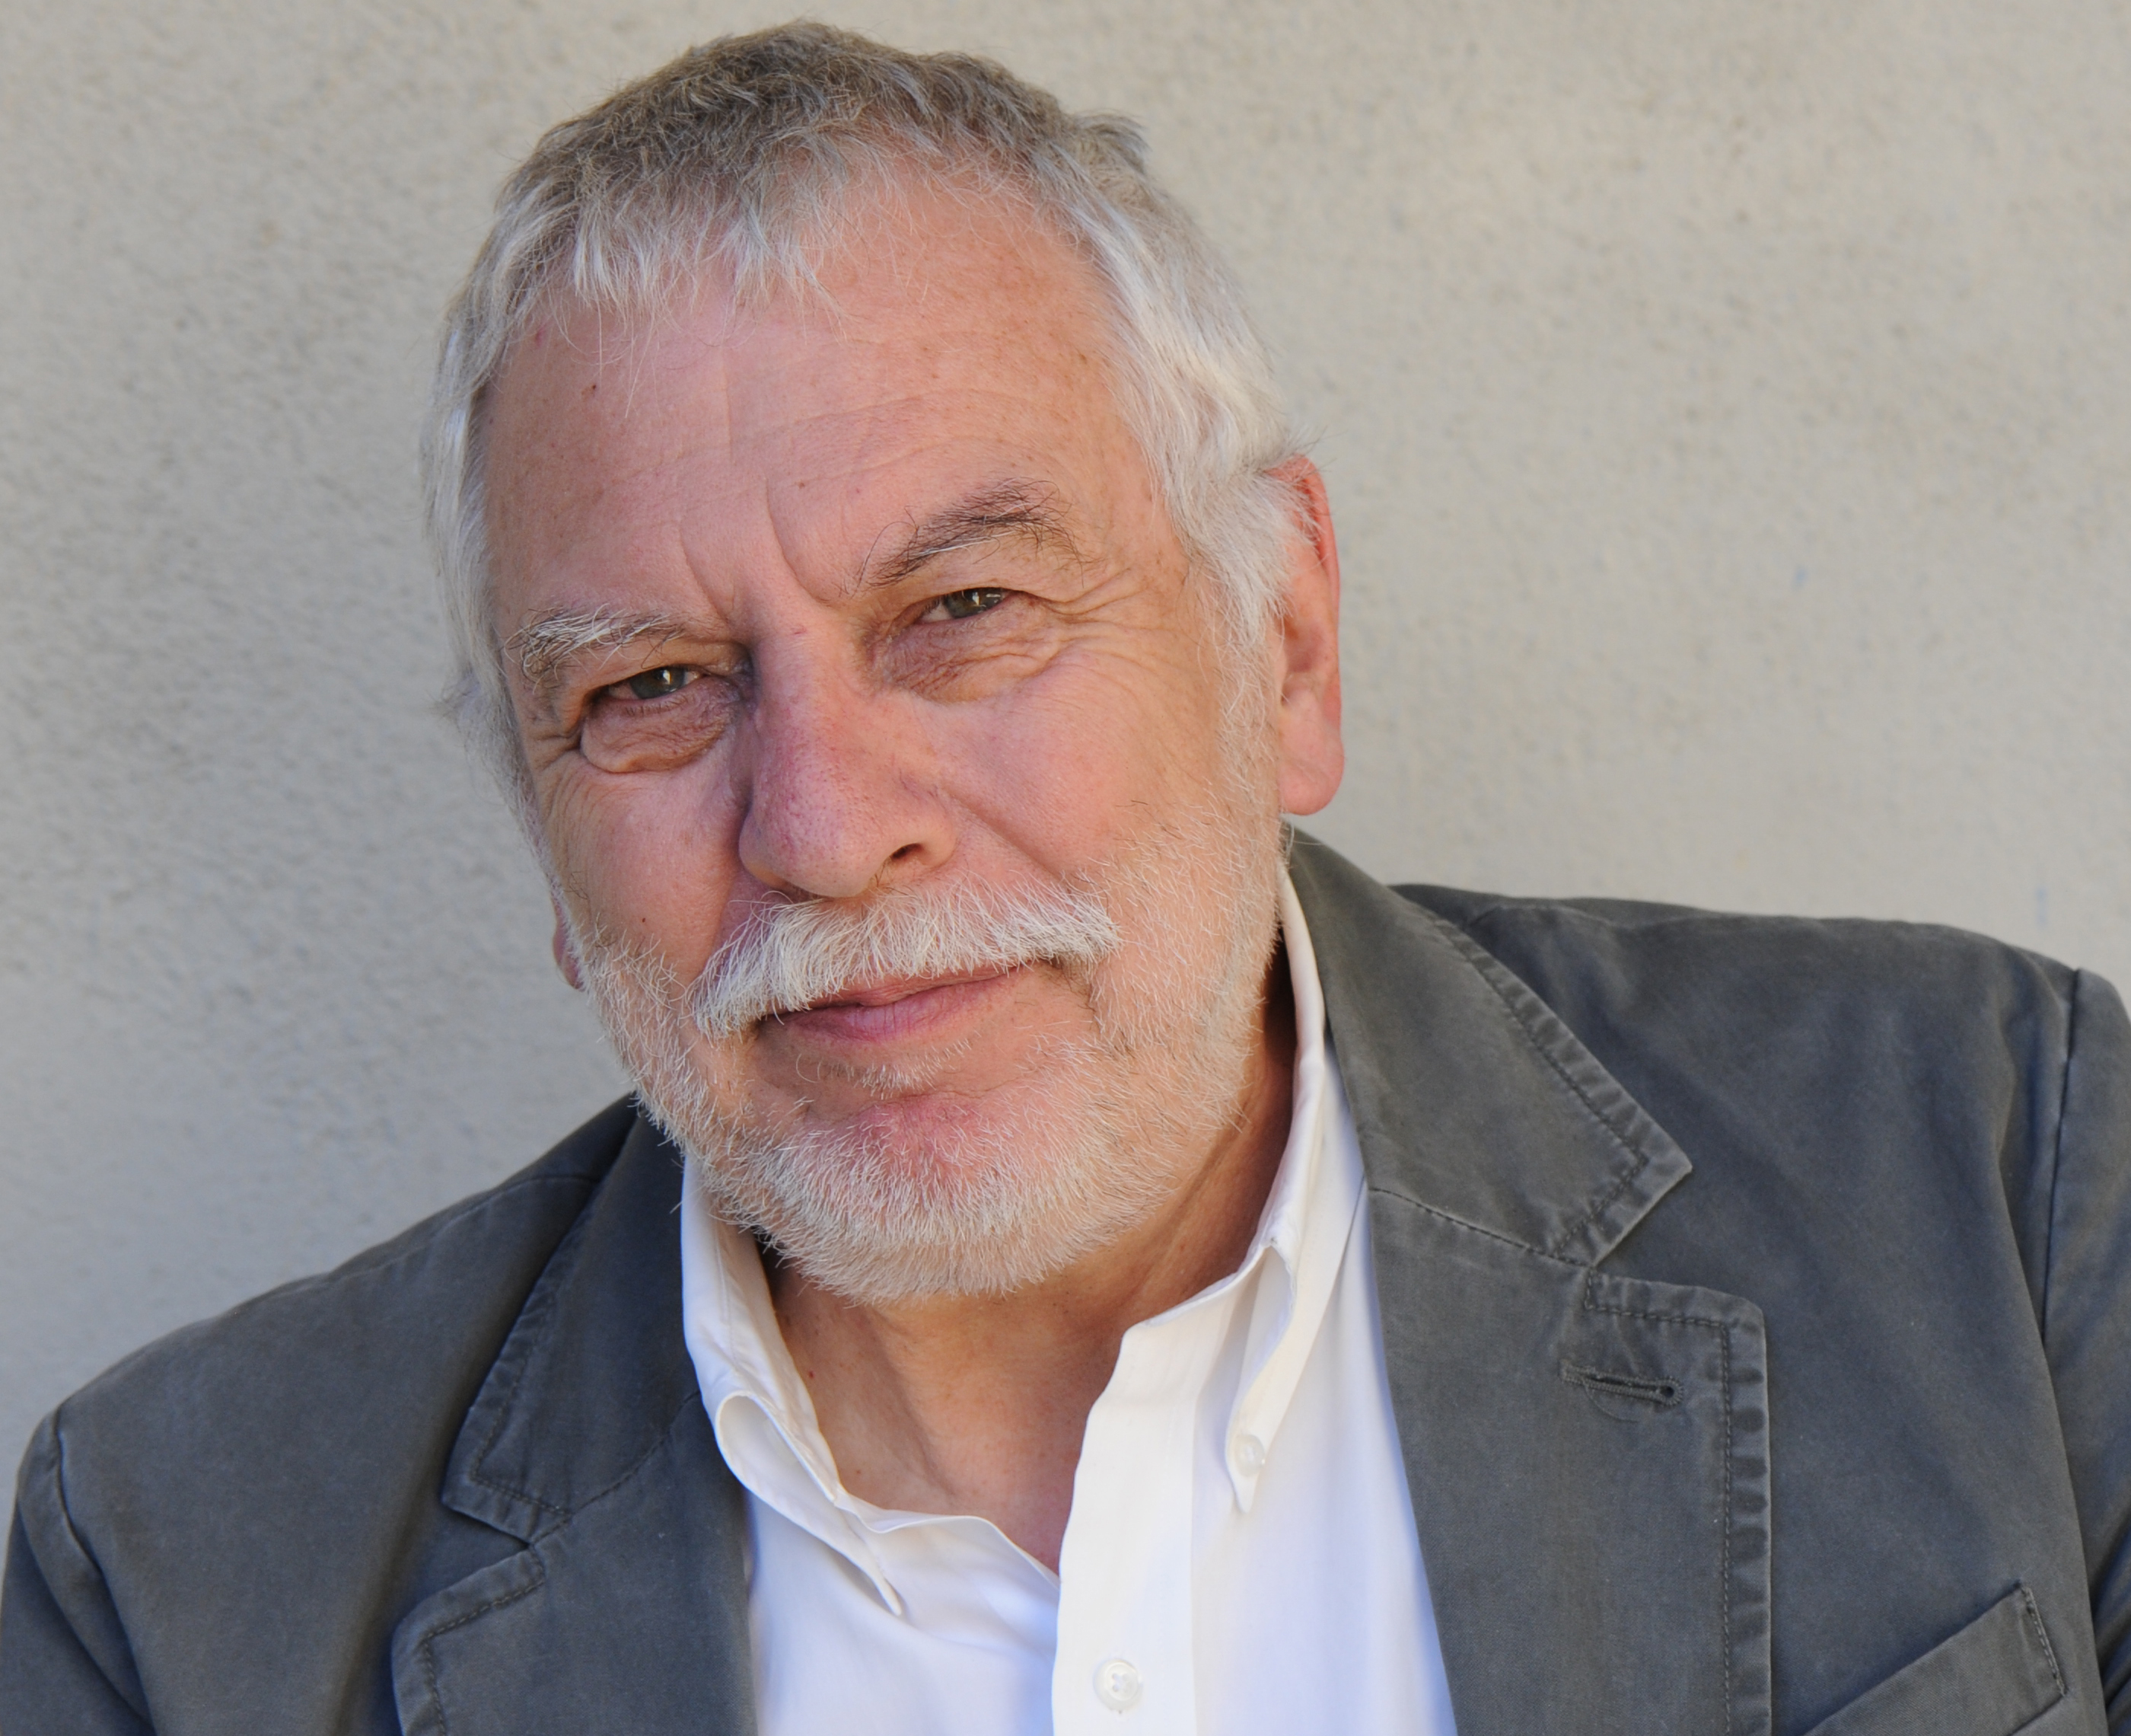
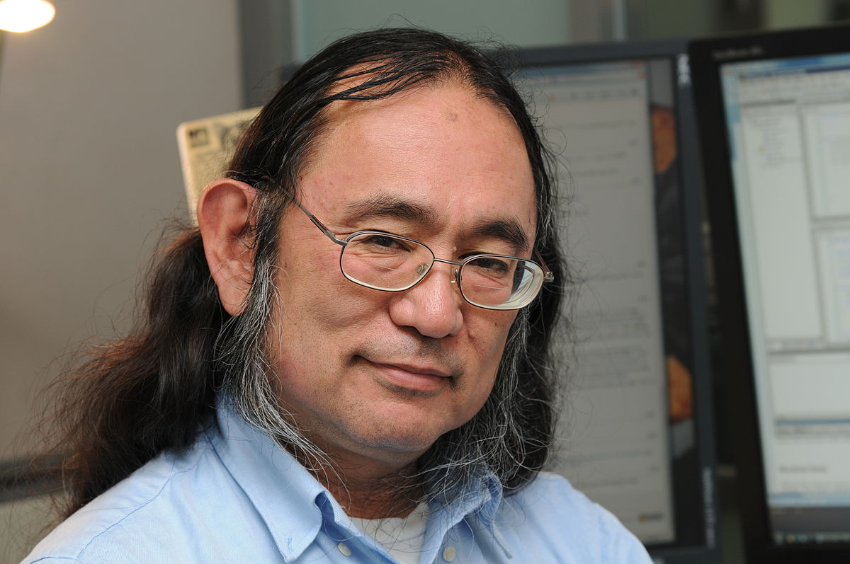
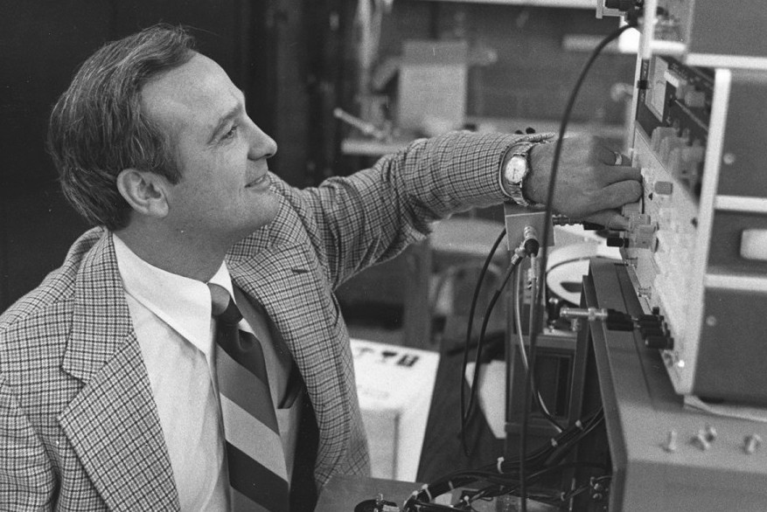
Graphics, VR, and the Internet at Utah
1
2
3
4
5
6
7
8
9
10
11
12
13
1, 2. David Evans /Ivan Sutherland
Founded CS Dept at the UofU in 1968
Ivan Sutherland - Turing award
Founded Evans & Sutherland Company
3. John Warnock
Worked at Evans & Sutherland
Founded Adobe
Hidden Line Removal Algorithm
Helped invent Postscript @ Adobe
4. Ed Catmull
Worked at Lucas Film
Co-Founded Pixar
President of Disney Animation Studios
Chair of CoE External Advisory Board
5. Jim Clark
Founded SGI, Netscape, Healtheon
Work in Geometry Pipelines
6. Alan Kay
Personal Computer
Turing Award Winner
Object Oriented Languages
7. Nolan Bushnell
Invented Pong
Founded Atari
8. Jim Kajyia
Rendering Equation
VP Research at Microsoft
9. Tom Stockham
Known for work in Signal Processing
Helped to invent the CD Player
10. Jim Blinn
Invented Blinn-Phong Shading Model
11. Henri Gouraud
Invented Gouraud Shading Model
12. Bui Tuong Phong
Invented Phong Reflection and Shading Models
13. Allen Ashton
Word Perfect
My CFO Founder

Slide 21
More Information
www.sci.utah.edu
crj@sci.utah.edu

