Slide 1
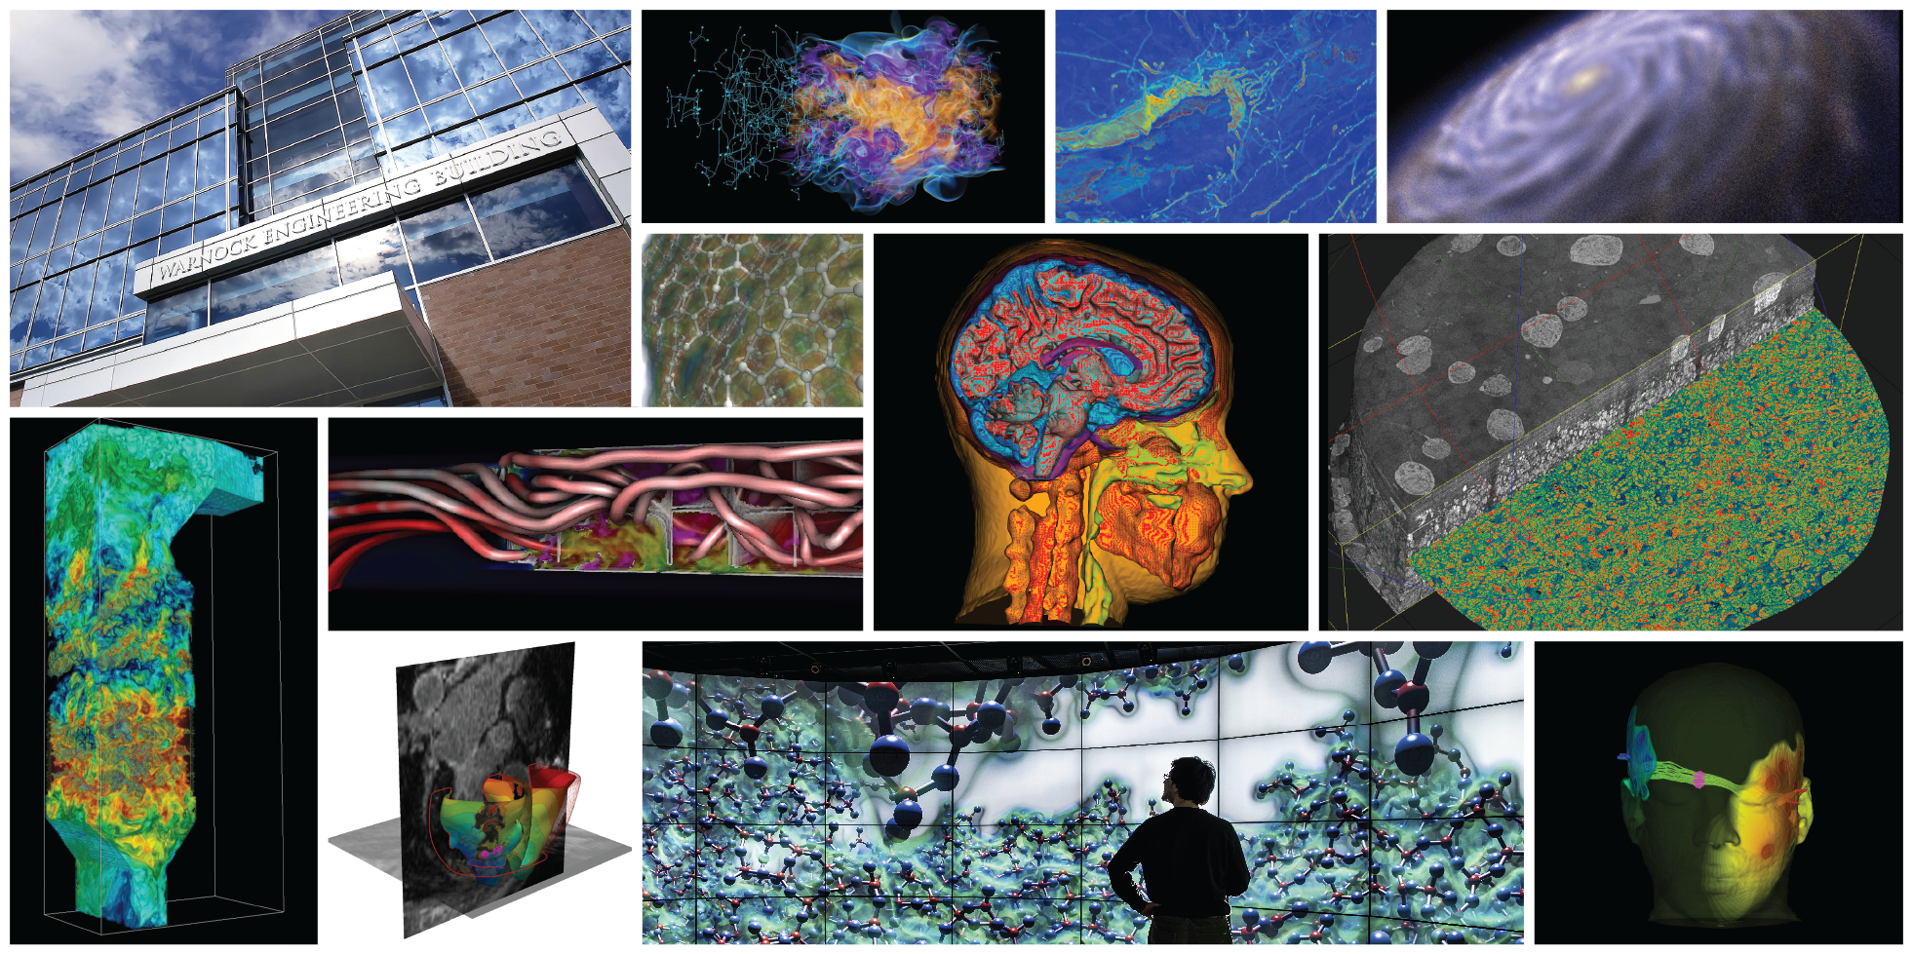
Extending Visualization Algorithms to Include Uncertainty

Slide 2
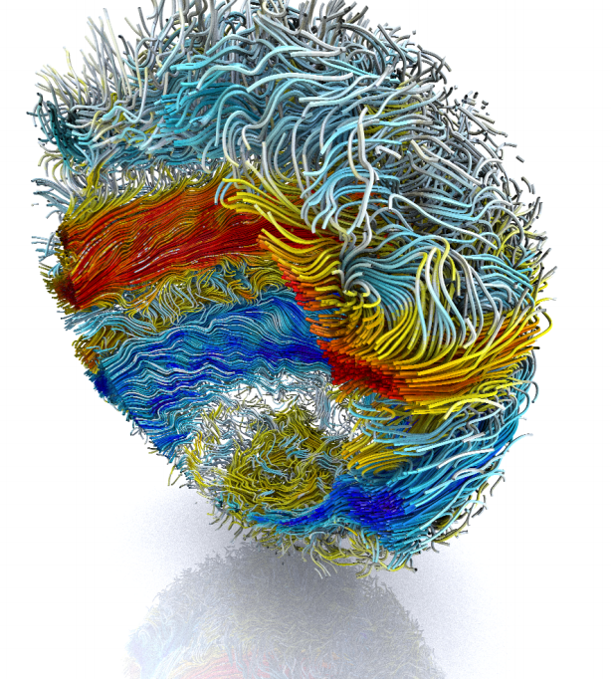
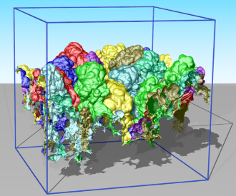
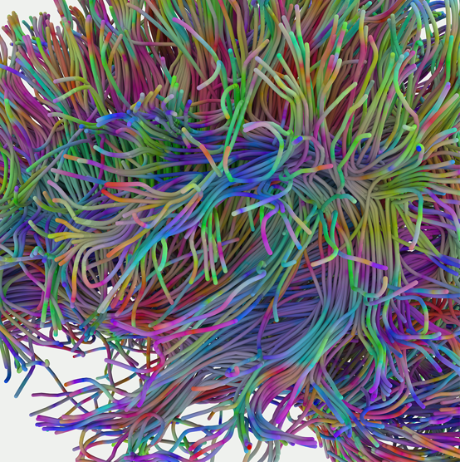
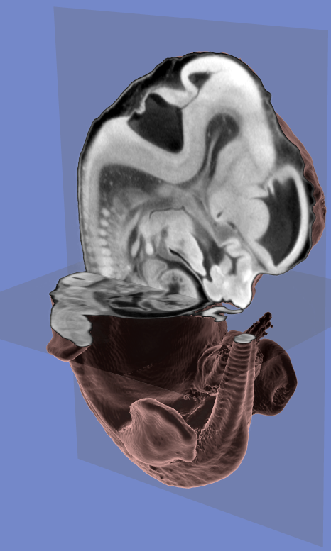
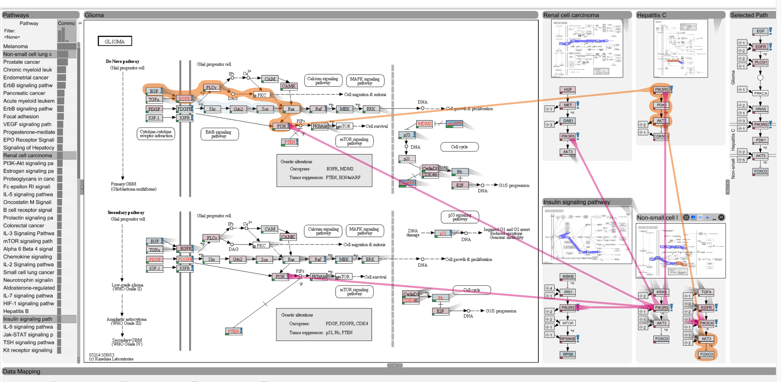
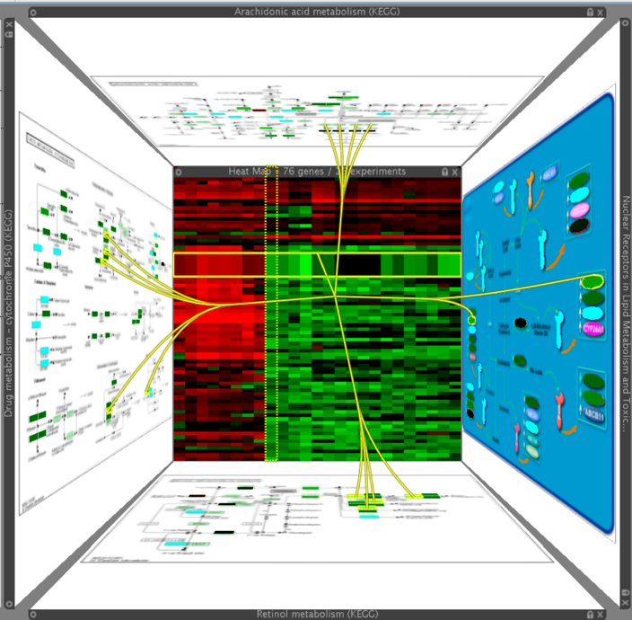

Slide 3
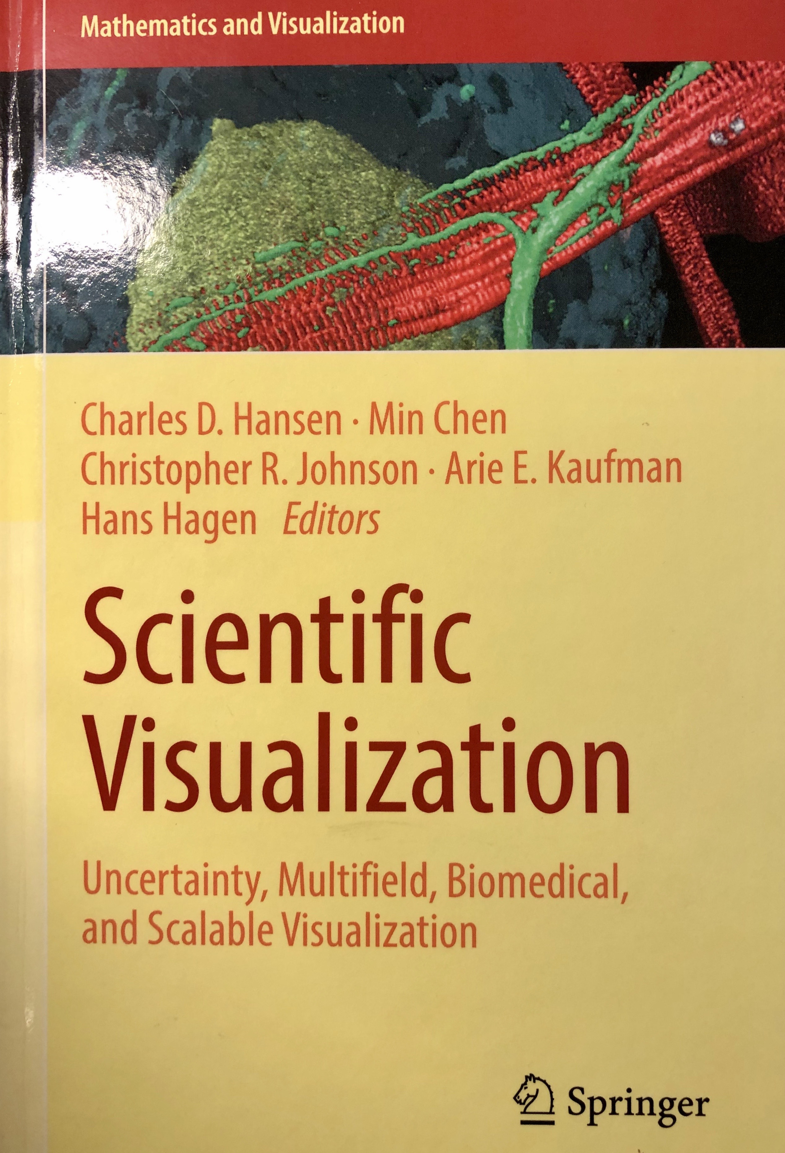

Slide 4
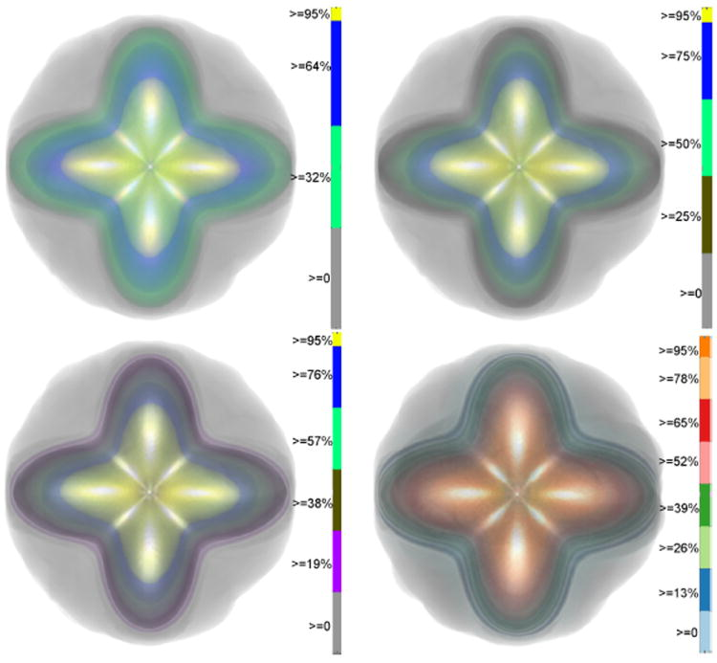
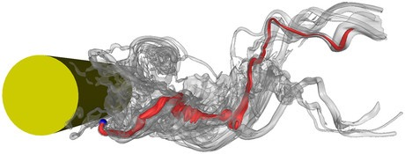
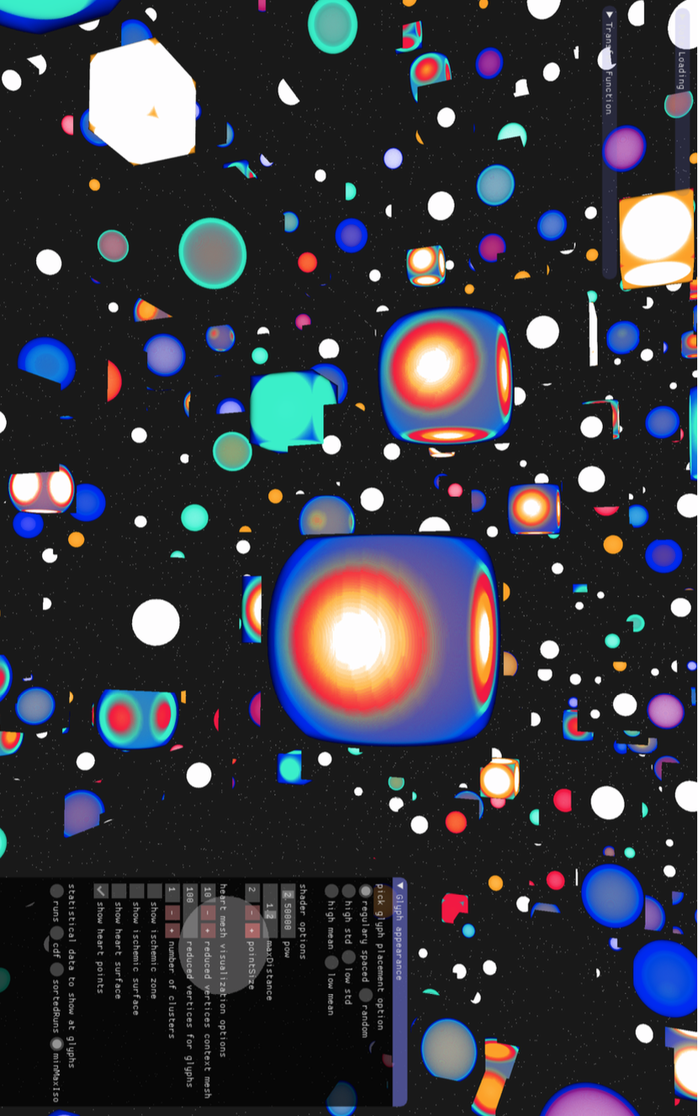
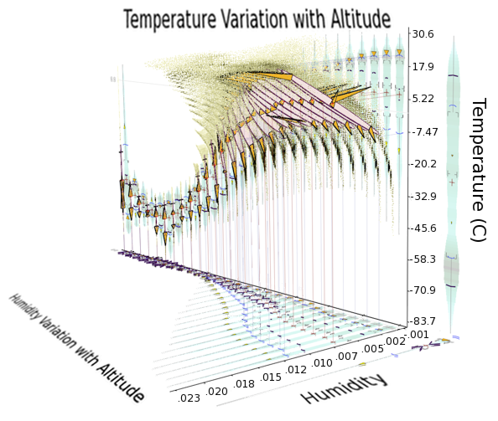
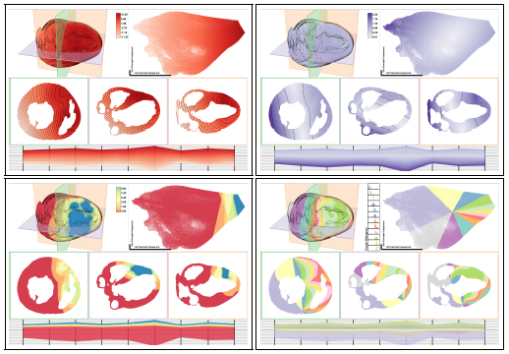
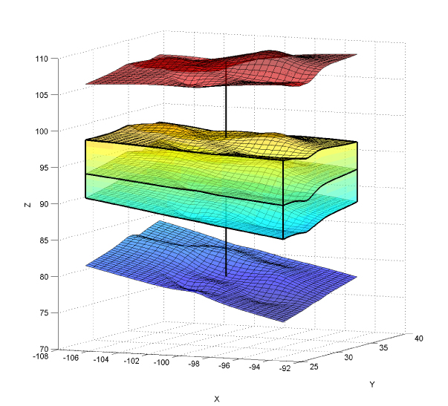
Uncertainty Visualization
G.P. Bonneau, H.C. Hege, C.R. Johnson, M.M. Oliveira, K. Potter, P. Rheingans, T. Schultz. “Overview and State-of-the-Art of Uncertainty Visualization,” In Scientific Visualization: Uncertainty, Multifield, Biomedical, and Scalable Visualization, Edited by M. Chen and H. Hagen and C.D. Hansen and C.R. Johnson and A. Kauffman, Springer-Verlag, pp. 3-27. 2014.
M.G. Genton, C.R. Johnson, K. Potter, G. Stenchikov, Y. Sun. “Surface boxplots,” In Stat Journal, Vol. 3, No. 1, pp. 1-11. 2014.
K. Potter, P. Rosen, C.R. Johnson. “From Quantification to Visualization: A Taxonomy of Uncertainty Visualization Approaches,” In Uncertainty Quantification in Scientific Computing, IFIP Series, Vol. 377, Springer, pp. 226-249. 2012.
K. Potter, A. Wilson, P.-T. Bremer, D. Williams, C. Doutriaux, V. Pascucci, C.R. Johnson. “Ensemble-Vis: A Framework for the Statistical Visualization of Ensemble Data,” In Proceedings of the 2009 IEEE International Conference on Data Mining Workshops, pp. 233-240. 2009.
C.R. Johnson, A.R. Sanderson. “A Next Step: Visualizing Errors and Uncertainty,” In IEEE Computer Graphics and Applications, Vol. 23, No. 5, pp. 6-10. September/October, 2003.
When is the last time you’ve seen an error
bar on an isosurface?

Slide 5
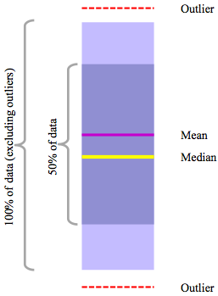
Contour and Surface Box Plots
Whitaker, Mirzargar, Kirby, IEEE Transactions on Visualization and Computer Graphics, Vol. 19, No. 12, pp. 2713--2722, 2013.
M.G. Genton, C.R. Johnson, K. Potter, G. Stenchikov, Y. Sun. “Surface boxplots,” In Stat Journal, Vol. 3, No. 1, pp. 1-11. 2014.

Slide 6
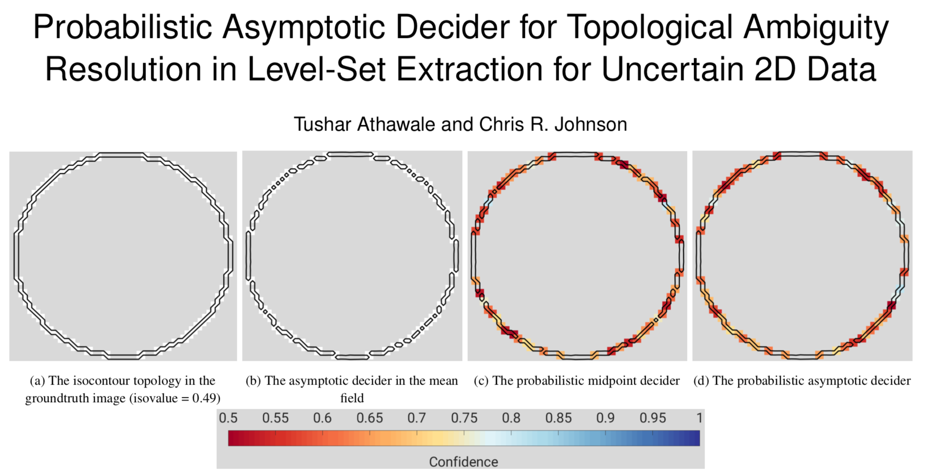
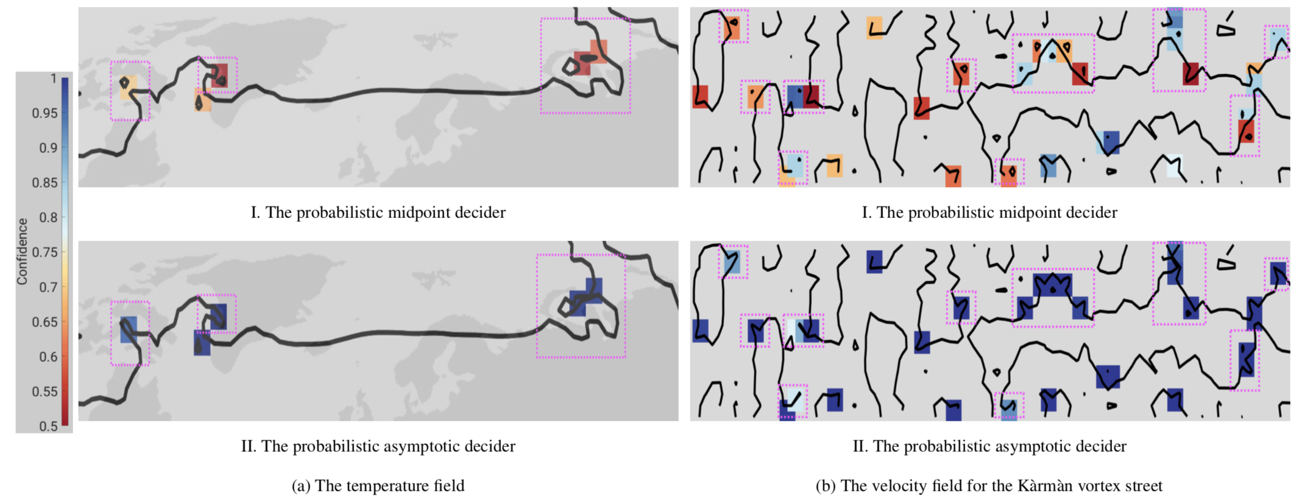

Slide 7
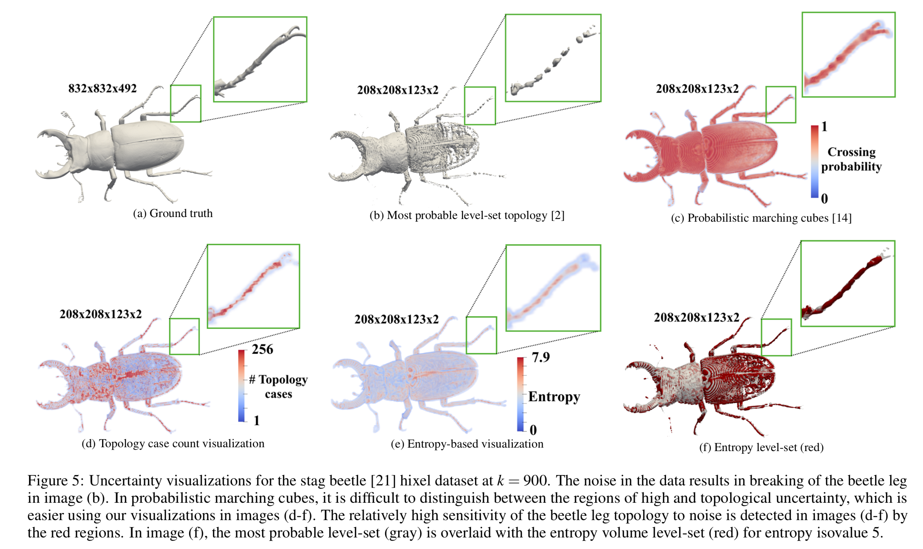
Uncertainty Visualization of the Marching Squares and Marching Cubes Topology Cases - VIS 2021

Slide 8
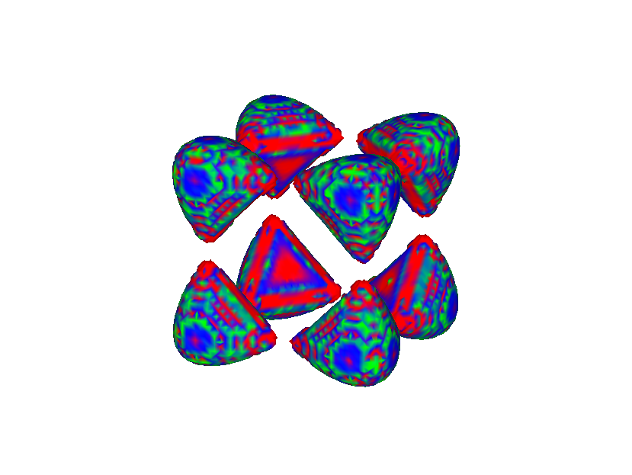
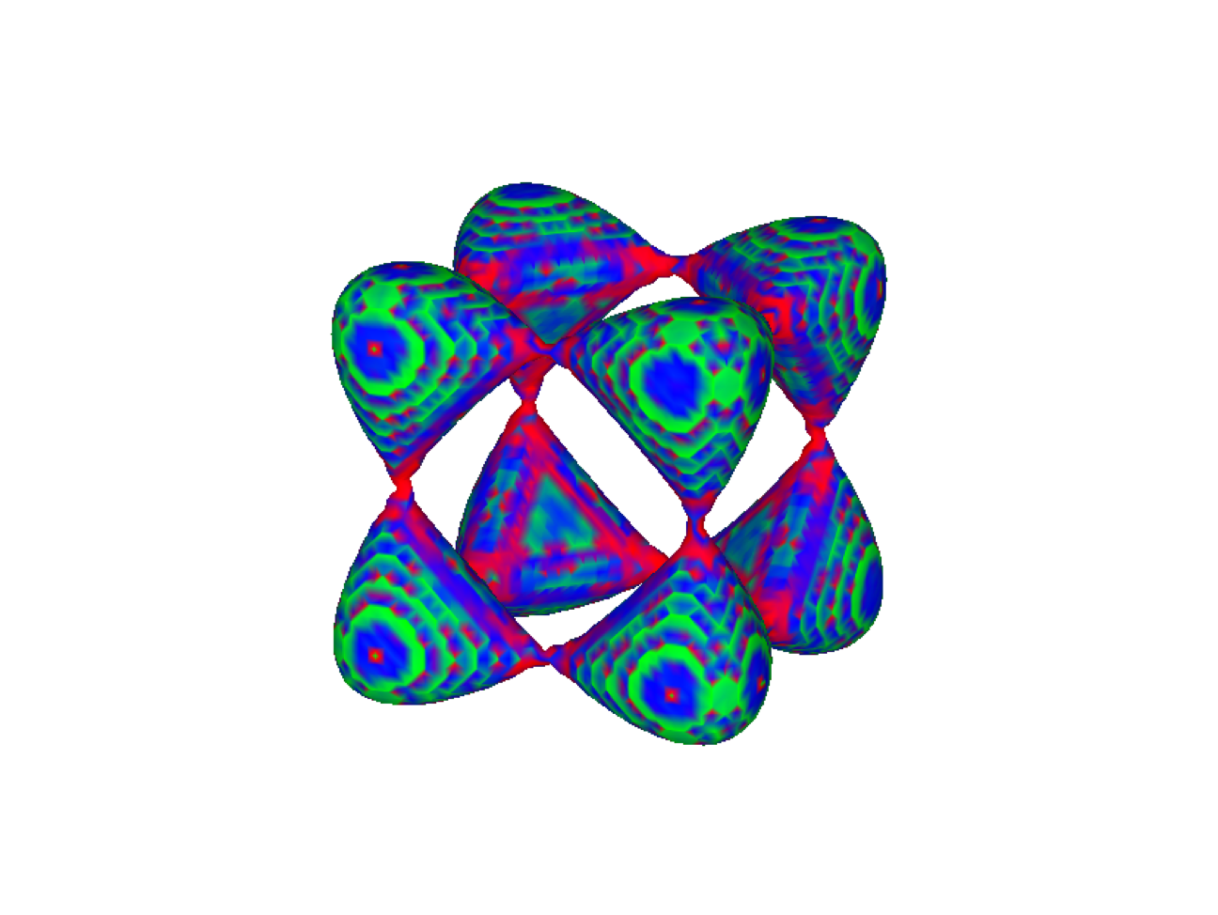
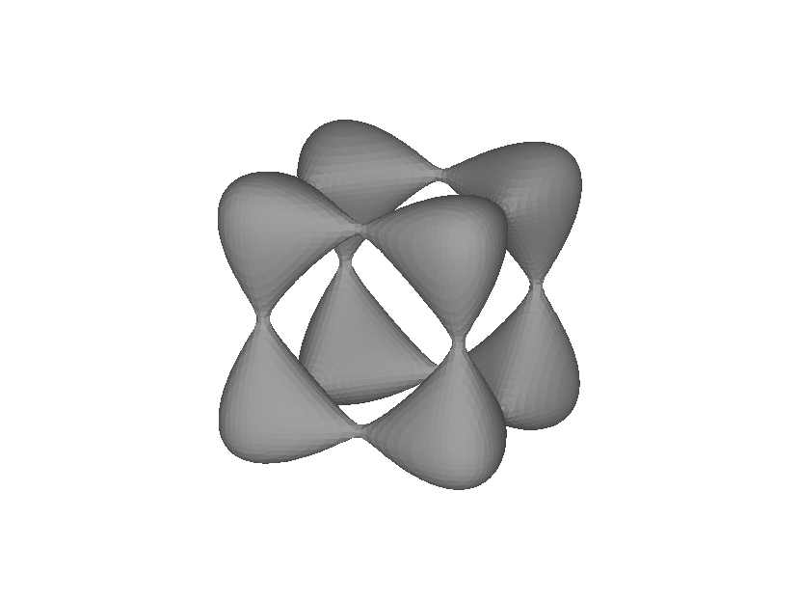
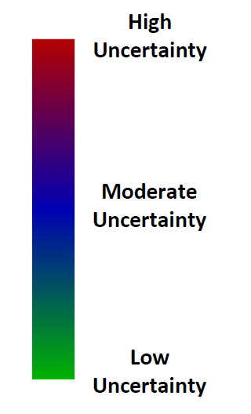
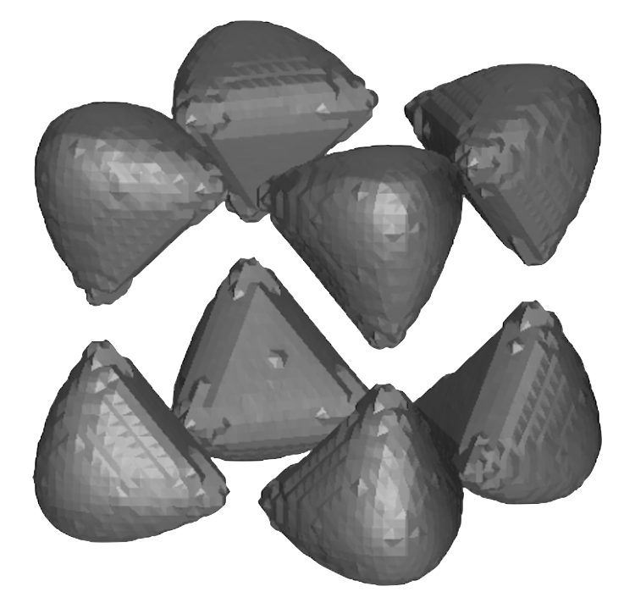
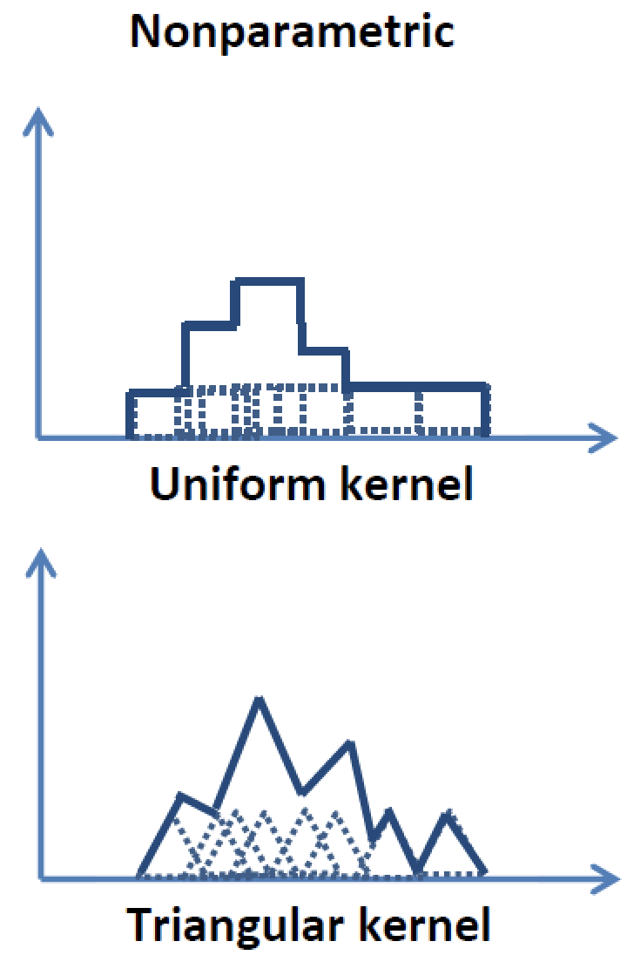
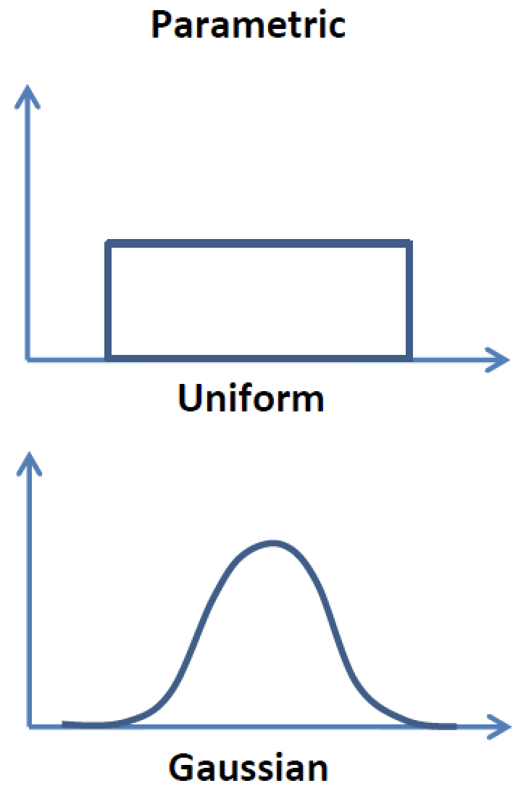
Models of Uncertainty
Ground truth:
Tangle function
mixed with noise
Mean
Parametric
Nonparametric
One value per-voxel
Two values per-voxel
(mean and width)
n representative samples
per-voxel (e.g., min, Q1, median, Q2, max)
Probabilistic marching cubes, [P thkow et al., 2013];
Uncertainty-aware marching cubes [Athawale et al., 2015]

Slide 9
Volume Rendering With Nonparametric Statistics
Represent probability
distribution using quantiles
Transfer
function (TF)
Grid vertex
Color/opacity
PdfX
X
X
Intensity(x)
Quantile
interpolation
Integrate
against
transfer
function
Expected fragment color
computation:
A single grid cell
$$E(TF(x))=∫TF(x)Pdf_{X}(x)dx$$

Slide 10
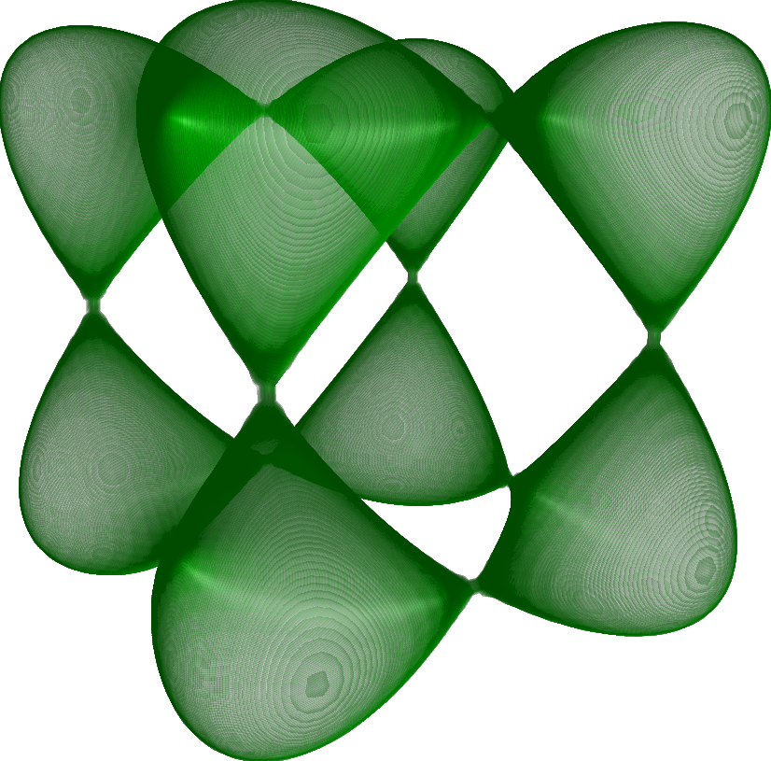
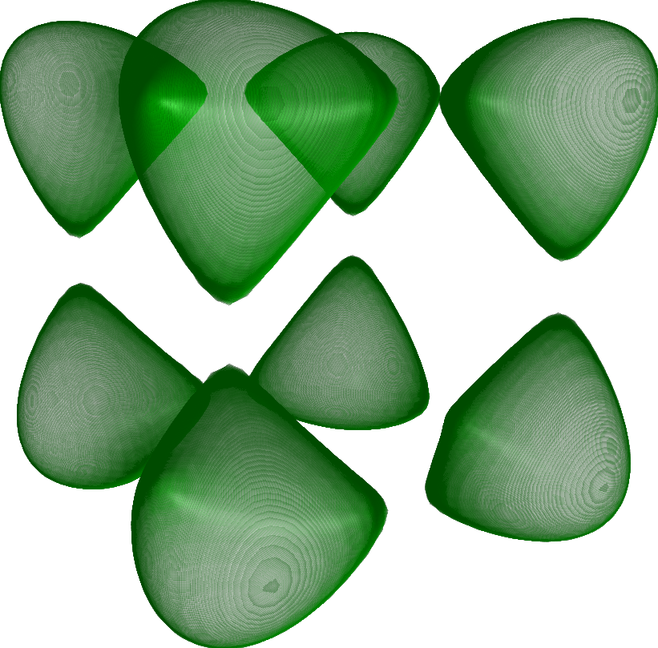
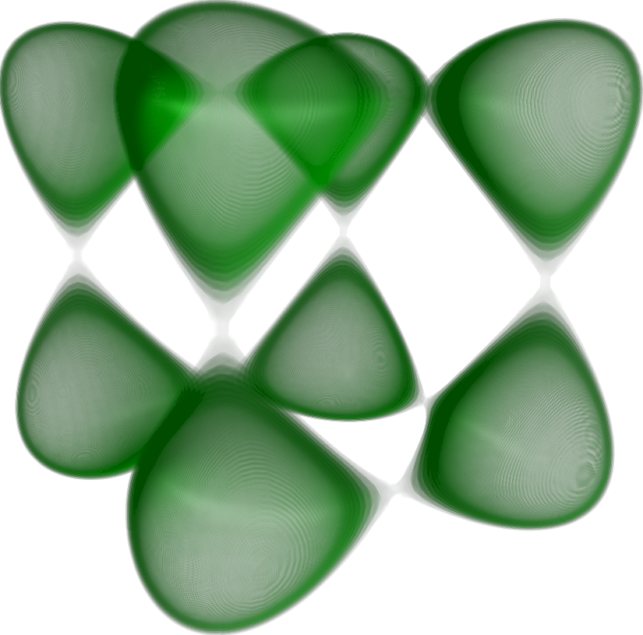
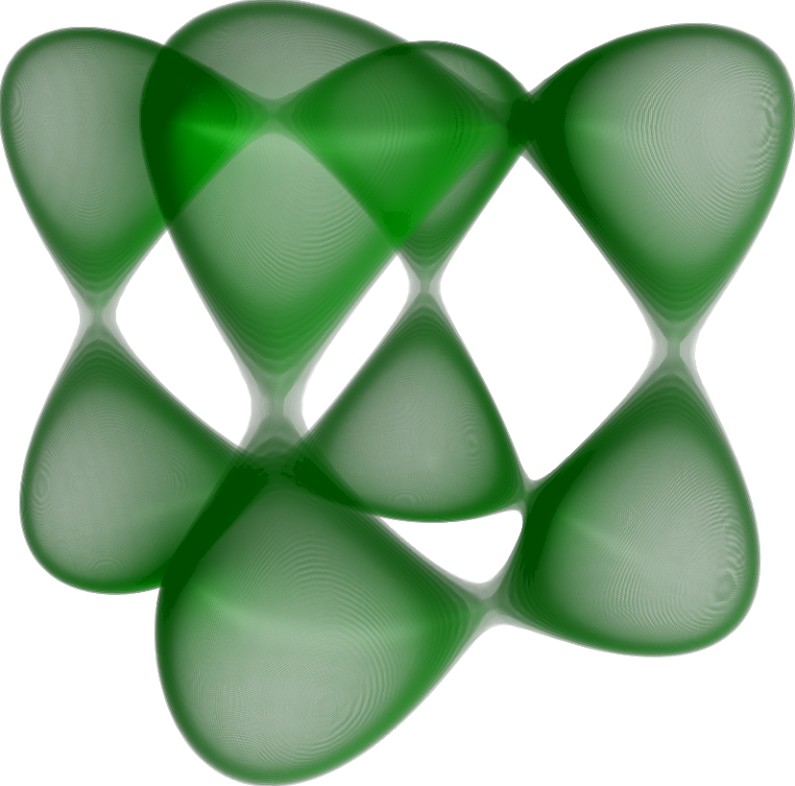
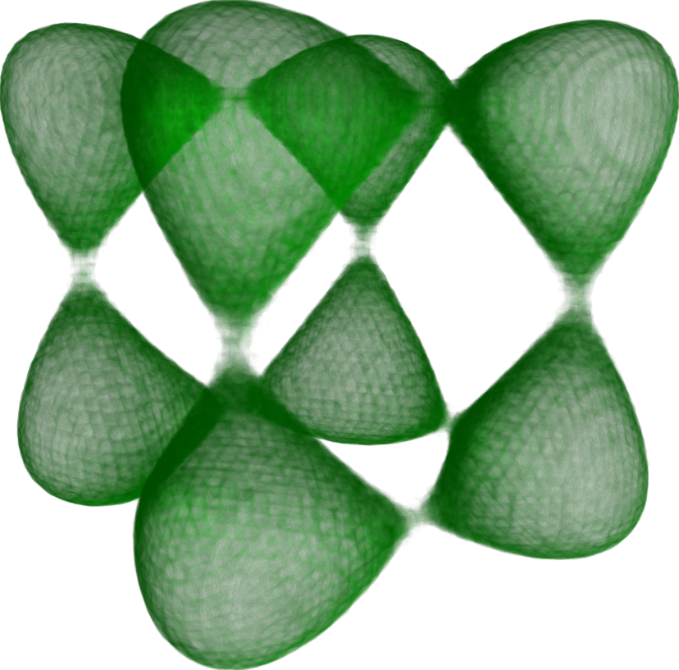
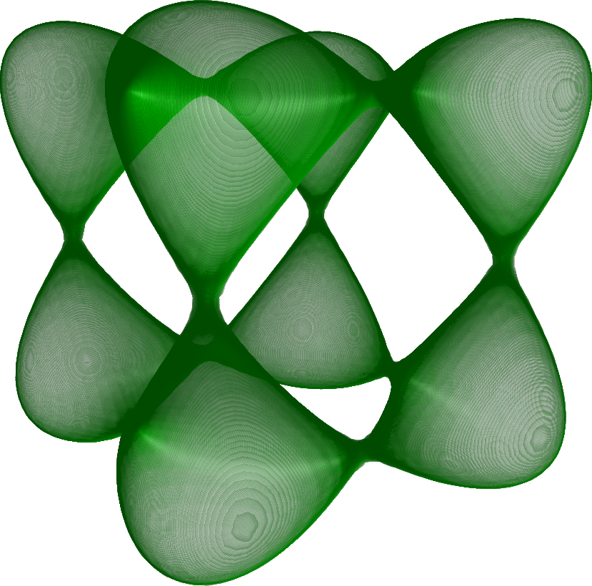
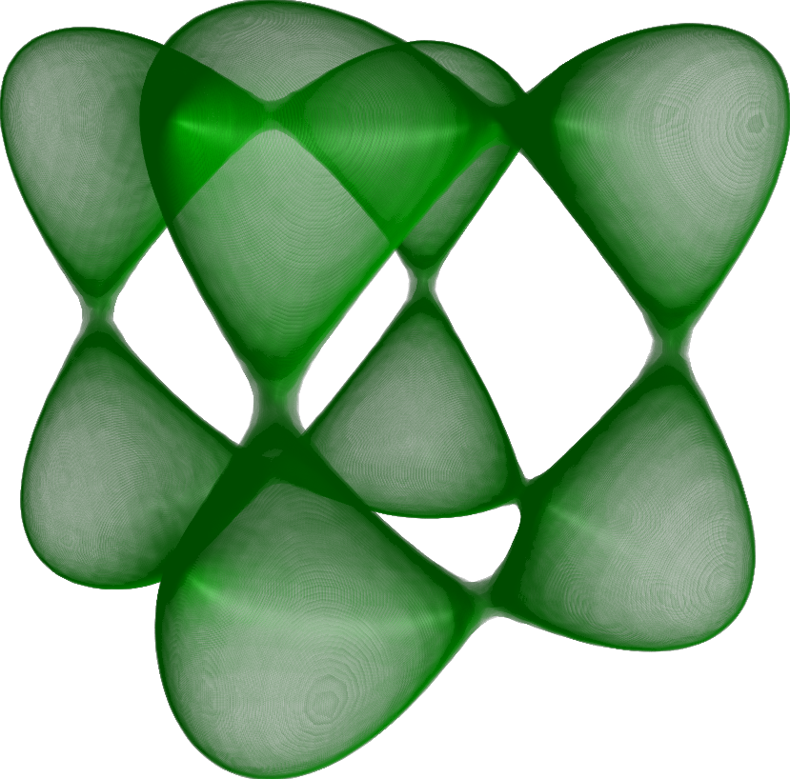
Tangle Function (Qualitative Comparisons)
Ground truth
Mean
Uniform
Gaussian
Gaussian mixtures
(four Gaussians)
(Monte Carlo)
Quantile interpolation
(two quantiles)
Quantile interpolation
(four quantiles)
Quantile interpolation
(eight quantiles)

Slide 11
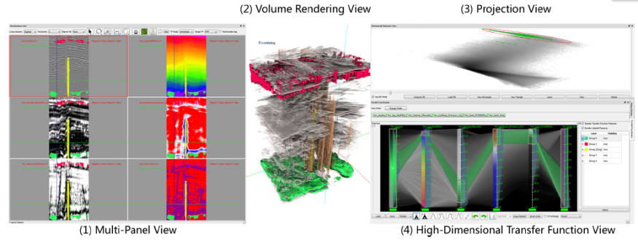
High Dimensional Transfer Functions
Create Transfer Functions (TFs) from user selected samples in spatial domain and error/uncertainty.
Multiple linked views.
L. Zhou, C.D. Hansen. “Transfer Function Design based on User Selected Samples for Intuitive Multivariate Volume Exploration,” In Proceedings of the 2013 IEEE Pacific Visualization Symposium (PacificVis), pp. 73--80. 2013.
Notes:
We propose to create TFs from …
A system with three stages and four linked views is proposed: … explain
Use the animation

Slide 12
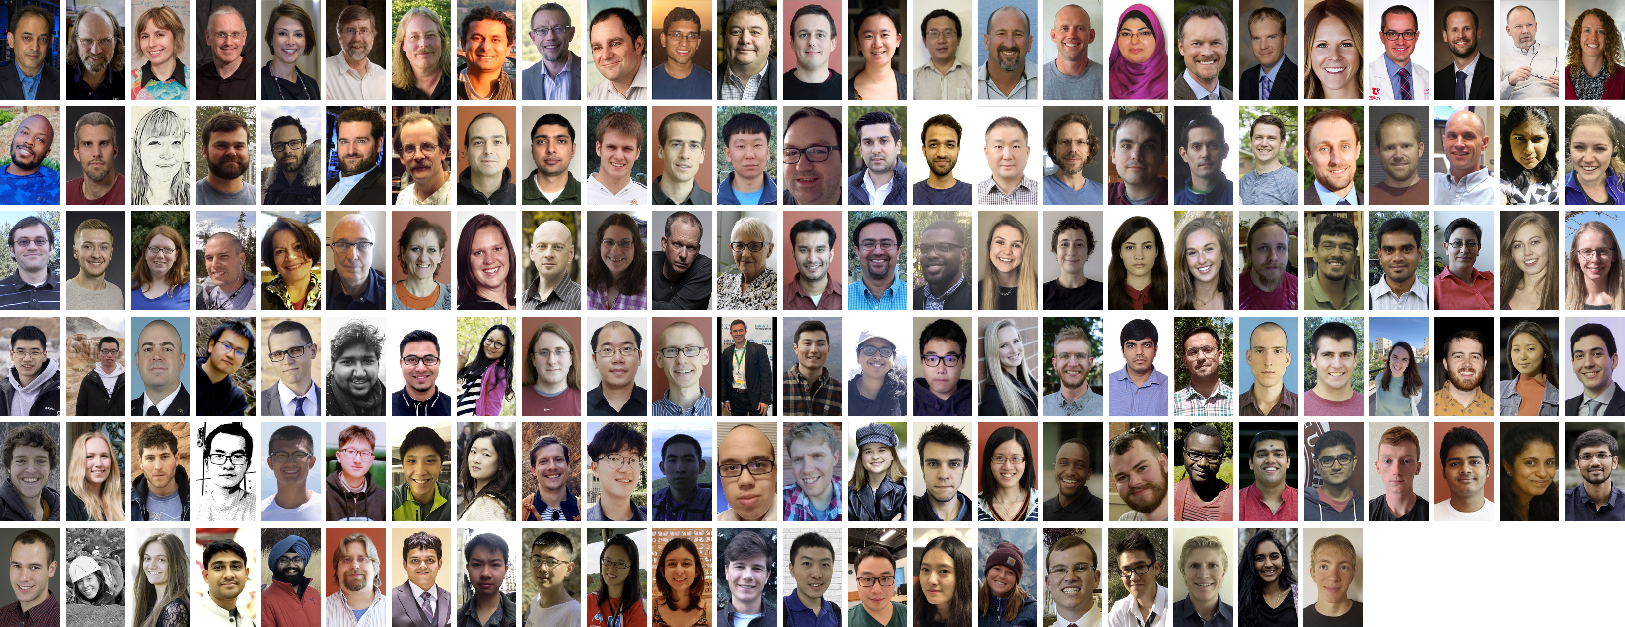
www.sci.utah.edu
crj@sci.utah.edu

