Slide 2
Ensemble Wildfire Simulation Visualization and Analysis and Visualization of Vector Fields Uncertainty and Variability
Jixian Li, Timbwaoga A. J. Ouermi (TAJO), Chris R. Johnson
Scientific Computing and Imaging (SCI) Institute
University of Utah
www.sci.utah.edu

Slide 3
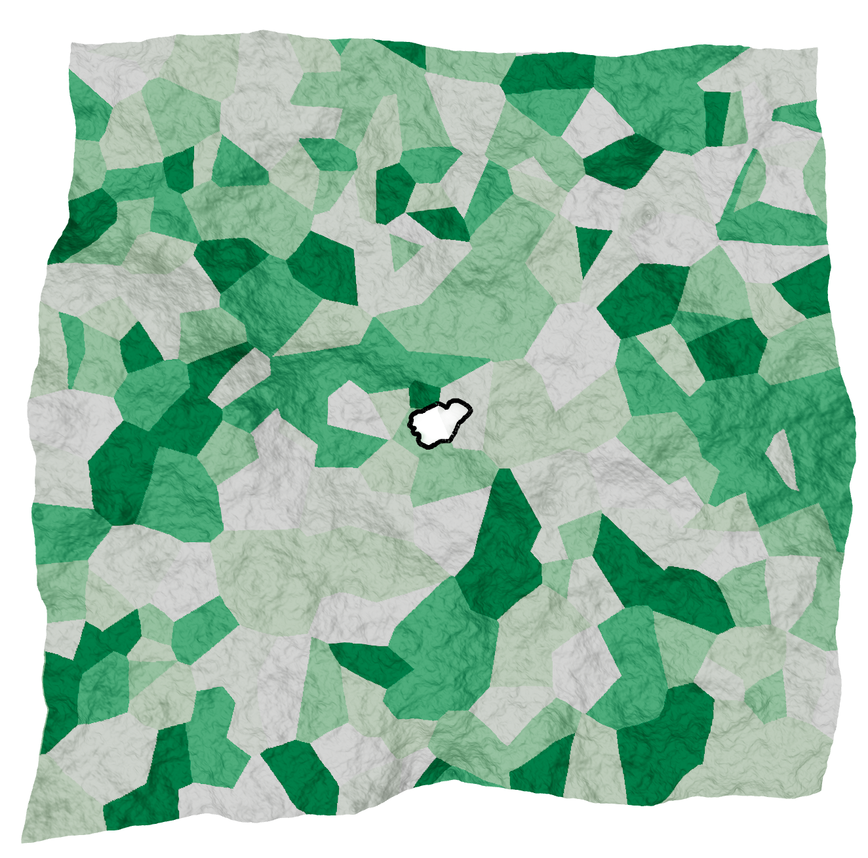
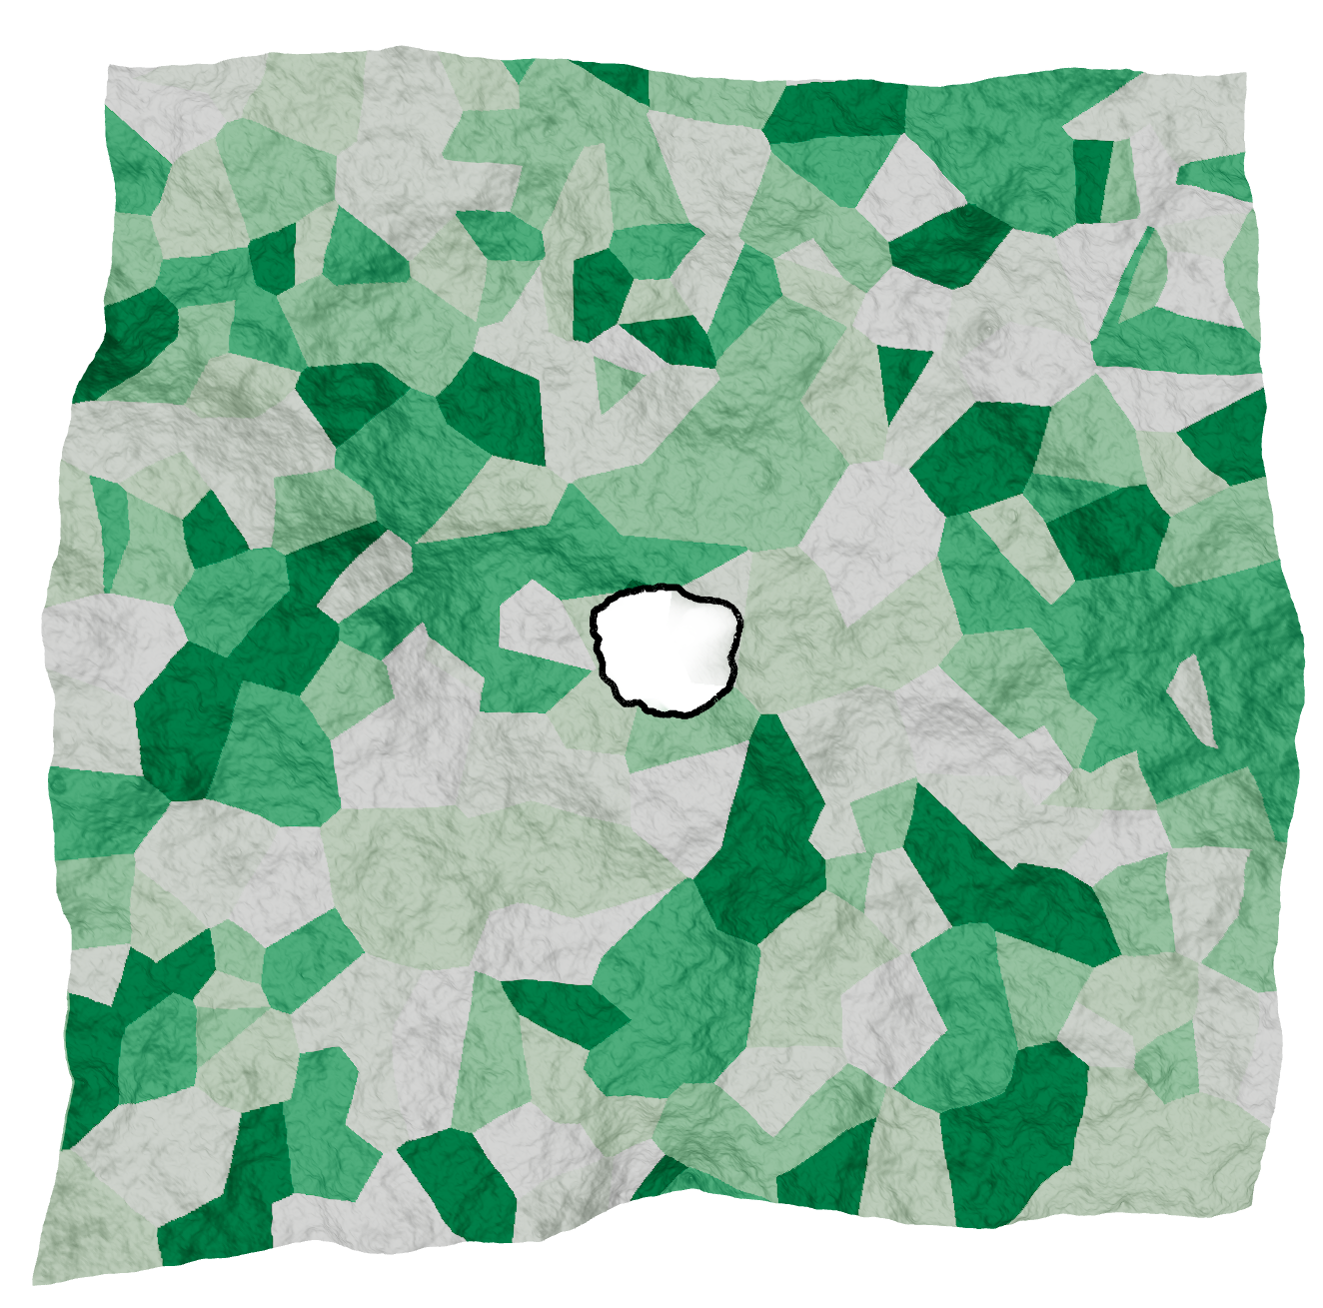
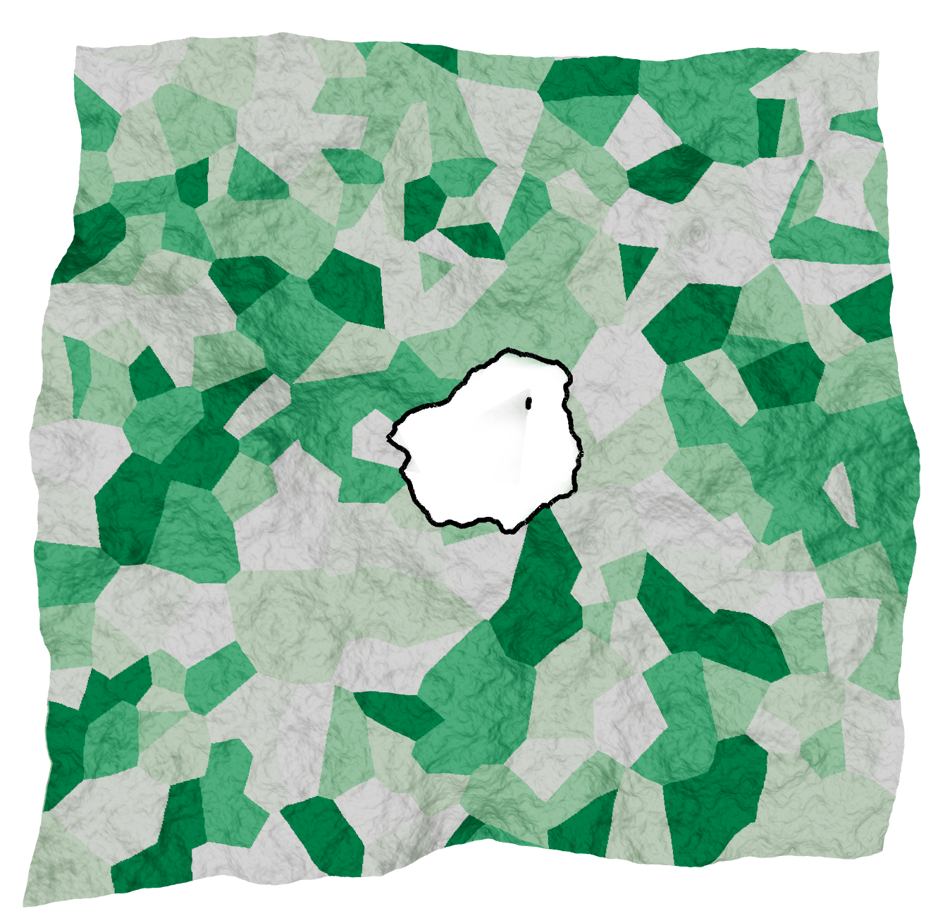
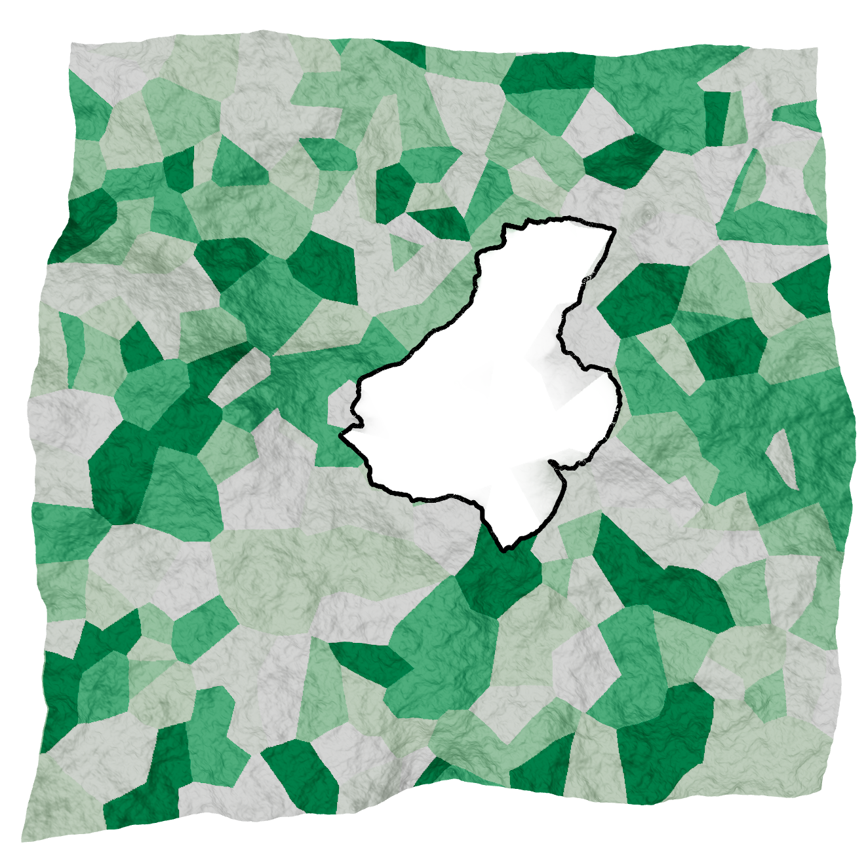
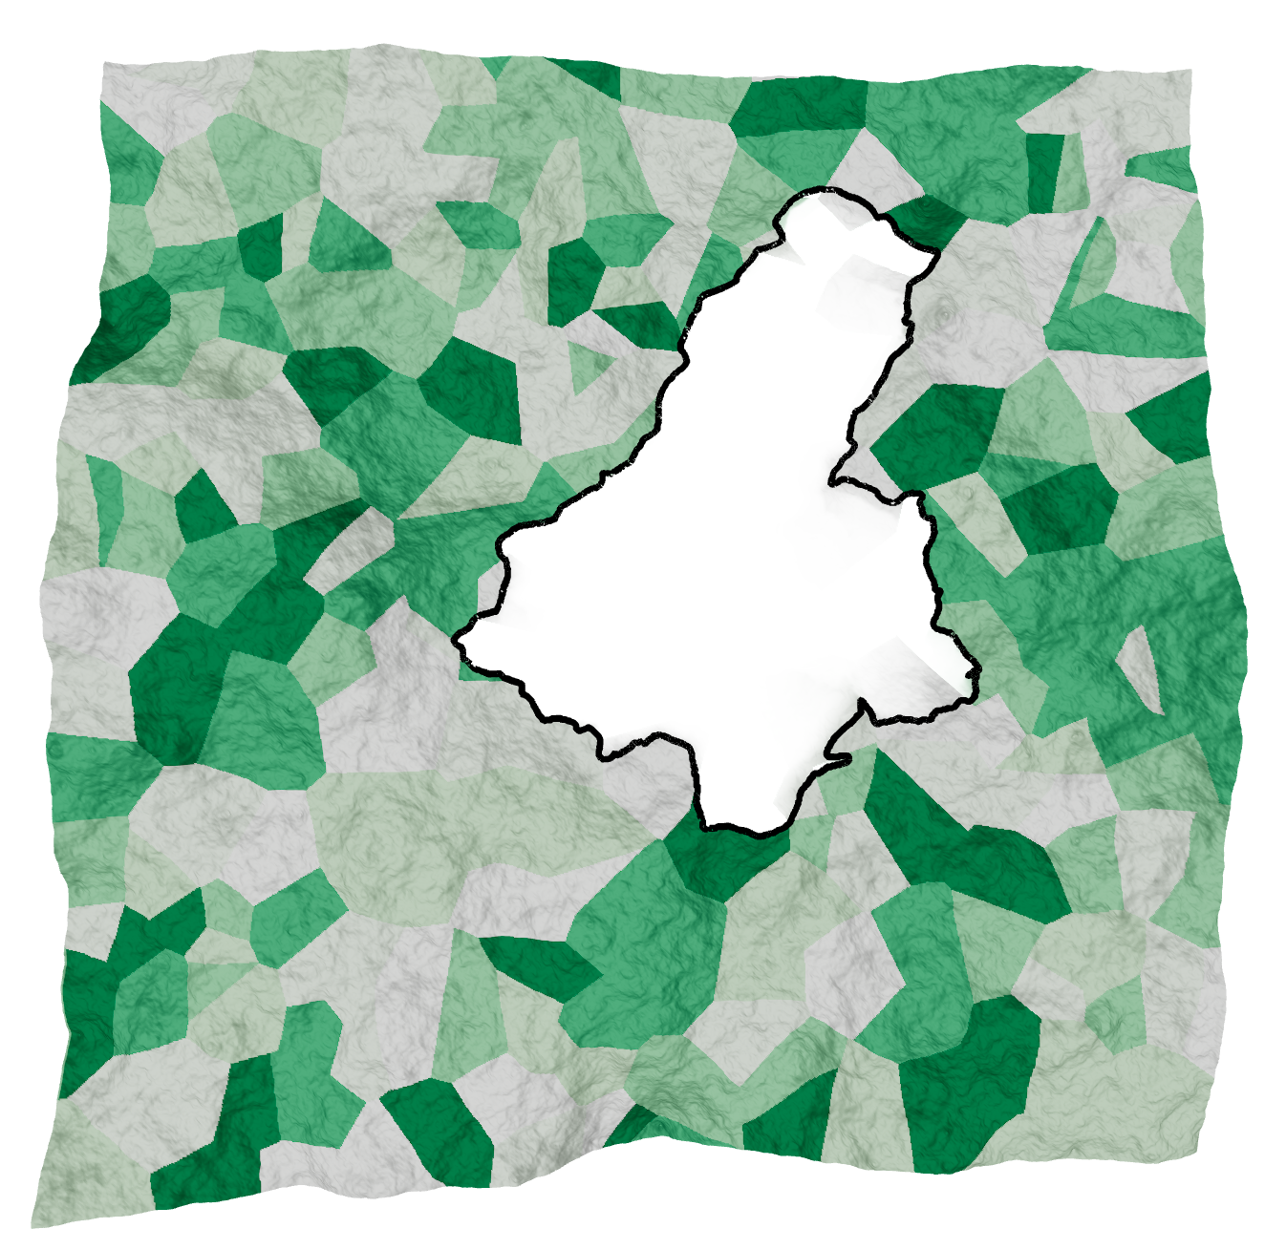
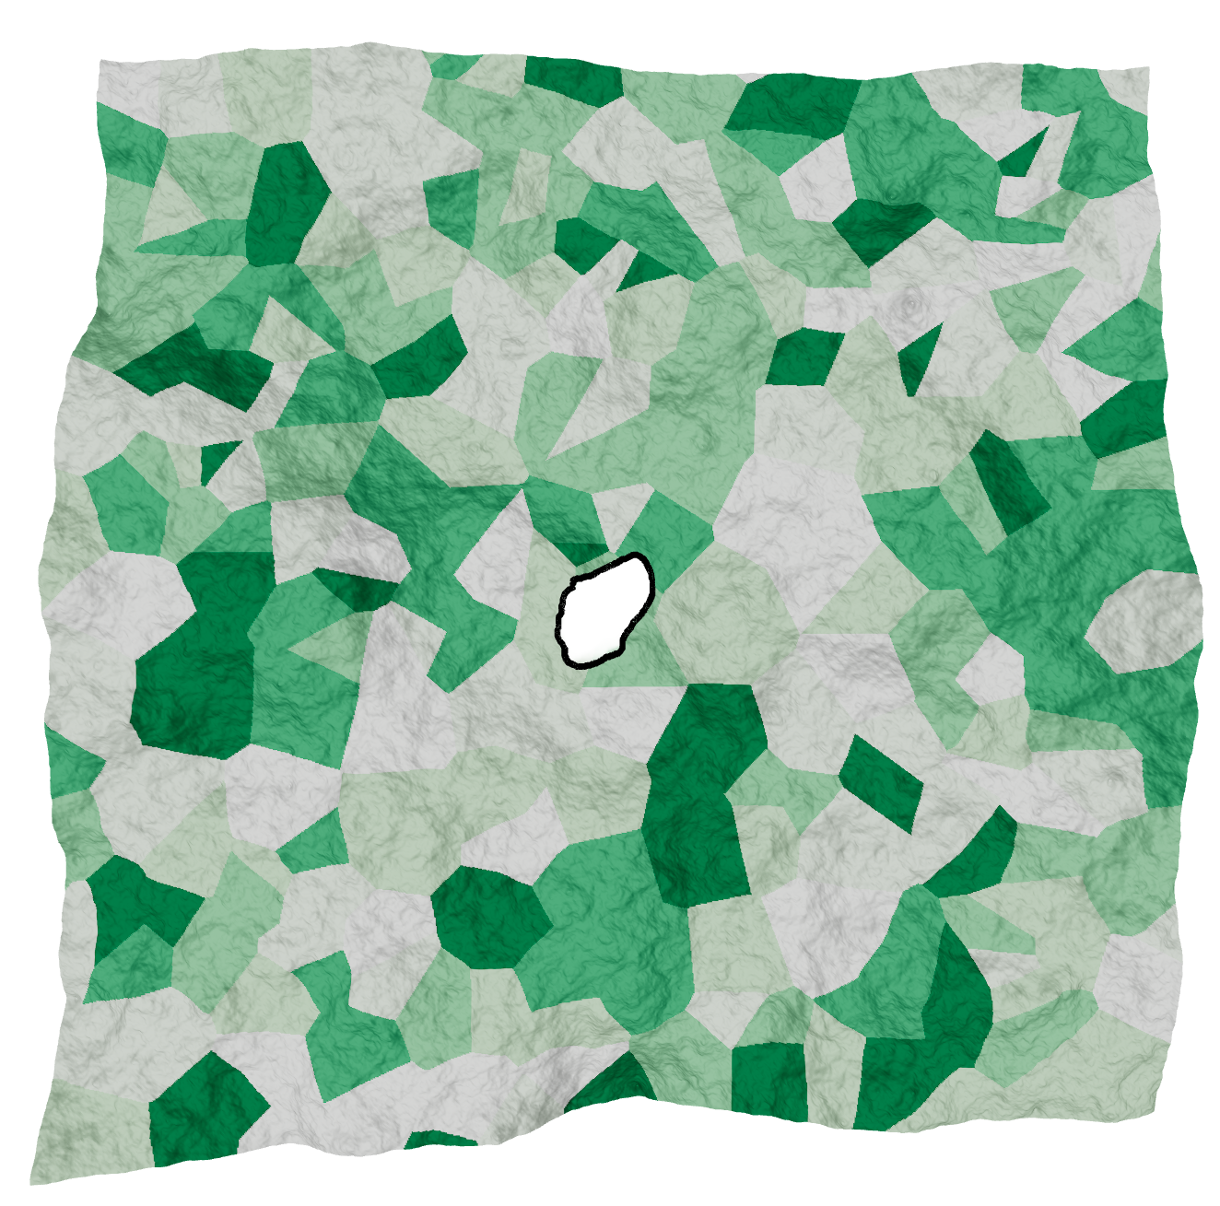
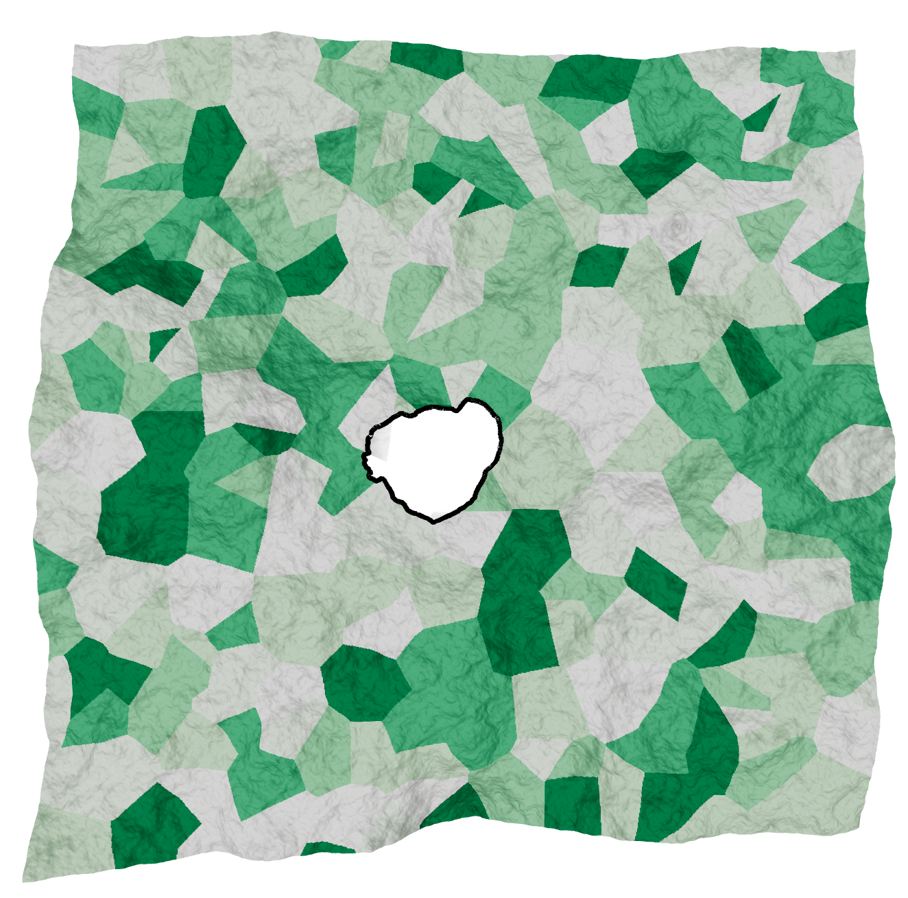
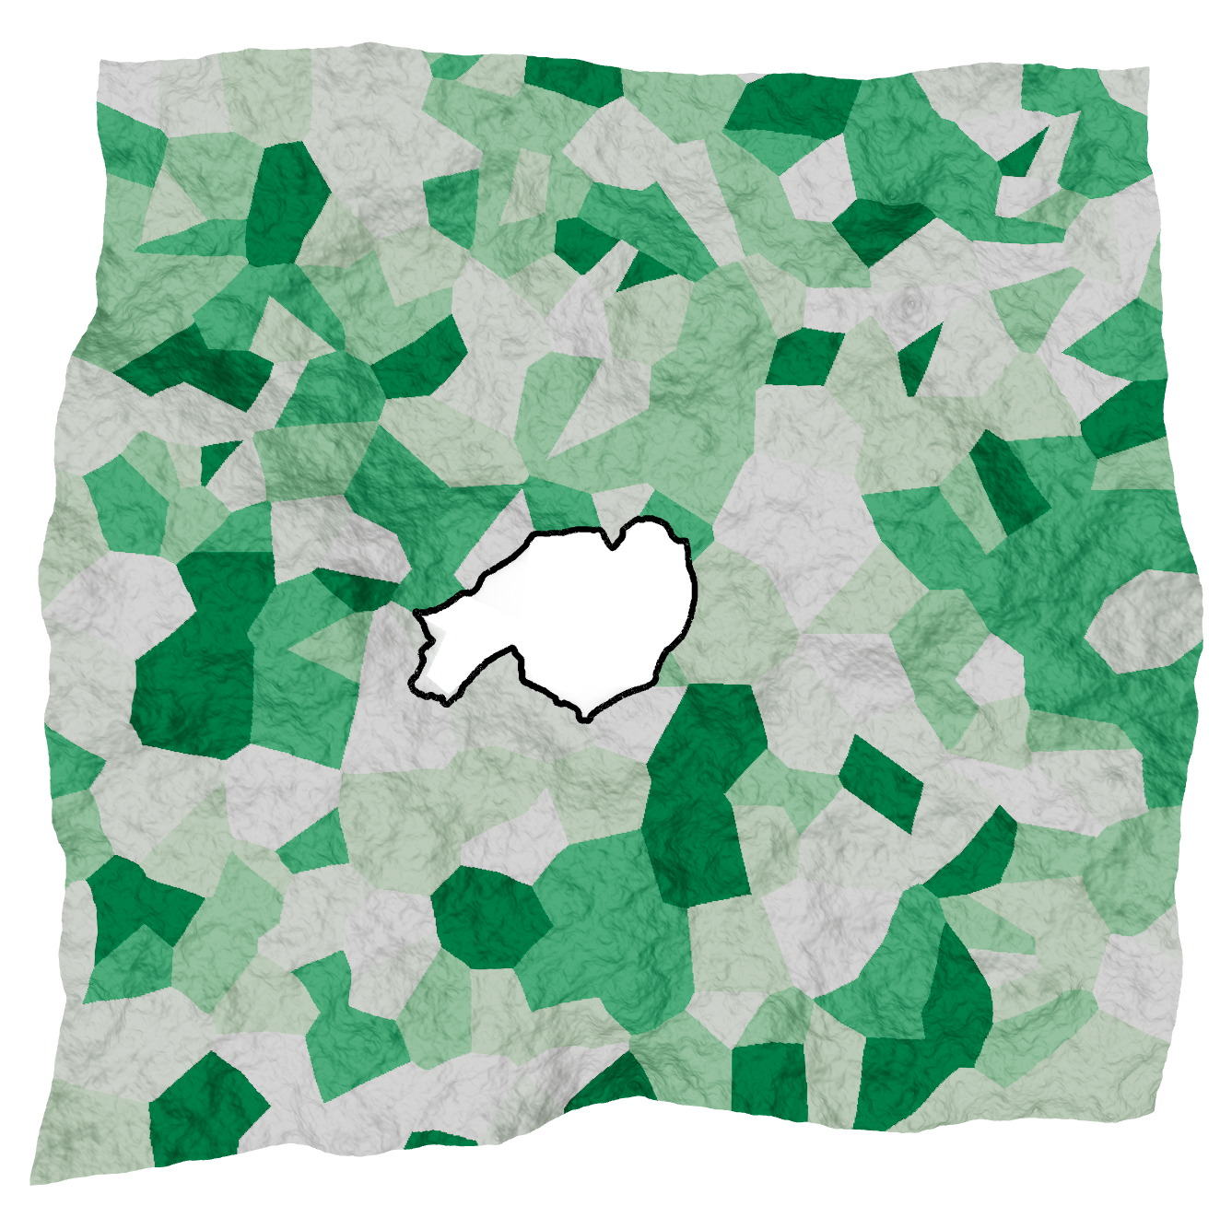
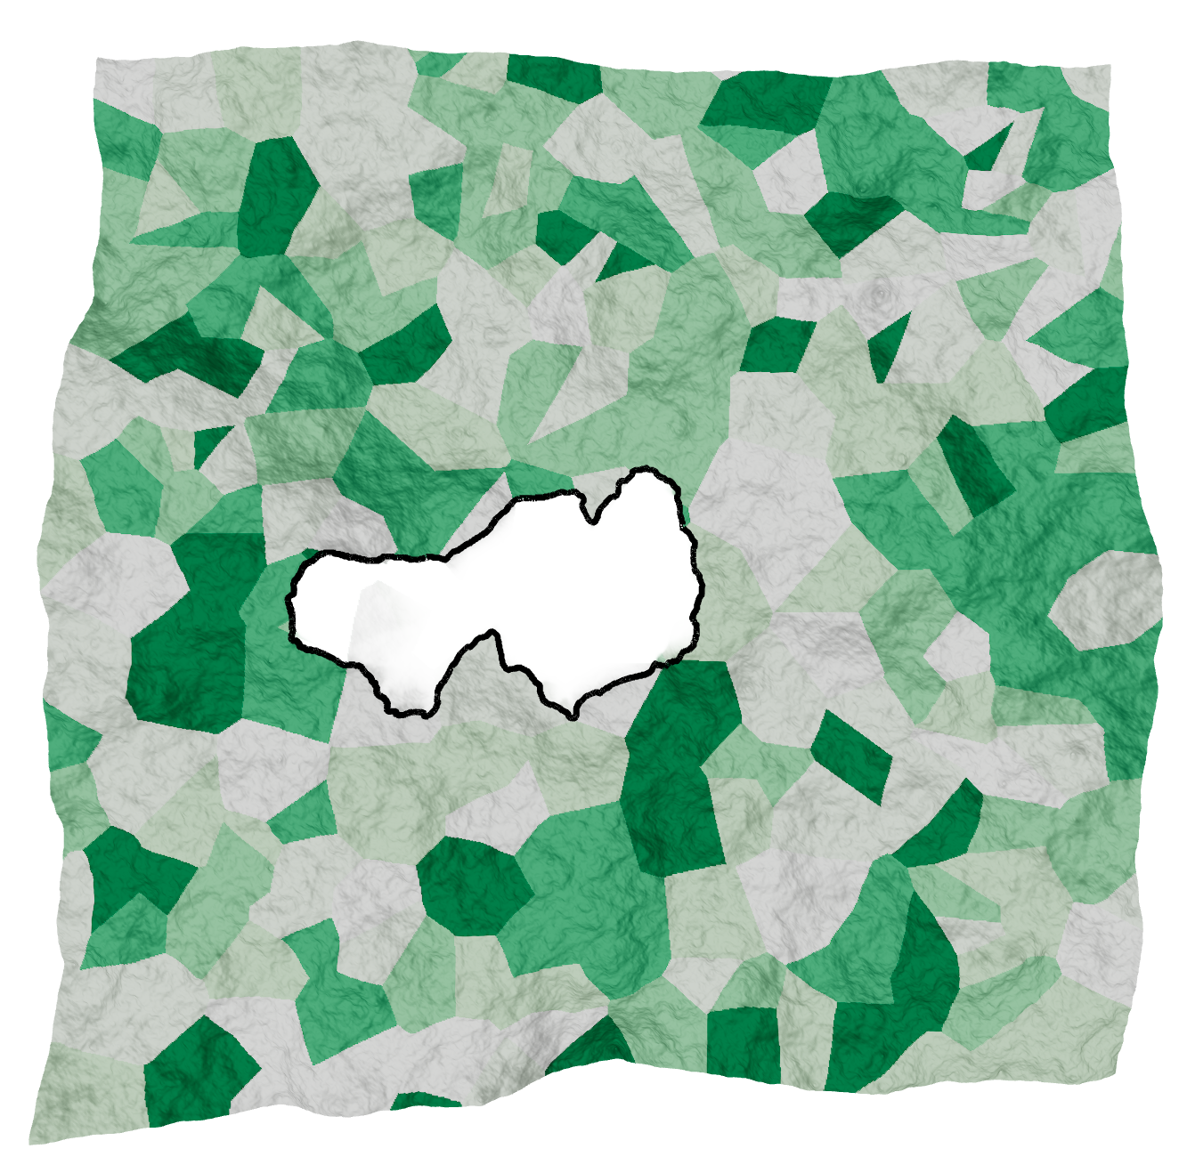
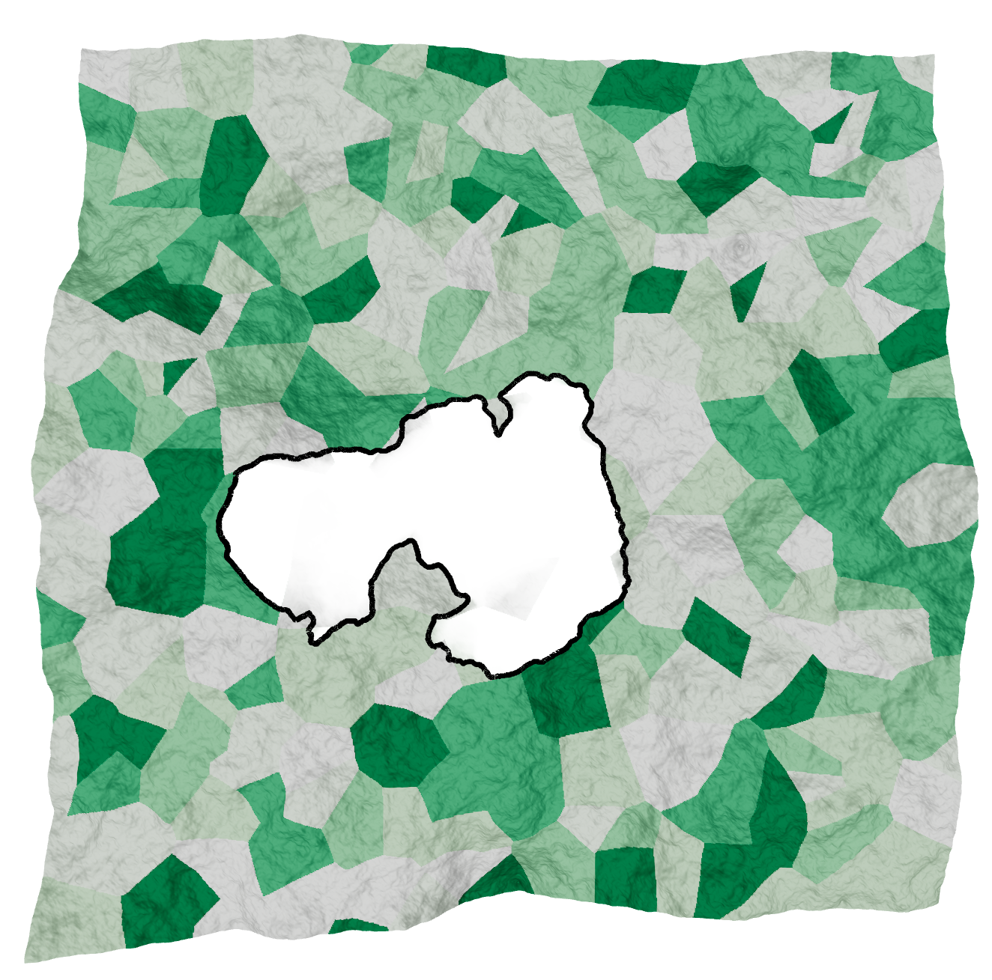
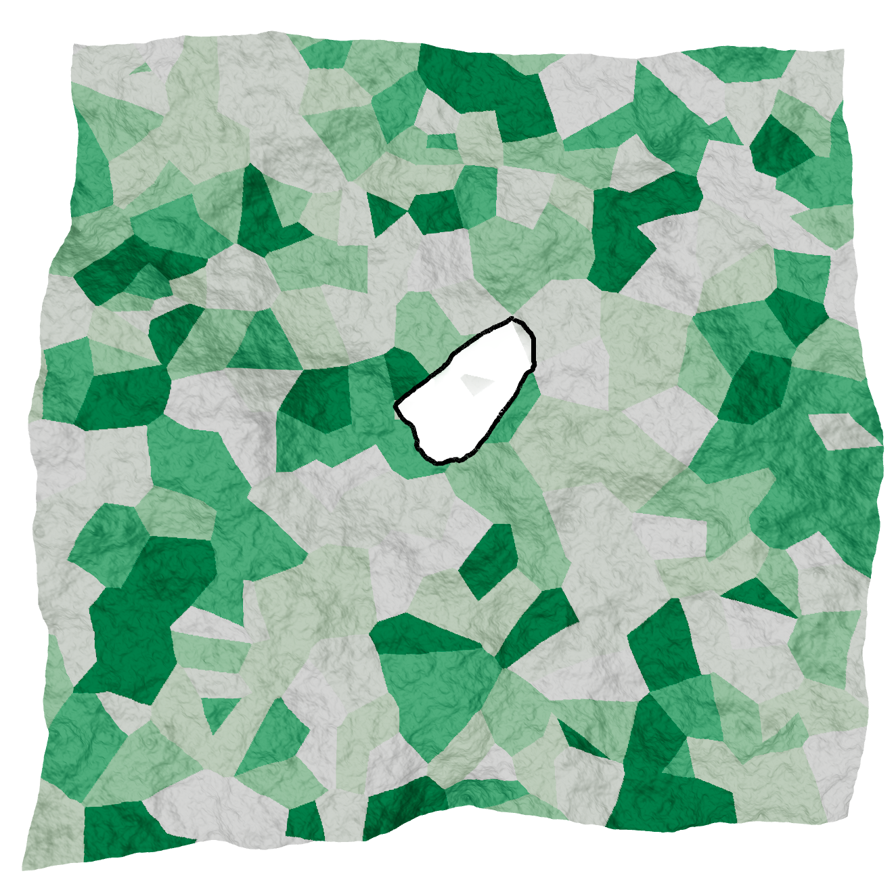
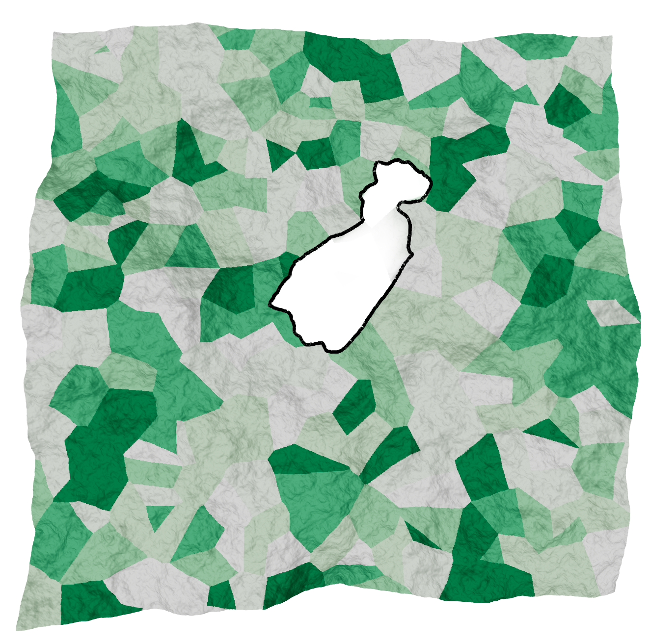
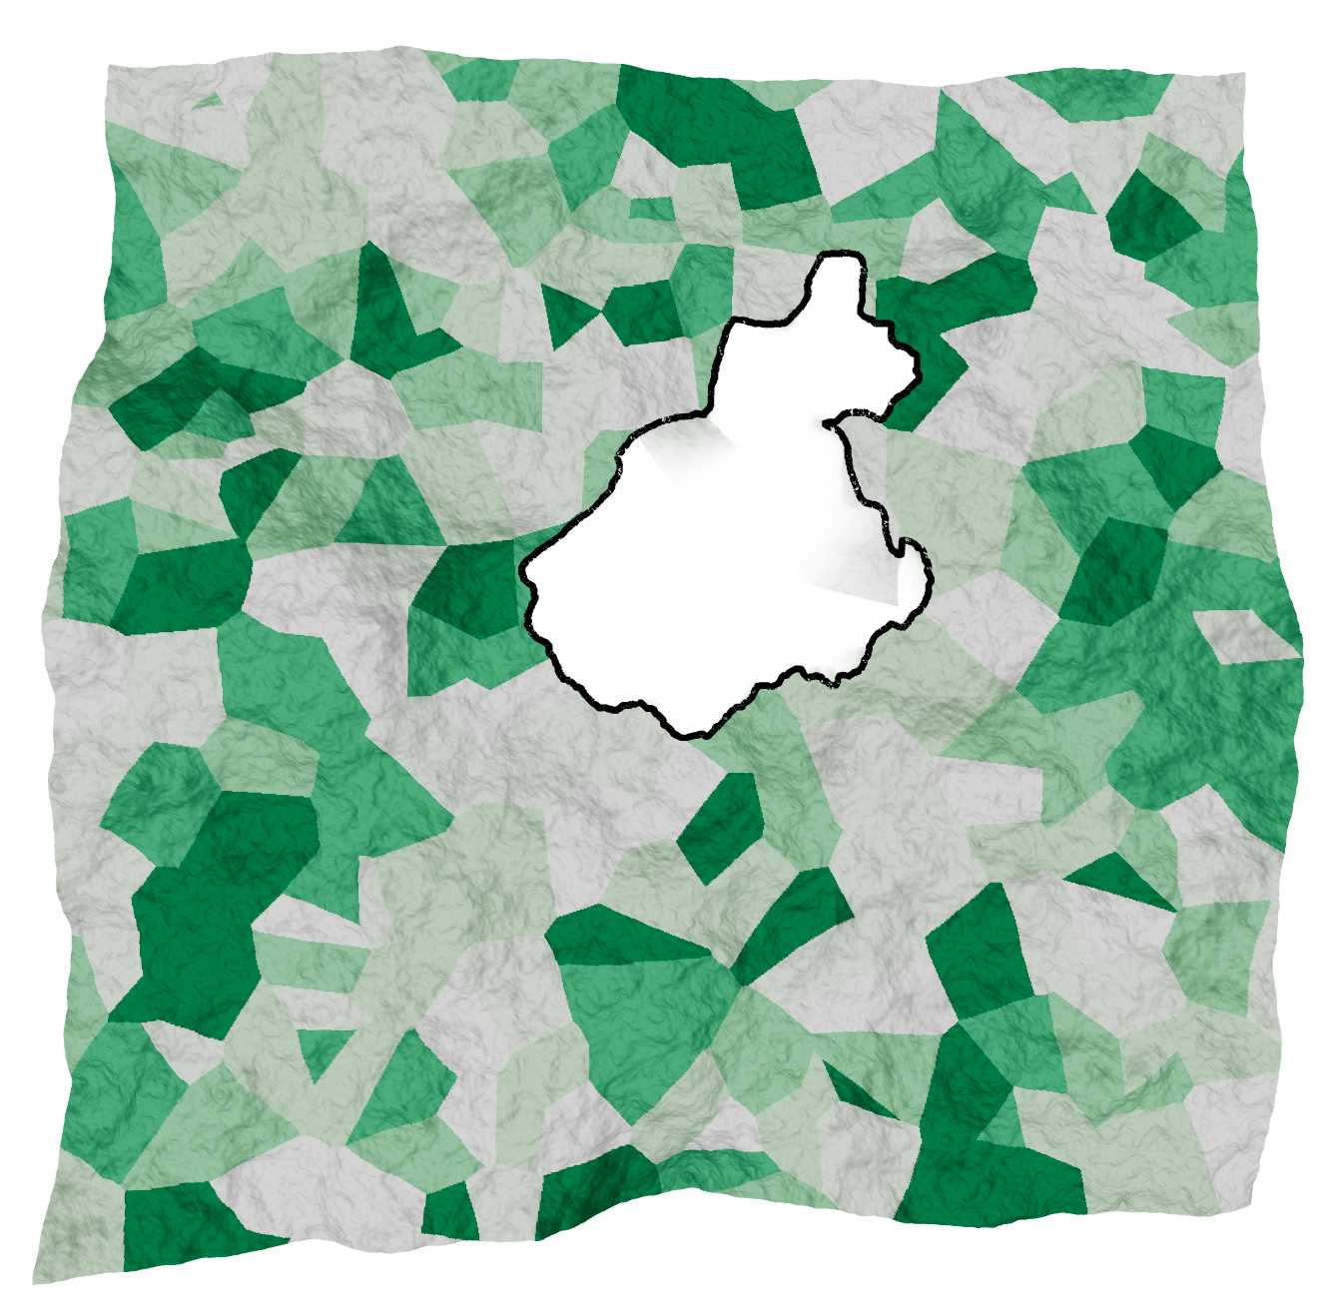
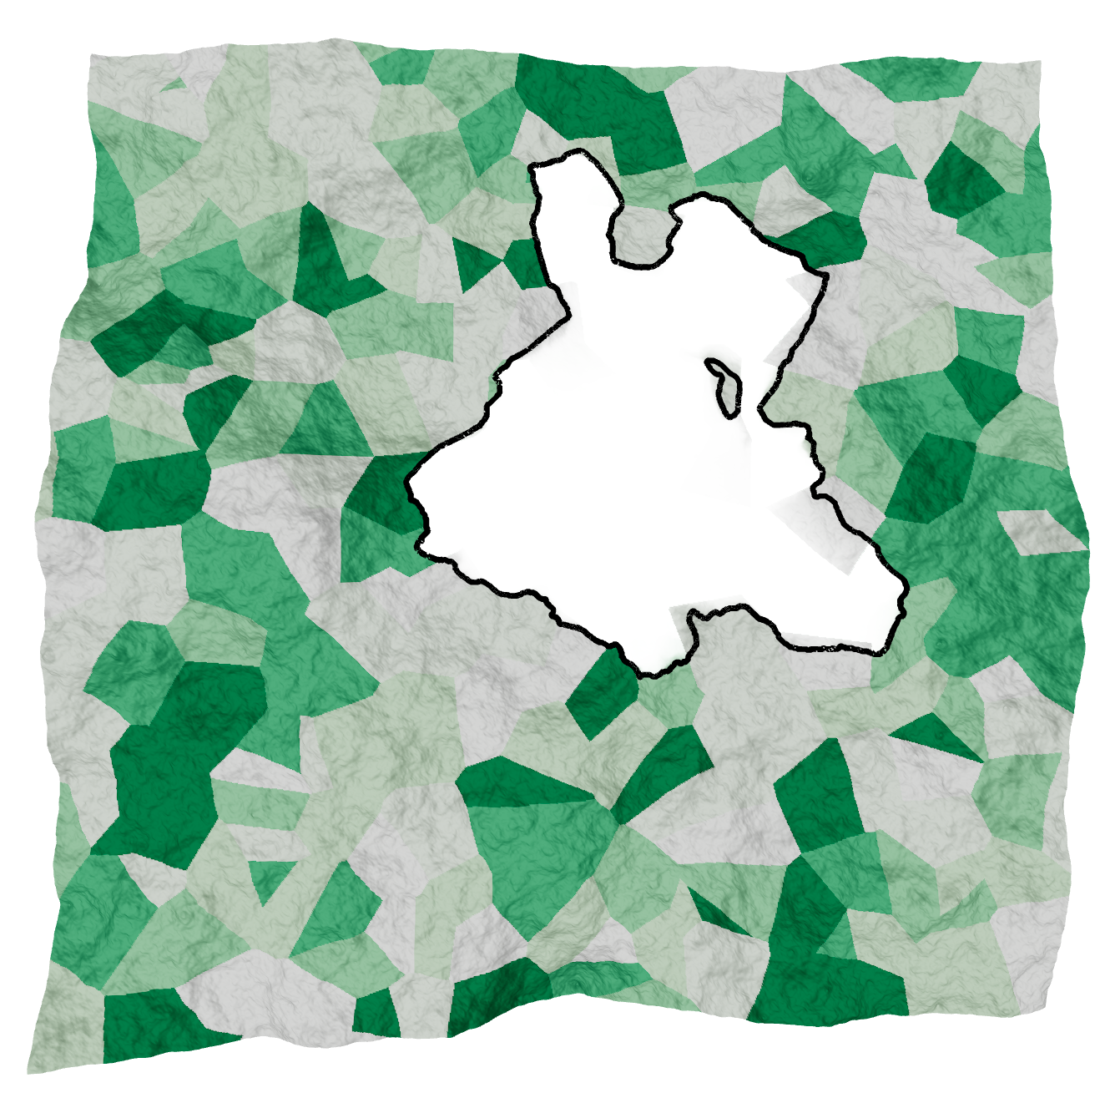
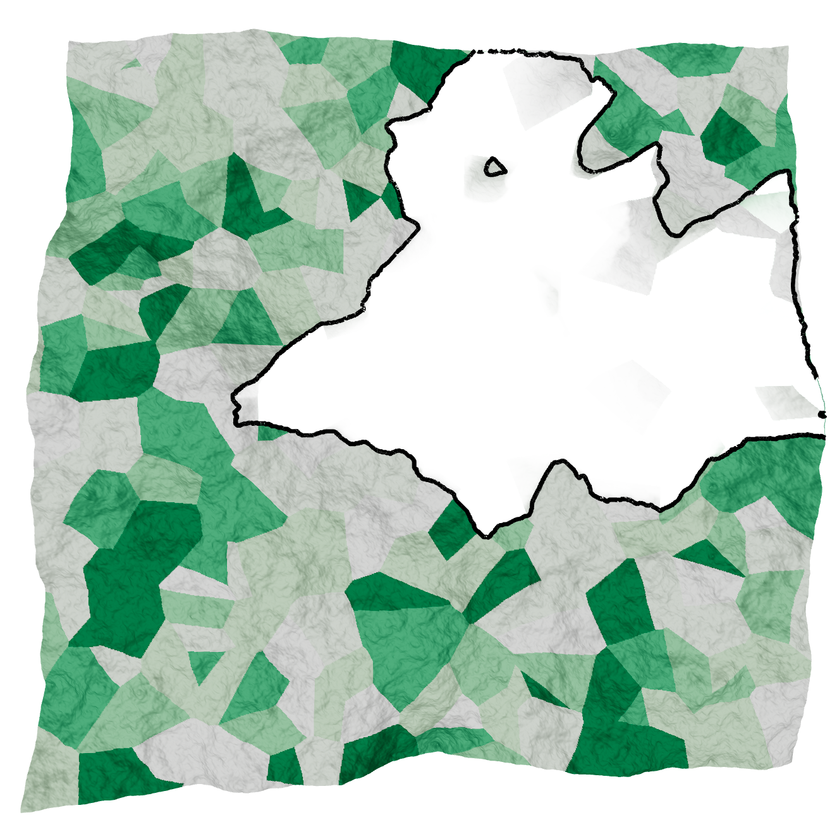
Visualizing Wildfire Forecasts
Multiple runs of simulation
Multiple instances over time →

Slide 4
Visualization Tasks
Visualize ensembles of wildfire forecasts from simulations
Identify similarities (differences) between ensemble members
Identify interesting events in time
Visualize uncertainty in flame front propagation

Slide 5
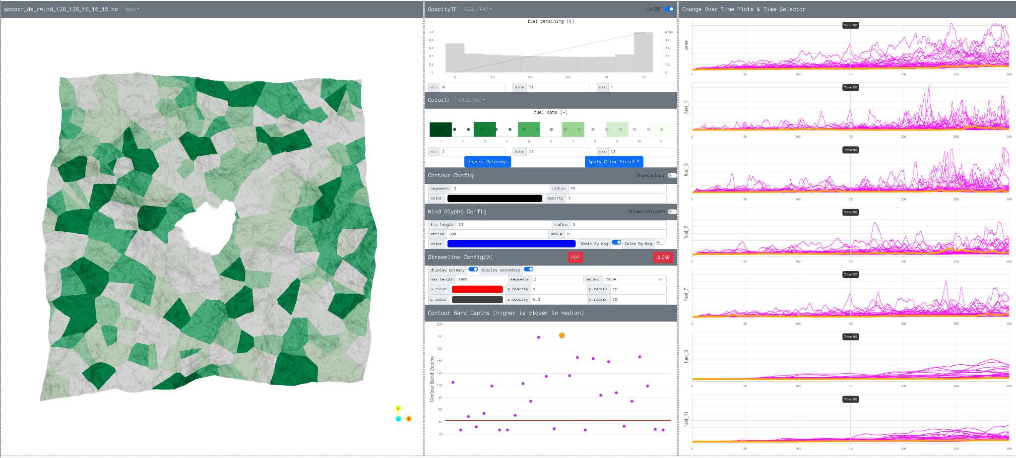
Terrain View
Config Panels
Changes Over Time
Contour Band Depth

Slide 6
Visualization System
Data processing: The data server is implemented in Python. It reads a collection of NetCDF files and serves the data to the web interface. The integral line tracing is distributed on multiple CPU cores. The contour boxplot is computed using CUDA. The resolution of the data is n_times x 1024 x 1024. The current pre-processing code can process 27 instances of 300 x 1024 x1024 datasets in less than 30 minutes.
Rendering: The web interface is implemented using Javascript. Three main libraries are React.js (for the framework), Three.js (a wrapper of WebGL), and Chart.js (for plotting charts).

Slide 7
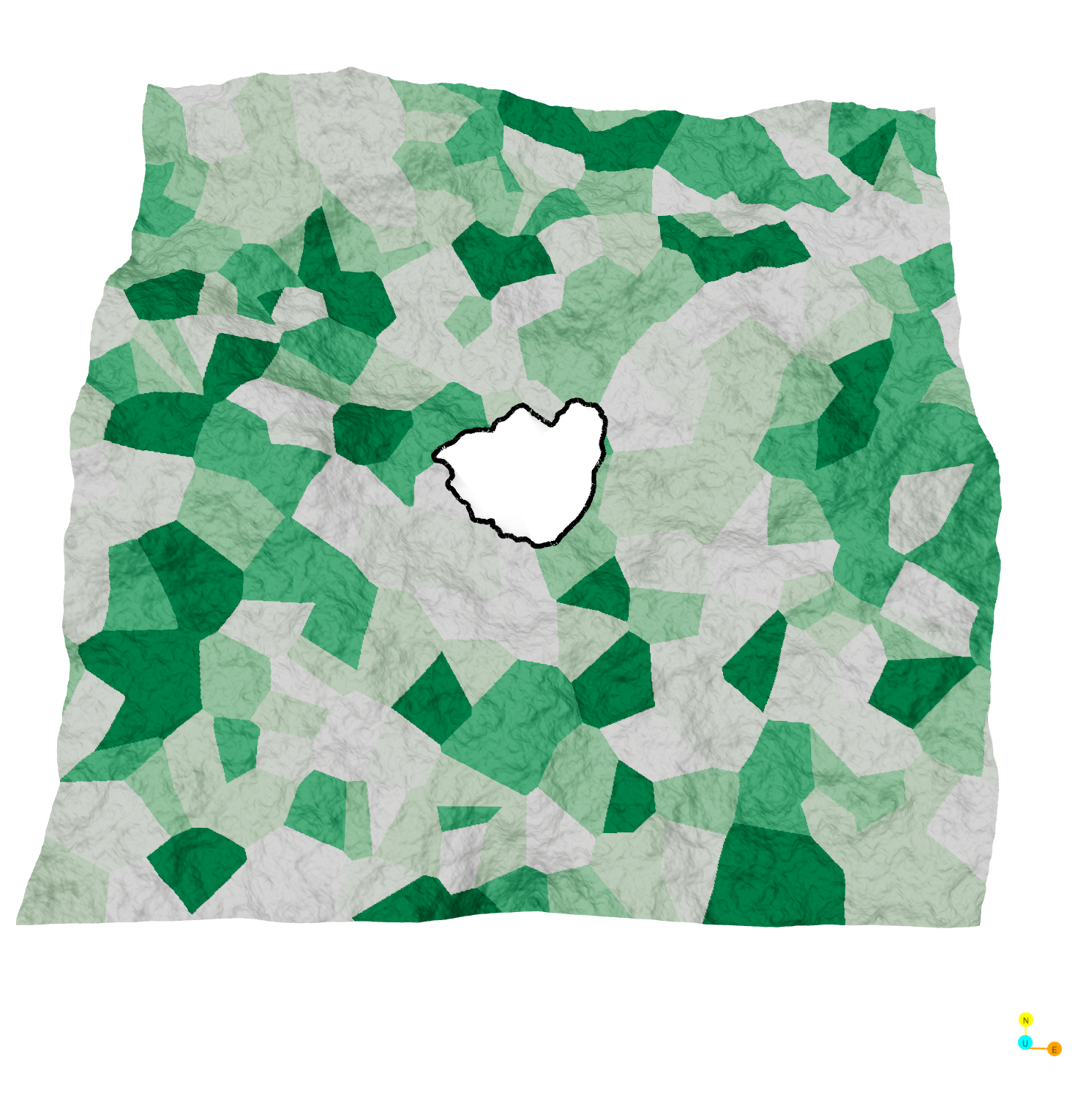
Flame Front Visualization
Use transparency to show remaining fuel percentage
Use contour line to show the flame front

Slide 8
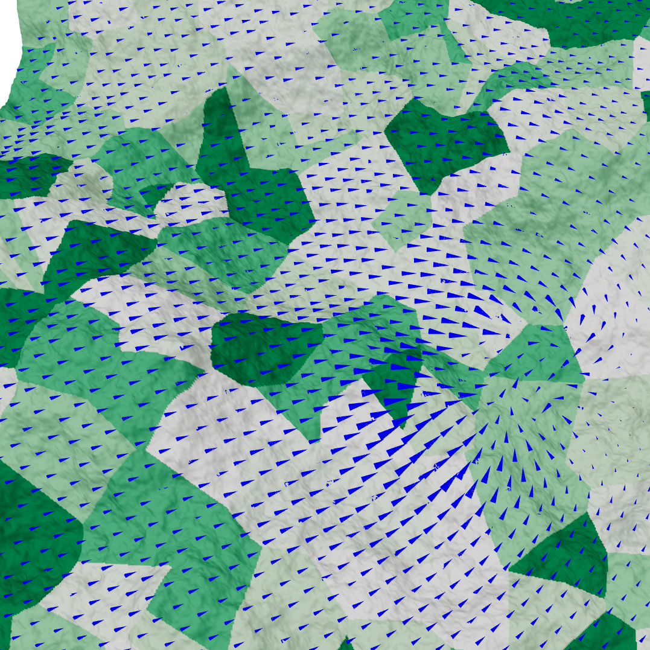
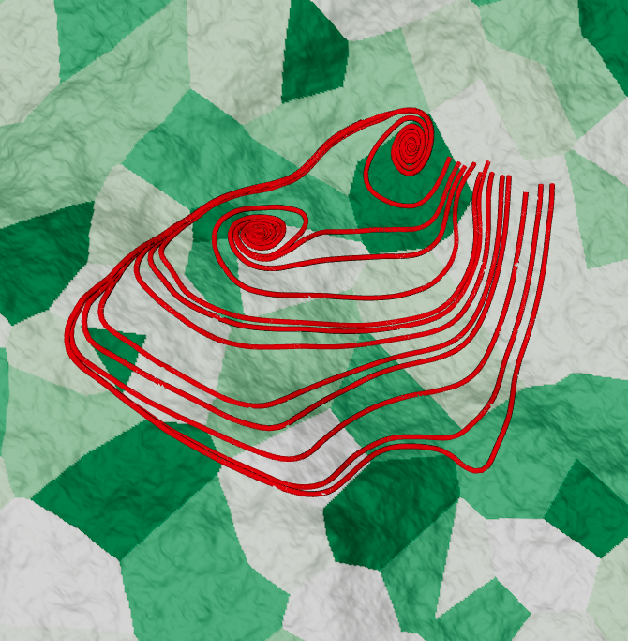
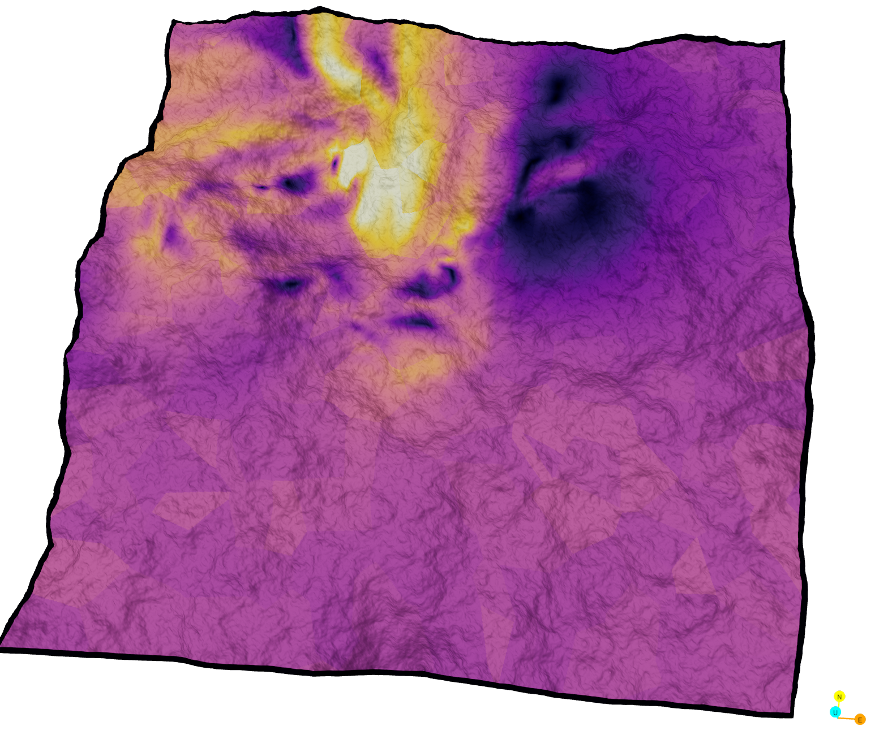
Wind Visualization
Glyphs showing wind direction and magnitude
Integral lines to trace the path
Color map wind velocity magnitude

Slide 9
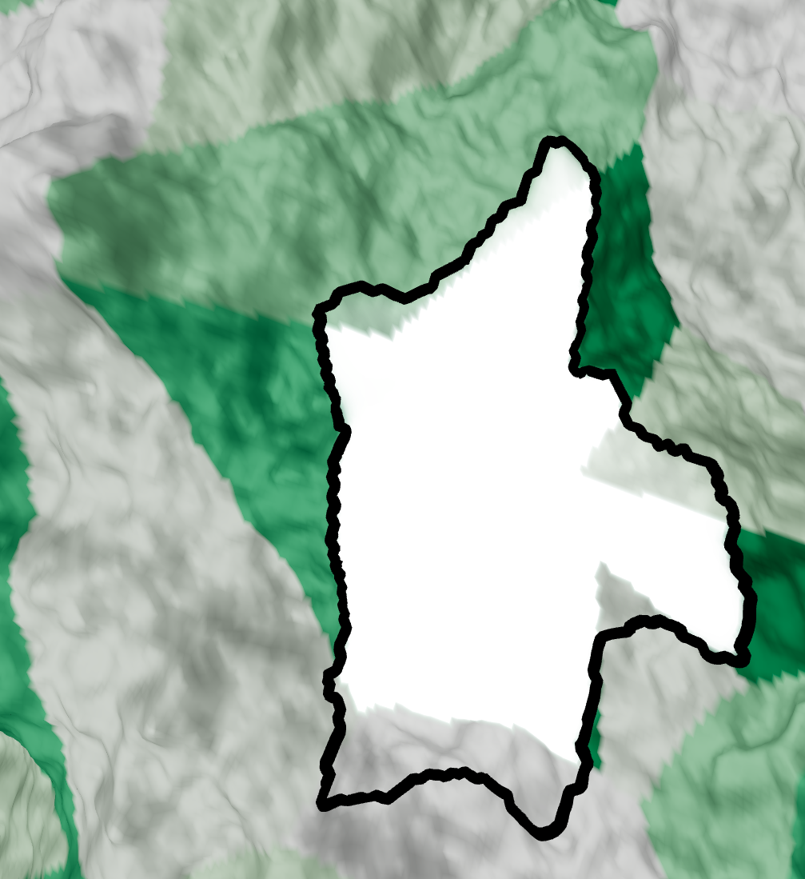
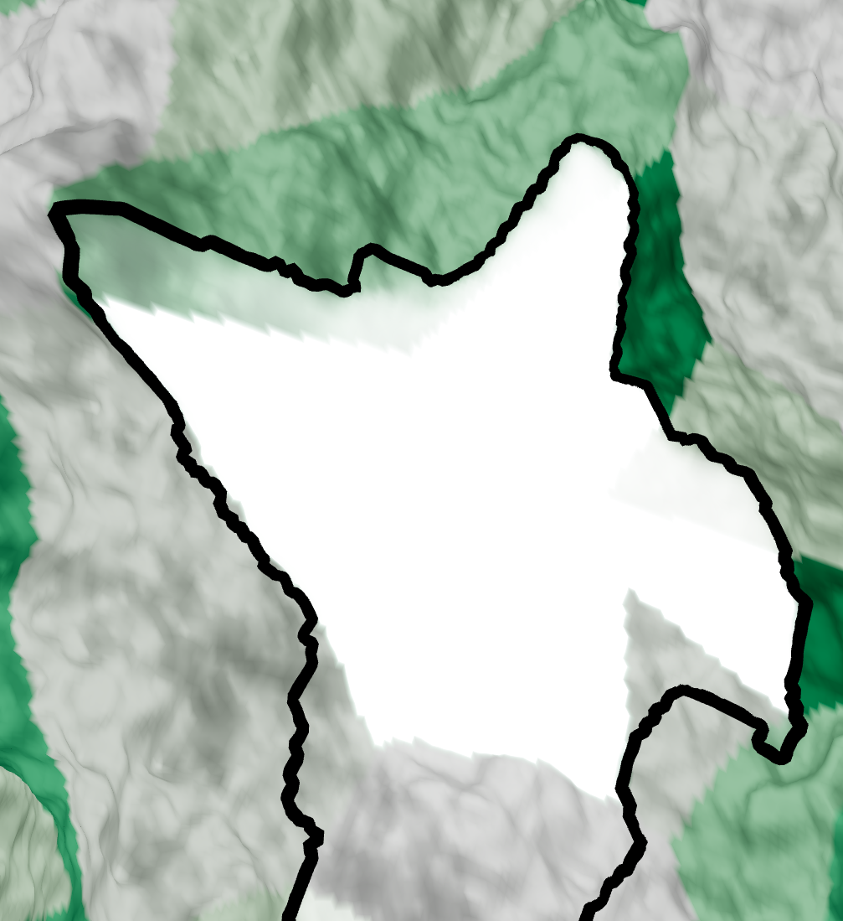
Time Visualization
t=170
t=260

Slide 10
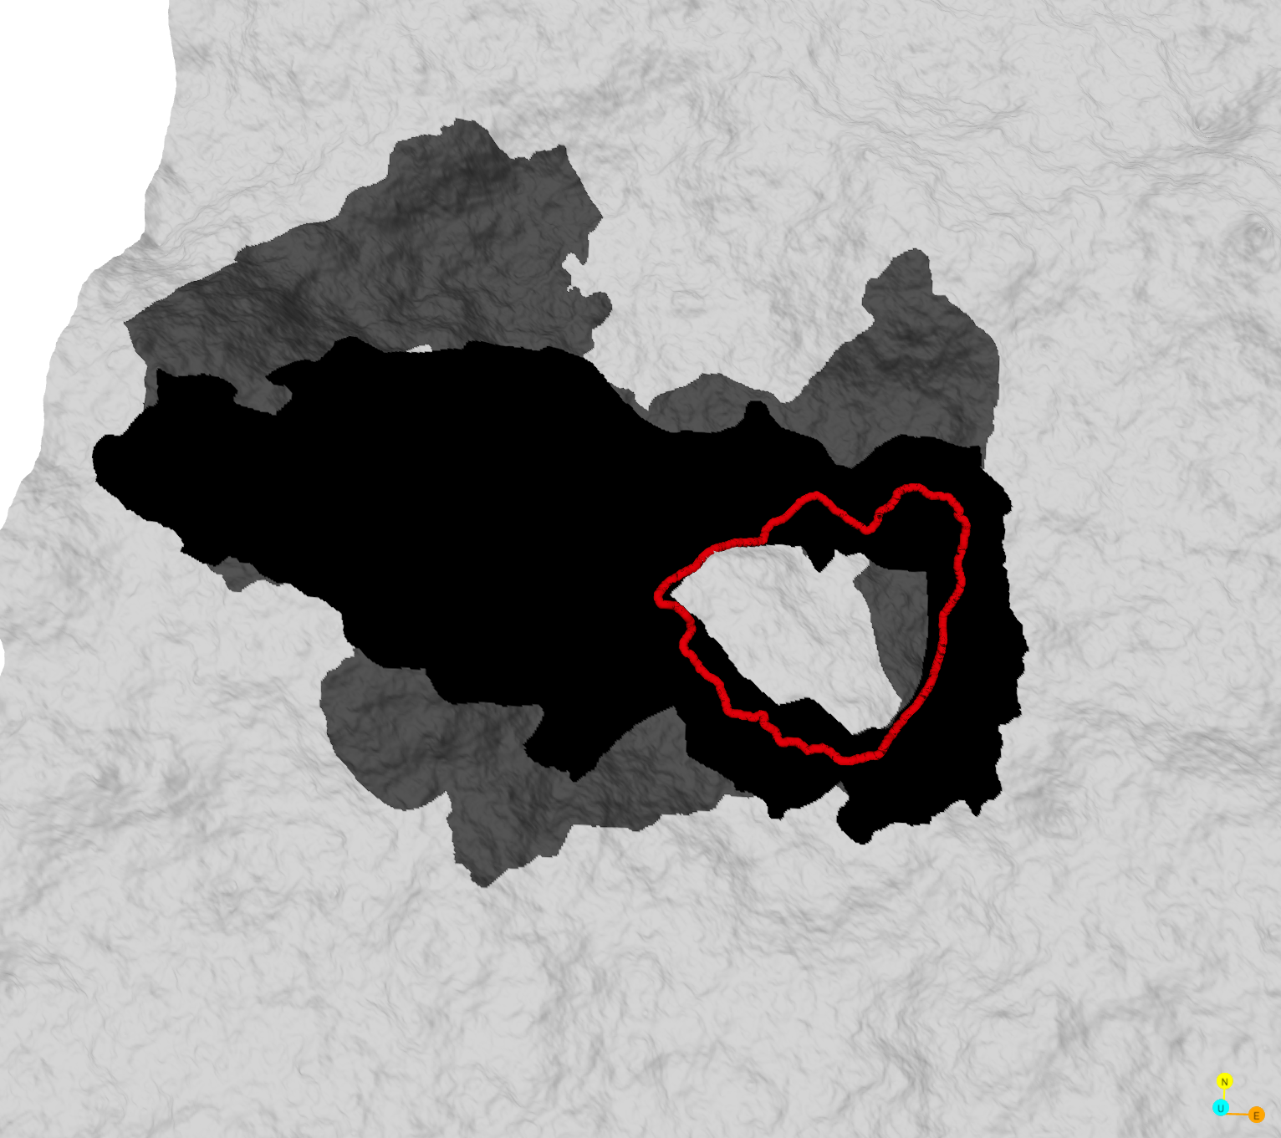
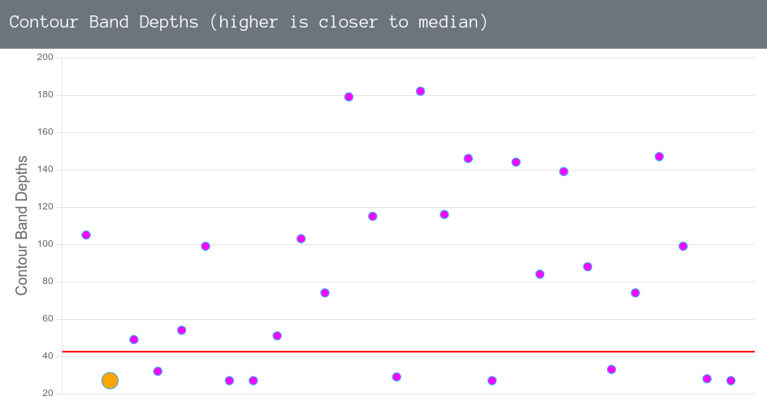
Ensemble Visualization
Contour Band Depth selector:
Orange - currently selected ensemble member (Display in terrain view)
Purple - other ensemble member
Contour Boxplot:
Red - median contour
Black - 50 % contours
Gray - 90 % contours

Slide 11
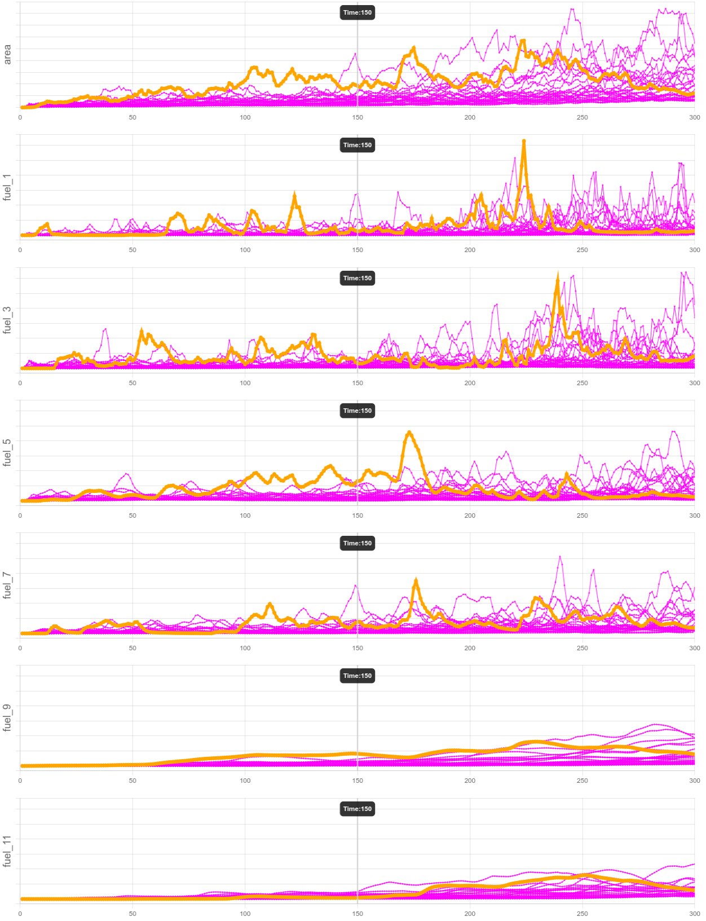
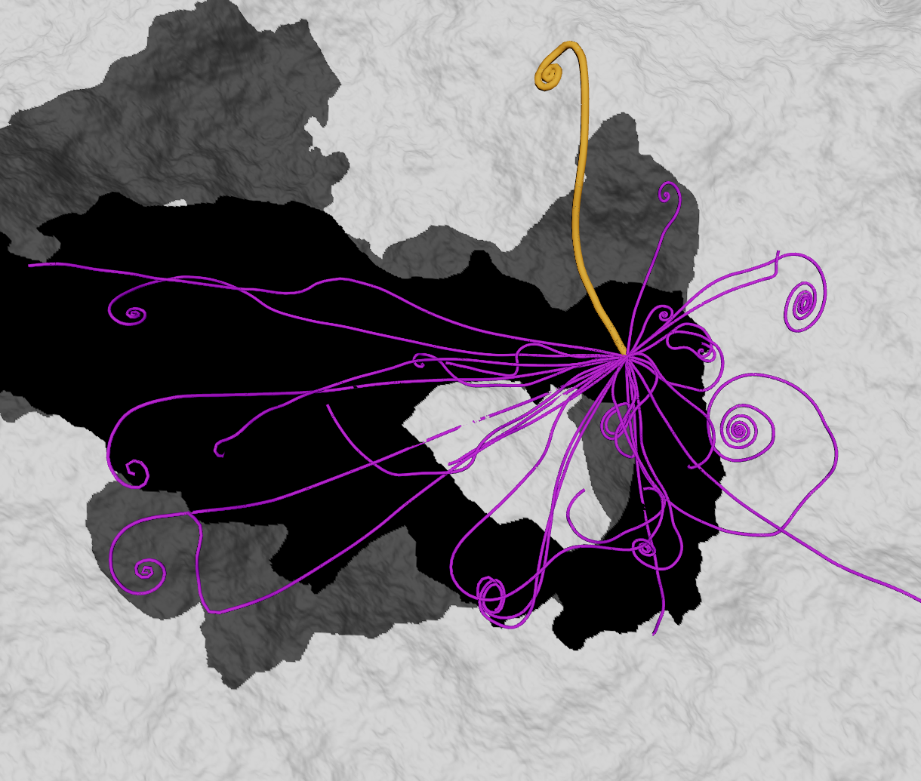
Ensemble Visualization
Integral lines helps to identify (ab)normal wind pattern
Timeline summary for all ensemble members

Slide 12
Future Work
Connection between visualization to scientific observation:
Currently the visualization is designed around visual features and visualization techniques. With helps from domain experts, we will examine how our visualization can better translate from visual features to domain knowledges.
Interactivity of the visualization:
Currently the interface can show 1024 x 1024 grids. The inter-activeness (FPS) can be improved by better data management and lighter weight rendering code.
Modular design of visual components:
Not all information needs to be shown at the same time for everyone. Our new interface will support better customization and interaction. This reduces the complexity of the visualization and provide complex functionalities on demand.

Slide 13
Streamline Uncertainty and Variability
Streamlines and vector field
Notes:
The streamlines uncertainty and variability is inspired by the "curved boxplot" and "streamline variability plot" by Mirzargar et al., and Ferstl et al. (see last slide for references)

Slide 14
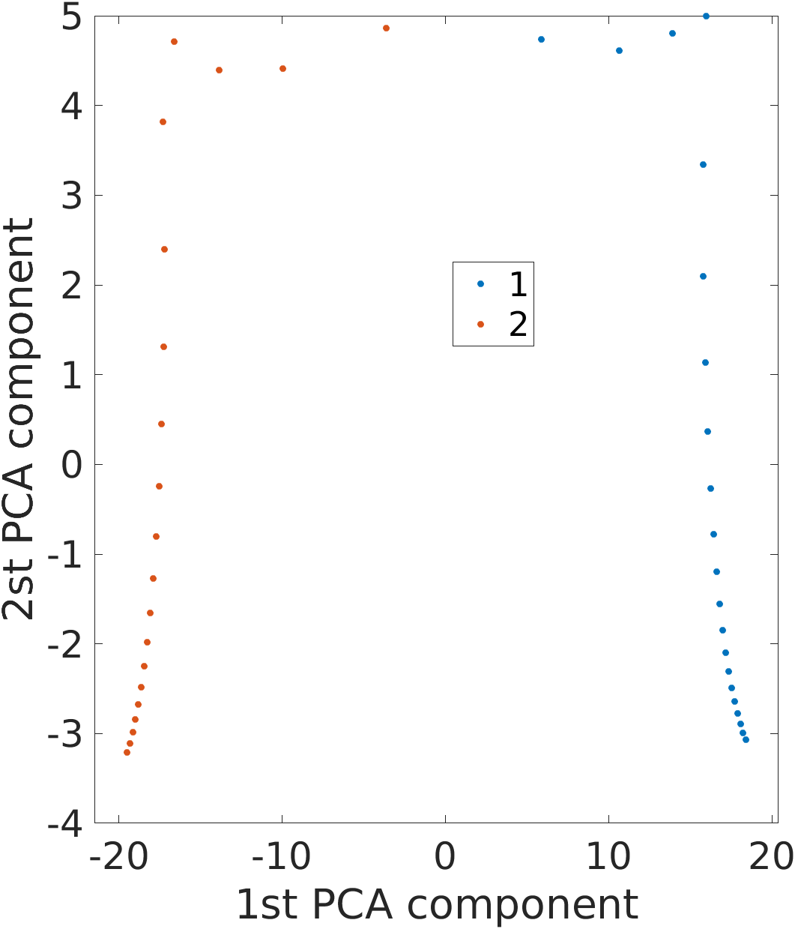
Streamline Uncertainty and Variability
Streamlines and vector field
Clustering in PCA space

Slide 15
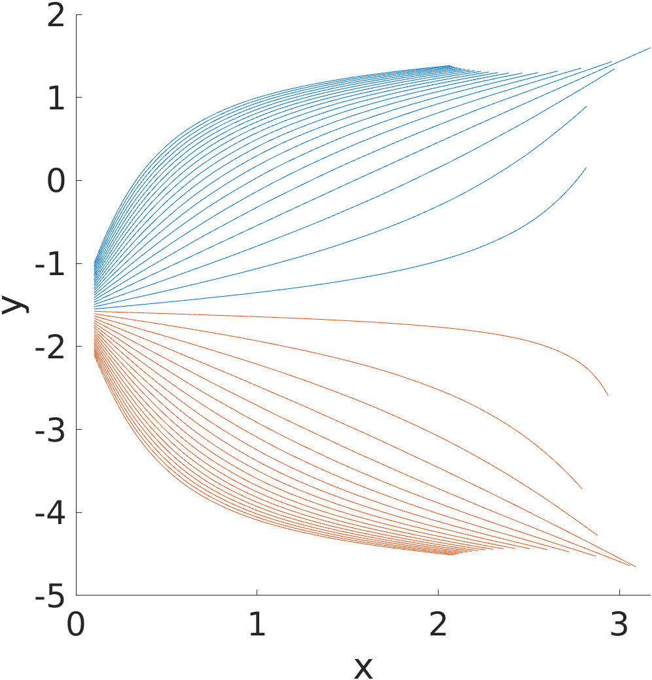
Streamline Uncertainty and Variability
Streamlines and vector field
Clustered streamlines using PCA

Slide 16
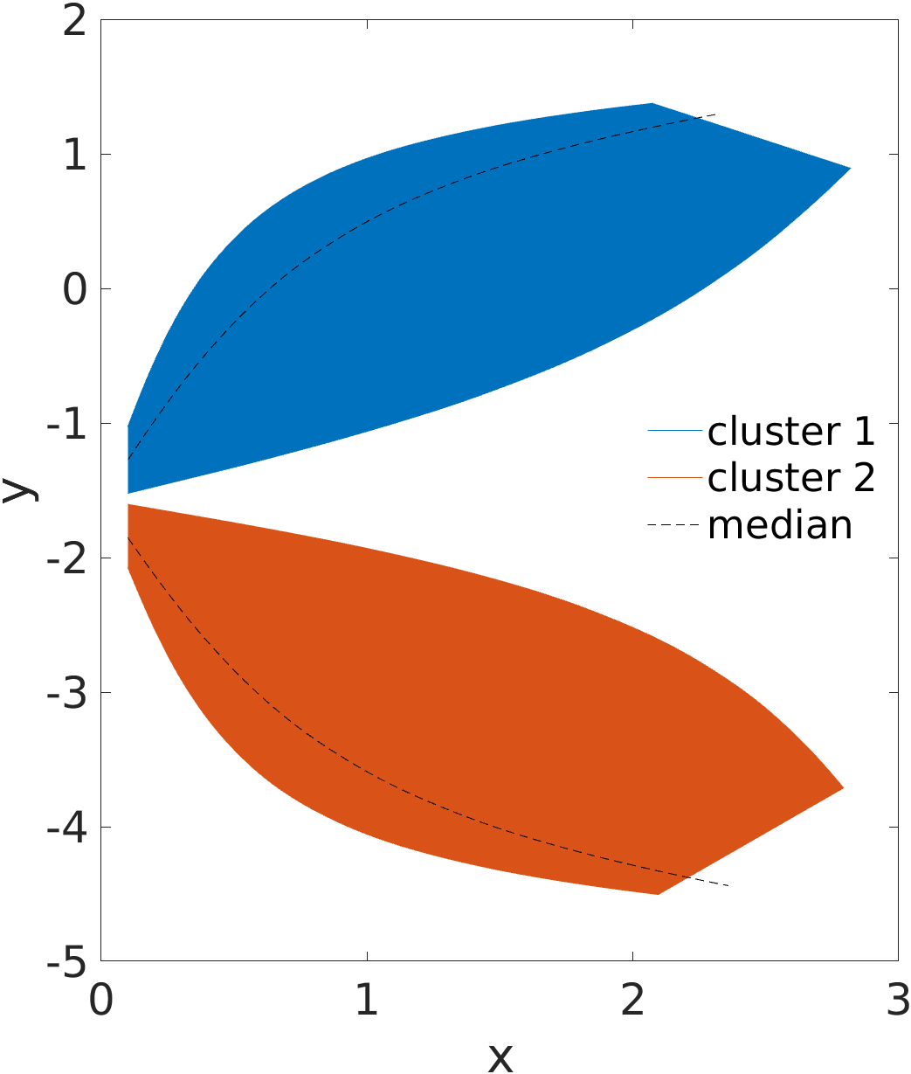
Streamline Uncertainty and Variability
Streamlines variability with Prod > 20%
Streamlines and vector field
Clustered streamlines using PCA

Slide 17
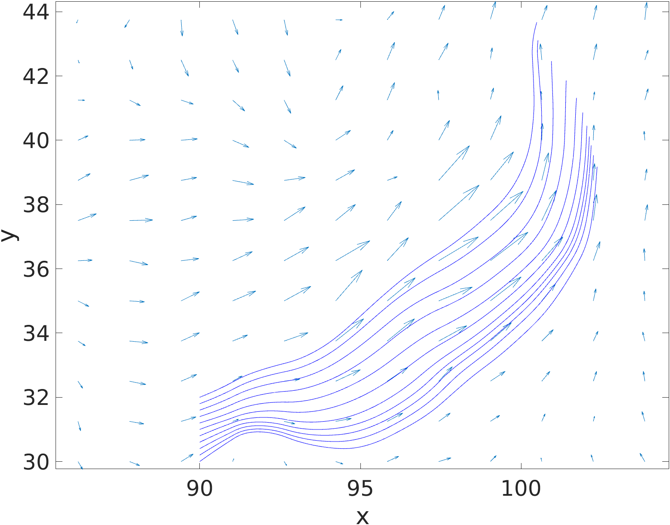
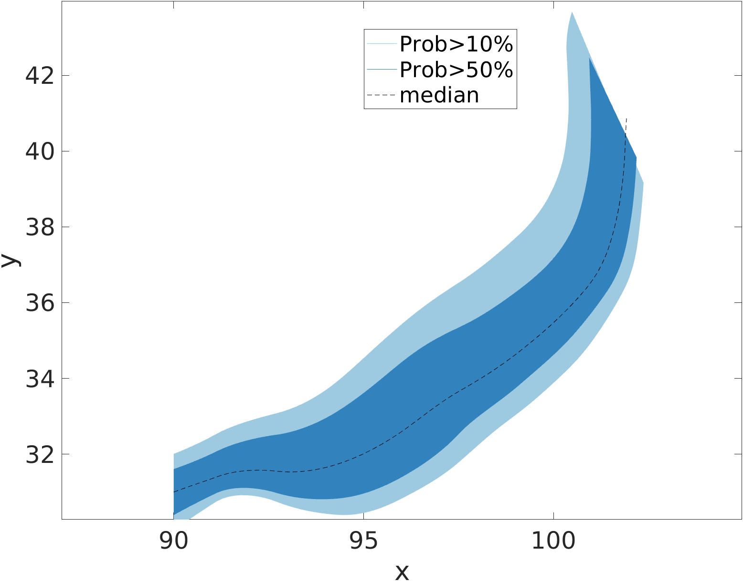
Streamline Uncertainty and Variability
Streamlines and vector field
Streamlines variability

Slide 18
Future Work
Streamlines variability plot from fire simulation data
Segmentation based on angular and magnitude variation
Embed magnitude variation in glyph (arrowhead)
Interface protype combining different visualization methods

