Slide 1
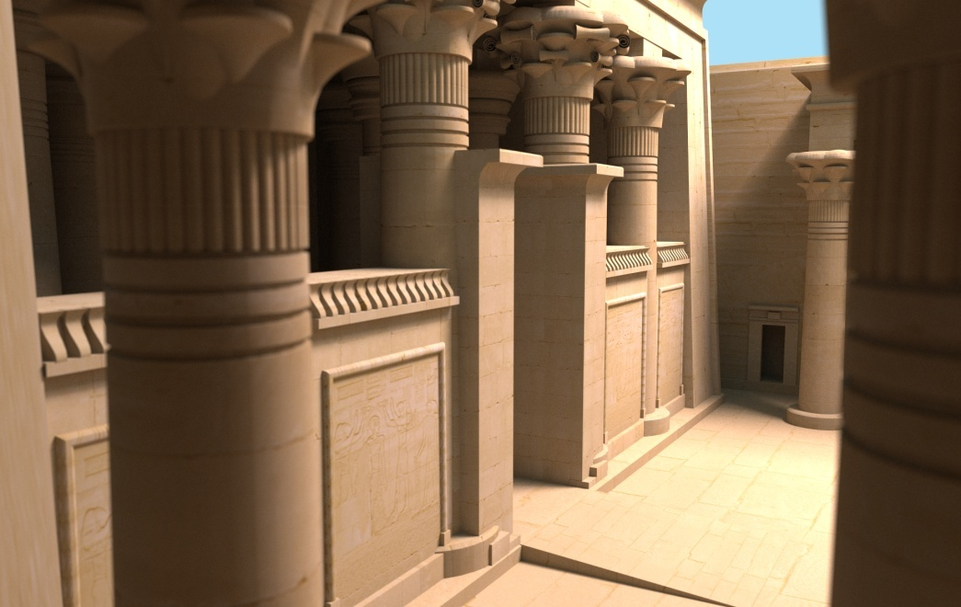
coherent ray tracing via stream filtering
christiaan gribble karthik ramani
ieee/eurographics symposium on interactive ray tracing
august 2008

Slide 2
acknowledgements
early implementation
andrew kensler (utah)
ingo wald (intel)
solomon boulos (stanford)
other contributors
steve parker & pete shirley (nvidia)
al davis & erik brunvand (utah)

Slide 3
wide SIMD environments
ray packets → SIMD processing
increasing SIMD widths
current GPUs
intel’s larrabee
future processors
how to exploit wide SIMD units for fast ray tracing?
Notes:
coherent ray tracing → good for highly coherent packets
secondary rays → potentially problematic, but difficult to know for sure
- boulos → packet assembly techniques, okay
- mannsson → reordering techniques, okay
- reshetov → perfectly specular only, bad

Slide 4
stream filtering
recast ray tracing algorithm
series of filter operations
applied to arbitrarily-sized groups of rays
apply filters throughout rendering
eliminate inactive rays
improve SIMD efficiency
achieve interactive performance

Slide 5
core concepts
ray streams
groups of rays
arbitrary size
arbitrary order
stream filters
set of conditional statements
executed across stream elements
extract only rays with certain properties
Notes:
ray stream = “generalized packet”

Slide 6
core concepts
input stream
a
b
c
d
e
f
test
conditional statement(s)
stream element
out_stream filter<test>(in_stream)
{
foreach e in in_stream
if (test(e) == true)
out_stream.push(e)
return out_stream
}

Slide 7
core concepts
input stream
a
b
c
d
e
f
test
a
output stream
a
out_stream filter<test>(in_stream)
{
foreach e in in_stream
if (test(e) == true)
out_stream.push(e)
return out_stream
}

Slide 8
core concepts
input stream
a
b
c
d
e
f
test
b
output stream
a
b
out_stream filter<test>(in_stream)
{
foreach e in in_stream
if (test(e) == true)
out_stream.push(e)
return out_stream
}

Slide 9
core concepts
input stream
a
b
c
d
e
f
test
c
output stream
a
b
out_stream filter<test>(in_stream)
{
foreach e in in_stream
if (test(e) == true)
out_stream.push(e)
return out_stream
}

Slide 10
core concepts
input stream
a
b
c
d
e
f
test
d
output stream
a
b
d
out_stream filter<test>(in_stream)
{
foreach e in in_stream
if (test(e) == true)
out_stream.push(e)
return out_stream
}

Slide 11
core concepts
input stream
a
b
c
d
e
f
test
e
output stream
a
b
d
out_stream filter<test>(in_stream)
{
foreach e in in_stream
if (test(e) == true)
out_stream.push(e)
return out_stream
}

Slide 12
core concepts
input stream
a
b
c
d
e
f
test
f
output stream
a
b
d
f
out_stream filter<test>(in_stream)
{
foreach e in in_stream
if (test(e) == true)
out_stream.push(e)
return out_stream
}

Slide 13
core concepts
input stream
a
b
c
d
e
f
test
output stream
a
b
d
f
out_stream filter<test>(in_stream)
{
foreach e in in_stream
if (test(e) == true)
out_stream.push(e)
return out_stream
}

Slide 14
SIMD filtering
process stream in groups of N elements
two steps
N-wide groups → boolean mask
boolean mask → partitioned stream
Notes:
takehome slide
active/inactive based on result of filter
output stream corresponds to active partition of input stream

Slide 15
SIMD filtering
input stream
a
b
c
d
e
f
test
boolean mask
step one

Slide 16
SIMD filtering
input stream
a
b
c
d
e
f
test
a
b
c
boolean mask
t
t
f
step one

Slide 17
SIMD filtering
input stream
a
b
c
d
e
f
test
d
e
f
boolean mask
t
t
f
t
f
t
step one

Slide 18
SIMD filtering
input stream
a
b
c
d
e
f
test
boolean mask
t
t
f
t
f
t

Slide 19
SIMD filtering
input stream
a
b
c
d
e
f
test
boolean mask
t
t
f
t
f
t
partition
a
b
f
d
e
c
output stream

Slide 20
key characteristics
all rays requiring same sequence of ops will always perform those ops together
independent of execution path
independent of order within stream
coherence defined by ensuing ops
no guessing with heuristics
adapts to geometry, etc.

Slide 21
key characteristics
all rays requiring same sequence of ops will always perform those ops together
independent of execution path
independent of order within stream
coherence defined by ensuing ops
no guessing with heuristics
adapts to geometry, etc.

Slide 22
key characteristics
all rays requiring same sequence of ops will always perform those ops together
independent of execution path
independent of order within stream
coherence defined by ensuing ops
no guessing with heuristics
adapts to geometry, etc.

Slide 23
potential benefits
SIMD execution → exploits parallelism within stream
improves efficiency → underutilization only when (# rays % N) > 0

Slide 24
hardware requirements
wide SIMD ops (N > 4)
scatter/gather memory ops
partition op
Notes:
direct support for partition op is ideal (our achitecture)
efficient data parallel algorithms can be used instead (e.g., horn’s algorithm)

Slide 25
application to ray tracing
recast ray tracing algorithm as a sequence of filter operations
possible to use filters in all three major stages of ray tracing
traversal
intersection
shading

Slide 26
filter stacks
sequence of stream filters
extract certain rays for processing
ignore others, process later
implicit or explicit
traversal → implicit filter stack
shading → explicit filter stack

Slide 27
traversal
while (!stack.empty())
(node, stream) = stack.pop()
substream = filter<isec_node>(stream)
if (substream.size() == 0)
continue
else if (node.is_leaf())
prims.intersect(substream)
else
determine front/back children
stack.push(back_child, substream)
stack.push(front_child, substream)
Notes:
current implementation decides front-to-back order based on sign of first ray’s direction
could implement more sophisticated mechanism
- majority based decision of gunther et al. 2007
- etc.

Slide 28
traversal
input stream
a
b
c
d
e
f
stack
y
current node → x
w (0, 5)
z
…
output stream
a
b
f
d
e
c
drop inactive rays
filter against node
Notes:
filter on every traversal step for maximum coherence
not strictly necessary if willing to carry some inactive rays through unnecessary work
filter according to some implicit/explict criterion
- utilization threshold
- every 3rd level of acceleration structure (explict)
- etc.

Slide 29
traversal
input stream
a
b
c
d
e
f
stack
y
current node → x
y (0, 3)
z
w (0, 5)
…
output stream
a
b
f
d
push back child
Notes:
filter on every traversal step for maximum coherence
not strictly necessary if willing to carry some inactive rays through unnecessary work
filter according to some implicit/explict criterion
- utilization threshold
- every 3rd level of acceleration structure (explict)
- etc.

Slide 30
traversal
input stream
a
b
c
d
e
f
stack
y
current node → x
z (0, 3)
z
y (0, 3)
w (0, 5)
output stream
…
a
b
f
d
push front child
Notes:
filter on every traversal step for maximum coherence
not strictly necessary if willing to carry some inactive rays through unnecessary work
filter according to some implicit/explict criterion
- utilization threshold
- every 3rd level of acceleration structure (explict)
- etc.

Slide 31
traversal
input stream
a
b
c
d
e
f
stack
y
current node → x
z (0, 3)
z
y (0, 3)
w (0, 5)
output stream
…
a
b
f
d
continue to next traversal step
Notes:
filter on every traversal step for maximum coherence
not strictly necessary if willing to carry some inactive rays through unnecessary work
filter according to some implicit/explict criterion
- utilization threshold
- every 3rd level of acceleration structure (explict)
- etc.

Slide 32
intersection
explicit filter stacks
decompose test into sequence of filters
sequence of barycentric coordinate tests
…
too little coherence to necessitate additional filter ops
simply apply test in N-wide SIMD fashion

Slide 33
shading
explicit filter stacks
extract & process elements
shadow rays for explicit direct lighting
rays that miss geometry
rays whose children sample direct illumination
…
streams are quite long
filter stacks are used to good effect
shading achieves highest utilization
Notes:
shading results in paper reflect average utilization for only those rays that spawn next-generation rays

Slide 34
algorithm – summary
general & flexible
supports parallel execution
process only active elements
yields highest possible efficiency
adapts to geometry, etc.
incurs low overhead
Notes:
flexible → free to apply at as many points within the rendering pipeline as desired (or not)
parallel execution across stream of only active elements
highest possible efficiency for given SIMD width
no guessing, adapts to scene characteristics
relatively low overhead → efficient partitioning

Slide 35
hardware simulation
why a custom core?
skeptical that algorithm could perform interactively
provides upper bound on expected performance
explore parameter space more easily
if successful, implement for available architectures
Notes:
if not possible with special-purpose architecture, very likely not with architectures that only approximate such a design

Slide 36
simulator highlights
cycle-accurate
models stalls & data dependencies
models contention for components
conservative
could be synthesized at 1 GHz @ 135 nm
we assume 500 MHz @ 90 nm

Slide 37
simulator highlights
four major subsystems
distributed memory
N-wide SIMD execution units
dedicated address generation units
flexible, hierarchical interconnect
additional details available in companion papers
Notes:
focus on hw details
- memory bandwidth
- interconnection strategies
- frequency scaling
currently submitted for publication

Slide 38
programming model
stream filter → C++ class template
filter tests → C++ functors
ray/node intersection
ray/triangle intersection
…
scatter/gather ops used to manipulate operands, rendering state

Slide 39
key questions
does sufficient coherence exist to use wide SIMD units efficiently?
focus on SIMD utilization
is interactive performance achievable with a custom core?
initial exploration of design space
Notes:
why custom core/hw simulation?
- skeptical that algorithm could perform interactively → if not possible with custom core, very likely not possible on any architecture that only approximates the design
- provides upper bound on expected performance (provides best-case scenario)
- explore parameter space of the algorithm more easily

Slide 40
key questions
does sufficient coherence exist to use wide SIMD units efficiently?
focus on SIMD utilization
is interactive performance achievable with a custom core?
Notes:
sufficient = greater than SIMD width so we’re not always underutilizing capabilities

Slide 41
key questions
does sufficient coherence exist to use wide SIMD units efficiently?
focus on SIMD utilization
is interactive performance achievable with a custom core?
initial exploration of design space
Notes:
why custom core/hw simulation?
- skeptical that algorithm could perform interactively → if not possible with custom core, very likely not possible on any architecture that only approximates the design
- provides upper bound on expected performance (provides best-case scenario)
- explore parameter space of the algorithm more easily

Slide 42
rendering
monte carlo path tracing
explicit direct lighting
glossy, dielectric, & lambertian materials
depth-of-field effects
tile-based, breadth-first rendering
Notes:
why monte carlo path tracing?
- chosen to stress stream filtering
- rays considered extremely incoherent for current packet-based methods
why only 64 spp?
- approximate fact that “real” global illumination renderers would likely generate more coherent rays
- gathered data for 256 spp, but not reported in paper
tile-based
- 1 spp → 32x32 or 64x64 pixels/tile
- 64 spp → 4x4 or 8x8 pixels/tile
breadth-first
- primary rays traced to completion, spawn secondary rays as necessary
- secondary rays traced to completion, spawn tertiary rays as necessary
- …

Slide 43
experimental setup
1024x1024 images
stream size → 1K or 4K rays
1 spp → 32x32 or 64x64 pixels/tile
64 spp → 4x4 or 8x8 pixels/tile
per-frame stats
O(100s millions) rays/frame
O(100s millions) traversal ops
O(10s millions) intersection ops
Notes:
rtrt → constant ambient
conf, kala → diffuse interreflection to maximum 3 bounces

Slide 44
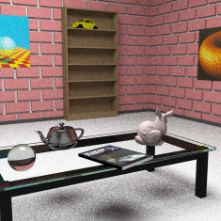
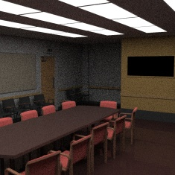
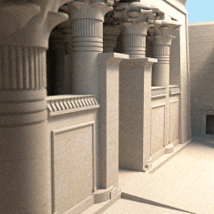
test scenes
rtrt
conf
kala
high geometric & illumination complexity
representative of common scenarios

Slide 45
primary rays
initial stream size = 64x64 rays
Notes:
why does trav utilization increase in moving from 4 to 16?
choose to present kalabsha results because
- most geometrically complex model (2+ million triangles, 600+ MB geometry + textures)
- only path traced lambertian surfaces → extremely random ray distributions
observations
- get from paper

Slide 46
secondary rays
initial stream size = 64x64 rays
Notes:
observations
- get from paper

Slide 47
predicted performance
Notes:
why not N > 16?
- average stream length too short in traversal & intersection to warrant SIMD widths longer than 16
- address generation begins to dominate, improvements diminish accordingly
other observations
- tension between SIMD width & various overheads
- N = 12 seems to balance overheads against performance
- optimal stream length still an open question
- get from paper

Slide 48
results – summary
achieve high utilization
as high as 97%
SIMD widths of up to 16 elements
utilization increases with stream size
achieve interactive performance
15-25 fps
performance increases with stream size
currently requires custom core

Slide 49
limitations – parallelism
too few common ops → no improvement in utilization
possible remedies
longer ray streams
parallel traversal
Notes:
not enough coherence → no improvement in SIMD utilization
- “can’t exploit what’s not there”
- particularly true with intersection stage and highly complex models with lots of tiny triangles
possible remedies
- parallel traversal
- allow rays to be active in different nodes within the same traversal step & add a merge step to sort out results
- is this what ingo just presented?
- shallow hierarchies → reduce # of traversal operations, intersect leaf nodes earlier (higher utilization because more rays active, no additional filter ops in intersection)

Slide 50
limitations – memory system
ray stream
generalized ray packet
longer streams → better performance
could perform poorly
possible remedies
carefully designed memory system
streaming memory systems
Notes:
ray stream
- dynamically determined group of rays
- sufficient coherence requires large streams → at least 1024, but more like 4096
- much larger than packet sizes of current CRT implementations
- could perform poorly due to cache spilling, etc.
streaming memory systems → high bandwidth, opportunities for latency hiding
current gpu memory systems
- as i currently understand them, address computations compete for execution units with data computations, which is a bummer
- our architecture isolates these computations to allow to execute in parallel to the extent possible (what’s the impact? about 48% in our simulations)
optimal initial stream length is an open question

Slide 51
limitations – hw support
conventional cpus
narrow SIMD (4-wide SSE & altivec)
limited support for scatter/gather ops
partition op → software implementation
possible remedies
custom core
current GPUs
time
Notes:
ongoing CUDA-based implementation
- uses horn’s algorithm for stream partitioning
- achieves interactive rates for simple scenes
- working to balance use of programmer-managed cache (shared memory) against more expensive global memory accesses while maintaining high occupancy for latency hiding
- not fastest ray tracing algorithm for the hardware
time
- expect to see most of the required features in future processor designs
- blurring of distinction between cpus & gpus

Slide 52
conclusions
new approach to coherent ray tracing
process arbitrarily-sized groups of rays in SIMD fashion with high utilization
eliminates inactive elements, process only active rays
stream filtering provides
sufficient coherence for wider-than-four SIMD processing
interactive performance with custom core

Slide 53
conclusions
key strengths
parallel processing
implicit reordering
modest hw requirements
general
key challenges
hw support for required ops

Slide 54
future work
additional hw simulation
parameter tuning
homogeneous multicore
heterogeneous multicore
…
improved GPU-based implementation
implementations for future processors

Slide 55
(more) acknowledgements
temple of kalabsha
veronica sundstedt
patrick ledda
other members of the university of bristol computer graphics group
financial support
swezey scientific instrumentation fund
utah graduate research fellowship
nsf grants 0541009 & 0430063

