Slide 1
Appearance Changes in
Image Registration
Marc Niethammer
Department of Computer Science
Biomedical Research Imaging Center (BRIC)
UNC Chapel Hill
TexPoint fonts used in EMF.
Read the TexPoint manual before you delete this box.: AAAAA

Slide 2

Warning
Appearance Changes in Image Registration
Warning
This talk is about approaches I have personally been involved
with. Other people have been working in this area also and
I will not do proper justice in terms of referencing.

Slide 3
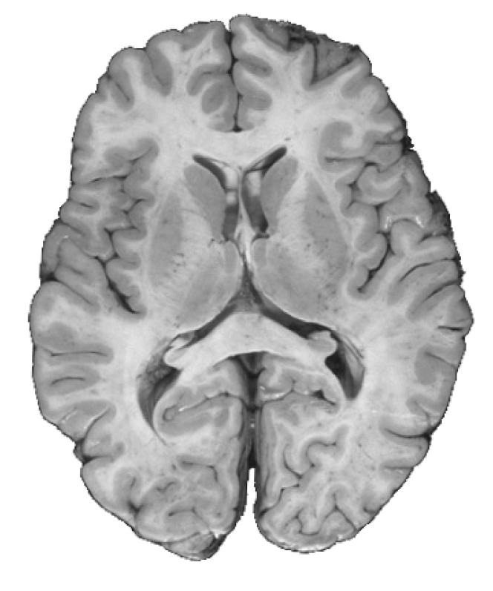
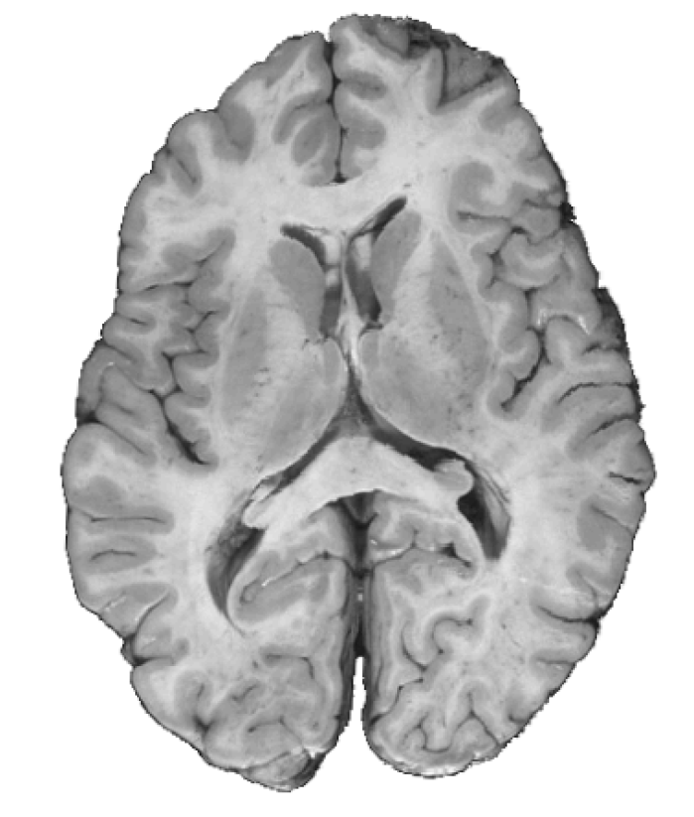
Image Registration
Appearance Changes in Image Registration
Motivation
Goal: Spatial alignment of two images
?
Source Image
Target Image
minimize Irregularity of transformation + image mismatch
Sounds simple enough …

Slide 4

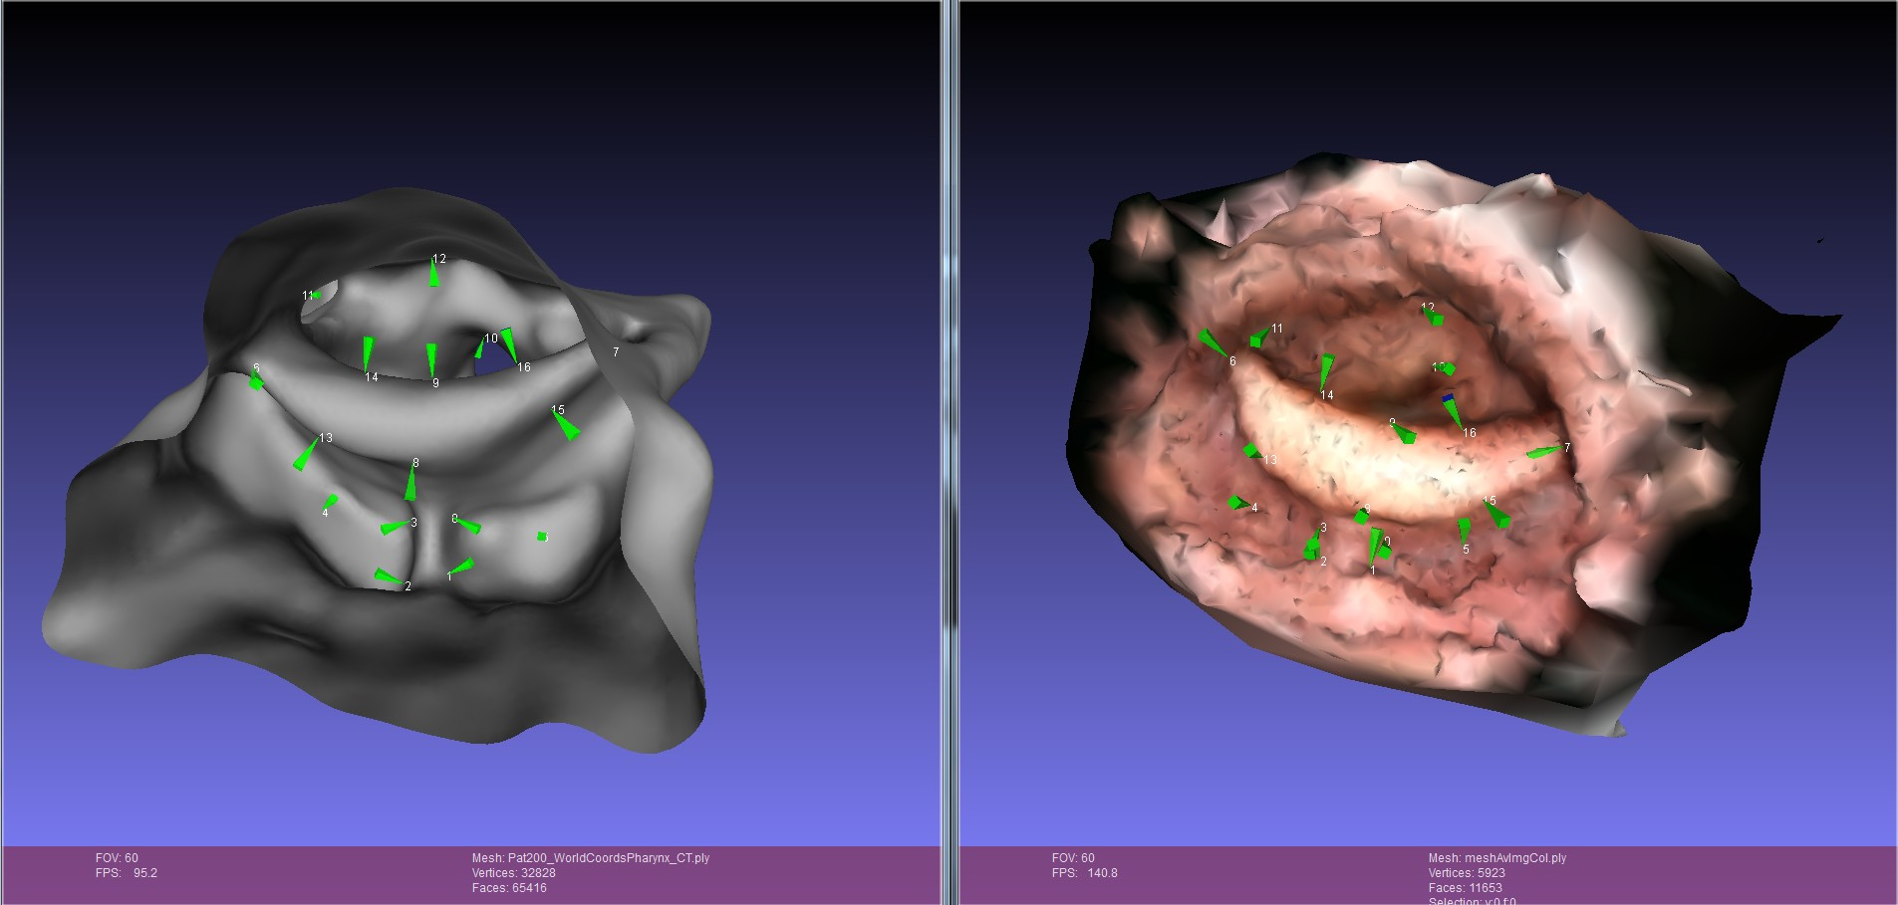
The MD’s perspective
Appearance Changes in Image Registration
Practical Image Registration
Example Goal: Combine endoscopy and CT images
for improved cancer treatment planning.
CT surface
Endoscopogram
Julian Rosenman, MD
Approach: Registration (=spatial alignment)

Slide 5
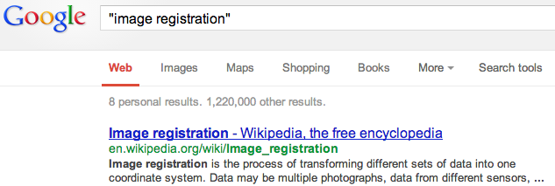
The MD’s perspective
Appearance Changes in Image Registration
Practical Image Registration
A millions hits. ”This is probably a solved problem.”

Slide 6
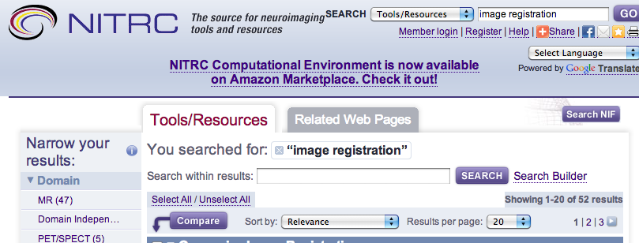
The MD’s perspective
Appearance Changes in Image Registration
Practical Image Registration
now we are down to 52 results
“Certainly 52 solutions to my problem are enough.”

Slide 7

The MD’s perspective
Appearance Changes in Image Registration
Practical Image Registration
now we are down to 52 results
A
A closer look reveals:
None of these programs
solve this problem.
Image: www.shapingyouth.org

Slide 8
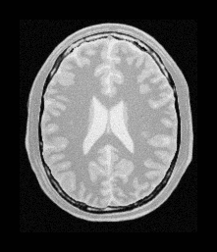
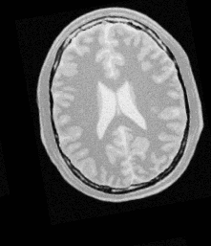
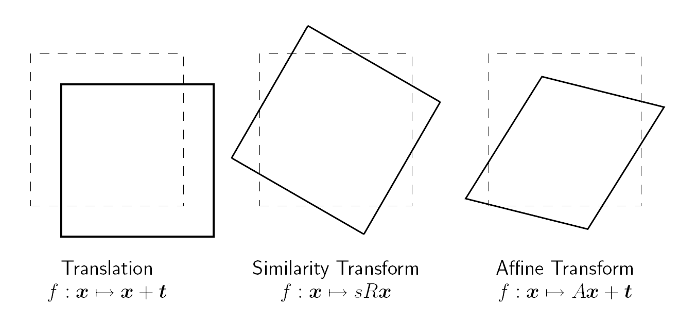
The sad reality: with a bit of hyperbole
Appearance Changes in Image Registration
State of Affairs
Registration works really well when there is not much to register!
Similar
images
☑
Simple
transforms
However, in reality deformations are often more complex.
➔ Need for general deformable registration methods.

Slide 9
Deformable Image Registration
Appearance Changes in Image Registration
Motivation
Goal: Spatial alignment of two images (beyond affine)
… for example to capture changes over time as in STIA …
?
Source Image
Target Image
minimize Irregularity of transformation + image mismatch
Why is this hard?

Slide 10
Why is Deformable Image Registration Hard?
Appearance Changes in Image Registration
Motivation
A: affine, NP: non-parametric (elastic, fluid, …)
Within subject (WS); between subject (BS); with pathology (P)
model realism
A-WS
A-P
A-BS
A-WS
A-BS
A-P
NP-WS
model robustness
model complexity
NP-BS
NP-P
NP-BS
NP-WS
NP-P
model realism

Slide 11

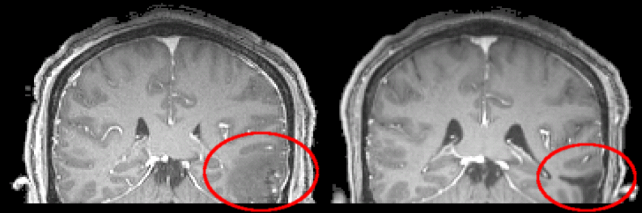
Why is Deformable Image Registration Hard?
Appearance Changes in Image Registration
Motivation
Problem 1: Unsuitable deformation models
Does your brain, leg, heart, …
behave like a fluid?
Should it between two subjects?
Image: classicwatersolutions.com
Problem 2: Unsuitable similarity measures
What if images have
different appearances?
Problem 3: Unsuitable numerical solutions

Slide 12
Basis of Similarity Measures
Appearance Changes in Image Registration
Similarity Measures
What is considered similar?
Intensity Image2
Intensity Image2
Intensity Image2
Intensity Image1
Intensity Image1
Intensity Image1
Normalized
cross correlation
Mutual
Information
SSD
But sometimes correspondences are not quite so easy …

Slide 13
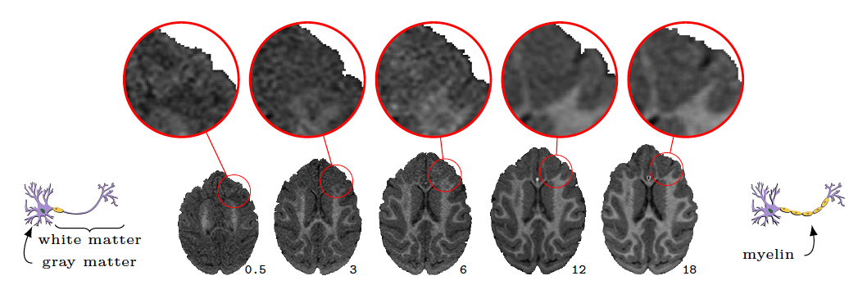
Motivating issue 1: Intensity changes over time
Appearance Changes in Image Registration
Appearance Change Example
Normal brain development (macaque)
Locally changing image intensities cause problems for
image similarity measures (SSD, mutual information, …)

Slide 14
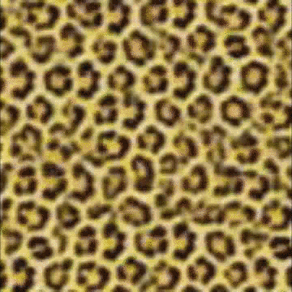
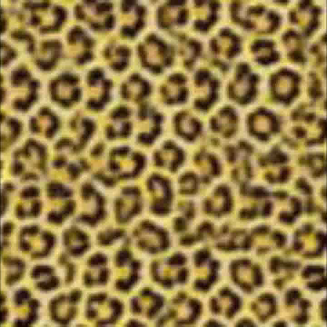
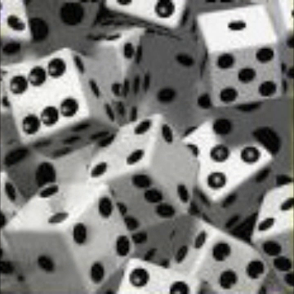
Motivating issue 2: Texture-blending
Appearance Changes in Image Registration
Appearance Change Example
Texture blending for computer graphics.
Extreme case: images are vastly different.

Slide 15
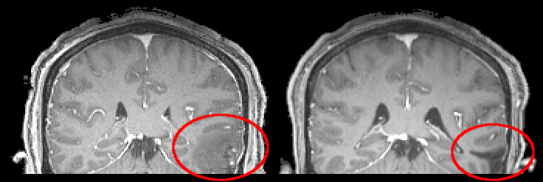
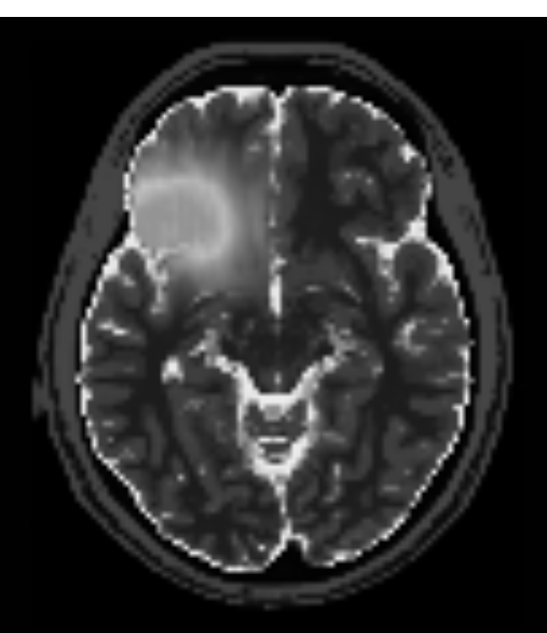
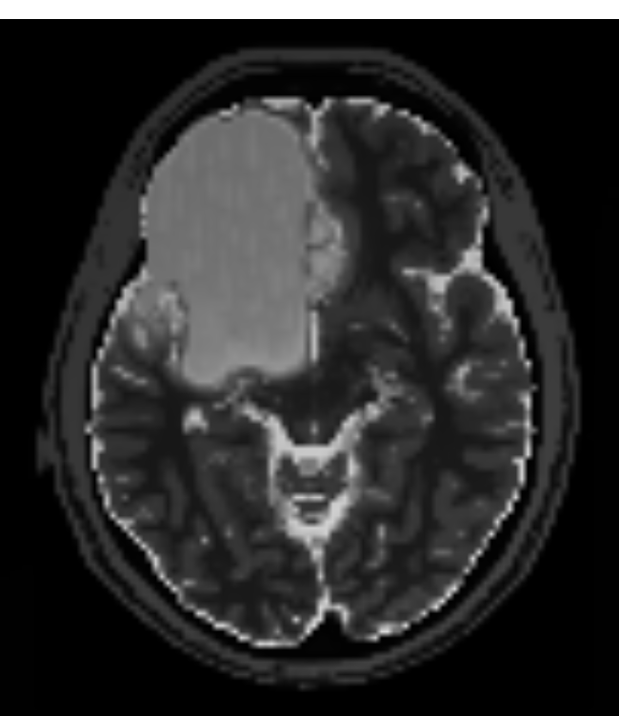
Motivating issue 3: Intensity/Structural changes
Appearance Changes in Image Registration
Appearance Change Example
Traumatic brain injury
(real data)
Brain tumor
(simulated data)
“Similar looking regions” do not correspond.
Structures only exist in one of the two images.

Slide 16
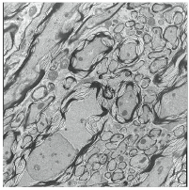
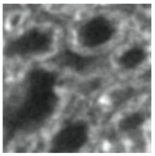
Motivating issue 4: Multimodal Registration
Appearance Changes in Image Registration
Appearance Change Example
Electron microscopy
Light microscopy
Image intensities differ, but additional complexities such as
blurring are present and need to be accounted for.

Slide 17
What to do?
Appearance Changes in Image Registration
Possible Solutions
Is all hope lost here?

Slide 18
Possible Solutions
Appearance Changes in Image Registration
Possible Solutions
(Non)parametric modeling
vs
Data-driven approaches

Slide 19
Possible Solutions
Appearance Changes in Image Registration
Possible Solutions
Parametric Modeling

Slide 20
Motivating issue 1: Intensity changes over time
Appearance Changes in Image Registration
Intensity changes over time
Normal brain development (macaque)
Possible solution:
Impose a model over time to change your similarity measure

Slide 21
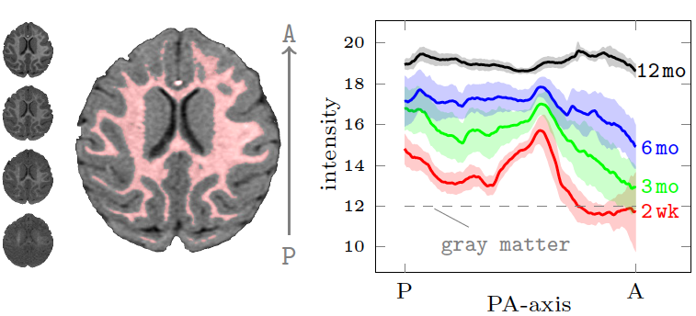
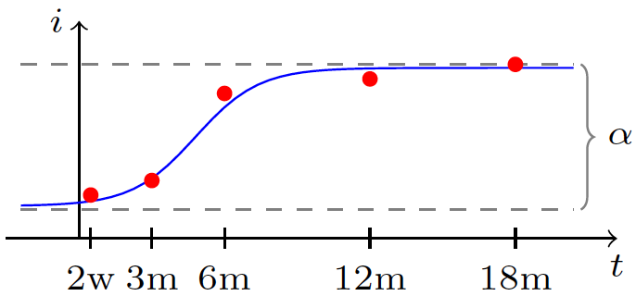
Modeling of Appearance Changes
Appearance Changes in Image Registration
Intensity changes over time
Normal temporal change (for a macaque monkey)
Concretely: Impose logistic model
[your favorite model] to account
for expected changes over time

Slide 22
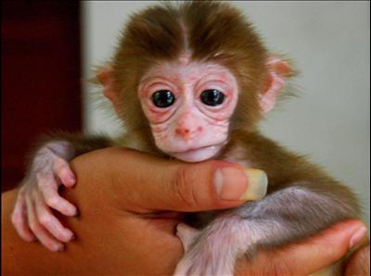
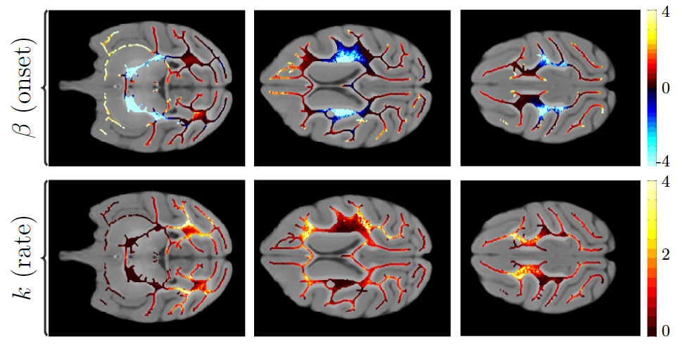
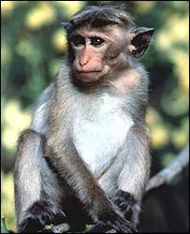
Appearance Change: Brain Development
Appearance Changes in Image Registration
Intensity changes over time
Inferior (bottom)
superior (top)
This strategy not only allows for improved registration results,
but also provides interesting information about the general
brain maturation process …

Slide 23
What do we do with non-corresponding regions?
Appearance Changes in Image Registration
Non-corresponding regions
Traumatic brain injury
(real data)
Brain tumor
(simulated data) – TumorSim [Prastawa et al.]
As we cannot match them we somehow need to
model or ignore the changes.

Slide 24
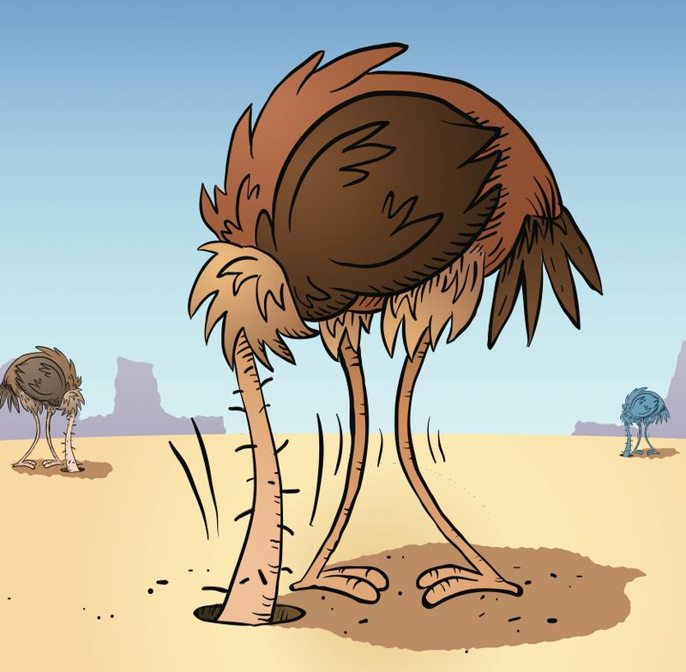
Solution 1: Cost-function masking
Appearance Changes in Image Registration
Non-corresponding regions
One solution: Cost function masking [Brett2001]
= ignoring matching cost in region of source image
X
… let’s just not look at it!
Image: gerdleonhard.typepad.com

Slide 25
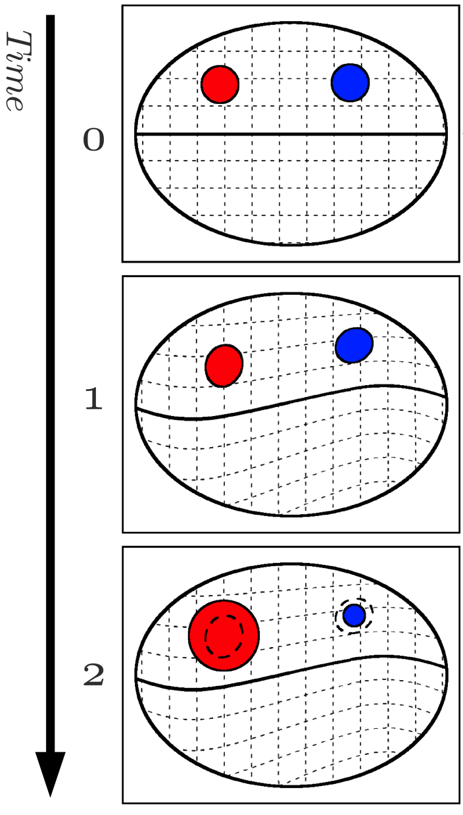


Solution 2: Geometric Metamorphosis
Appearance Changes in Image Registration
Non-corresponding regions
Model lesion/tumor/… and its
temporal change
Composition of two deformations
- e.g., tissue displacement & infiltration
- jointly estimated
Image composition model
- = “glorified cost-function masking”
Model is probably more interesting
from a deformation modeling
perspective..
Notes:
Needs to be streamlined and used instead of an outline. Combine this with cost function masking from previous slide. Make more compact. Relate back to global deformation and infiltration. Picture of brain with mask to illustrate cost function masking. Explain masked out image with white mask to help ppl understanding in future slides. Wherever we introduce masking, say we have a mask too.

Slide 26
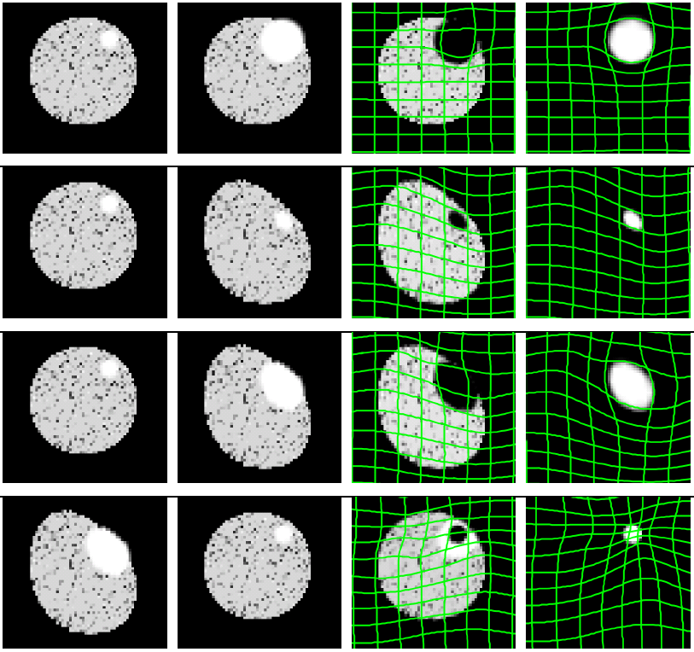
Geometric Metamorphosis: Synthetic Results
Appearance Changes in Image Registration
Non-corresponding regions
Only infiltration
Only deformation
Deformation + infiltration
Deformation + recession

Slide 27
Possible Solutions
Appearance Changes in Image Registration
Possible Solutions
Non-parametric Modeling
w/o learning
to deal with very complex changes

Slide 28
Possible Solutions
Appearance Changes in Image Registration
Possible Solutions
One solution is metamorphosis,
which requires a little LDDMM detour
[Miller, Trouve, Younes, …]

Slide 29
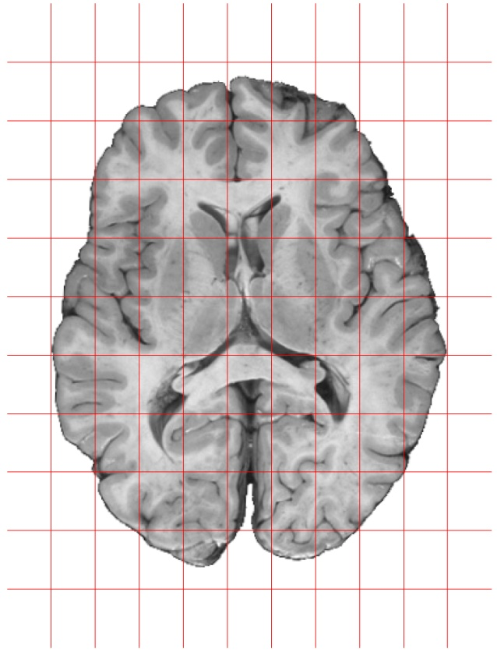
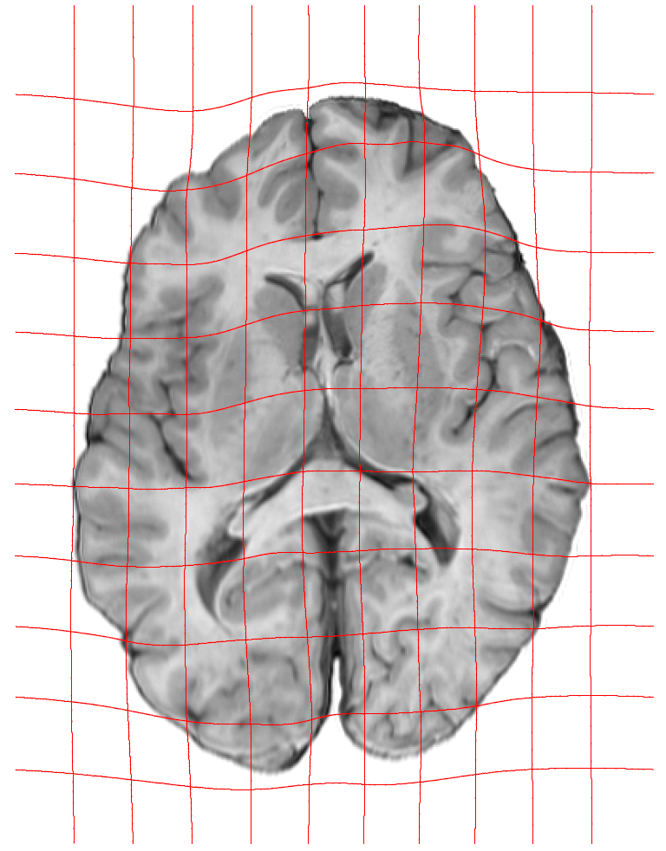
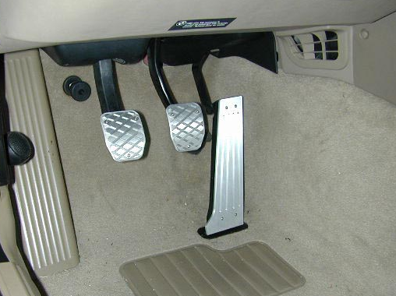
LDDMM detour
Appearance Changes in Image Registration
Metamorphosis
?
What is the best
velocity field, v,
to deform one
image into
the other?
Fluid flow setup [Miller, Younes, Trouve, …]:
s.t.
Optimal control problem, which can can be rewritten as …

Slide 30
Constrained Optimization for LDDMM
Appearance Changes in Image Registration
Metamorphosis
?
Can be rewritten as
This just requires
infinite-dimensional
constrained
optimization.
s.t.
… and I am telling you this because …

Slide 31
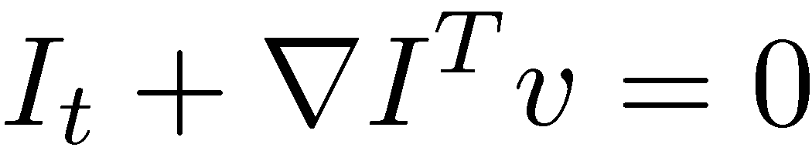
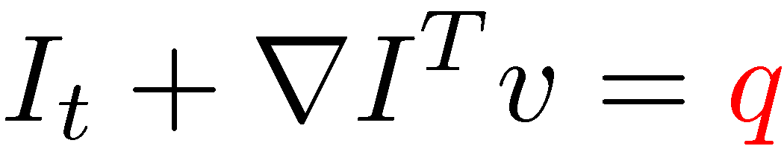
Image Registration + Image Metamorphosis
Appearance Changes in Image Registration
Metamorphosis
Standard Image Registration
Image Metamorphosis
?
Assumes 1-1 correspondence
Registration and blending
add
to energy

Slide 32
Image Metamorphosis
Appearance Changes in Image Registration
Metamorphosis
Metamorphosis is an elegant model,
but work remains to be done
  to improve the numerical solution methods
  to extend it to longitudinal data
  to possibly couple it with some parametric models
  for greater control over the appearance change

Slide 33
Possible Solutions
Appearance Changes in Image Registration
Possible Solutions
Let’s switch gears a bit …
Data-Driven (Learning) Approaches
… will tell you about two different approaches:
  Image analogies (for microscopy)
  Recap of “Low-rank to the rescue”

Slide 34
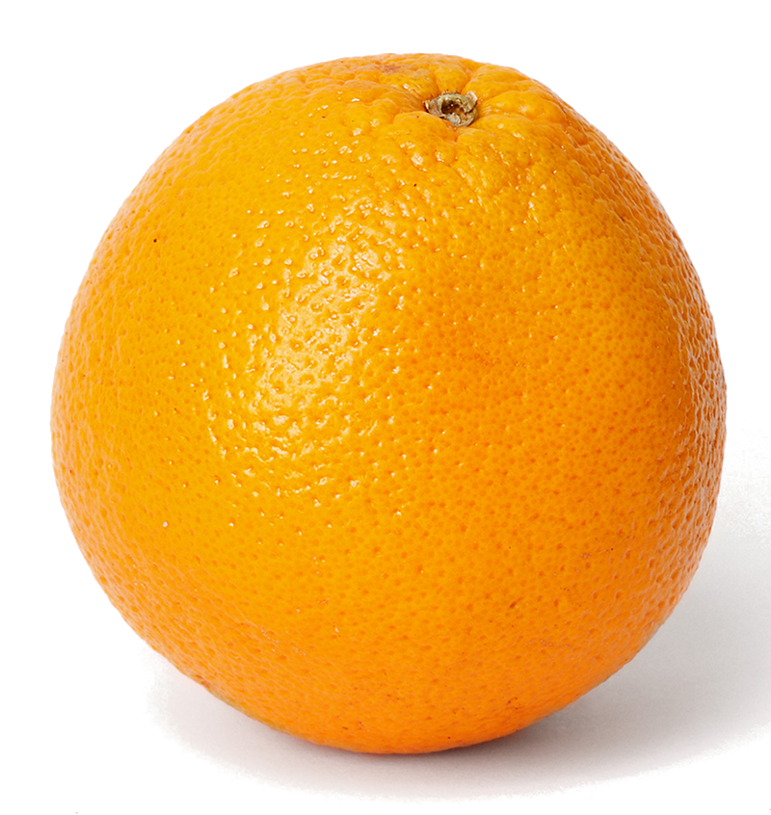
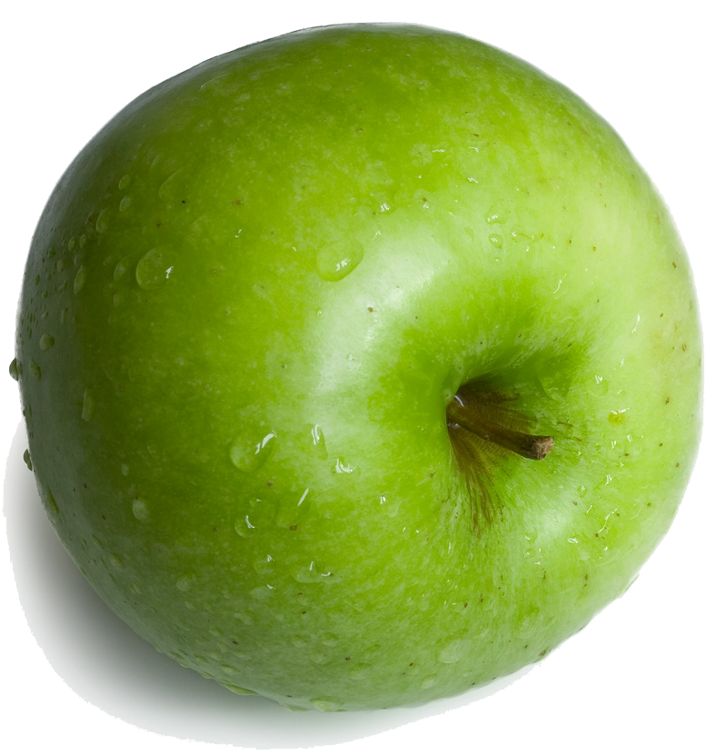
Registration for Microscopy
Appearance Changes in Image Registration
Image Analogies
Registration is difficult between
different image modalities
(mutual information may be the best hope)
Light microscopy
B
A’
?
Electron microscopy
Other possible solution: Image Analogies (from graphics)

Slide 35
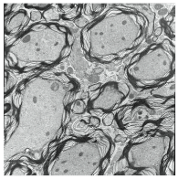
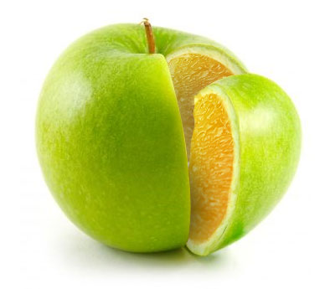
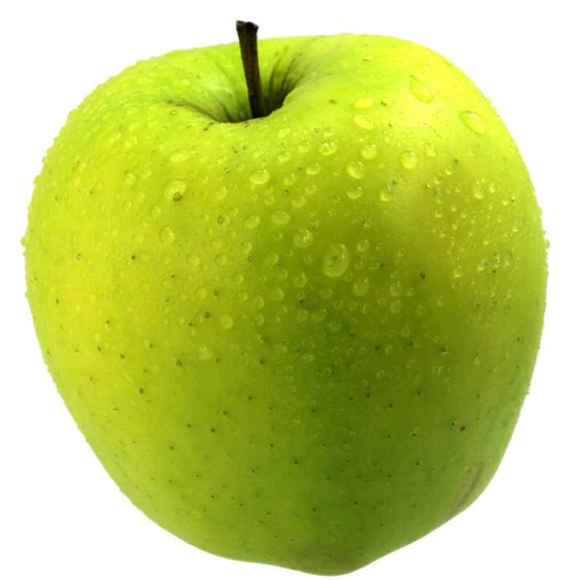
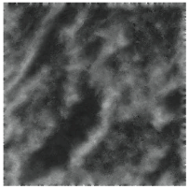
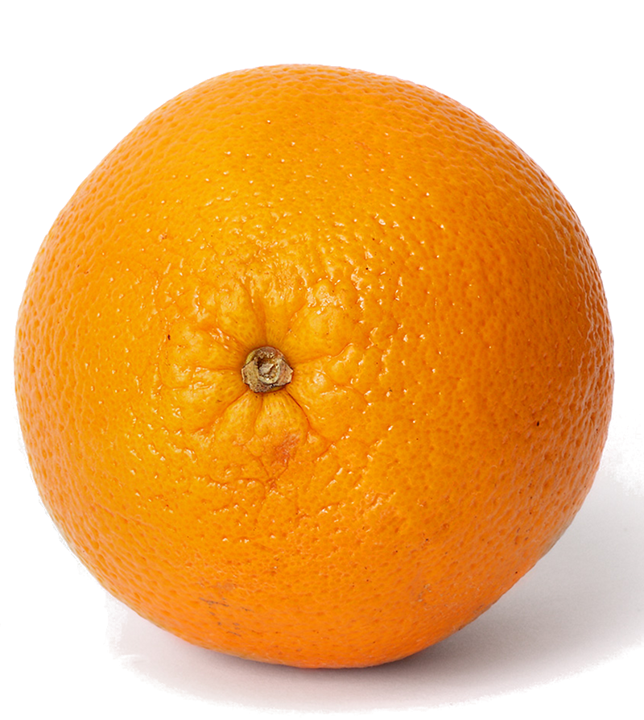
Registration for Microscopy: Image Analogies
Appearance Changes in Image Registration
Image Analogies
Solution approach:
Image Analogies:
A
B
A’
B’
learned
A’ relates to B’
A’ relates to B’
unknown

Slide 36
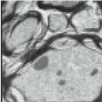
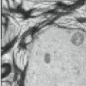
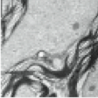
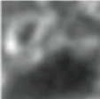
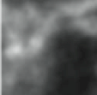
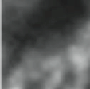
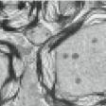
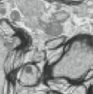
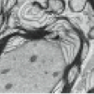
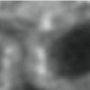
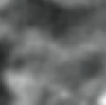
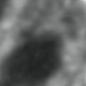






Image-Analogies by Lookup
Appearance Changes in Image Registration
Image Analogies
Generate corresponding
Image patches
A
B
Notes:
Explain each methods
If
Some people change image appearance, for example, do some segmentation remove some unwanted image information. Or convert image modality from one to another based on knowledge about the image formation process, and the similar intensity distribution
Simulate ultrasound from CT, reflection parameter and transmission parameter

Slide 37


















Image-Analogies by Lookup
Appearance Changes in Image Registration
Image Analogies
Synthesize a new image
by lookup
C
D
?
Notes:
Explain each methods
If
Some people change image appearance, for example, do some segmentation remove some unwanted image information. Or convert image modality from one to another based on knowledge about the image formation process, and the similar intensity distribution
Simulate ultrasound from CT, reflection parameter and transmission parameter

Slide 38

Image-Analogies by Lookup
Appearance Changes in Image Registration
Image Analogies
Synthesize a new image
by lookup
Notes:
Explain each methods
If
Some people change image appearance, for example, do some segmentation remove some unwanted image information. Or convert image modality from one to another based on knowledge about the image formation process, and the similar intensity distribution
Simulate ultrasound from CT, reflection parameter and transmission parameter

Slide 39
Image-Analogies by Lookup
Appearance Changes in Image Registration
Image Analogies
Synthesize a new image
by lookup
Notes:
Explain each methods
If
Some people change image appearance, for example, do some segmentation remove some unwanted image information. Or convert image modality from one to another based on knowledge about the image formation process, and the similar intensity distribution
Simulate ultrasound from CT, reflection parameter and transmission parameter

Slide 40
Image-Analogies by Lookup
Appearance Changes in Image Registration
Image Analogies
Synthesize a new image
by lookup
Notes:
Explain each methods
If
Some people change image appearance, for example, do some segmentation remove some unwanted image information. Or convert image modality from one to another based on knowledge about the image formation process, and the similar intensity distribution
Simulate ultrasound from CT, reflection parameter and transmission parameter

Slide 41
Image-Analogies by Lookup
Appearance Changes in Image Registration
Image Analogies
Synthesize a new image
by lookup
Notes:
Explain each methods
If
Some people change image appearance, for example, do some segmentation remove some unwanted image information. Or convert image modality from one to another based on knowledge about the image formation process, and the similar intensity distribution
Simulate ultrasound from CT, reflection parameter and transmission parameter

Slide 42

Image-Analogies by Dictionary Learning
Appearance Changes in Image Registration
Image Analogies
Use LASSO for dictionary
learning to learn a basis
for patches which can be
used to predict one modality
from the other.
Notes:
Explain each methods
If
Some people change image appearance, for example, do some segmentation remove some unwanted image information. Or convert image modality from one to another based on knowledge about the image formation process, and the similar intensity distribution
Simulate ultrasound from CT, reflection parameter and transmission parameter

Slide 43
Possible Solutions
Appearance Changes in Image Registration
Possible Solutions
Learning from Populations
Super-brief summary of Roland Kwitt’s talk from yesterday:
Low-rank to the rescue:
Atlas-Based Analyses in the Presence of Pathologies

Slide 44
Motivating Problem: Registration w/ Pathologies
Appearance Changes in Image Registration
Low-rank to the rescue

Slide 45
What if?
Appearance Changes in Image Registration
Low-rank to the rescue
What if there were a method to transform an image with
pathology into a healthy-looking image?
magic
This is exactly what “Low-rank to the Rescue” does!

Slide 46
Low-rank + sparse decomposition
Appearance Changes in Image Registration
Low-rank to the rescue

Slide 47
Low-rank + sparse decomposition for images
Appearance Changes in Image Registration
Low-rank to the rescue
Images are represented by column-vectors.

Slide 48
Low-rank + sparse decomposition example
Appearance Changes in Image Registration
Low-rank to the rescue
Now we can work with “almost-normal” images!

Slide 49
Summary
Appearance Changes in Image Registration
Summary
Multiple possibilities to deal with image differences:
The classics: mutual information, normalized cross correlation
Explicit modeling:
- parametric (e.g., logistic curve)
- non-parametric (metamorphosis)
- cost-function masking
Data-driven modeling:
- image analogies through dictionary learning
- creating “normal images” using low-rank + sparse
Which method to use will of course be application-dependent.

Slide 50
Questions?
Appearance Changes in Image Registration
The End
Questions?

