Slide 1
Volume Rendering
Chris Johnson
Guoning Chen
Chuck Hansen
Bob Laramee
Josh Levine
Han-Wei Shen
Alex Teleau

Slide 2
Reading Assignment:
Visualization Handbook
Overview of Volume Rendering
Arie Kaufman and Klaus Mueller page 127
Multidimensional Transfer
Functions for Volume Rendering
Joe Kniss, Gordon Kindlmann, and Charles D. Hansen page 189

Slide 3
Limitations of Isosurfaces

Slide 4
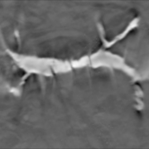
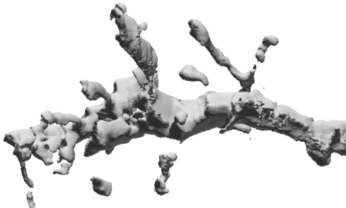
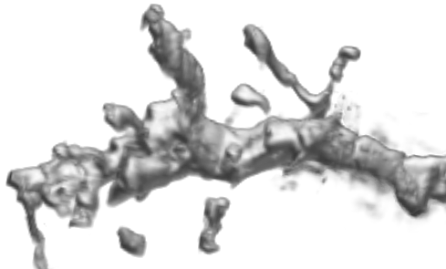
Isosurfacing is "binary"
  What about points inside isosurface?
  How does each voxel contribute to the image?
Is a hard, distinct boundary necessarily appropriate for the visualization task?
Slice
Isosurface
Volume Rendering

Slide 5
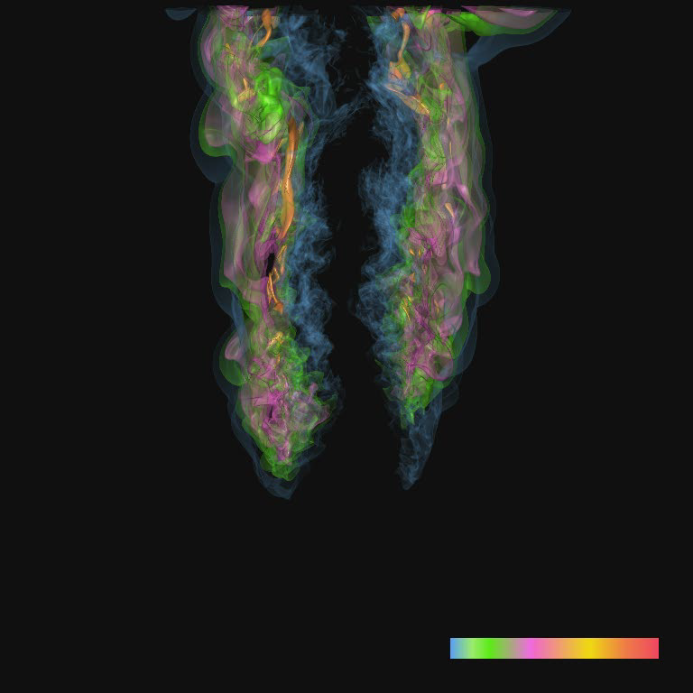
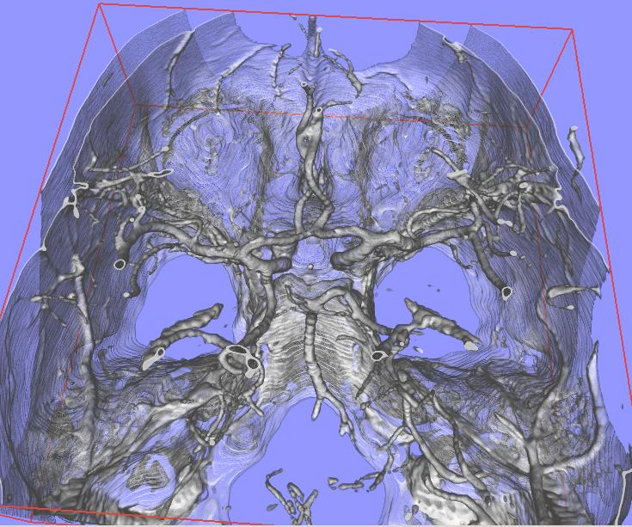
Isosurfacing is poor for ...
  Measured, "real-world" (noisy) data
  Amorphous, "soft" objects
http://www.cg.informatik.uni-siegen.de/
http://vis.cs.ucdavis.edu/gallery/Yu/combustion/

Slide 6
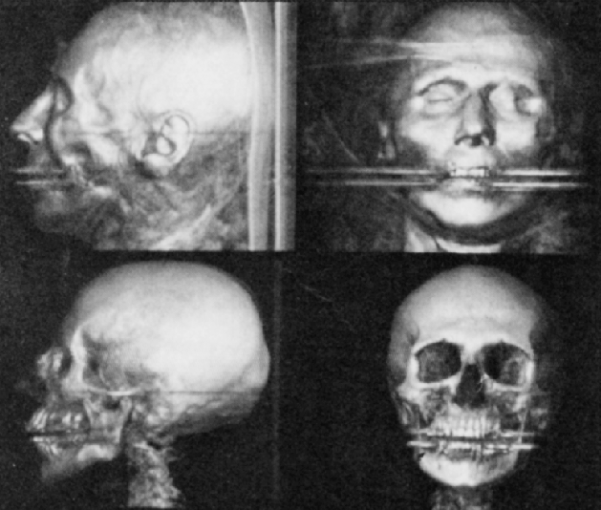
Why Volume Rendering?
Allows every voxel to contribute to image
Provides greater flexibility
Marc Levoy, Display of Surfaces from Volume Data, 1988

Slide 7
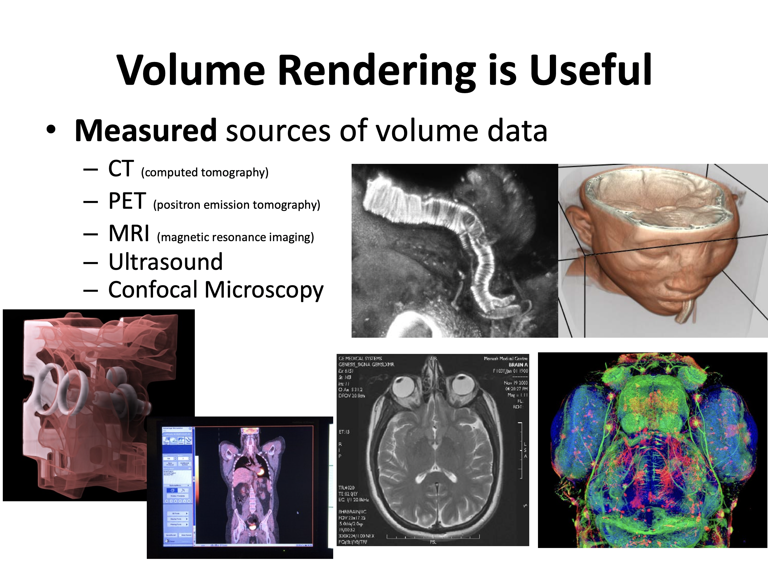

Slide 8
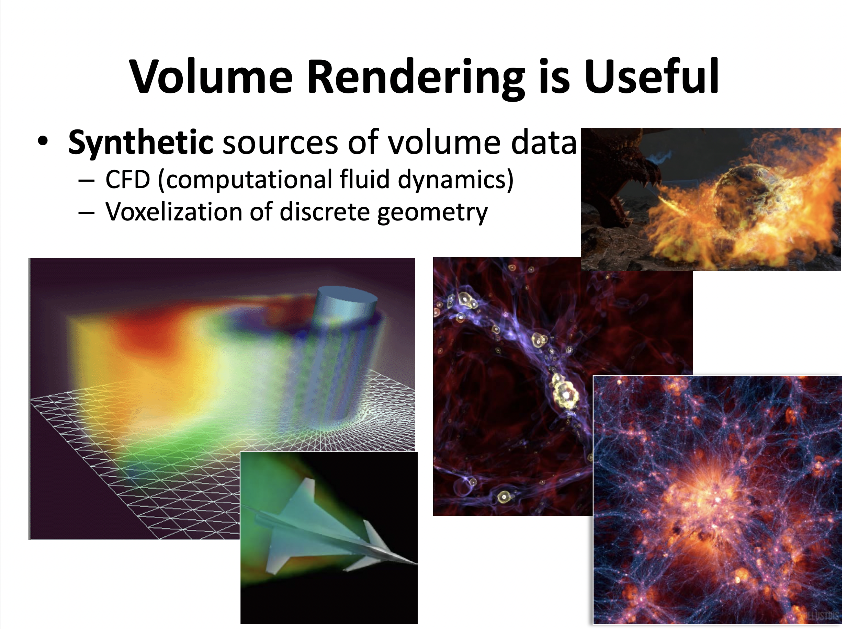

Slide 9
Volume Rendering

Slide 10
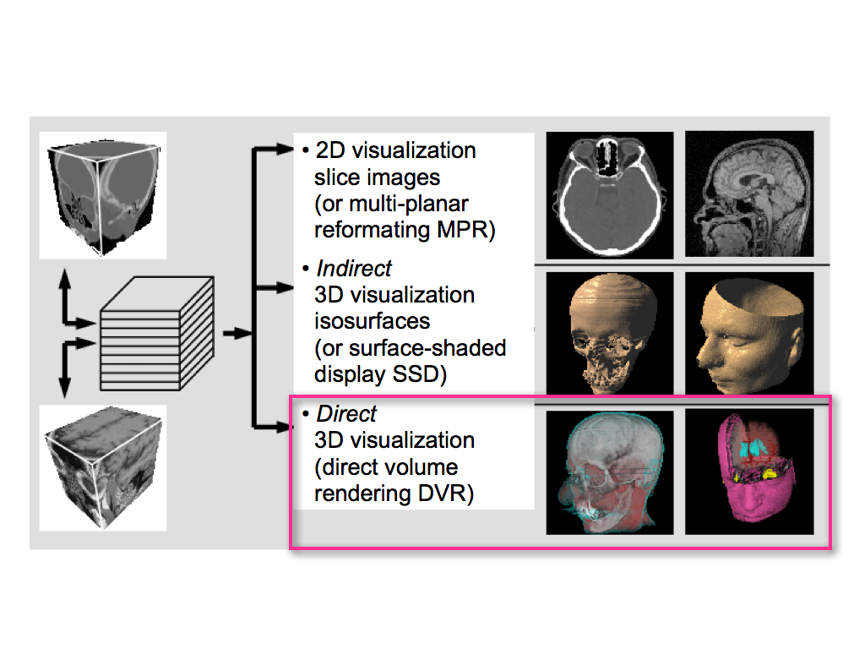

Slide 11
Pipelines: Isosurfacing vs. Volume Rendering
the standard pipeline:
no intermediate geometric structures
Volume Data
Volume Data
isosurface
extraction
volume
rendering
Triangles
surface
rendering
standard graphics operations:
shading, lighting, compositing
Rendered Image
Rendered Image

Slide 12
What is Volume Rendering?
  Any rendering process which maps from volume data to an image (without introducing binary distinctions or intermediate geometry)
Core question (for the visualizer):
  How do you make the data visible?
  Answer: color and opacity

Slide 13
Direct 3D Representation of Volume Data
Data considered to represent a semi-transparent light-emitting medium
  Also gaseous phenomena can be simulated
Approaches based on laws of physics (emission, absorption, scattering)
Volume data used as a whole (look inside, see all interior structures)

Slide 14
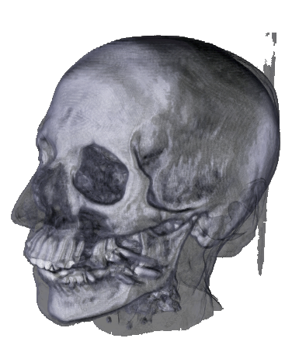
DVR: Render volume without extracting any surfaces
Map scalar values to optical properties (color, opacity)
Needs an optical model
Solve volume rendering
integral for viewing
rays into the volume

Slide 15
Volume Ray Casting

Slide 16
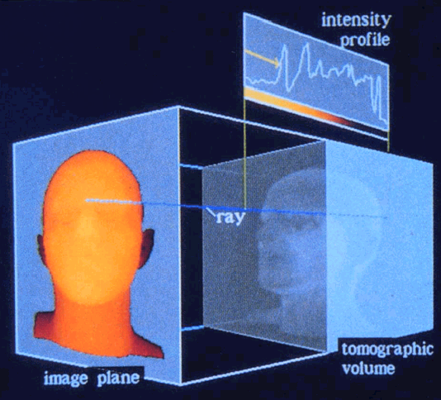
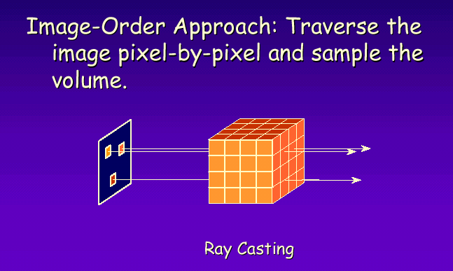
Direct Volume Visualization
Ray Casting: the value of each pixel in the image is determined by sending a ray through the pixel into the scene (image order volume rendering)

Slide 17
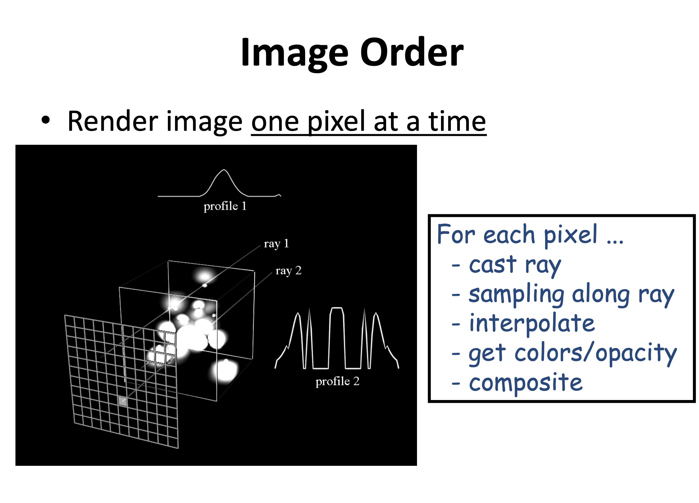

Slide 18
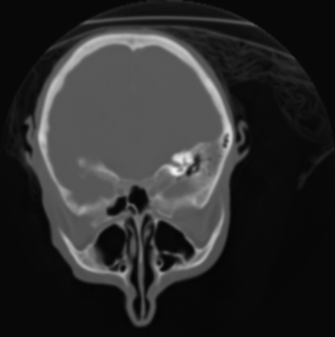
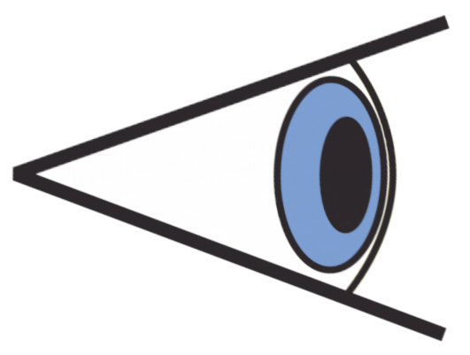
Image order approach
Data Set
Image Plane
Eye
For each pixel {
calculate color of the pixel
}

Slide 19
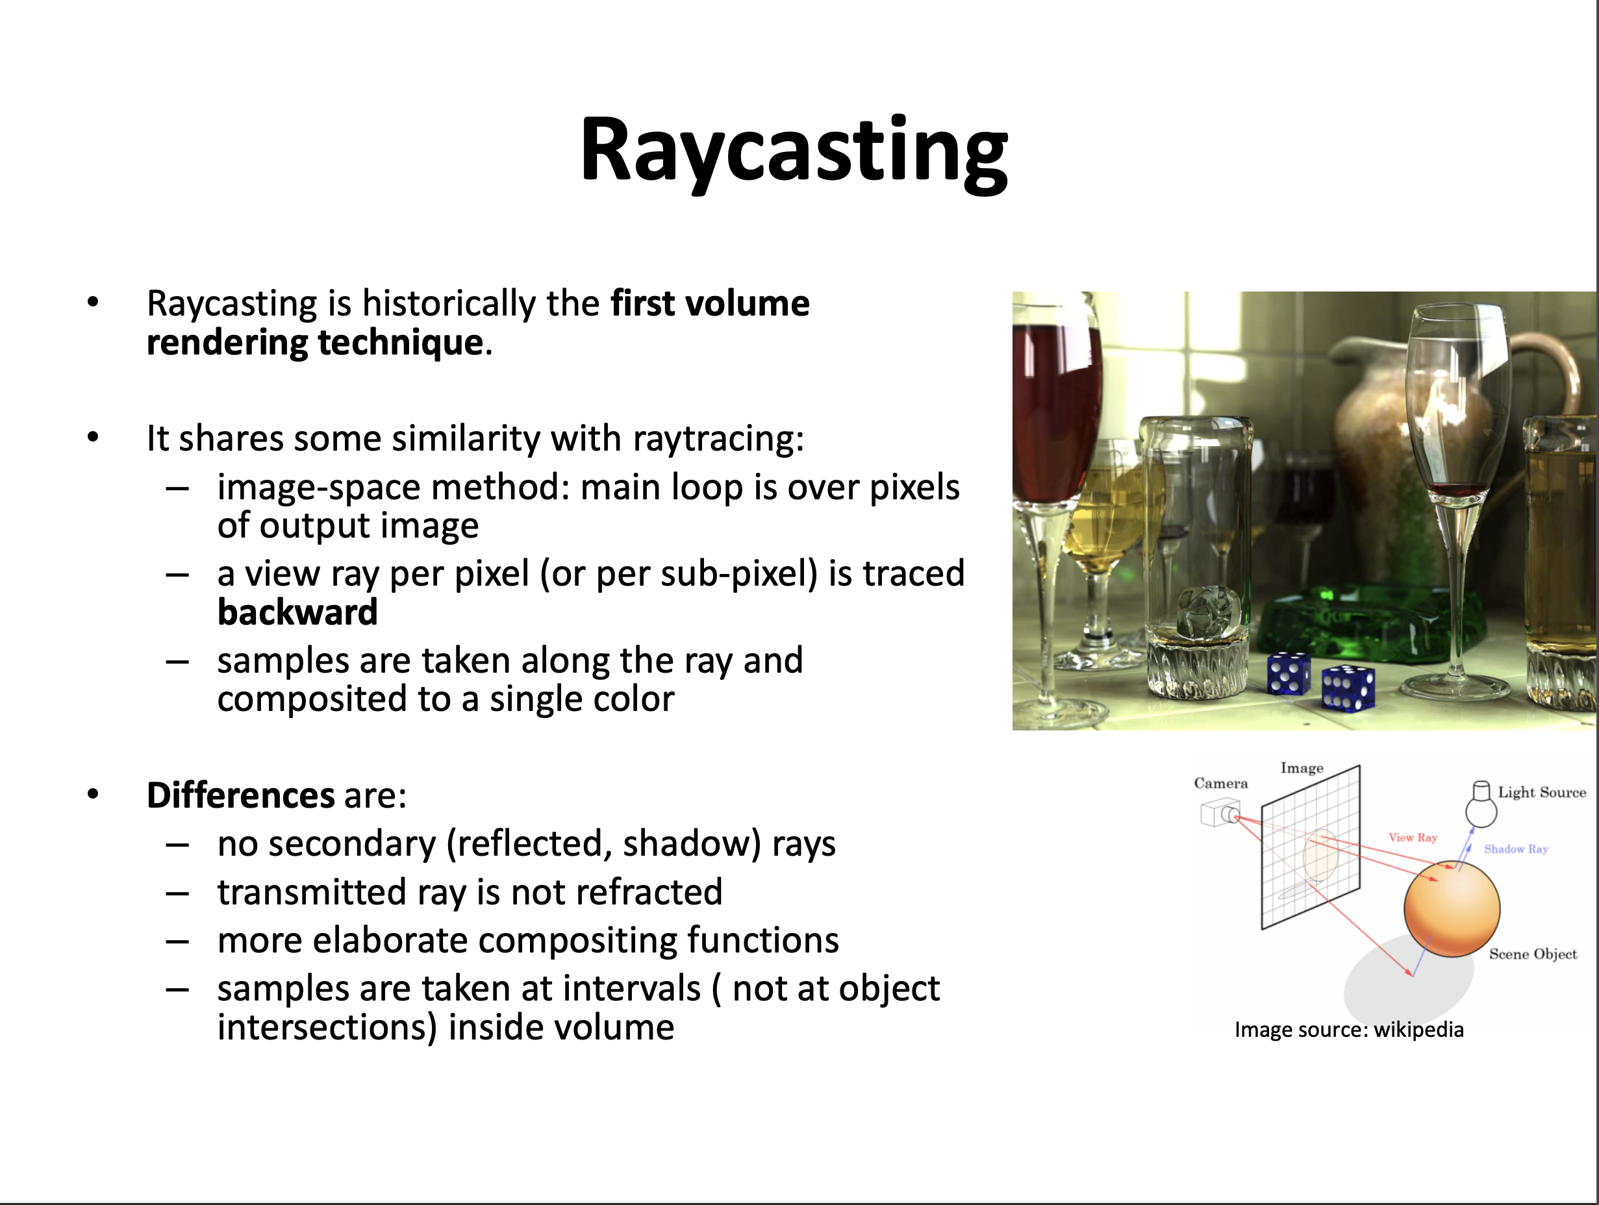

Slide 20
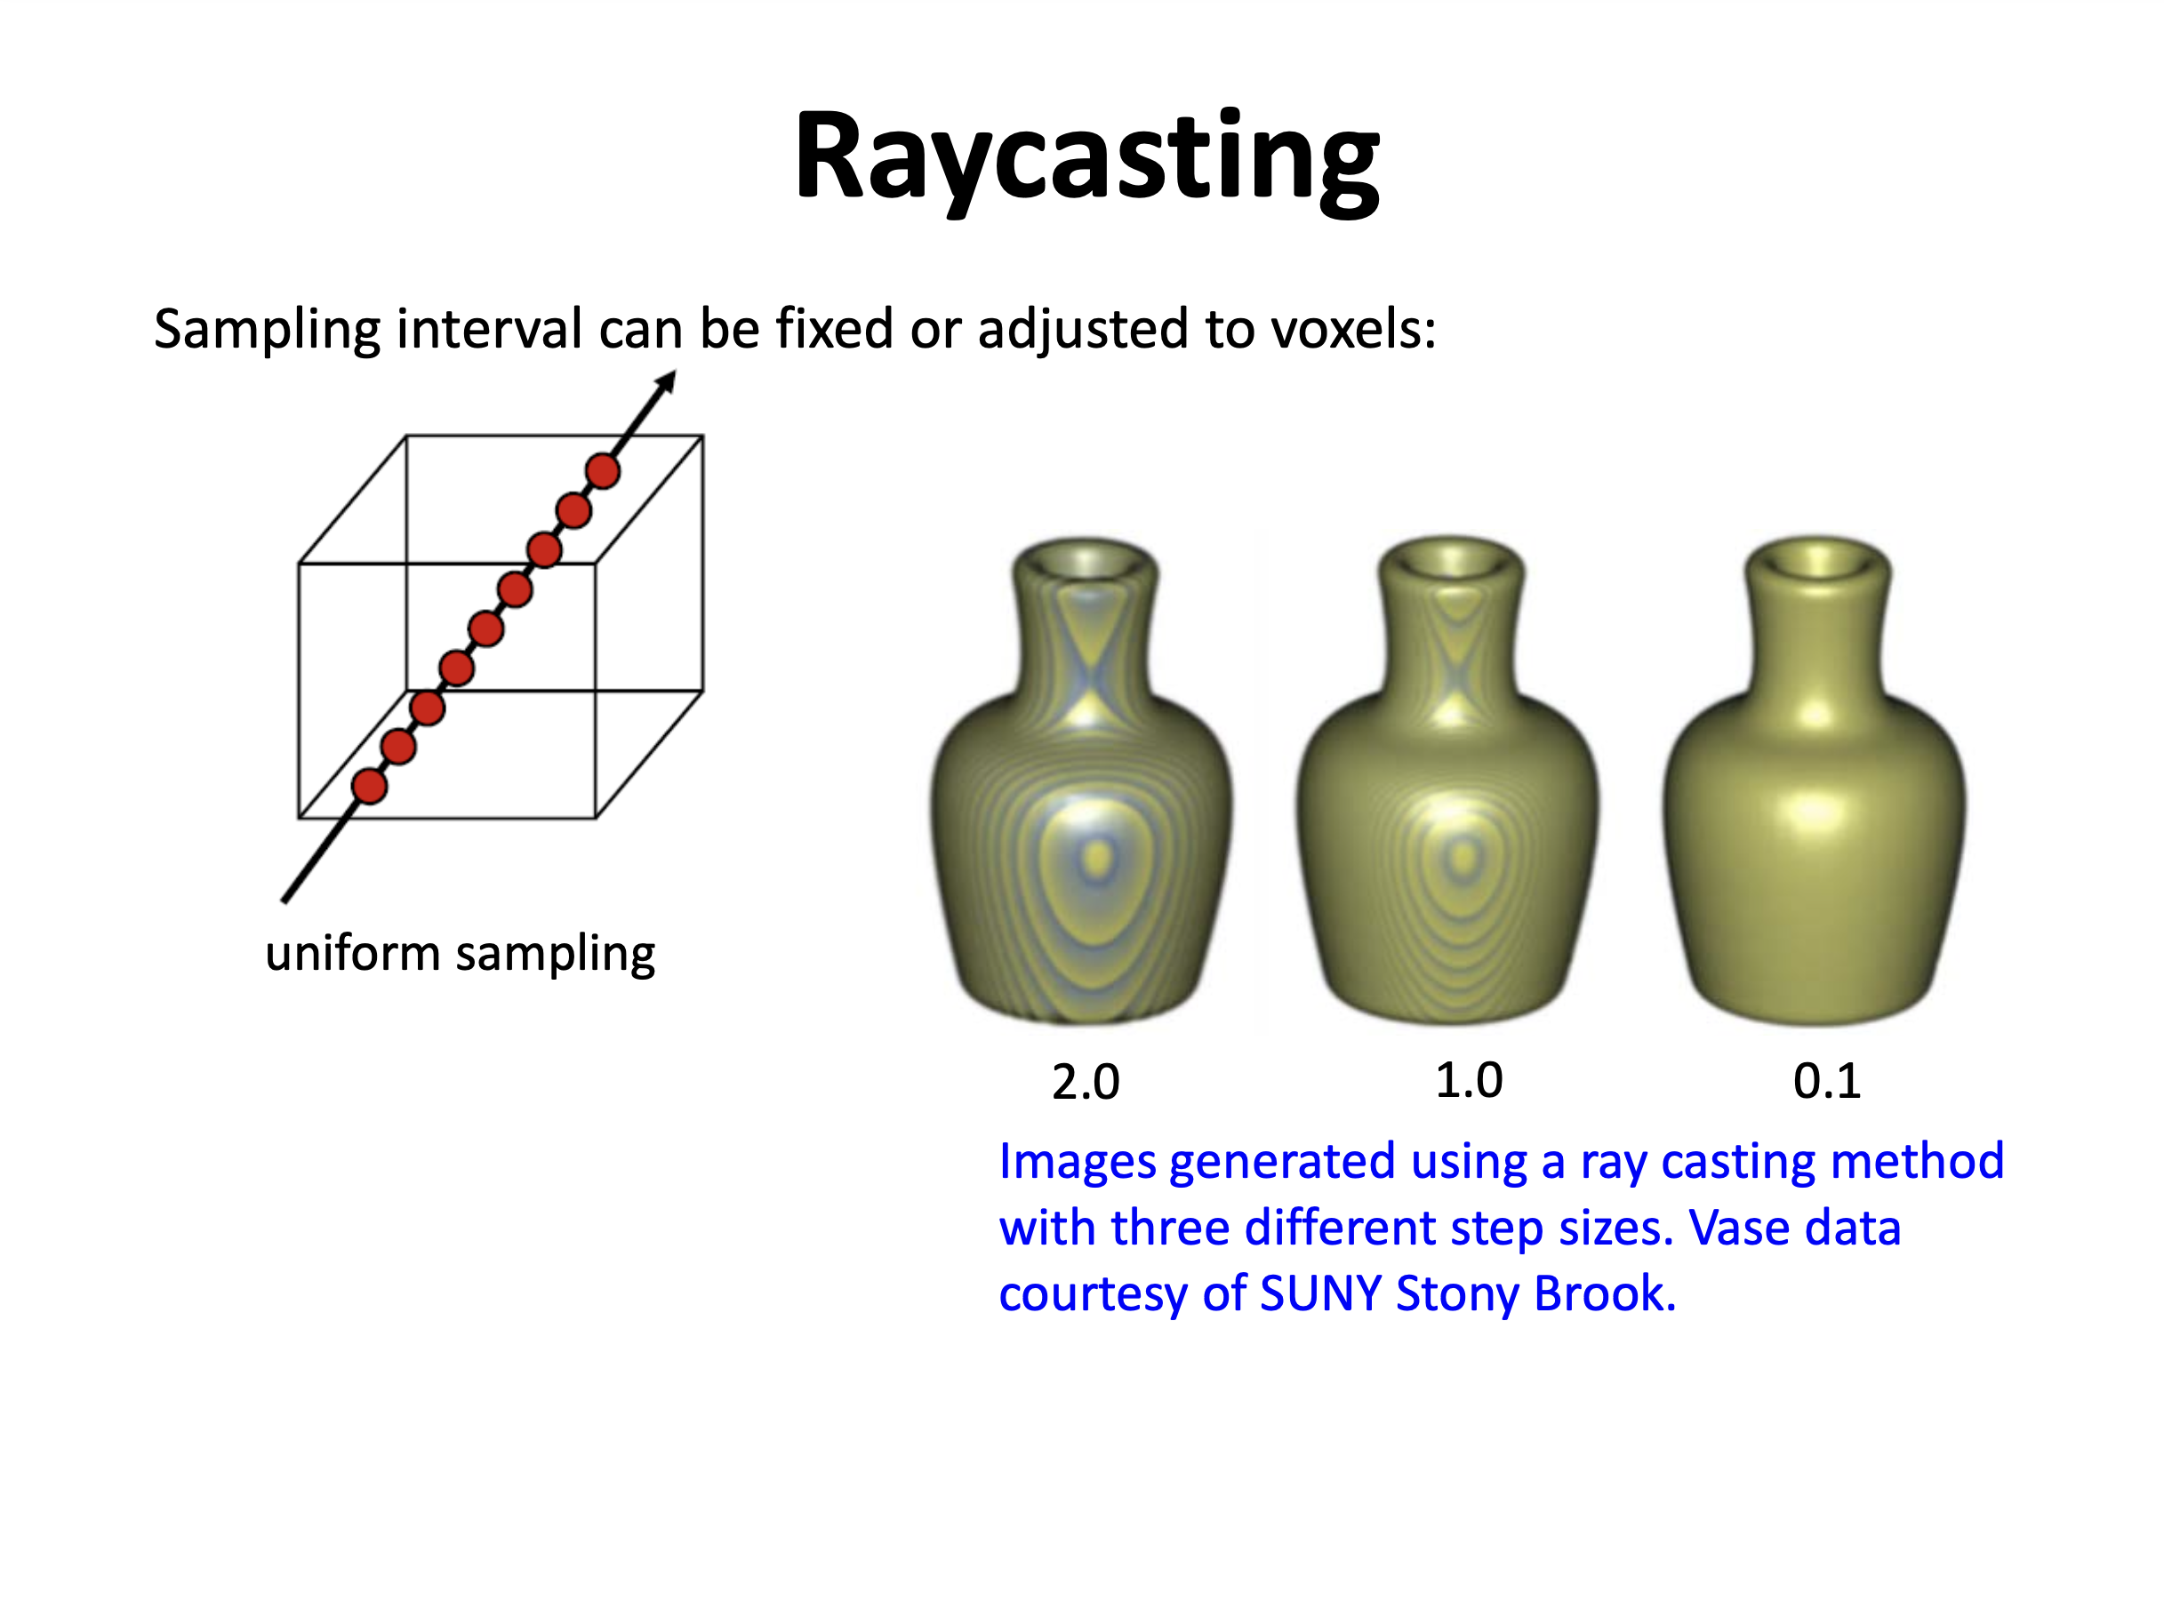

Slide 21
Compositing

Slide 22
cf = (0,1,0)
af = 0.4
?
Over operator
Alvy Ray Smith (1970s)
cb = (1,0,0)
ab = 0.9
c = af*cf + (1 - af)*ab*cb
a = af + (1 - af)*ab
Permutation
ci = aiCi

Slide 23
cf = (0,1,0)
af = 0.4
cred = 0.4*0 + (1-0.4)*0.9*1 = 0.6*0.9 = 0.54
cgreen = 0.4*1 + (1-0.4)*0.9*0 = 0.4
cblue = 0.4*0 + (1-0.4)*0.9*0 = 0
a = 0.4 + (1 – 0.4)*(0.9) = 0.4 + 0.6*0.9
c = (0.54,0.4,0)
a = 0.94
cb = (1,0,0)
ab = 0.9
over operator
c = af*cf + (1 - af)*ab*cb
a = af + (1 - af)*ab

Slide 24
?
cf = (0,1,1)
af = 0.4
c1 = (0,1,0)
a1 = 0.4
cb = (0.54,0.4,0)
ab = 0.94
c2 = (1,0,0)
a2 = 0.9
over operator
c = af*cf + (1 - af)*ab*cb
a = af + (1 - af)*ab

Slide 25
cf = (0,1,1)
af = 0.4
c_{red} = 0.4*0 + (1-0.4)*0.94*0.54 = 0.6*0.94*.54 = 0.30
c_{green} = 0.4*1 + (1-0.4)*0.94*0.4 = 0.6*0.94*.4 = 0.23
c_{blue} = 0.4*1 + (1-0.4)*0.94*0 = .4
a = 0.4 + (1 – 0.4)*(0.94) = 0.4 + 0.6*0.94) = .964
c1 = (0,1,0)
a1 = 0.4
cb = (0.54,0.4,0)
ab = 0.94
c2 = (1,0,0)
a2 = 0.9
over operator
c = af*cf + (1 - af)*ab*cb
a = af + (1 - af)*ab

Slide 26
cf = (0,1,1)
af = 0.4
c = (0.3,0.23,0.4)
a = 0.964
c1 = (0,1,0)
a1 = 0.4
cb = (0.54,0.4,0)
ab = 0.94
c2 = (1,0,0)
a2 = 0.9
over operator
c = af*cf + (1 - af)*ab*cb
a = af + (1 - af)*ab

Slide 27
Order Matters!
c = (0.3,0.23,0.4)
a = 0.964
c = (0.3,0.23,0.23)
a = 0.964

Slide 28
Grassman's 2nd Law of Color Science:
The appearance of a mixture of light made from two components changes if either component changes. Corollary: A mixture of two colored lights that are non-complementary result in a mixture that varies in hue with relative intensities of each light and in saturation according to the distance between the hues of each light.
This is where the order comes in. Say we have Red and Green lights producing Yellow. The Yellow will be influenced by the saturation and intensity of Red and Green.

Slide 29
Pixel Compositing Schemes
max intensity
accumulate
intensity
average
first
depth

Slide 30
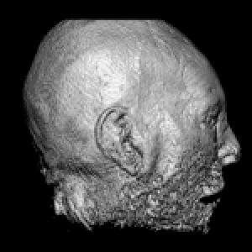
Pixel Compositing Schemes
max intensity
accumulate
intensity
average
first
Exact Isosurface
depth

Slide 31
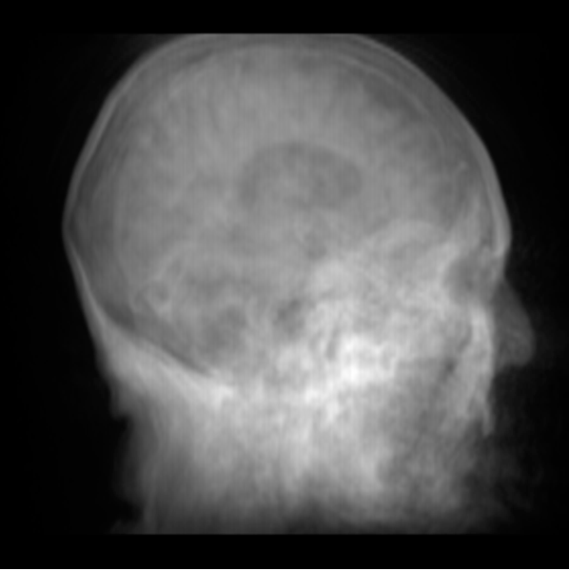
Pixel Compositing Schemes
max intensity
Synthetic Reprojection
accumulate
intensity
average
first
depth
Similar to X-rays

Slide 32
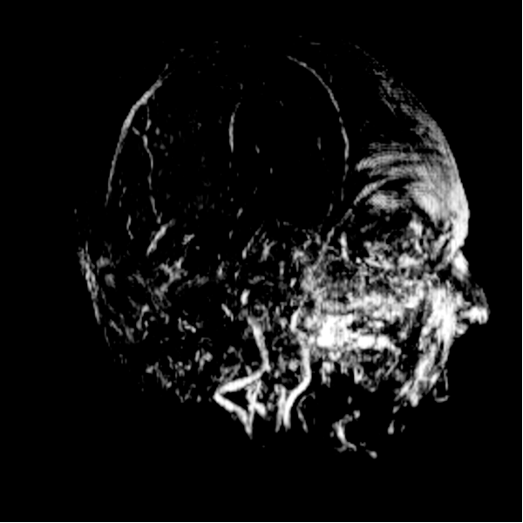
Pixel Compositing Schemes
maximum intensity projection (MIP)
max intensity
accumulate
intensity
average
first
depth
Used in PET and Magnetic Resonance Angiograms

Slide 33
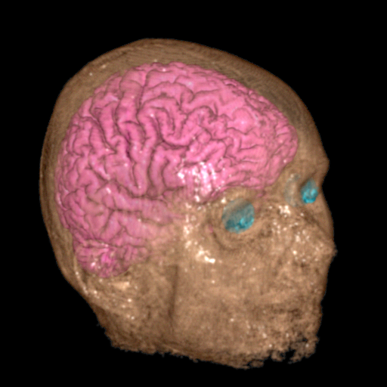
Pixel Compositing Schemes
max intensity
accumulate
intensity
average
first
depth
color to distinguish structures
opacity to show inside

Slide 34
Modeling Light

Slide 35
Direct Volume Rendering
Simulate light transport through a continuous volume
Data are interpolated from the samples at the grid points
Optical properties such as colors and opacities are assigned to the interpolated data
Optical properties must be integrated along each viewing ray
X
c2
c1
c3

Slide 36
Optical Model
Participating medium (the voxels) can absorb, emit, or both absorb and emit light
How much light will reach the eye?
Absorption Model
Emission Model
Absorption + Emission
S = 0
S = D

Slide 37
Absorption Only
The simplest participating medium
Consists of perfectly black particles that absorb all the light that they intercept
Assume
  each particle has an area of A = πr²
  Number of particles per unit volume = ρ
  A small cylindrical slab with a base area E and thickness Δs
Δs
  Total number of particles = E Δs ρ
  Total area occluded by particles = A E Δs ρ
  The fraction of occluded area = AEΔsρ / E = A Δs ρ
E
A = πr²
d I(s)
ds
= - I(s) x A Δs ρ(s) = - A ρ (s) I(s)
Solve this ODE
Δs

Slide 38
Absorption Only
The simplest participating medium
Consists of perfectly black particles that absorb all the light that they intercept
Assume
  each particle has an area of A = πr²
  Number of particles per unit volume = ρ
  A small cylindrical slab with a base area E and thickness Δs
Δs
dI
ds
Solve this ODE
= - A ρ (s) I(s)
E
A = πr²

Slide 39
Absorption Only
Δs
E
A = πr²
I₀
: extinction coefficient
I₀ = Initial light intensity
Can be seen as the transparency, or
1 – opacity of the medium from 0 to s

Slide 40
Emission Only
Each particle will glow diffusively with an intensity C
In a small cylindrical slab, the
total area occupied by the
particles is AEΔsρ
So the glow flux will be CAEΔsρ
Then the glow per unit area is CAEΔsρ /E = CAΔsρ
Δs
E
A = πr²
dI
ds
Solve this ODE
= C(s) A ρ(s) = C(s)τ(s) = g(s)

Slide 41
Emission Only
Each particle will glow diffusively with an intensity C
In a small cylindrical slab, the
total area occupied by the
particles is AEΔsρ
So the glow flux will be CAEΔsρ
So the glow per unit area is CAEΔsρ /E = CAΔsρ
Δs
E
A = πr²
dI
ds
Solve this ODE
= C(s) A ρ(s) = C(s)τ(s) = g(s)

Slide 42
Emission plus Absorption
Simply add emission and absorption together
Δs
dI
ds
= C(s)τ(s) - A ρ (s) I(s) = g(s) – τ(s)I(s)
E
A = πr²
emission
absorption
Solve this ODE
S = 0
S = D

Slide 43
Put It All Together
S = 0
S = D
Absorption only:
Emission only:
Emission plus absorption:

Slide 44
Look More Closely
: background light
: extinction coefficient at t , related to the rate that light
is occluded
: total distance light will travel
: transparency of medium between 0 and D
: opacity of medium between 0 and D
: source term at point s, typically derived from the data value
S = 0
S = D

Slide 45
Discrete Implementation
Numerical integration:
X₀ X₁ X₂ X₃ X₄ X₅ …
Δx = X_{i} – X_{i-1}
(Riemann Sum)
(Remember )

Slide 46
Discrete Implementation
= g_{n} + (1-α_{n})(g_{n}-1+(1-α_{n-1})(g_{n-2}+ (1-α_{n-2}(…. α₂(g₂+(1-α₁)(g₁+I₀)))))…)))))
This is called - Back to Front Compositing
S = 0
S = D
g₁ g₂ g₃ g₄ g₅ g₆ g₇ g₈ g₉ g₁₀ …
α₁ α₂ α₃ α₄ α₅ α₆ α₇ α₈ α₉ α₁₀ …

Slide 47
Discrete Implementation
( )
= g_{n} + (1-α_{n})(g_{n-1}+(1-α_{n-1})(g_{n-2}+ (1-α_{n-2}(…. (1-α₂)(g₂+(1-α₁)(g₁+I₀)))))…)))))
S = 0
S = D
g₁ g₂ g₃ g₄ g₅ g₆ g₇ g₈ g₉ g₁₀ …
α₁ α₂ α₃ α₄ α₅ α₆ α₇ α₈ α₉ α₁₀ …

Slide 48
Ray Casting Algorithm
For each pixel
  Cast a ray into the volume
  Linearly interpolate data values from cell (voxel) corners
  Convert the data values to optical properties (color and opacity)
  Composite the optical properties
  Return the final color
g1
g2
X
g3

Slide 49
Shading and Classificaton
Shading: computer a color for every sample in the volume
Classification: computer an opacity for every sample in the volume
This is often done through a table (transfer function) lookup
f(x_{i})
c(x_{i}), a(x_{i})

Slide 50
Shading
Use the Phong illumination model
illumination = ambient + diffuse + specular
= C(x_{i}) x I_{a} + C(x_{i}) x I_{d} x (N.L) + C(x_{i}) x I_{s} x (R.V)^{n}
C(x_{i}) : color of sample i
I_{a}, I_{d}, I_{s}: light’s ambient, diffuse, and specular colors (usually set as white)
N: normal at sample i
V: vector from sample point to eye
L: light vector, from sample to light source
R: reflection vector of light vector
n: shininess
L
N
R
θ θ
φ
V
Sample i

Slide 51
Normal Estimation
How to compute the sample normal N?
  Normal: a vector that is perpendicular to the local surface, which is the gradient of the sample point
Compute the gradient G at the cell corners using central difference
Linearly interpolate the gradients

Slide 52
Classification
Classification: mapping from data values to opacities
  Region of interest: high opacity
  Rest: translucent or transparent
The opacity function, or called transfer function, is given by the user

Slide 53
Ray Sampling
Sample the volume at discrete
points along the ray
Perform tri-linear interpolation to get
the sample values
Look up the transfer function to
get the color and opacity
Compositing the color/opacity
(front-to-back or back-to-front)
c1
c2
c3

Slide 54
Back-to-Front Compositing
The initial pixel color = Black
Back-to-Front compositing:
use ‘under’ operator
C = C1 ‘under’ background
C = C2 ‘under C
C = C3 ‘under C
…
C_{out} = C_{in} * (1-α(x)) + C(x)*α(x)
(this is the alpha blending formula)
c1
c2
c3

Slide 55
Front-to-Back Compositing
Front-to-Back compositing:
use ‘over’ operator
C = background ‘over’ C1
C = C ‘over’ C2
C = C ‘over’ C3
…
C_{out} = C_{in} + C(x) α(x) *(1- α_{in});
α_{out} = α_{in} + α(x) *(1-α_{in})
c1
c2
c3

Slide 56
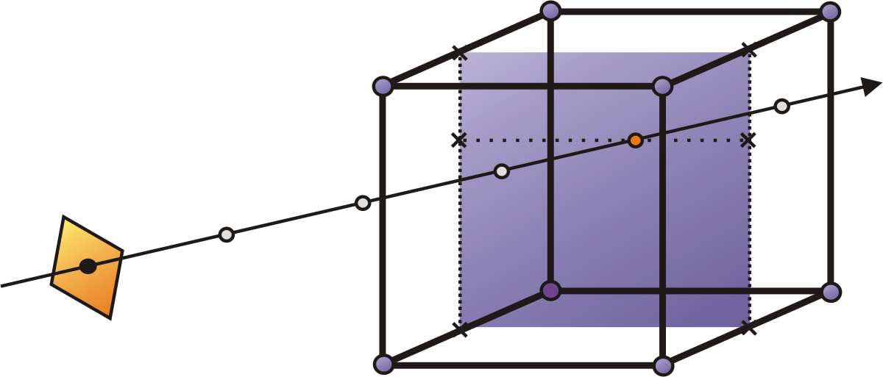
We perform a numerical approximation of volume rendering integral
Idea: resample volume at equispaced intervals along the ray
  Use trilinear interpolation

Slide 57
Ray-Casting Highlights
Advantages
  Simple algorithm
  Inherently parallel
  Can add features (like a ray-tracer)
Disadvantages
  Slow (lots of rays, lots of samples)
  Must sample densely
  Requires data set in memory

Slide 58
Object-Ordered Approaches

Slide 59
Object order approach
Data Set
Image Plane
Eye
For each slice {
calculate contribution to the image
}

Slide 60
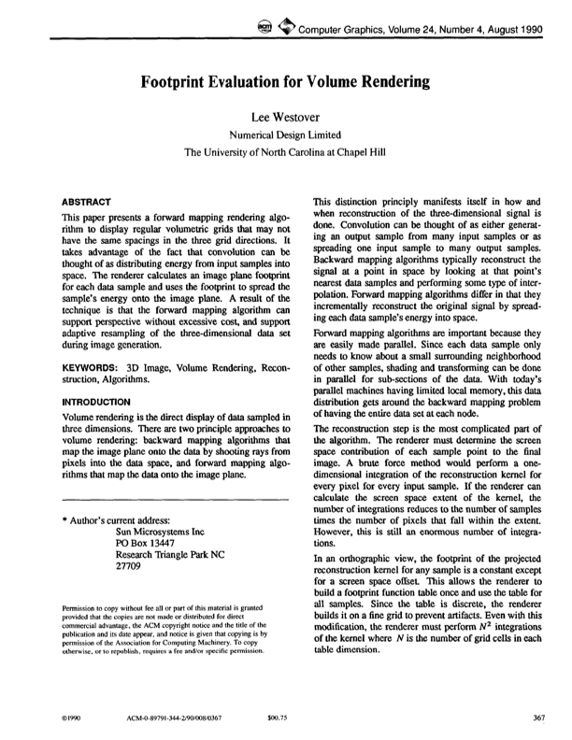
Object Order: Splatting
Main Idea: Throw voxels to the image
  Front-To-Back or Back-To-Front
Original method - fast, poor quality, many many improvements since then!
  Crawfis’93: textured splats
  Swan’96, Mueller’97: anti-aliasing
  Mueller’98: image-aligned sheet-based splatting
  Mueller’99: post-classified splatting
  Huang’00: new splat primitive: FastSplats

Slide 61
Splatting
Volume = field of 3D interpolation kernel
  One kernel at each grid voxel
Each kernel leaves a 2D footprint on screen
  Voxel contribution = footprint ·(C, opacity)
Weighted footprints accumulate into image
voxel kernels
screen footprints = splats
screen

Slide 62
Splatting
Volume = field of 3D interpolation kernel
  One kernel at each grid voxel
Each kernel leaves a 2D footprint on screen
  Voxel contribution = footprint ·(C, opacity)
Weighted footprints accumulate into image
voxel kernels
screen footprints = splats
screen

Slide 63
Splatting
Volume = field of 3D interpolation kernel
  One kernel at each grid voxel
Each kernel leaves a 2D footprint on screen
  Voxel contribution = footprint ·(C, opacity)
Weighted footprints accumulate into image
voxel kernels
screen footprints = splats
screen

Slide 64
Splatting
Volume = field of 3D interpolation kernel
  One kernel at each grid voxel
Each kernel leaves a 2D footprint on screen
  Voxel contribution = footprint ·(C, opacity)
Weighted footprints accumulate into image
voxel kernels
screen footprints = splats
screen

Slide 65
Ray-casting - revisited
Interpolation
kernel
volumetric compositing
color c = c _{s} α_{s}(1 - α) + c
opacity α = α _{s} (1 - α) + α
1.0
object (color, opacity)

Slide 66
Ray-casting - revisited
(Ideally) we would reconstruct the continuous volume (cloud) using the interpolation kernel h:
Then we would compute the analytic integral along a ray r:
This can only be approximated by discretization

Slide 67
Splatting - Principal Idea
This last equation
can be rewritten in the following way:
Splatting Kernel or “Splat”
Which can be computed analytically: known as footprint

Slide 68
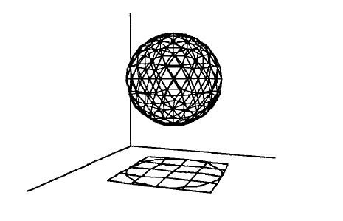
Footprint Extent
Approximate the 3D kernel (h(x,y,z))extent by
a sphere

Slide 69
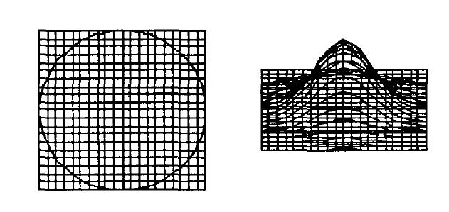
Footprint Table
A popular kernel is a three-dimensional Gaussian
(radially symmetric)
As 1D integration of 3D Gaussian is still a 2D Gaussian –
we can just skip the Z integration and evaluate the Gaussian
function on 2D image space after voxel projection
Generic footprint
table
preprocessing

Slide 70
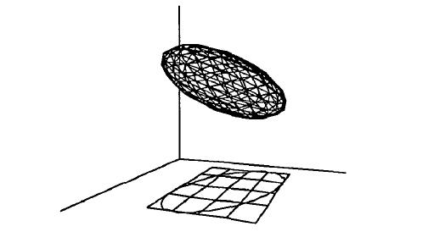
View-dependent footprint
It is possible to transform a sphere kernel into
A ellipsoid
The projection of an
ellipsoid is an ellipse
We need to transform the
generic footprint table
to the ellipse

Slide 71
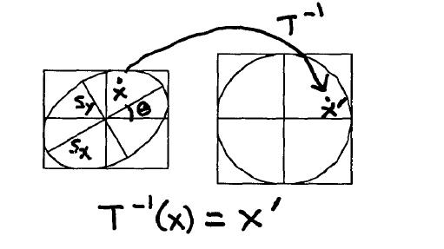
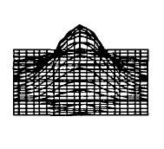
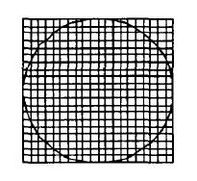
View-dependent footprint (2)

Slide 72
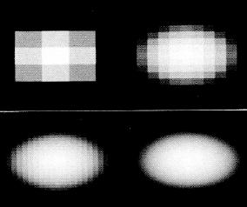
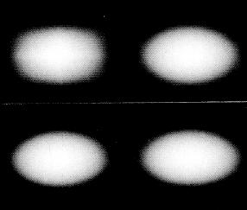
Example Footprint at Different Resolutions

Slide 73
Footprint - principal idea
Draw each voxel as a cloud of points (footprint) that spreads the voxel contribution across multiple pixels.
Larger footprint -> larger spatial kernel extent -> lower frequency components -> more blurring
  Large pixel/voxel ratio

Slide 74
Splatting - Evaluation
Advantages:
  Footprints can be pre-integrated
  Fast: voxel interpolation is in 2D on screen
  More accurate integration (analytic for X-ray)
  More accurate reconstruction (better kernels)
  Only relevant voxels must be projected
Disadvantages:
  Blurry images for zoomed views!
  High fill-rate for zoomed splats!
  Result is wrong where filter overlap

Slide 75
Texture-Mapping

Slide 76
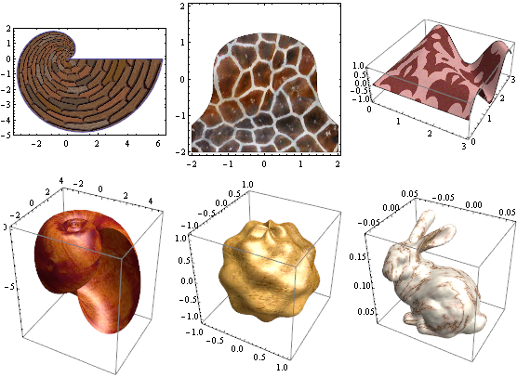
Texture Mapping
Idea: Use image data to make up for lack of complexity in the modeling process
Pixels get additional coordinate information (texture coordinates) which index an image.
Graphics pipelines are specifically designed to take of advantage of this concept, with fast access to memory and builtin interpolation, texture mapping units
3D textures are a common way to accelerate volume rendering
http://www.wolfram.com/mathematica/new-in-8/enhanced-2d-and-3d-graphics/

Slide 77
Review on Texturing
(Bilinear Interpolation)

Slide 78
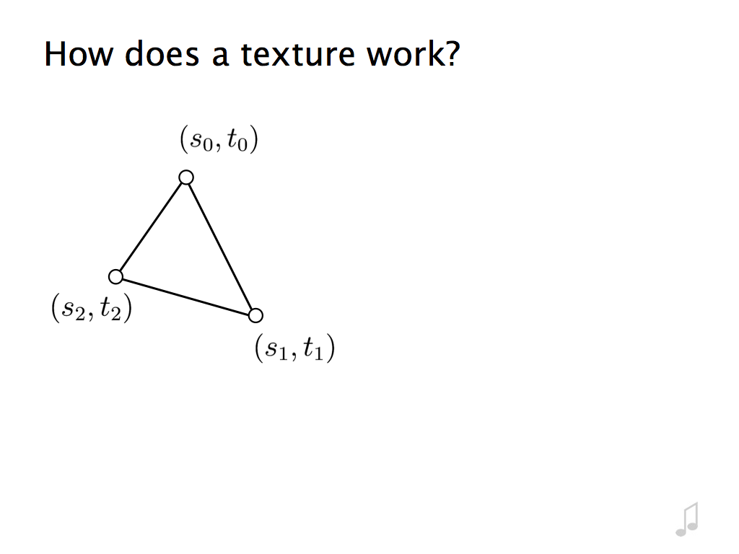

Slide 79
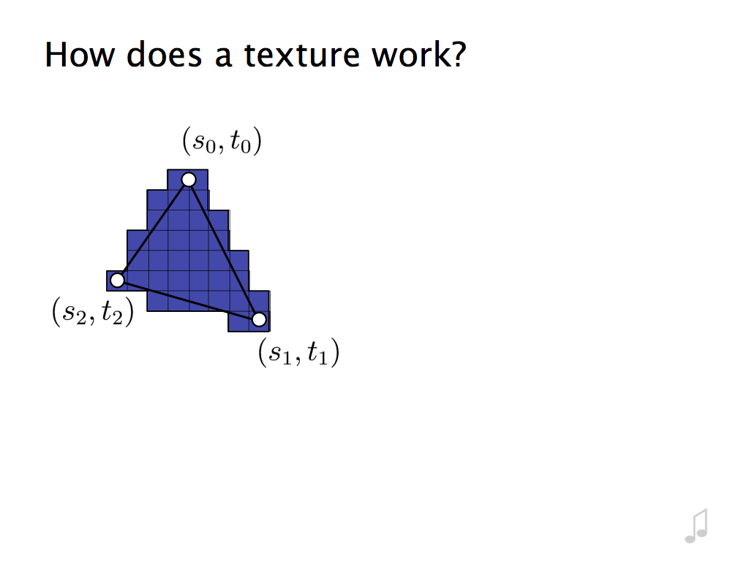

Slide 80
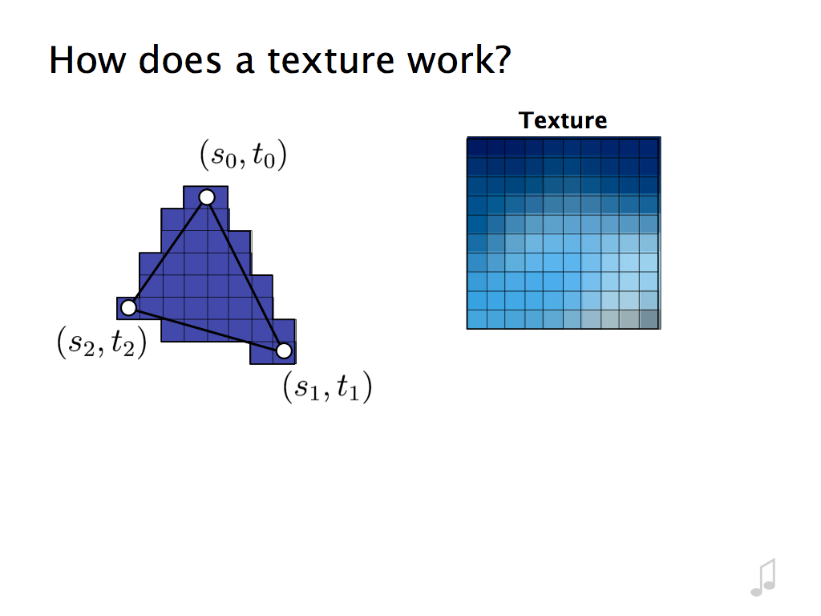

Slide 81
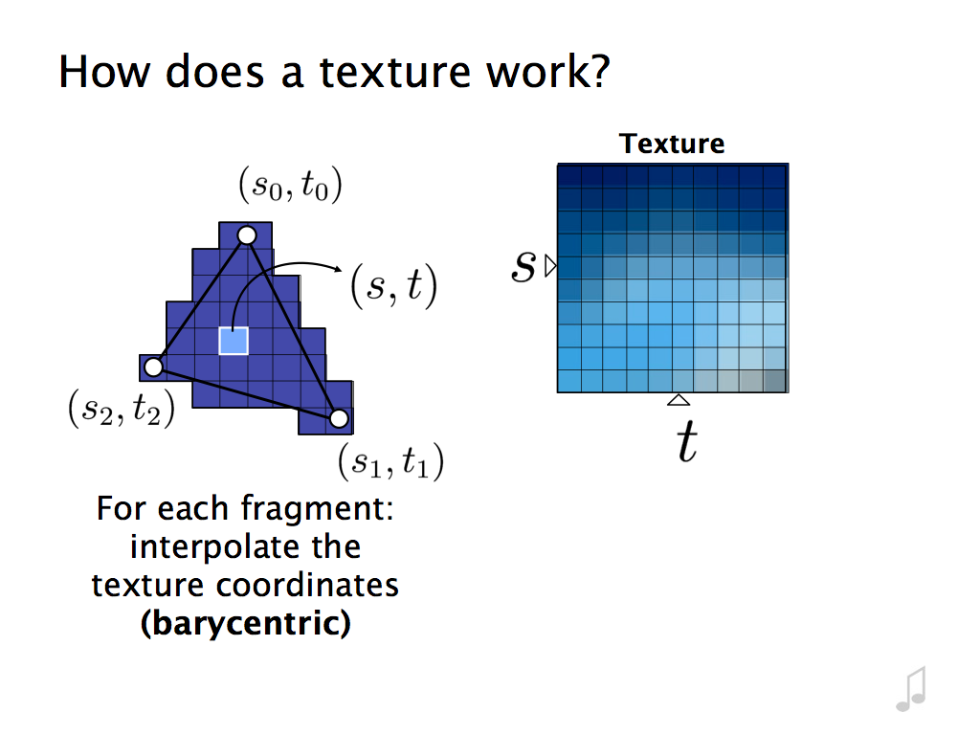

Slide 82
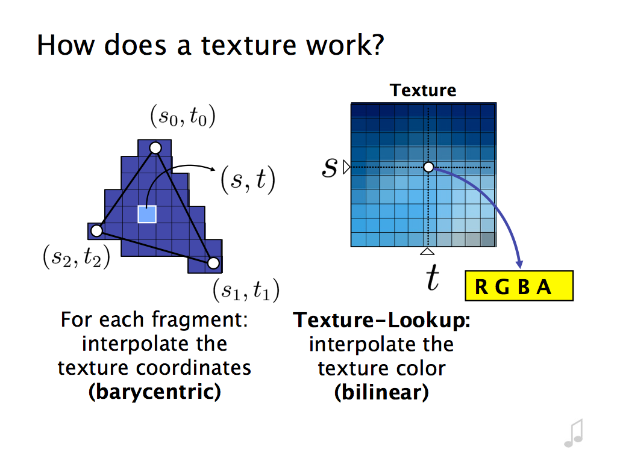

Slide 83
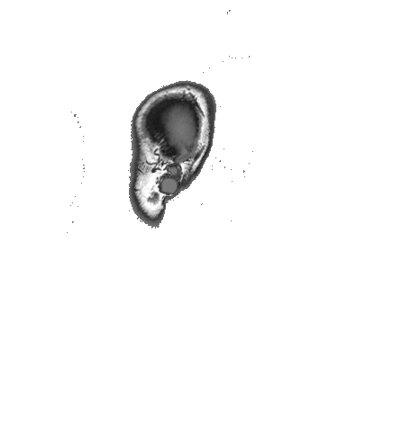
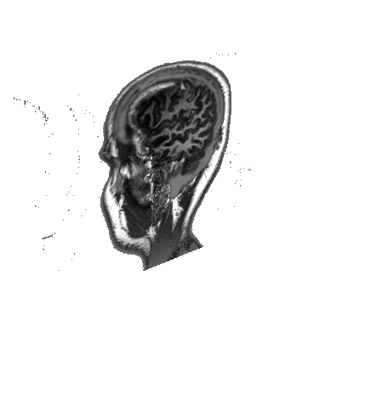
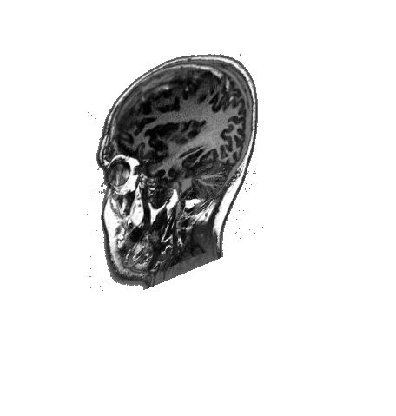
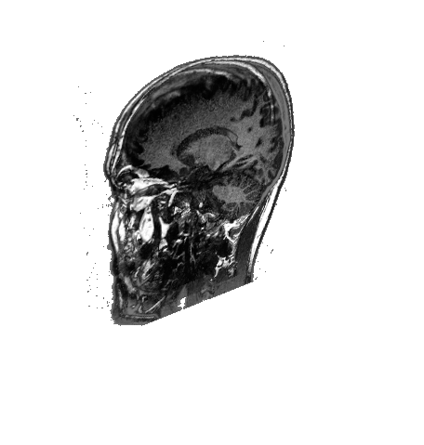
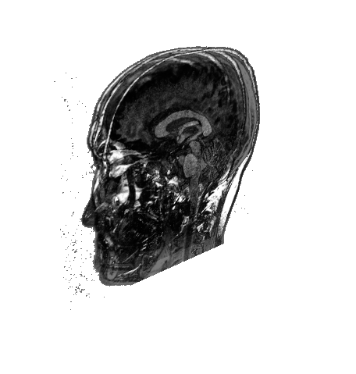
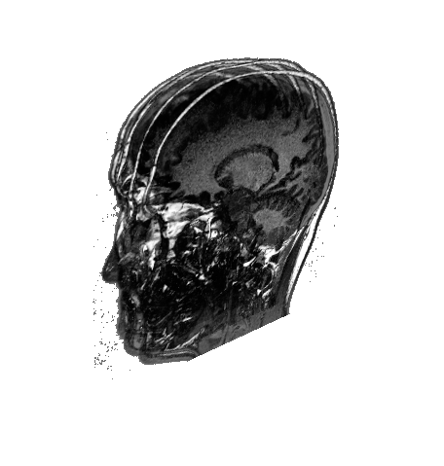
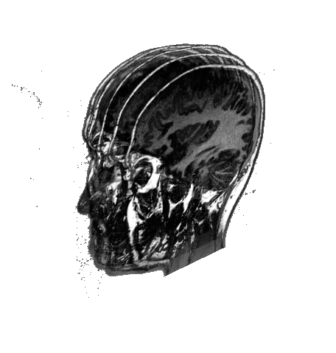
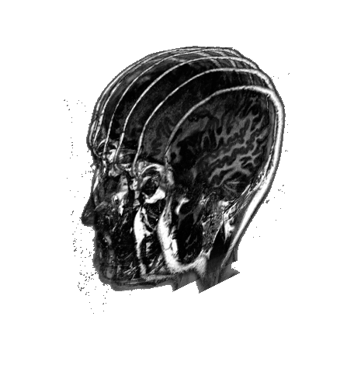
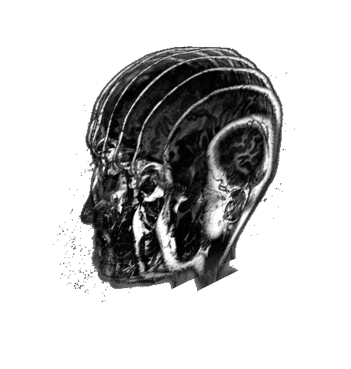
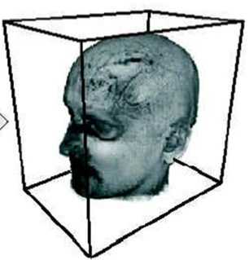
Texture-based
Volume rendering by 2D texture mapping
  Use planes parallel to “base plane” (front face of volume which is most orthogonal to view ray)
  Draw textured rectangles using bilinear interpolation
  Render back-to-front using compositing

Slide 84
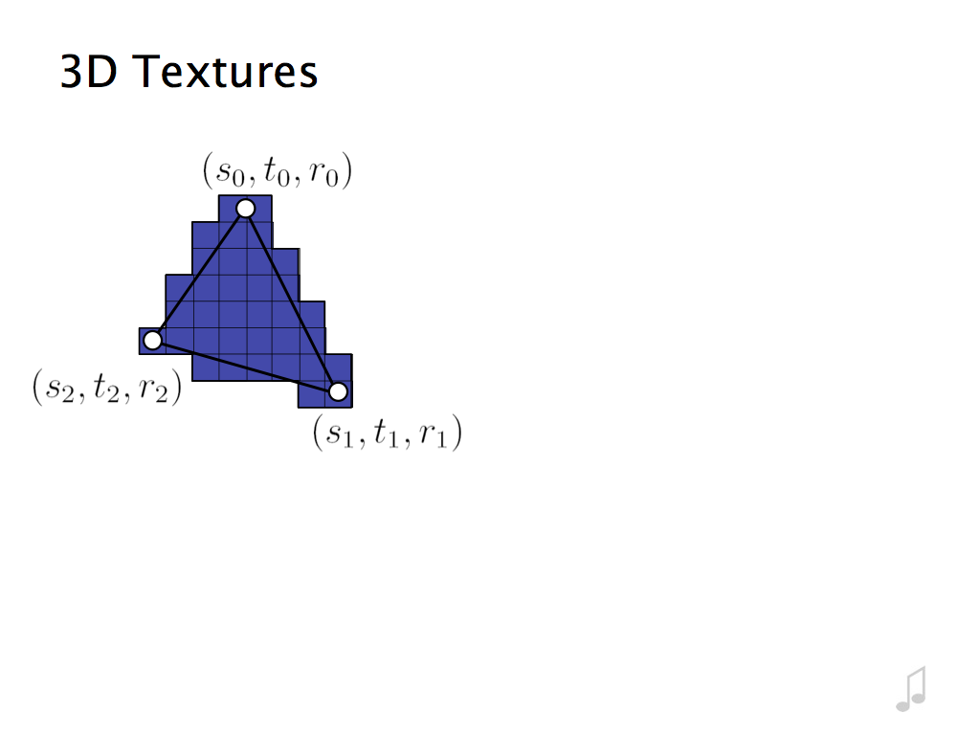

Slide 85
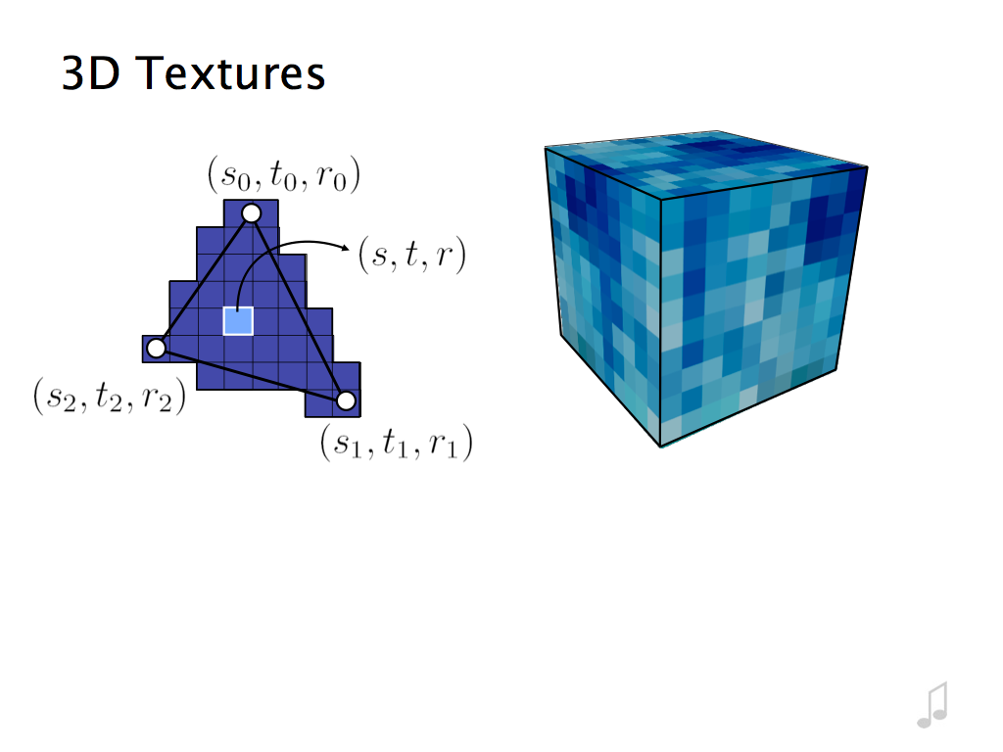

Slide 86
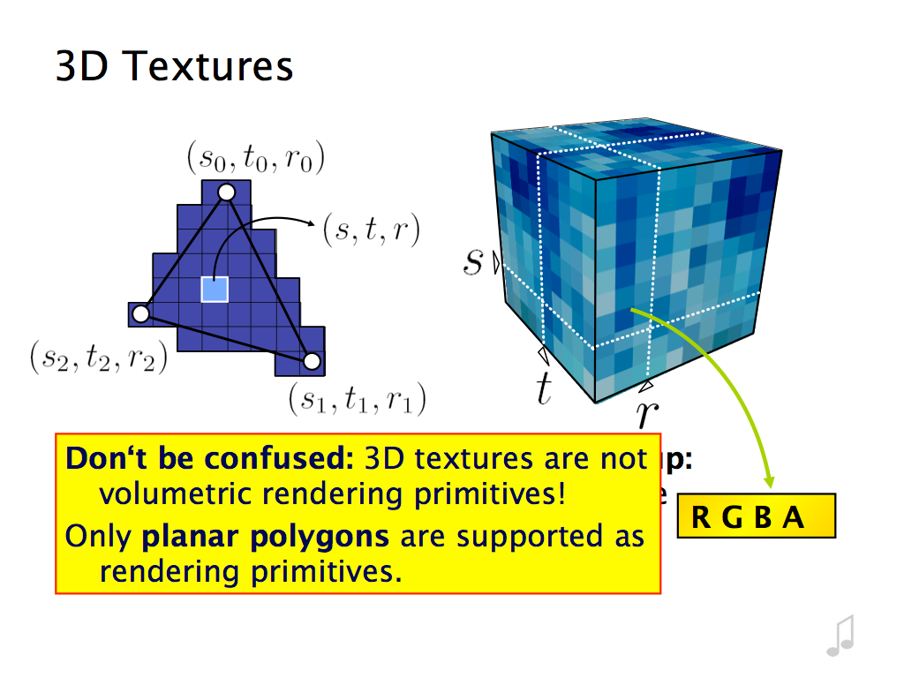

Slide 87
3D Textures
Voxel data becomes a 3D Texture Object
  Trilinear Interpolation in Hardware
  Uses an arbitrary number of slices parallel to the image plane
  Back-to-front compositing used just as in 2d texturing
  Can be limited by the size of the texture memory

Slide 88


Slide 89


Slide 90


Slide 91
Shear-Warp

Slide 92


Slide 93


Slide 94

Orthographic vs. Perspective Projections
Dianne Hansford

Slide 95


Slide 96


Slide 97
Shear-Warp Evaluation
Advantages
  Pixel scanlines (intermediate) are parallel to voxel rows
  All voxels in a slice are scaled uniformly
  Therefore, the sampling rate is uniform within each volume slice
  Similar to template-based volume ray casting (Yagel 91)
Disadvantages
  Affine projection (no perspective)
  Compute time (relative to splatting & slice-based)

Slide 98
Computational Strategies
Image Order:
  Ray casting (many options)
Object Order:
  Splatting, Texture mapping
Combinations:
  Shear-warp

Slide 99





