Slide 1
Research Awards and Recognition
Over 49 Best Paper or Best Panel Awards
IEEE Technical Achievement Award for Visualization
2 IEEE Visualization Career Award
5 Fellows: American Institute for Medical and Biological Engineers
3 Fellows: Institute for Electrical and Electronic Engineers
Fellow: American Association for the Advancement of Science
Fellow: Society of Industrial and Applied Mathematics
Fellow: Department of Energy
6 NSF CAREER Awards + 1 NSF NYI and 1 NSF PFF
3 Distinguished Alumni Awards
TR 35 Award
Microsoft Faculty Fellow
Charles Babbage Award
Sidney Fernbach Award
Rosenblatt Prize
IBM Faculty Awards
PopTech Science Fellow
TED Fellow
2 HPC Wire People to Watch

Slide 2
University Leadership
Rob MacLeod – Associate Director CVRTI and SCI and CARMA* and Director of UG BE
Martin Berzins – Director, ARL CDE3M*, Director of the SoC*, Director CES Program*
Mike Kirby – Director, ARL CDE3M, Director, CES Program*, Chair, Scientific Computing Ph.D. Program, Director of SoC Graduate Studies*, Associate Director, SoC
Valerio Pascucci – Chair, Graphics and Visualization Computing Degree Program*, Director, CEDMAV
Ross Whitaker – Director, SoC, Associate Director, SoC*
Chuck Hansen – Chair, Graphics and Visualization Computing Degree Program*
Chris Johnson – Director, SCI Institute, Director, SoC*, Director, CES Program*
* = Previous Position

Slide 3
National and International Leadership
DOE Advanced Scientific Computing Advisory Committee (ASCAC).
Board of Directors for the Computing in Cardiology Society
Flatiron Institute Advisory Board
Several Other National and International Advisory Boards
CRA Computing Community Consortium
CRA Board of Directors
CRA Awards Committee (Chair)
NSF HPC Committee
NSF Task Force on Software for Science and Engineering
NSF Task Force on Cyber Science and Engineering
CRA Education Committee
KAUST Advisory Committee
IEEE VGTC
DOE Advanced Scientific Computing Advisory Committee (ASCAC) Subcommittees
IEEE Fernbach and Cray Award Committees
SIAM Computational Science Awards Committee

Slide 4
SCI Institute - Utah Collaborations
Pediatrics
Psychiatry
HCI
Obstetrics
Pathology
Architecture
School of Computing
Pharmaceutical Chemistry
Mechanical Engineering
Chemical Engineering
UCAIR
Mathematics
Moran Eye Center
Materials Science
UPDB
TCO
CHPC
CVRTI
Neurology
Pathology / ARUP
Neurosurgery
Geography
ICSE
Biomedical Informatics
Cardiology
Genetics
Physics
Psychology
Nephrology
Chemistry
Biology
Brain Institute
Nuclear Engineering
EGI
Bioengineering
PCMC Cardiology
Radiation Oncology
CTSA
English
Epidemiology
Radiology
Physiology
Geology
Orthopedics

Slide 5
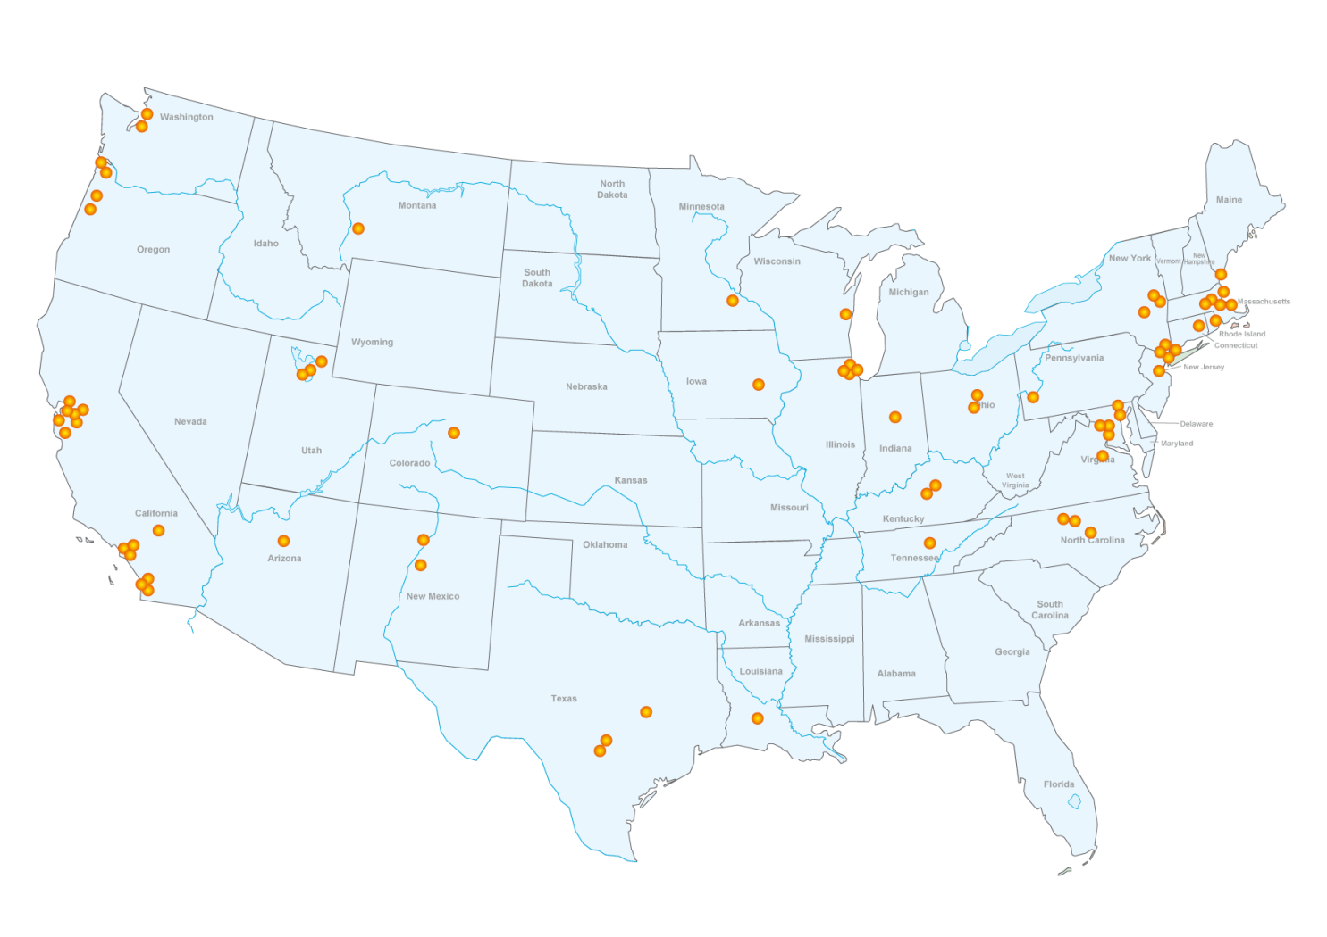
Collaborators
Lawrence Livermore National Laboratories
Lawrence Berkeley National Laboratories
Sandia National Laboratories
Oak Ridge National Laboratory
University of California San Francisco
University of California Davis
University of California Los Angeles
Texas A&M University
University of Texas Health Science Center at San Antonio
North Eastern University
University of Arizona
University of Iowa
Ohio State University
University of North Carolina
Louisiana State University
Massachusetts Institute of Technology
University of Texas Austin
University of Washington
Northwestern University
University of Pittsburg
Stanford University
University of Oregon
Imperial College London
Harvard University
Duke University
Medical College of Wisconsin
John's Hopkins University
Children's Hospital Boston
Mayo Clinic
Cleveland Clinic
Brigham & Womens Hospital
Smithsonian Institute
Kettering Cancer Center
Kitware
VisTrails.org
crowdLabs
National Resource for Cell Analysis and Modeling
National Center for Microscopy and Imaging Research
University of California San Diego
National Biomedical Computation Resource
Neuroimaging Informatics Tools and Resources Clearinghouse
Center for Coastal Margin Observation & Prediction
DataOne
Electrical Geodesics Inc
University of Tennessee
University of Kentucky
Yale University
University of Chicago
Indiana University
Utah State University
Brown University
University of Southern California
Princeton Plasma Physics Laboratory
Science Applications International Corporation
General Electric Research Labs
SGI
Mountain View Data
Montana State University
North Carolina State University
Celera.
General Atomics
Caltech Computer Science
Rensselaer Polytechnic Institute
Argonne National Lab
Pacific Northwest National Laboratories
Electrical Geodesics, Inc.
University of Colorado
Los Alamos National Laboratories
Cornell University

Slide 6
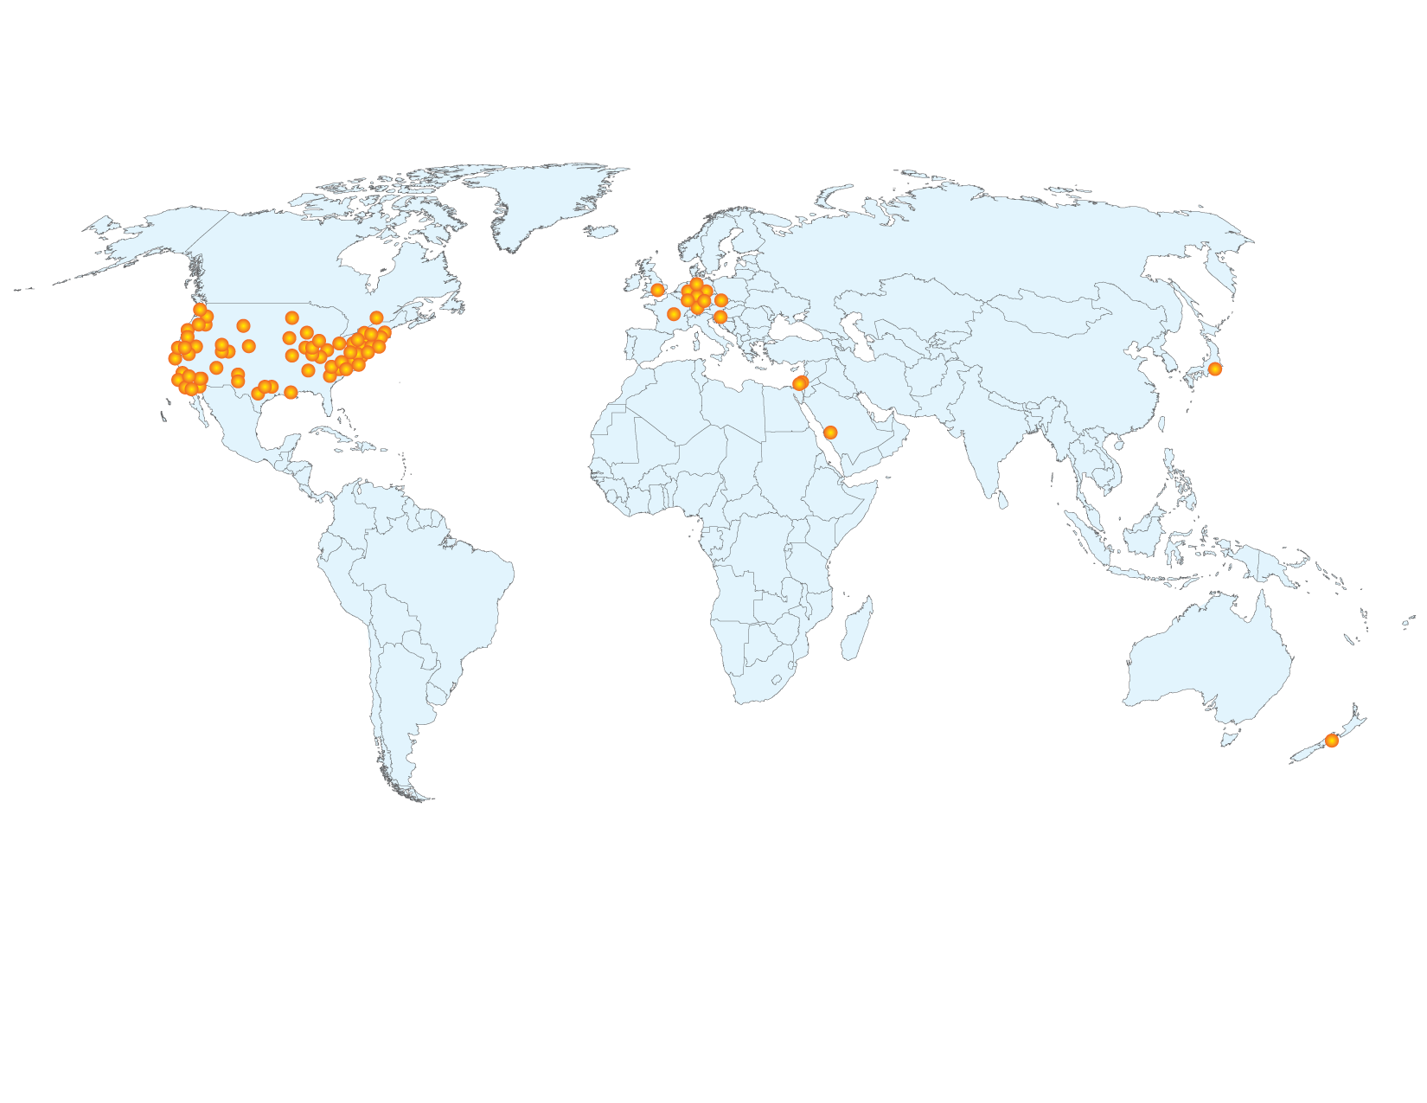
Collaborators
Imperial College London
King Abdullah University of Science and Technology
University of Kaiserslautern
Charles University Hospital, Prague
University of Ljubljana
Technical University of Munich
University of Münster
University of Aukland
National Institute for Research in Computer Science and Control (Inria)
TurboLinux
University of Erlangen
University of Duisburg
Center of Advanced European Studies And Research (CAESAR), Bonn
Ben Gurion University, Israel
Hebrew University of Jerusalem
University of Stuttgart
Canadian Meteorological Center

Slide 7
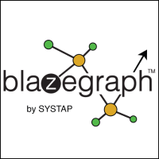
Industry Collaboration
Current Collaborations
Past Collaborations
ClinicNotes

Slide 8
Collaborations with National Labs

Slide 9
Research Centers/Large Projects
Current:
NIH CIBC – April 2020
DOD ARL CDE3M – November 2019
DOE CCMSC – February 2019
NCI U01 – August 2020
Exxon-Mobil – December 2017
NIH UH3 – August 2020
DoD OEA – August 2018
DARPA (Akil/Dongbin) – September 2018
DARPA (Mike/Ross) – December 2018

Slide 10
Research Centers/Large Projects
Planned:
NIH P41 Biomechanics – Jeff
DOE NETL CDP – Chris, Martin, Mike, Valerio
NIH Image Analysis PP – Sarang, Tom, Tolga, Ross?
Haliburton – EGI, Mike, Martin, Valerio, Chris
DOE Energy – Brian McPherson, Pani, Valerio, Chris

Slide 11
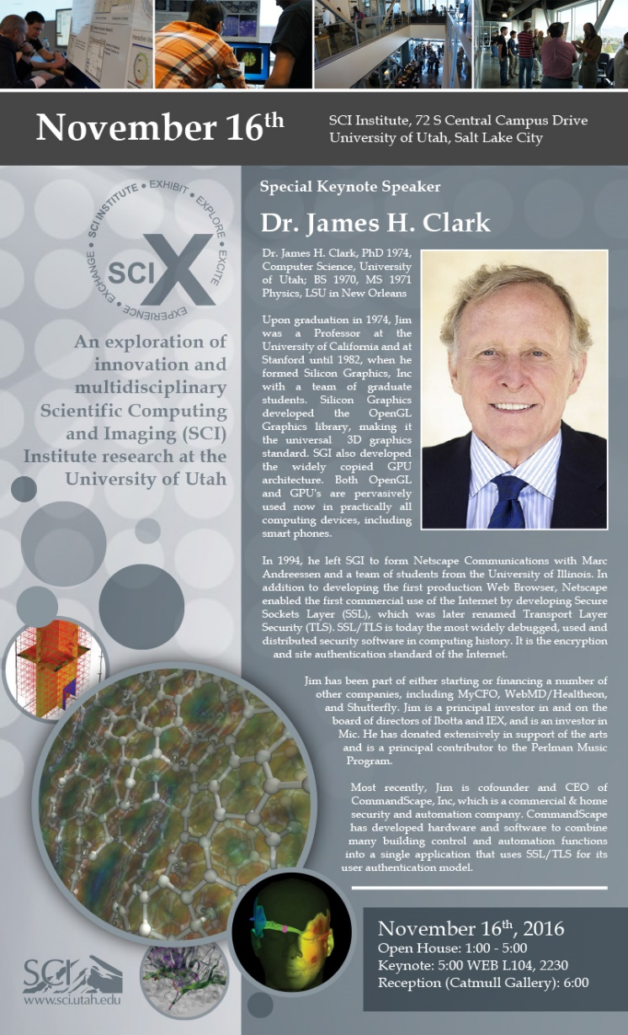
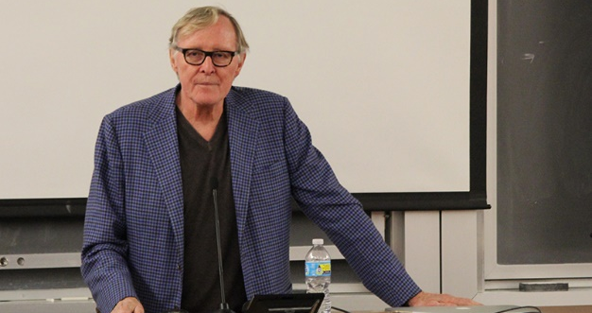
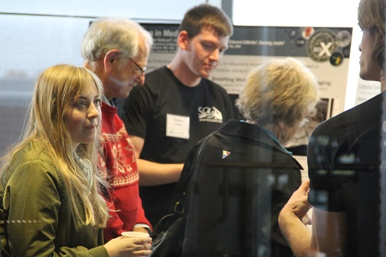
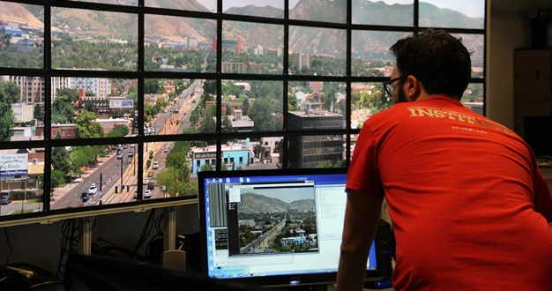
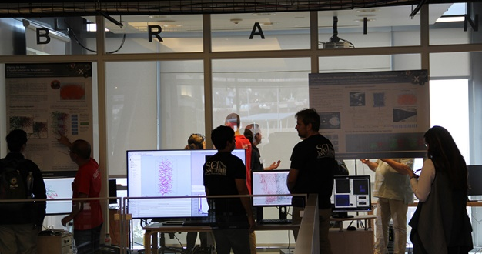
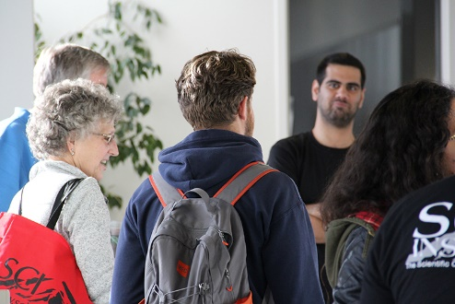
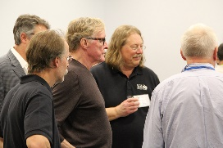
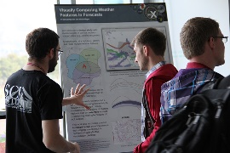
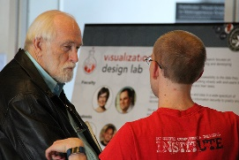
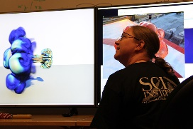
SCI X

Slide 12
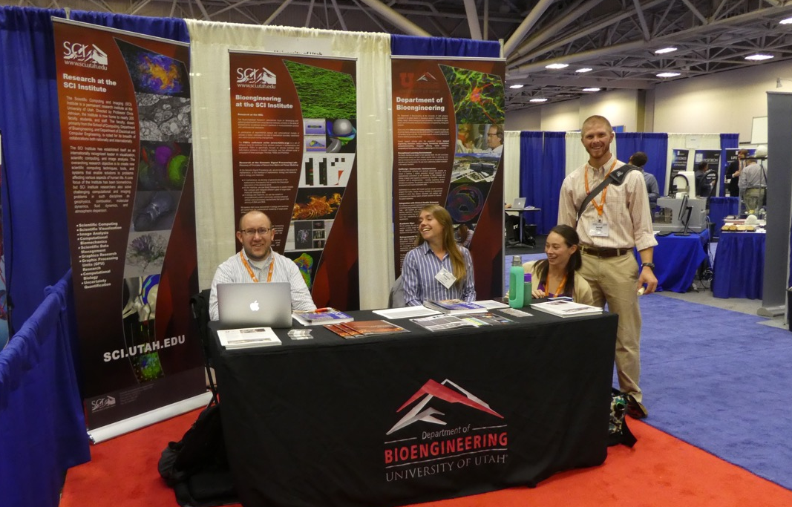
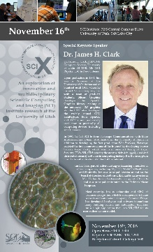
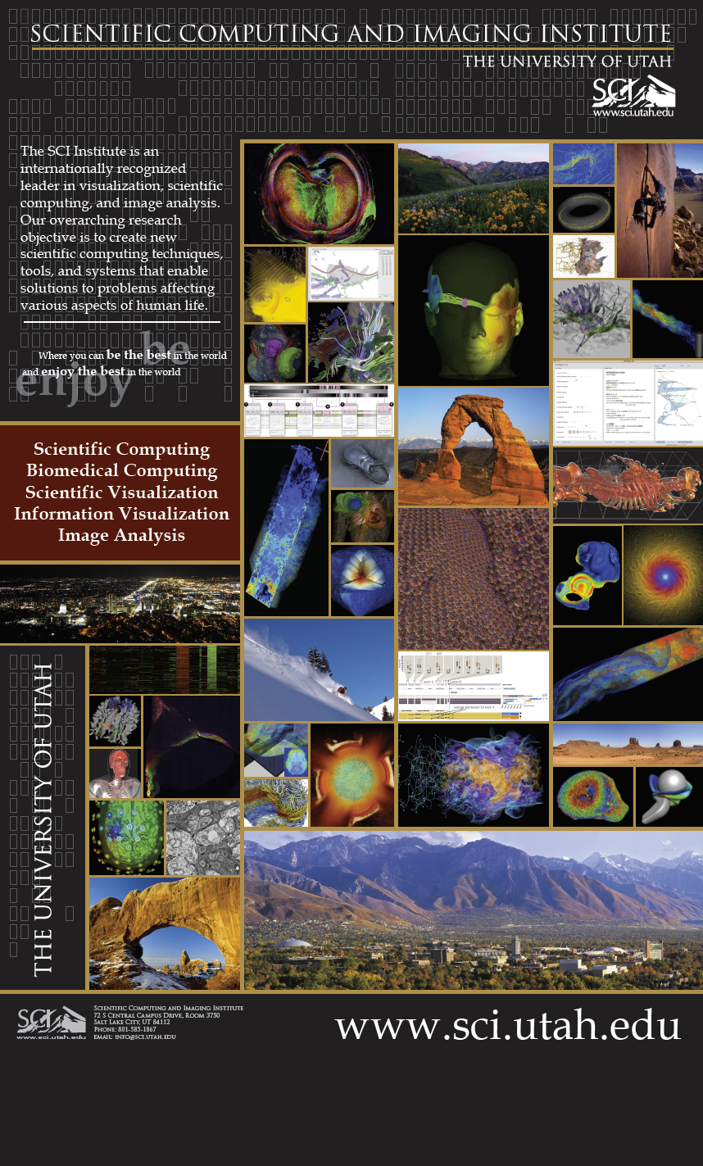
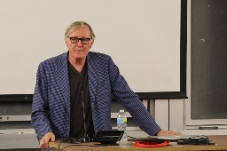
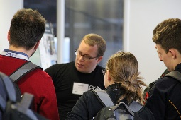
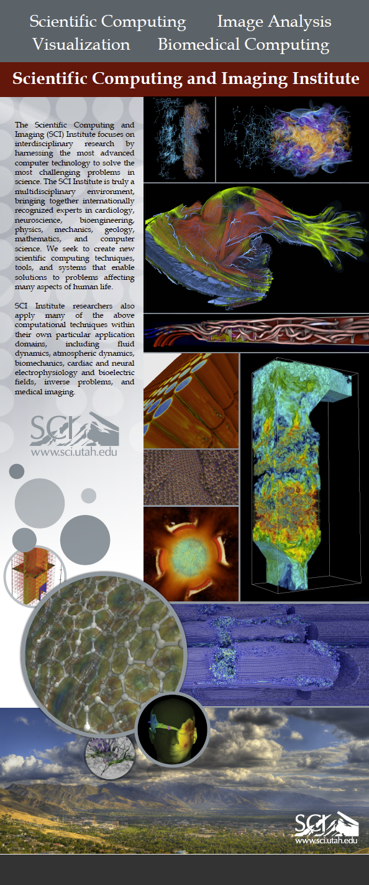
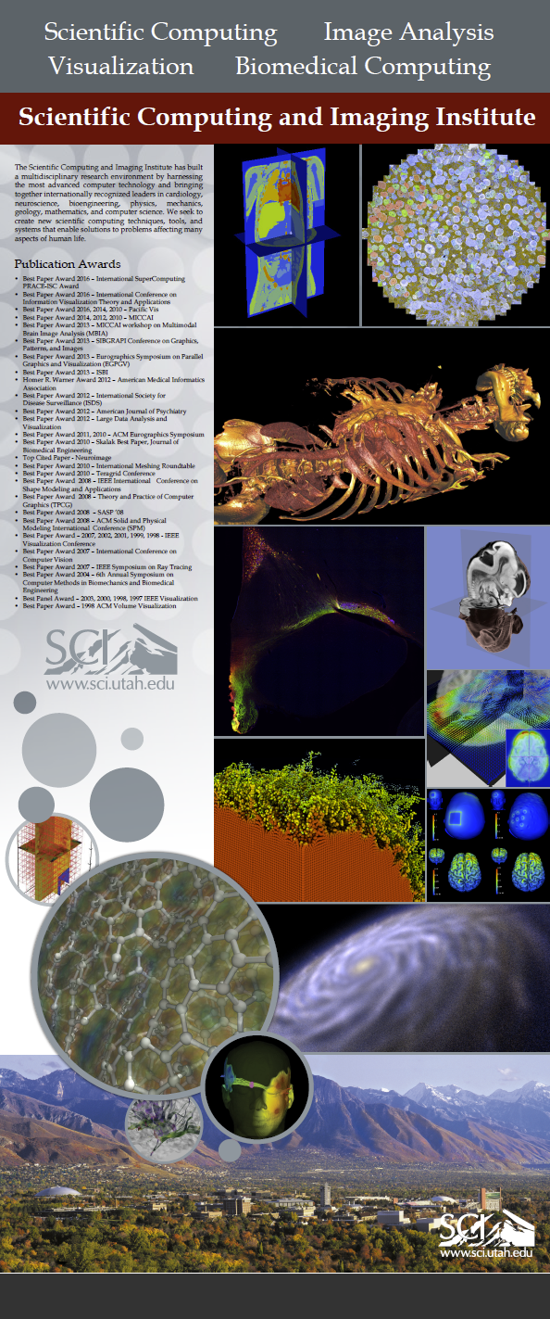
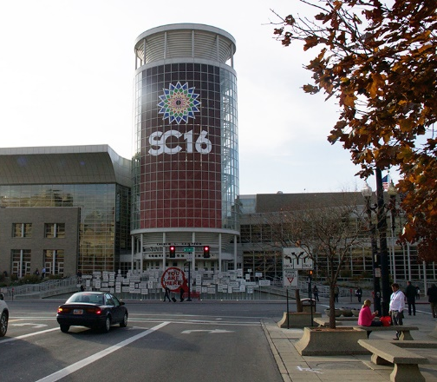
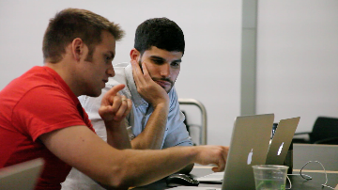
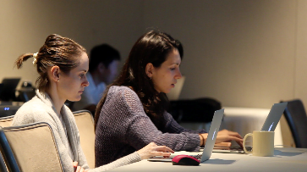
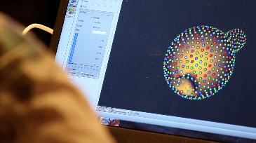
Outreach 2016
BMES
SCIx
VisWeek 2016
Supercomputing 2016
IBBM 2016

Slide 13
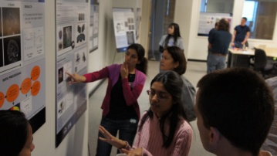
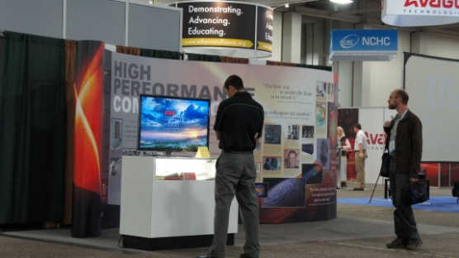
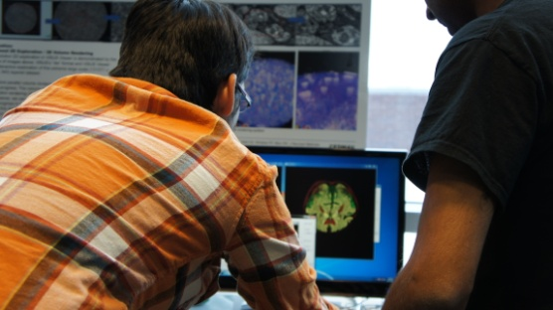
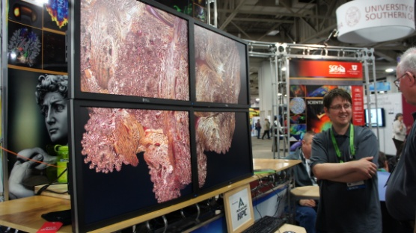
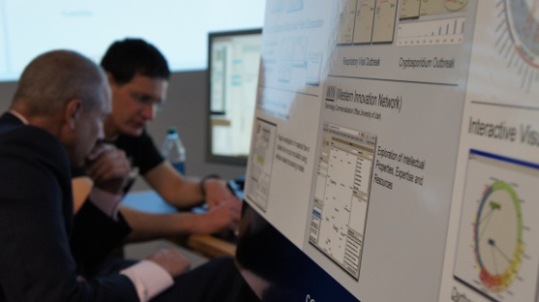
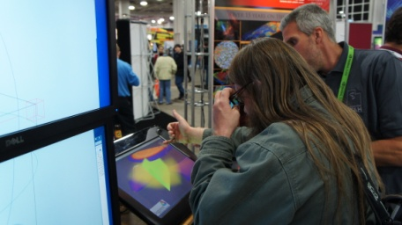
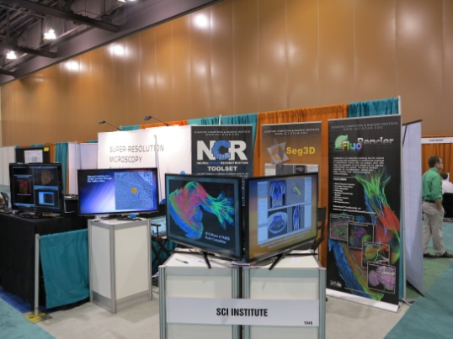
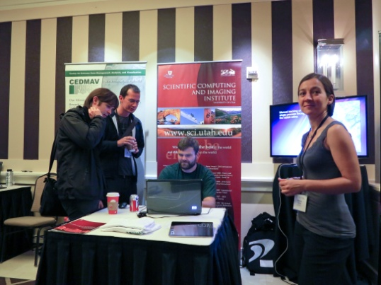
Outreach 2012
SCIx
Supercomputing 2012
Microscopy & Microanalysis
VisWeek 2012
Pushbutton Summit

Slide 14
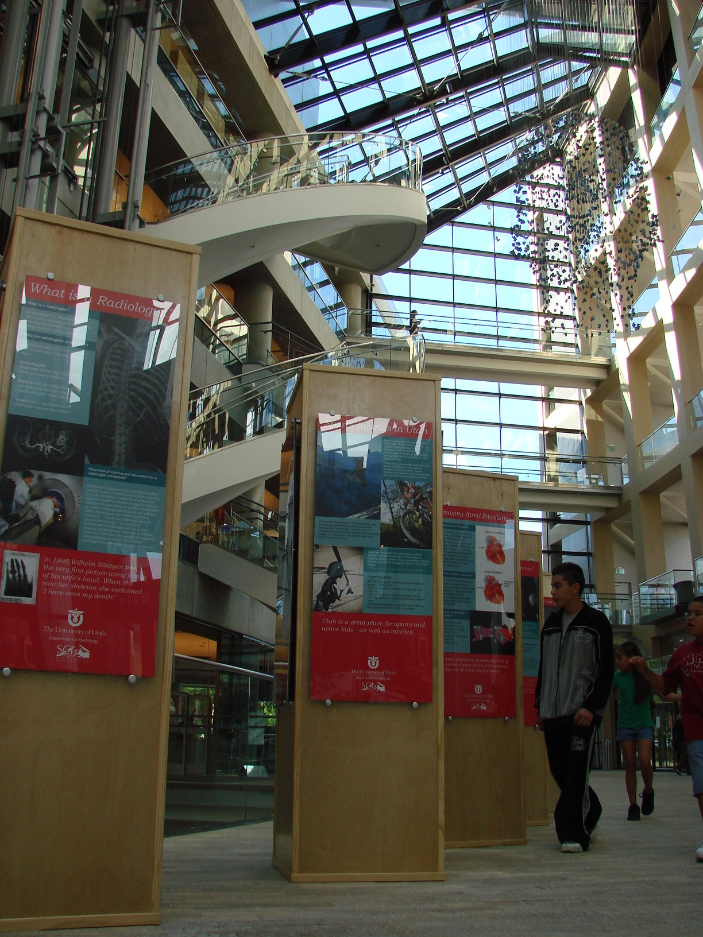
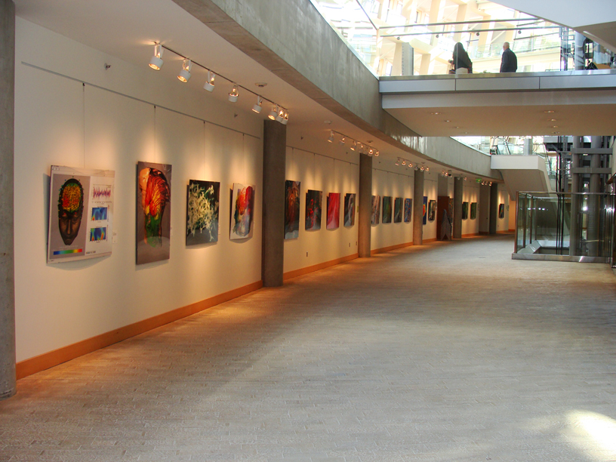
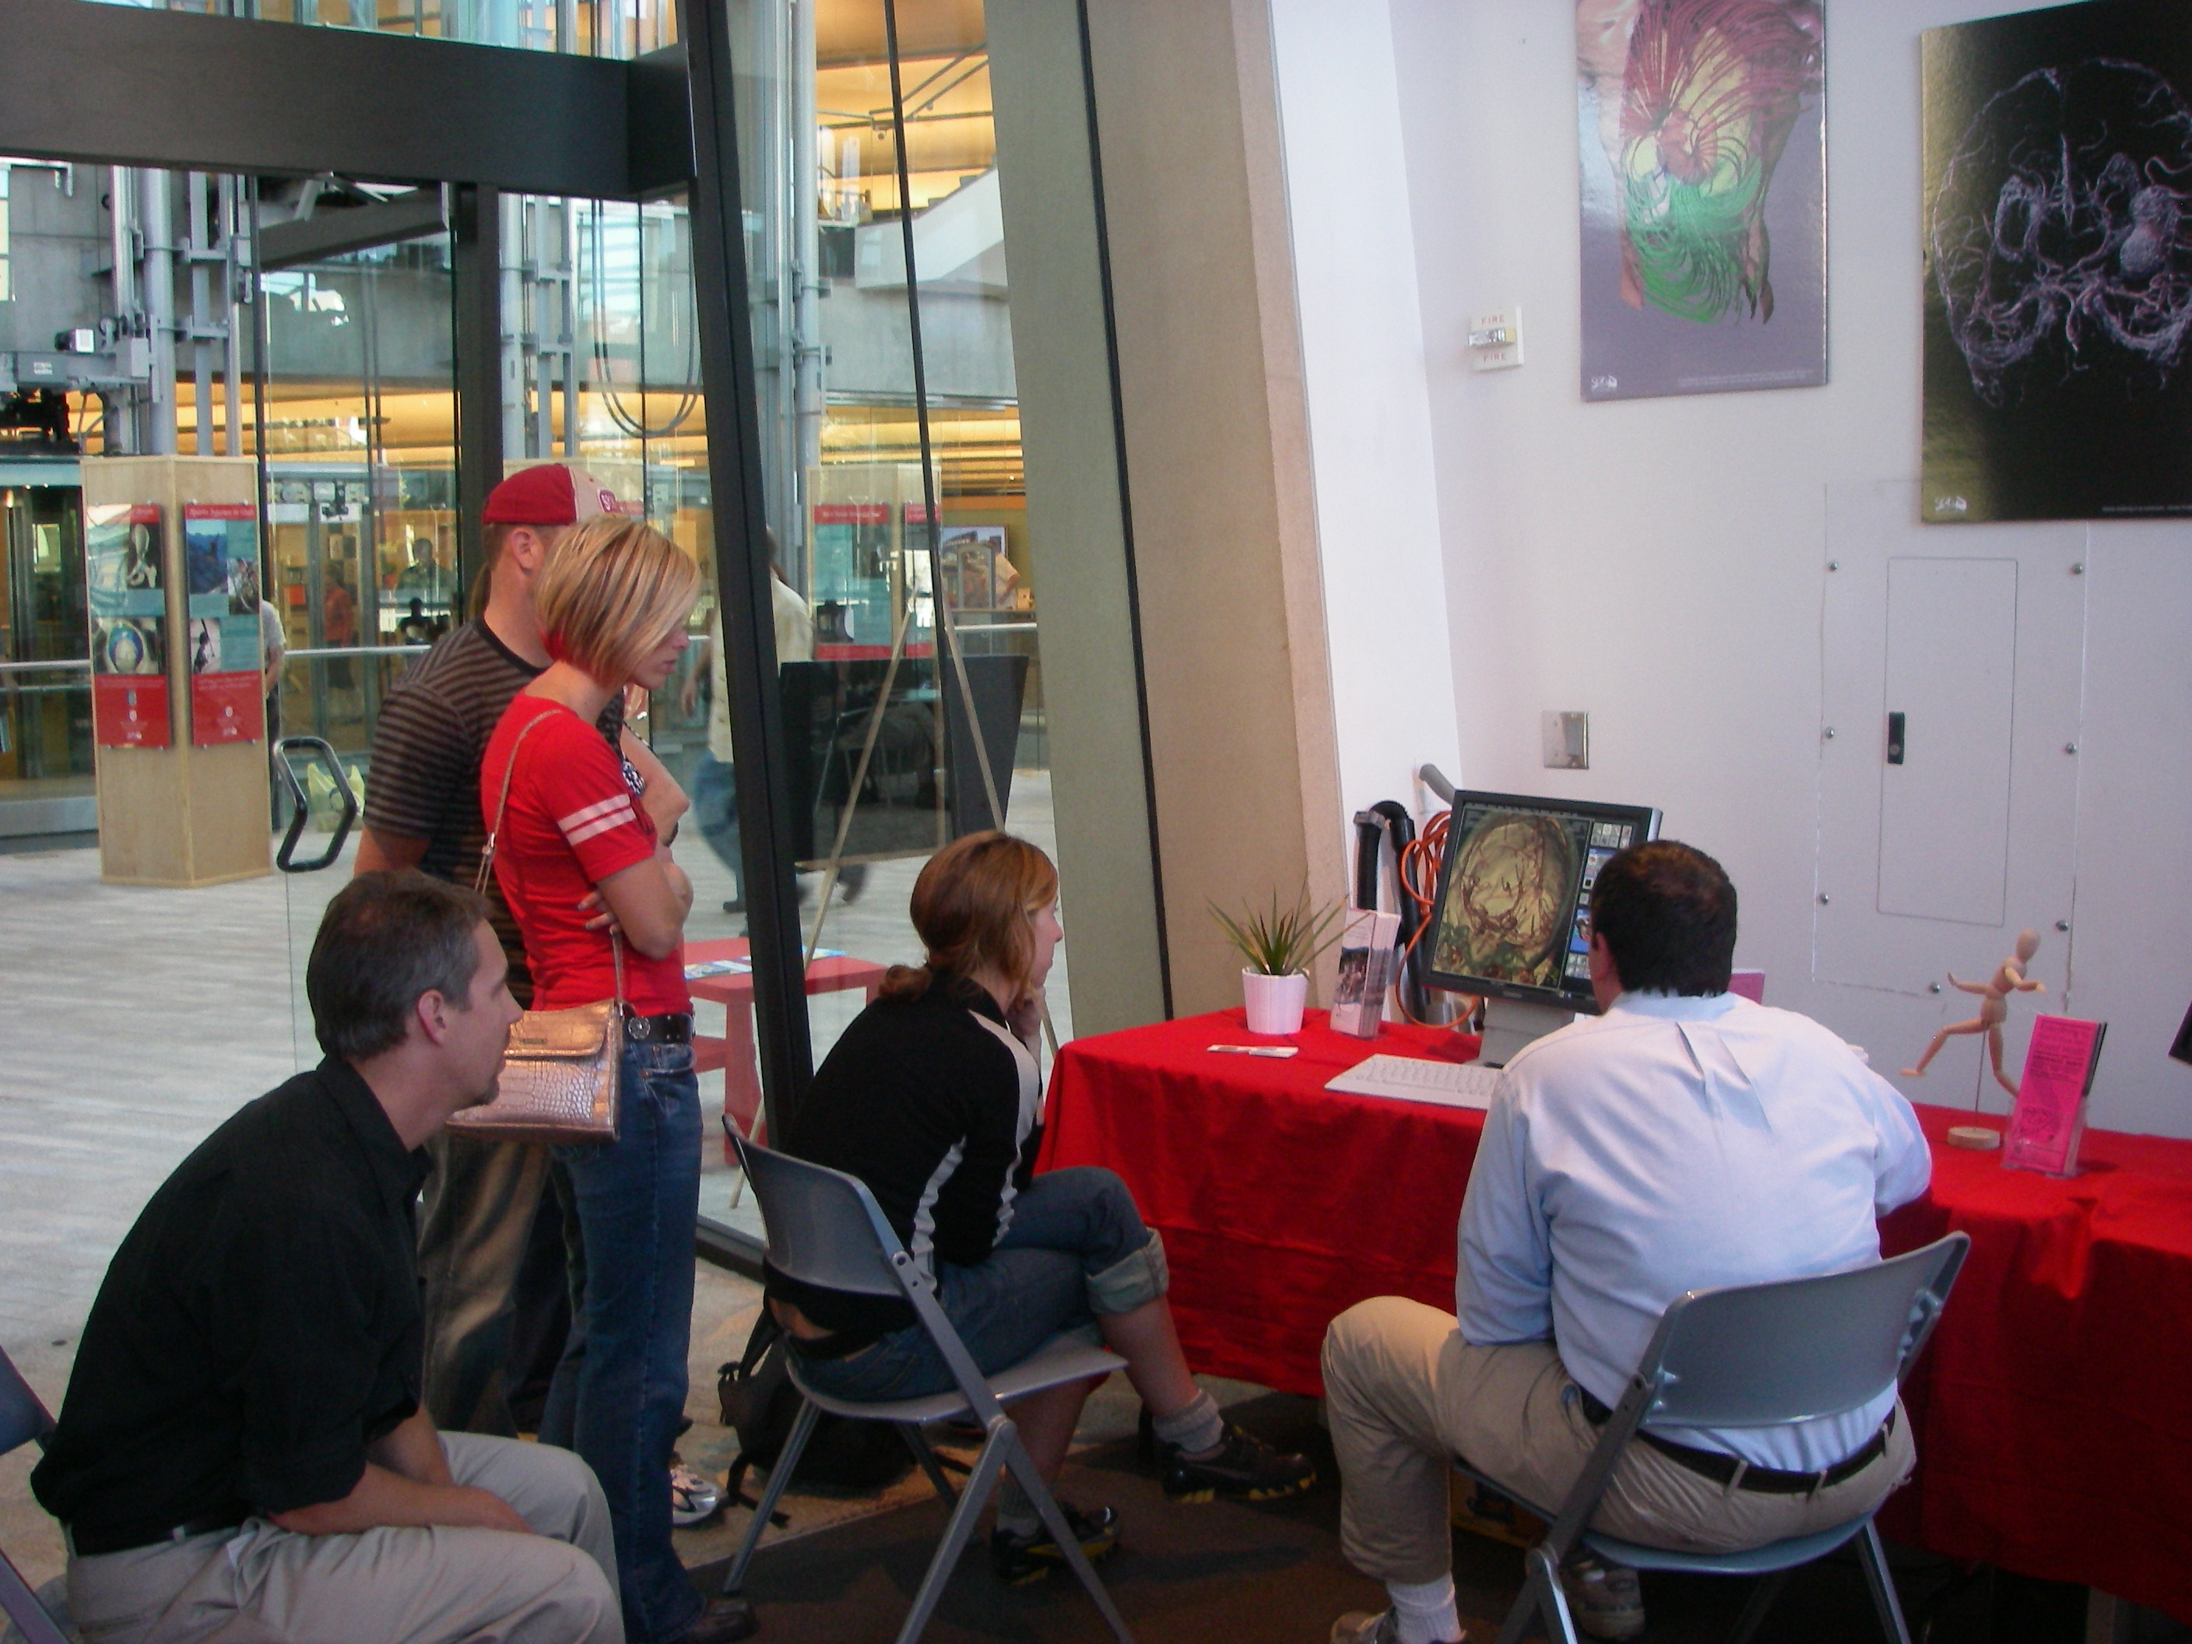
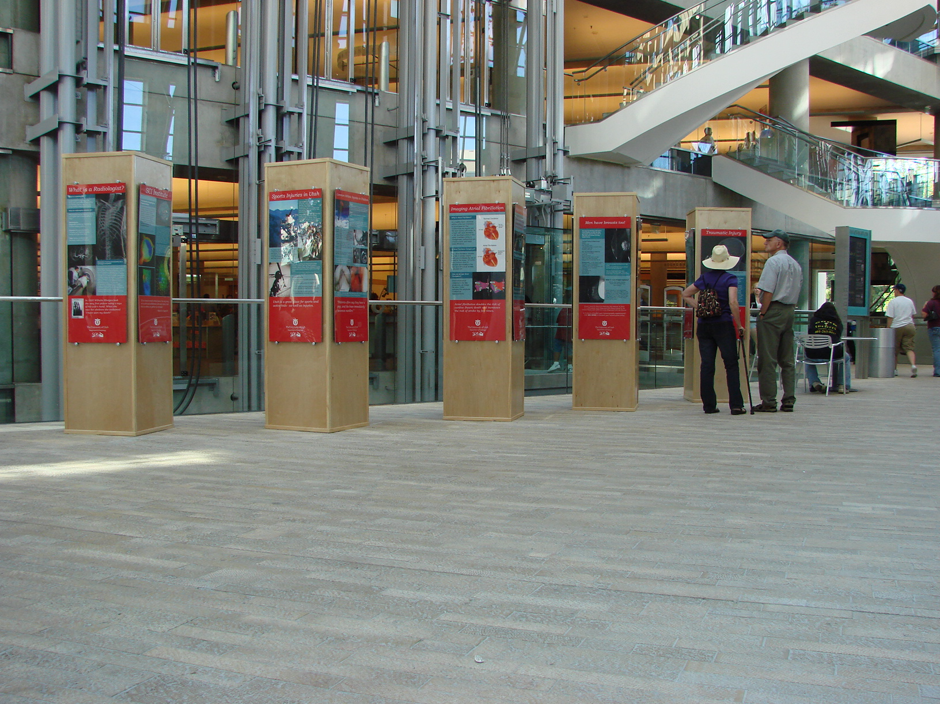
SCI Institute Outreach

Slide 15
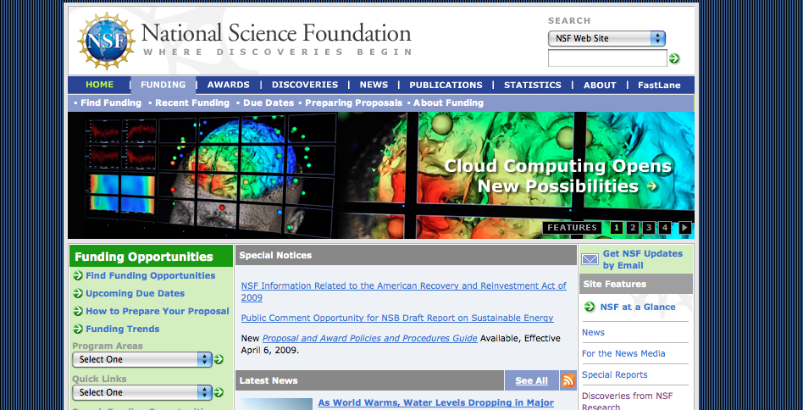
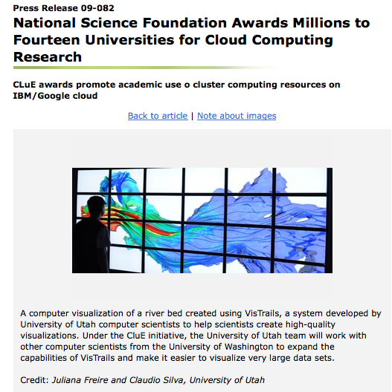
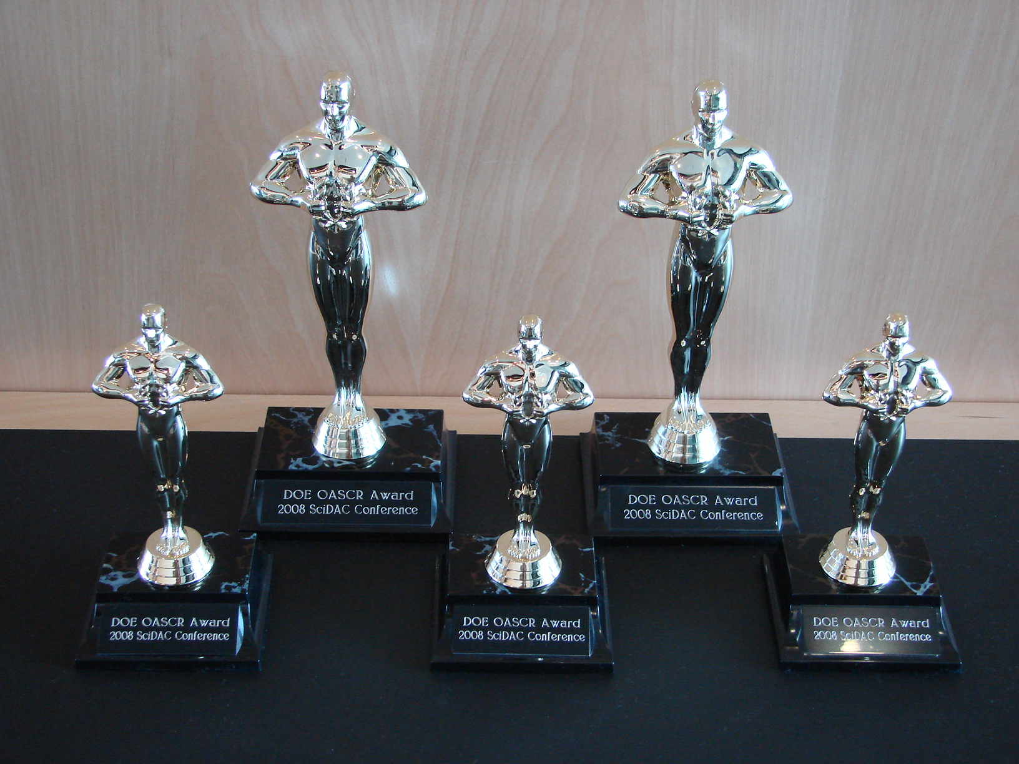
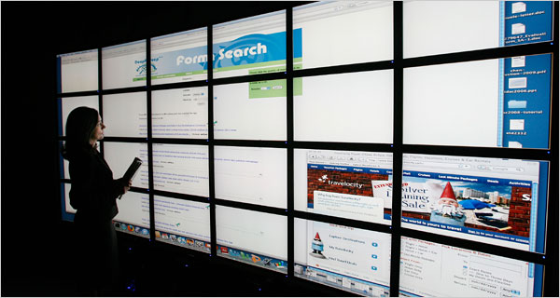
SCI Institute in the News

Slide 16
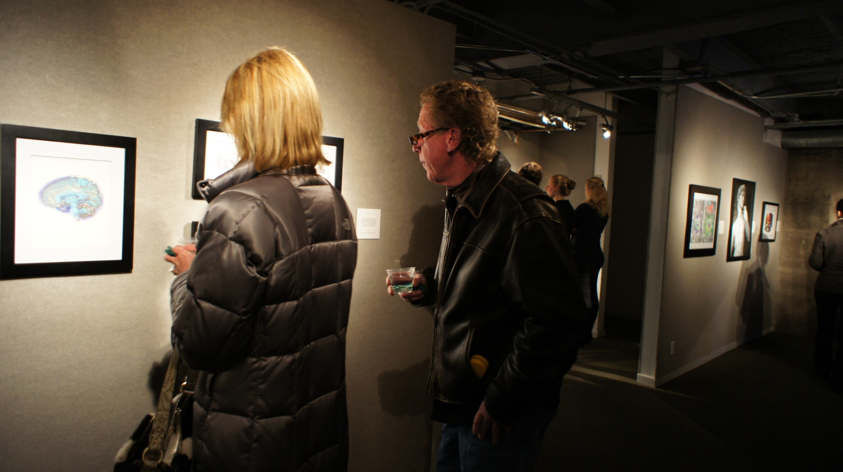
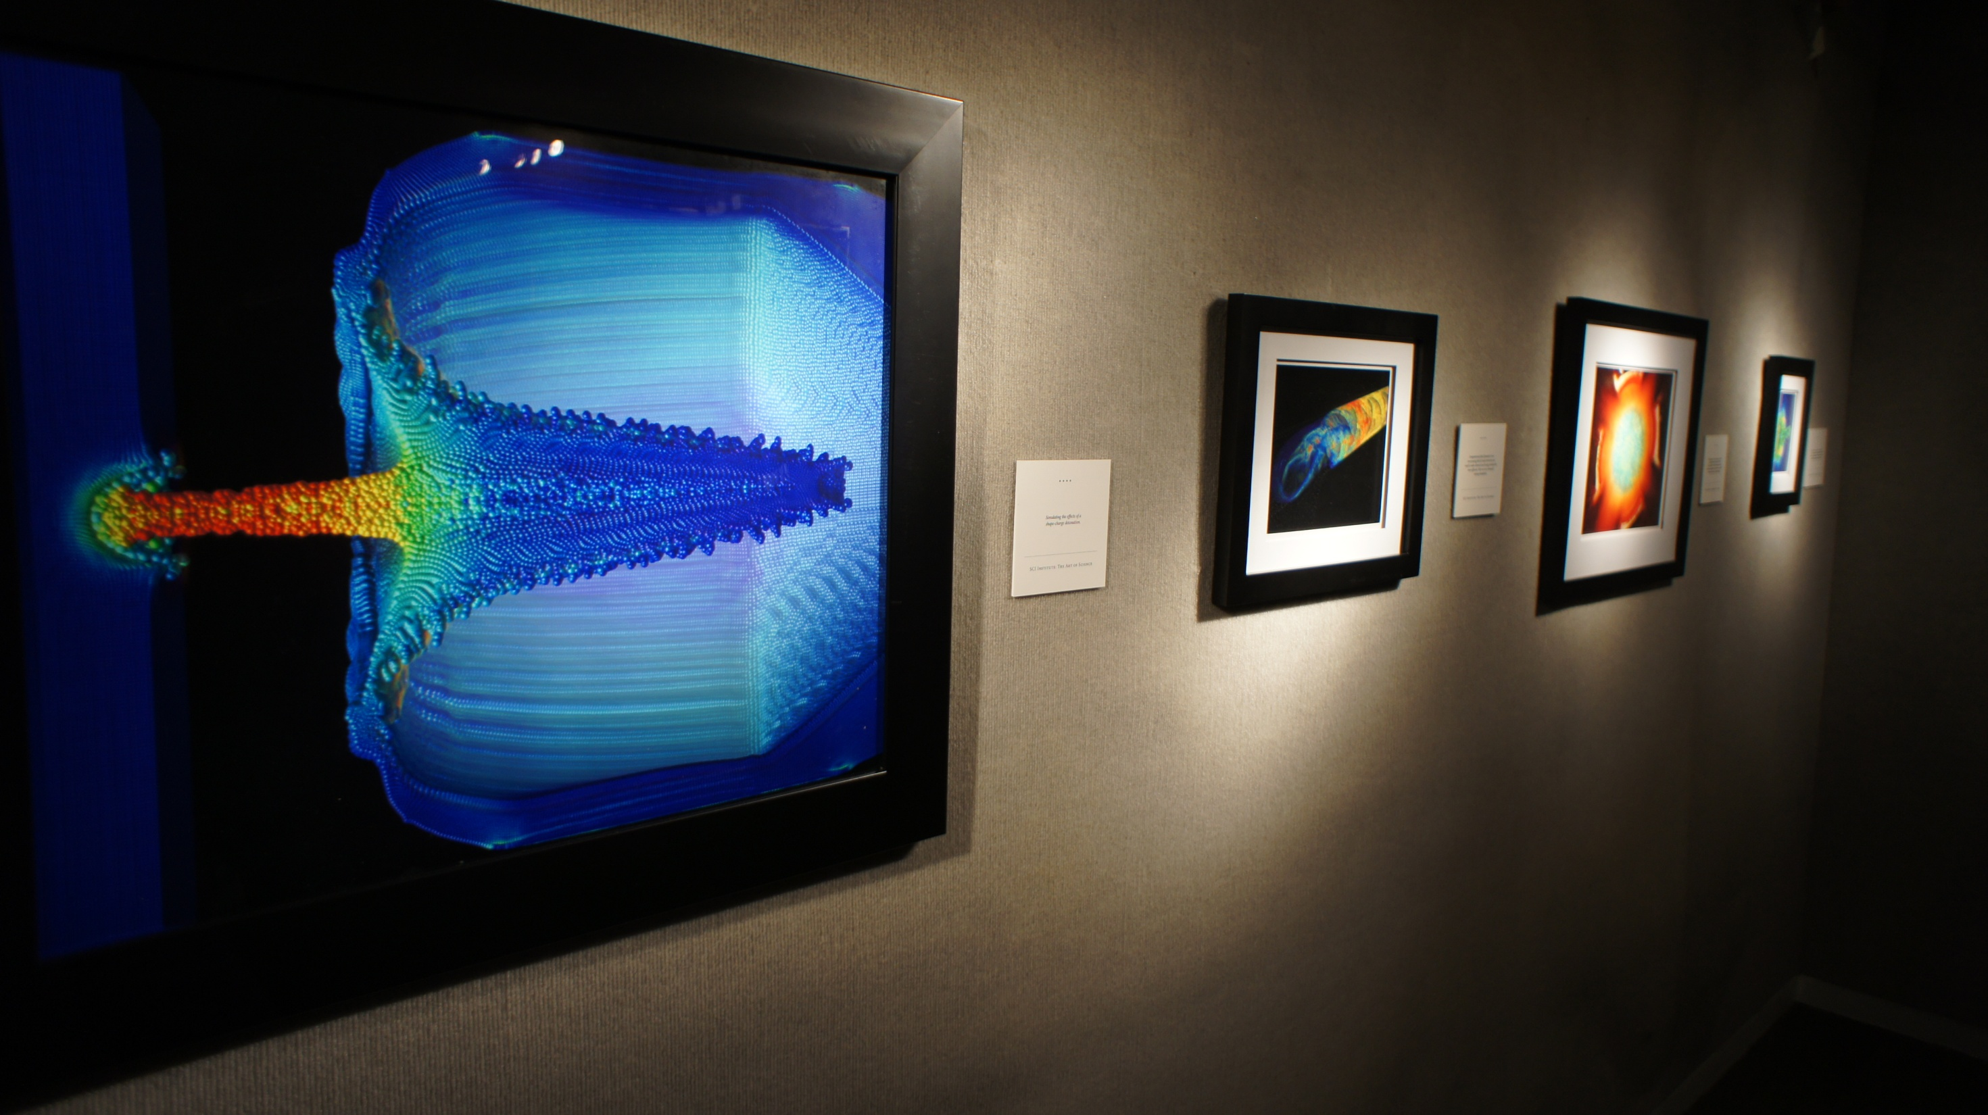
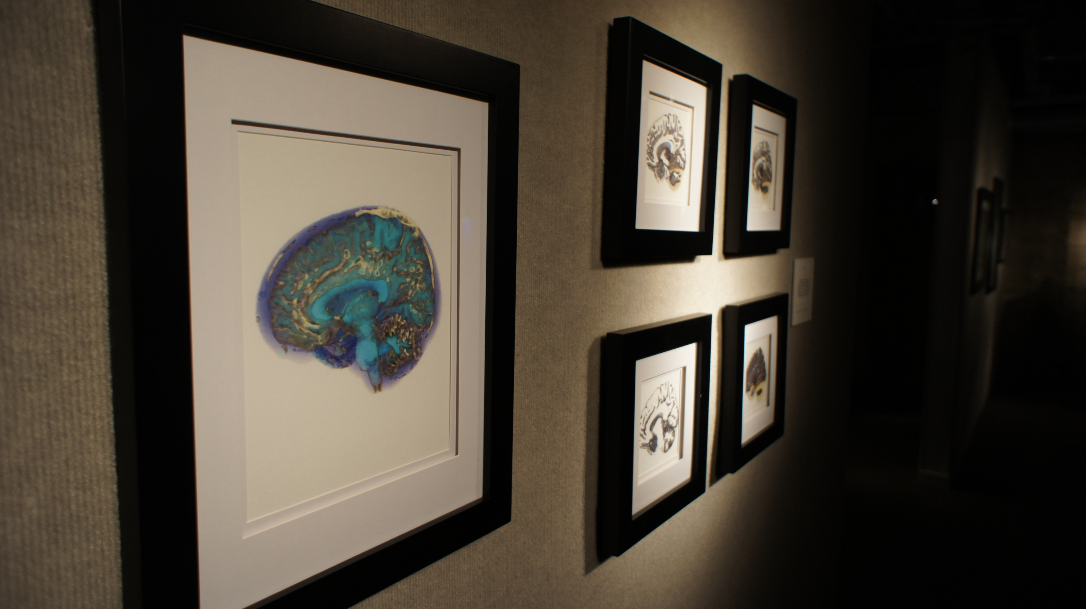
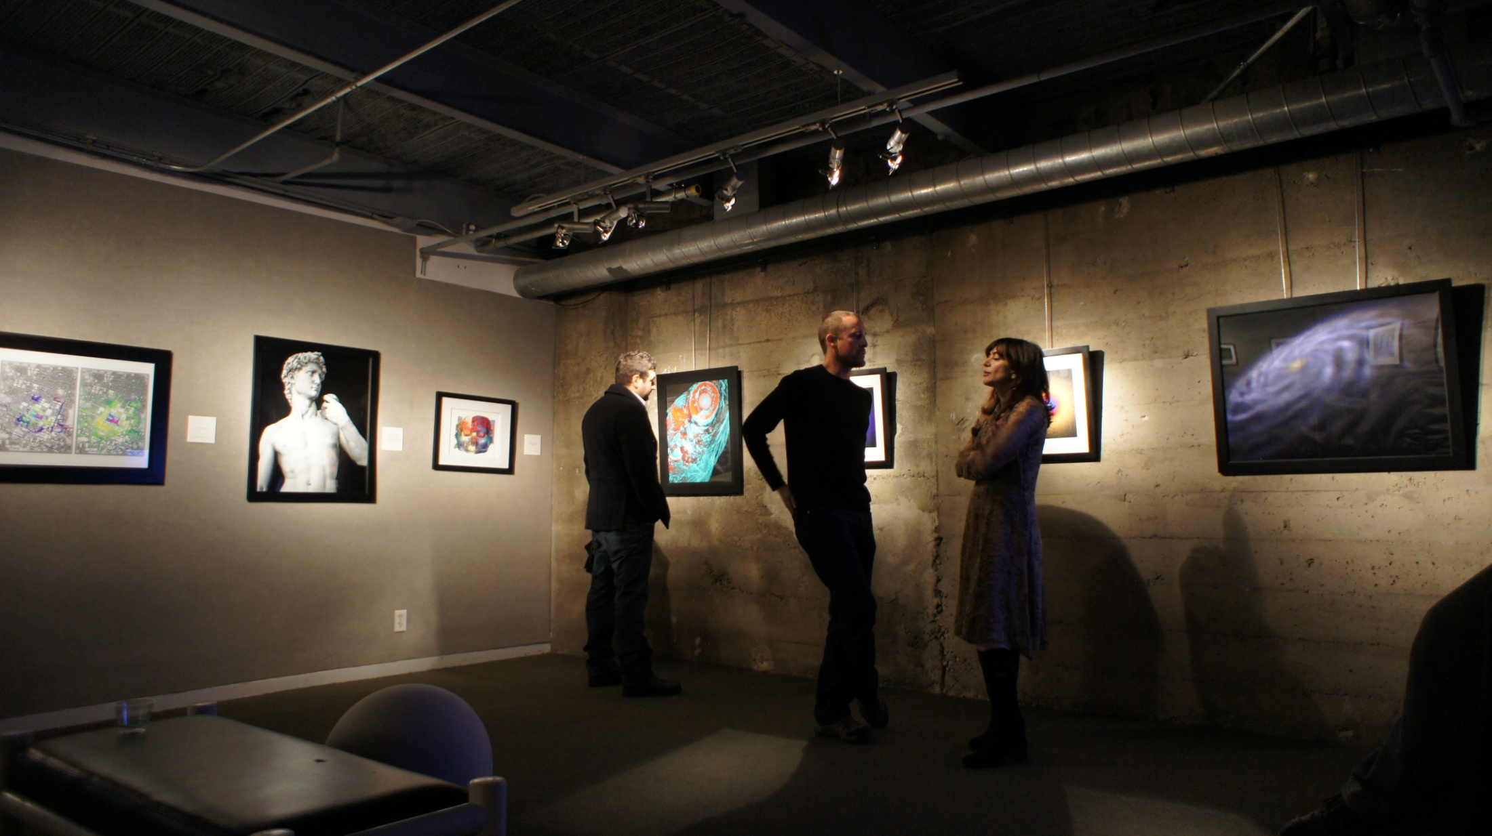
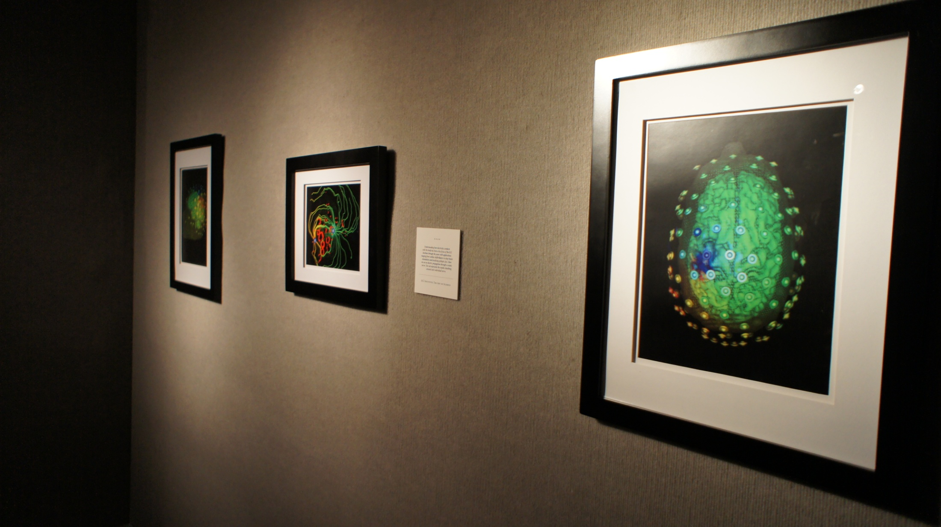
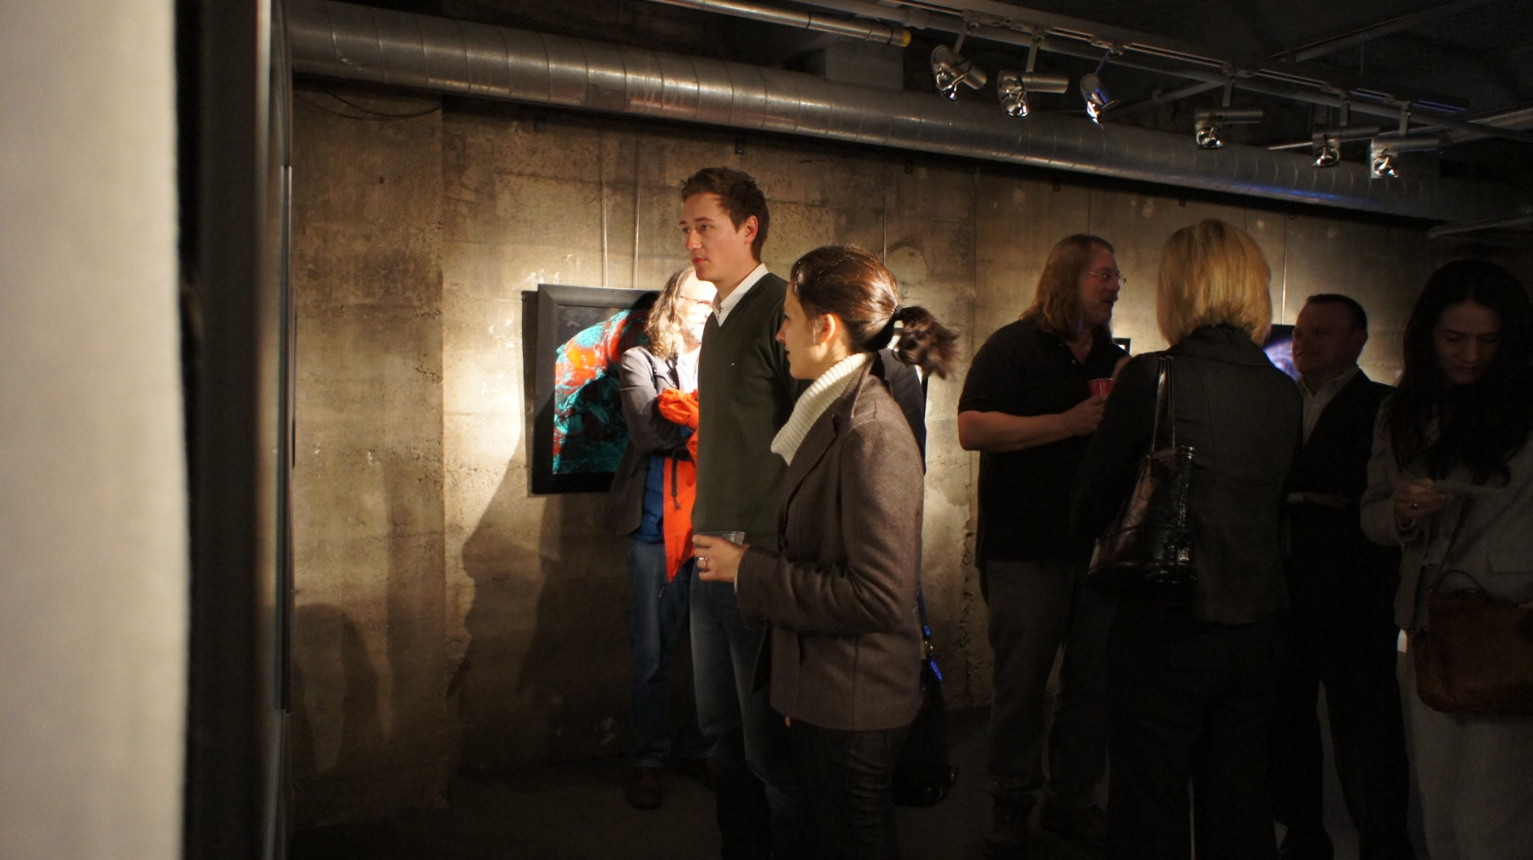
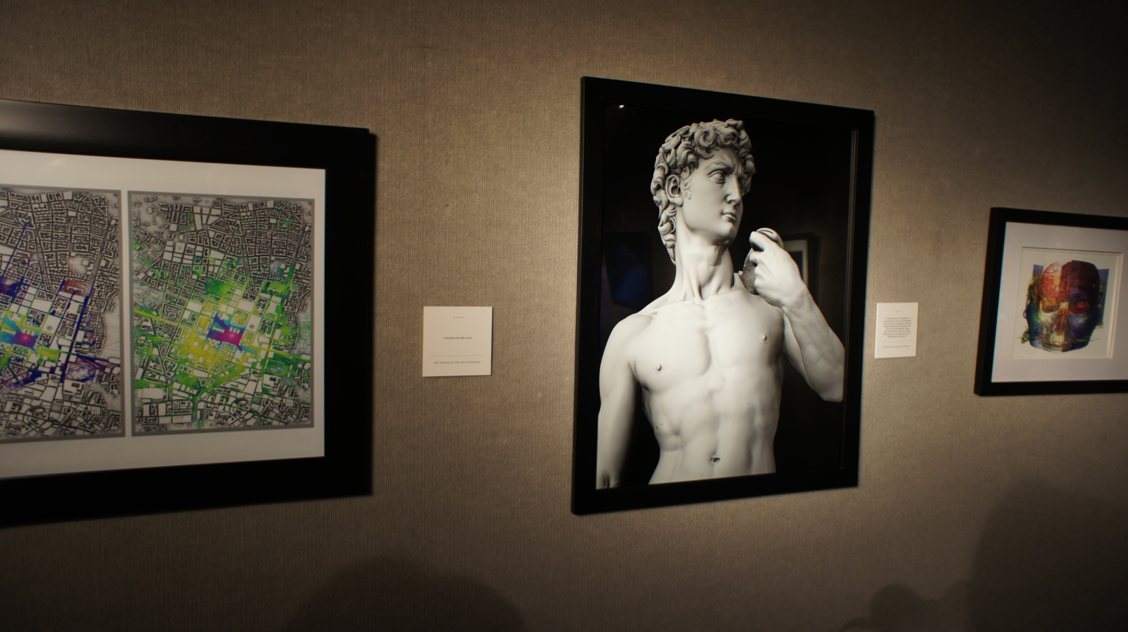
The Art of Science at the Kimball Art Center

Slide 17
SCI Institute Role at the University
“There is no question that the SCI Institute is one of the crown jewels of the University of Utah. All three of the senior leaders feel that way (Ruth, Vivian and me). SCI is important to us because of the multiple national centers with their associated major external funding, because of the national and international recognition it brings to the U, and because of the caliber of the faculty, staff and students it attracts.”
President David W. Pershing

Slide 18
SCI Institute Role at the University (Cont.)
“I am happy to have been able to support it for so many years and certainly expect that to continue. I looked over your agenda for the afternoon and am pleased to see that you are collectively thinking about what you want the institute to be like 5 years from now. Successful interdisciplinary research is very hard work - I know that personally - and you are a shinning example of how strong that can be when it works well.”
President David W. Pershing

Slide 19
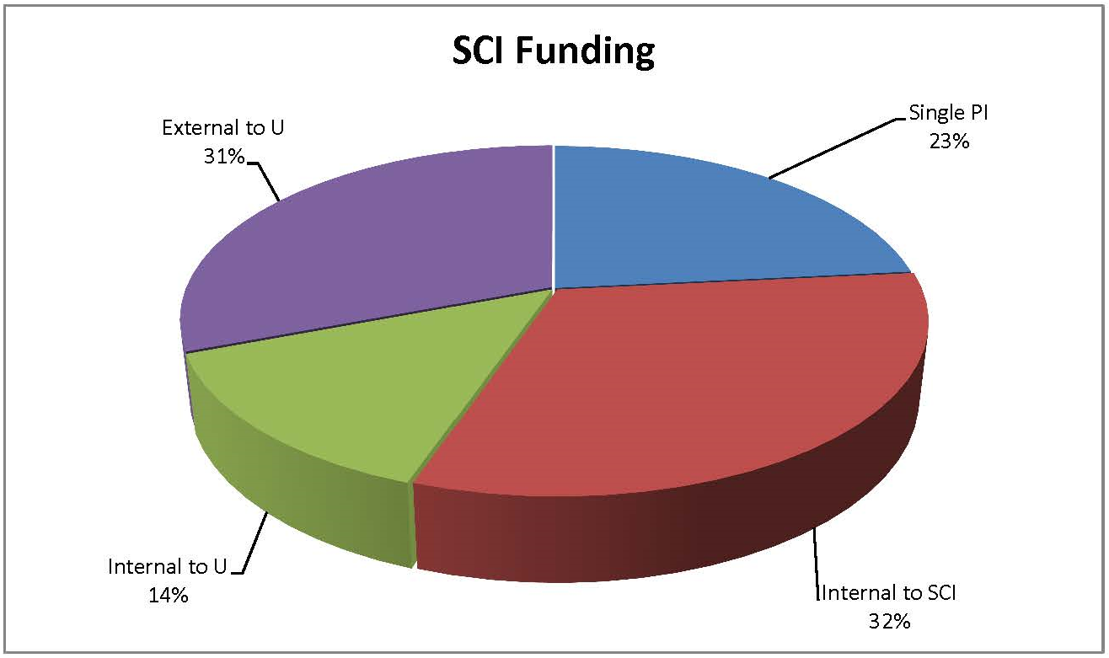
2014 SCI Funding Breakdown

Slide 20
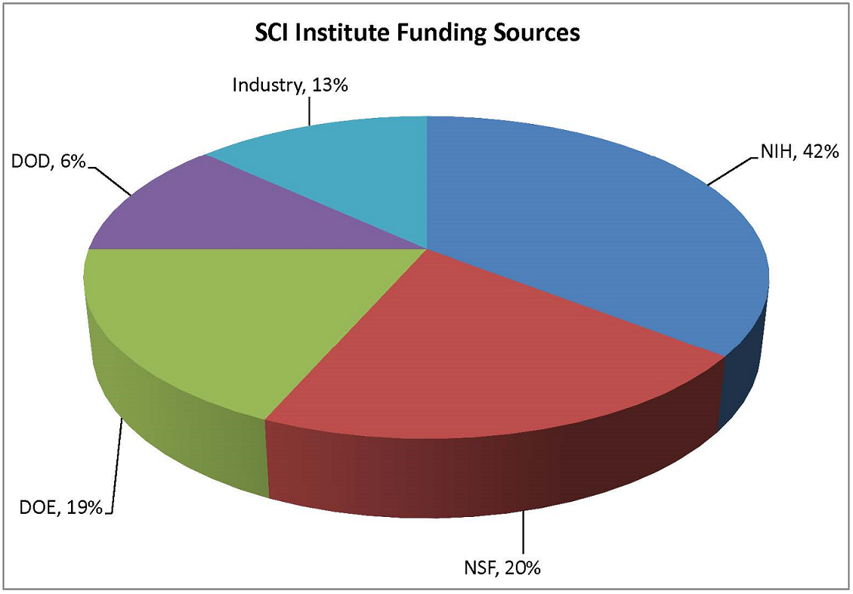
Funding By Agency

Slide 21
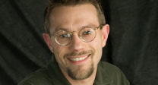
Internal Collaboration: Chris Johnson
Sarang
Dongbin
Valerio
Chris
Chuck
Ross
Mike
Jeff
Martin
Miriah
Tolga
Rob
Guido
Tom
Chris B
Orly

Slide 22
Internal Collaboration: Sarang Joshi
Sarang
Dongbin
Valerio
Chris
Chuck
Ross
Mike
Jeff
Martin
Miriah
Tolga
Rob
Guido
Tom
Chris B
Orly

Slide 23
Internal Collaboration: Dongbin Xiu
Sarang
Dongbin
Valerio
Chris
Chuck
Ross
Mike
Jeff
Martin
Miriah
Tolga
Rob
Guido
Tom
Chris B
Orly

Slide 24
Internal Collaboration: Valerio Pascucci
Sarang
Dongbin
Valerio
Chris
Chuck
Ross
Mike
Jeff
Martin
Miriah
Tolga
Rob
Guido
Tom
Chris B
Orly

Slide 25
Internal Collaboration: Chuck Hansen
Sarang
Dongbin
Valerio
Chris
Chuck
Ross
Mike
Jeff
Martin
Miriah
Tolga
Rob
Guido
Tom
Chris B
Orly

Slide 26
Internal Collaboration: Mike Kirby
Sarang
Dongbin
Valerio
Chris
Chuck
Ross
Mike
Jeff
Martin
Miriah
Tolga
Rob
Guido
Tom
Chris B
Orly

Slide 27
Internal Collaboration: Martin Berzins
Sarang
Dongbin
Valerio
Chris
Chuck
Ross
Mike
Jeff
Martin
Miriah
Tolga
Rob
Guido
Tom
Chris B
Orly

Slide 28
Internal Collaboration: Tolga Tasdizen
Sarang
Dongbin
Valerio
Chris
Chuck
Ross
Mike
Jeff
Martin
Miriah
Tolga
Rob
Guido
Tom
Chris B
Orly

Slide 29
Internal Collaboration: Guido Gerig
Sarang
Dongbin
Valerio
Chris
Chuck
Ross
Mike
Jeff
Martin
Miriah
Tolga
Rob
Guido
Tom
Chris B
Orly

Slide 30
Internal Collaboration: Orly Alter
Sarang
Dongbin
Valerio
Chris
Chuck
Ross
Mike
Jeff
Martin
Miriah
Tolga
Rob
Guido
Tom
Chris B
Orly

Slide 31
Internal Collaboration: Chris Butson
Sarang
Dongbin
Valerio
Chris
Chuck
Ross
Mike
Jeff
Martin
Miriah
Tolga
Rob
Guido
Tom
Chris B
Orly

Slide 32
Internal Collaboration: Tom Fletcher
Sarang
Dongbin
Valerio
Chris
Chuck
Ross
Mike
Jeff
Martin
Miriah
Tolga
Rob
Guido
Tom
Chris B
Orly

Slide 33
Internal Collaboration: Rob MacLeod
Sarang
Dongbin
Valerio
Chris
Chuck
Ross
Mike
Jeff
Martin
Miriah
Tolga
Rob
Guido
Tom
Chris B
Orly

Slide 34
Internal Collaboration: Miriah Meyer
Sarang
Dongbin
Valerio
Chris
Chuck
Ross
Mike
Jeff
Martin
Miriah
Tolga
Rob
Guido
Tom
Chris B
Orly

Slide 35
Internal Collaboration: Jeff Weiss
Sarang
Dongbin
Valerio
Chris
Chuck
Ross
Mike
Jeff
Martin
Miriah
Tolga
Rob
Guido
Tom
Chris B
Orly

Slide 36
Internal Collaboration: Ross Whitaker
Sarang
Dongbin
Valerio
Chris
Chuck
Ross
Mike
Jeff
Martin
Miriah
Tolga
Rob
Guido
Tom
Chris B
Orly

Slide 37
External Collaboration
KAUST
Sandia
TAMU
UCSF
LLNL
UT Austin
UCLA
Sarang
Valerio
Kaiserslautern
TAMU
Chris
Chuck
MIT
NEU
Ross
Mike
Imperial College
London
Jeff
Martin
Cleveland
Clinic
Claudio
Tolga
U of A
Harvard
Rob
Guido
Pitt.
Iowa
Inria
Tom
Juliana
Northwestern
B & W
Hospital
UNC
U Wash.
CMOP
DataOne
ALPS
LSU
VACET
Kitware
LLNL
crowdLabs
NBCR
NITRC
OHSU
VisTrails.org

