Slide 1
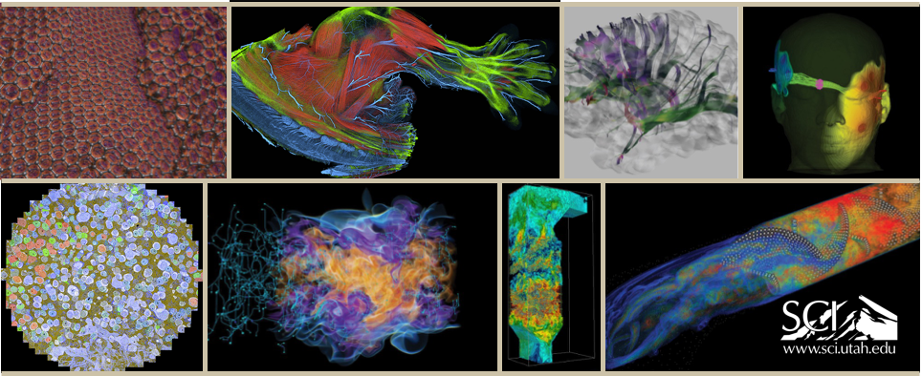
Intel Visualization Center at the University of Utah

Slide 2
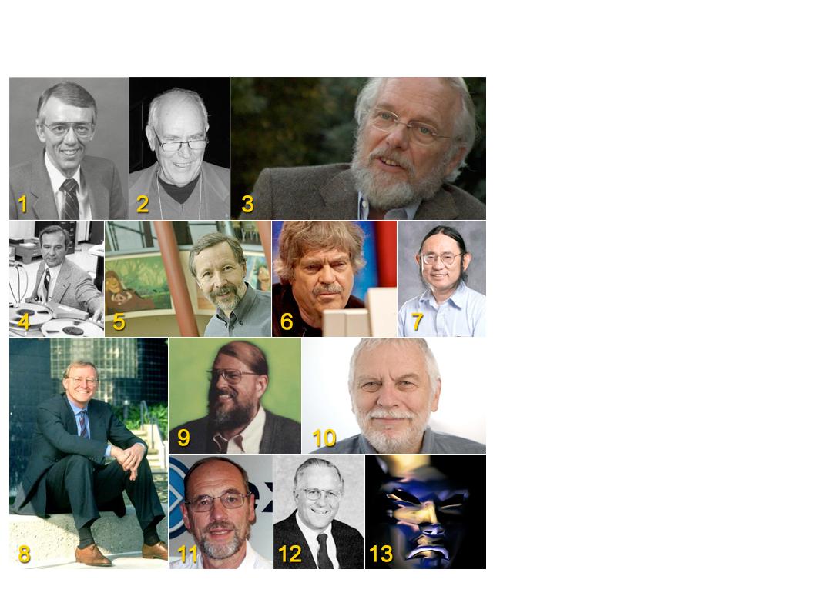
History of Computer Graphics in Utah

Slide 3
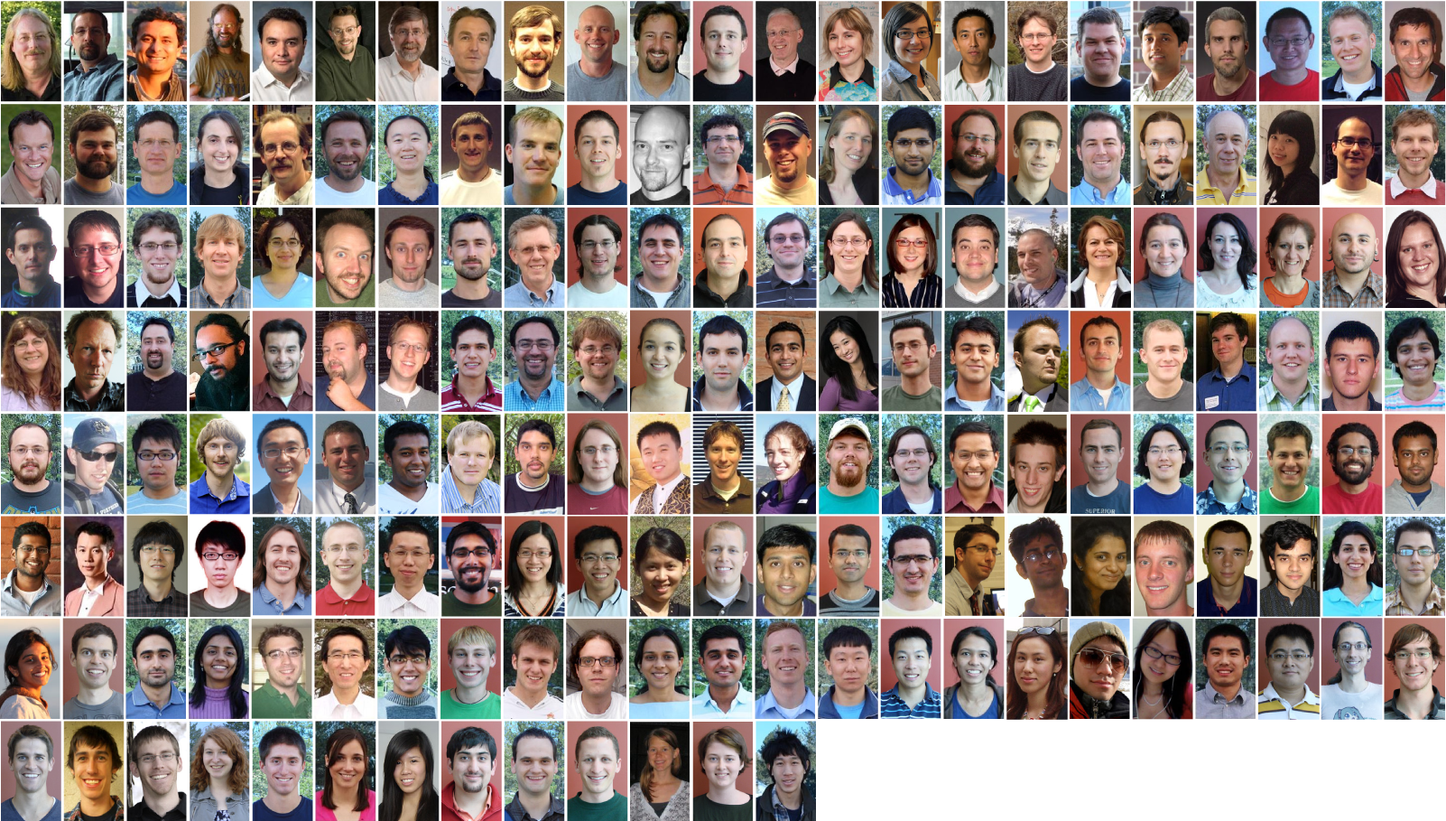
The SCI Institute

Slide 4
SCI Institute Faculty

Slide 5
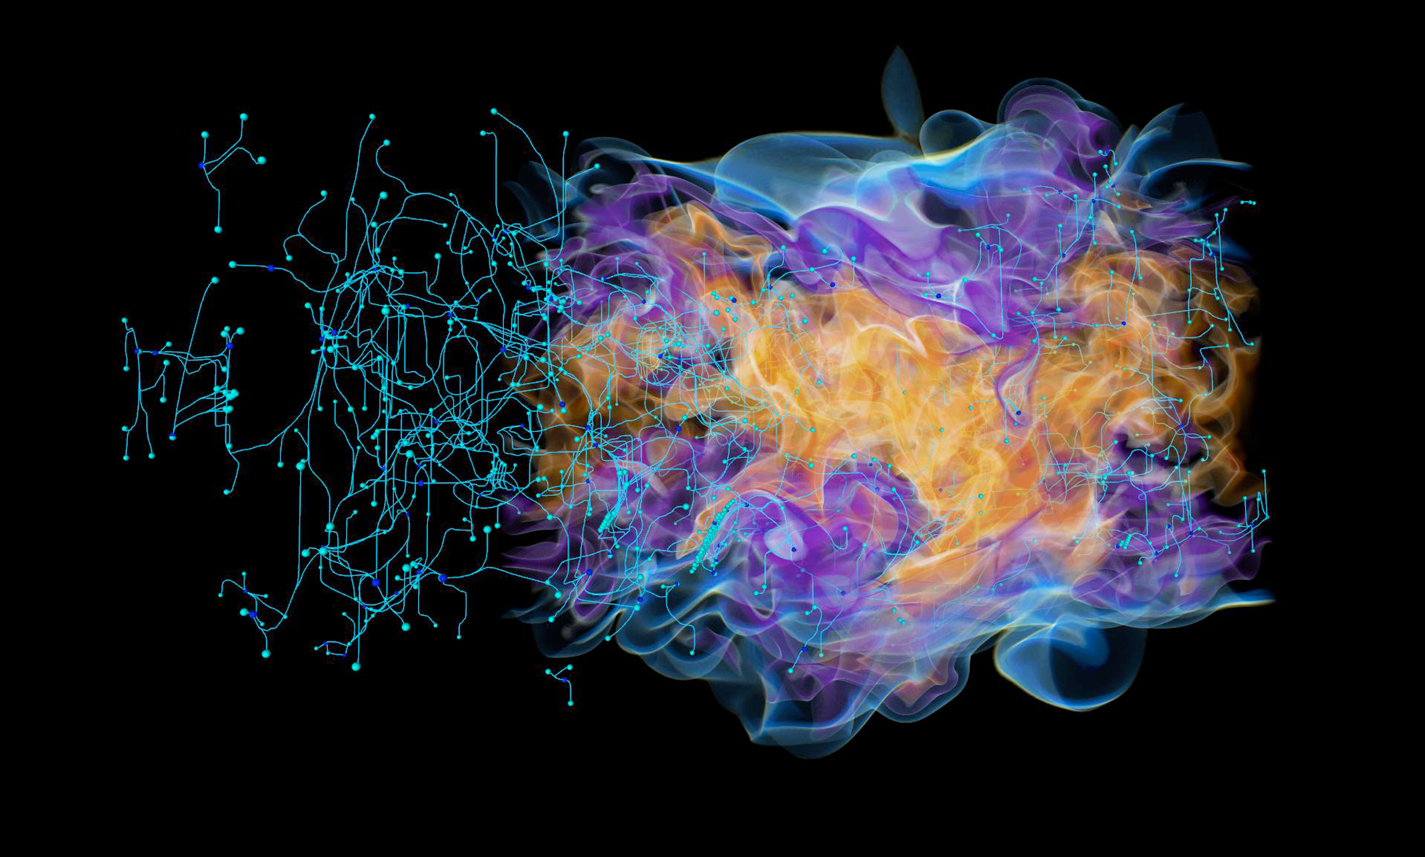
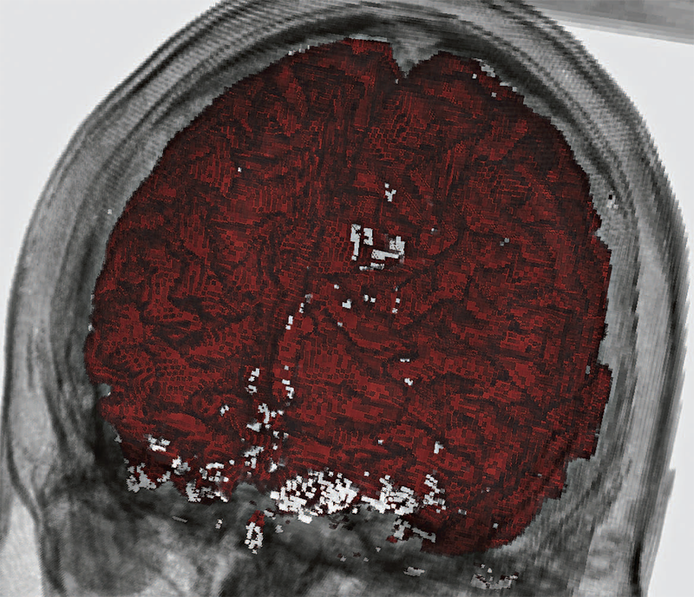
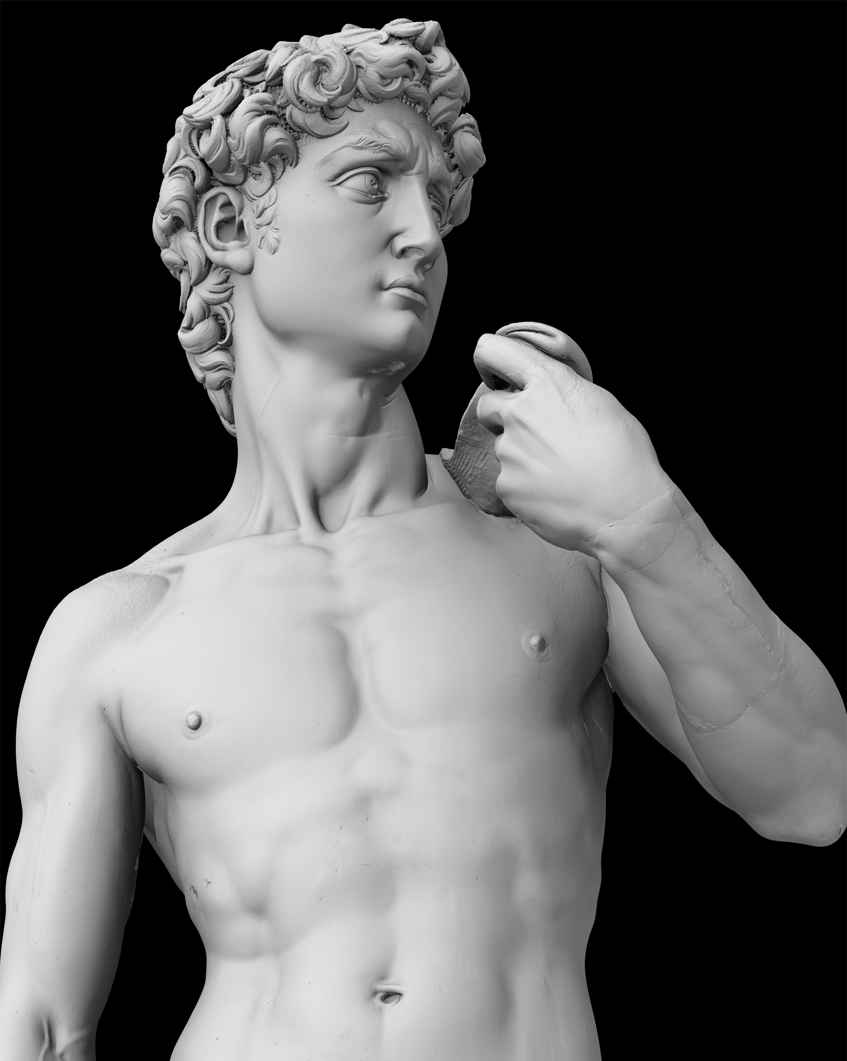
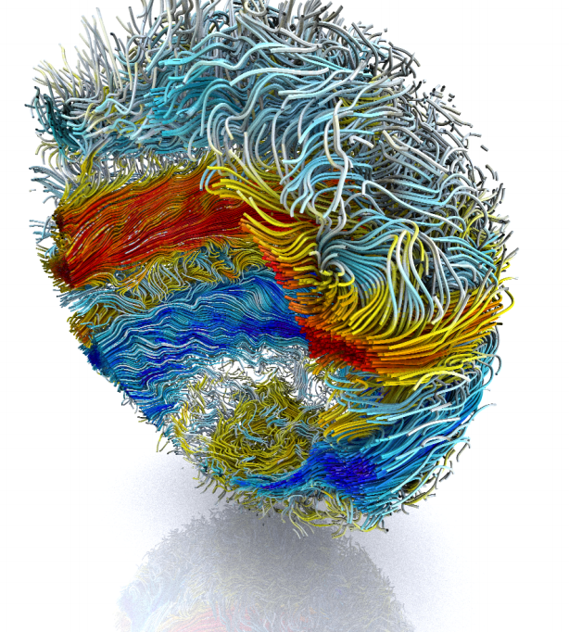
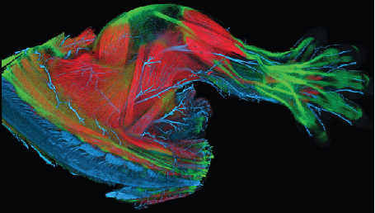
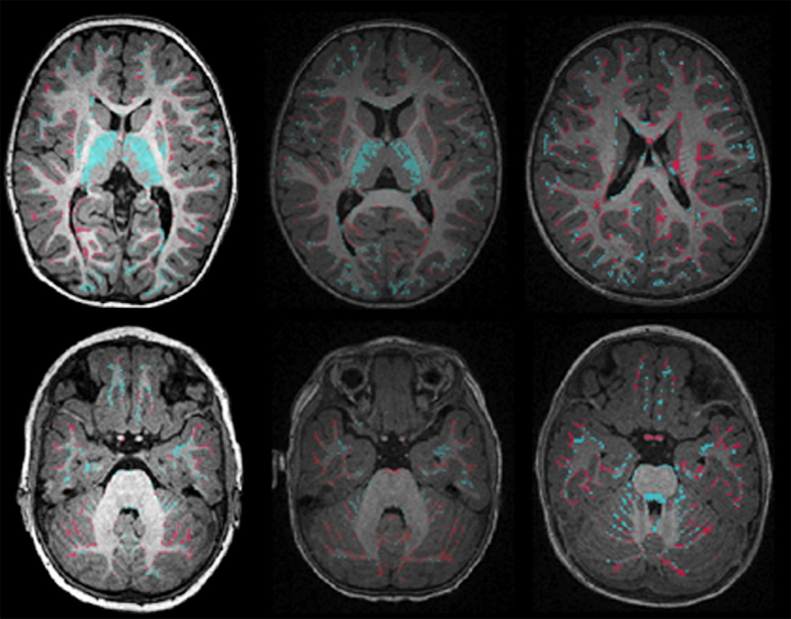
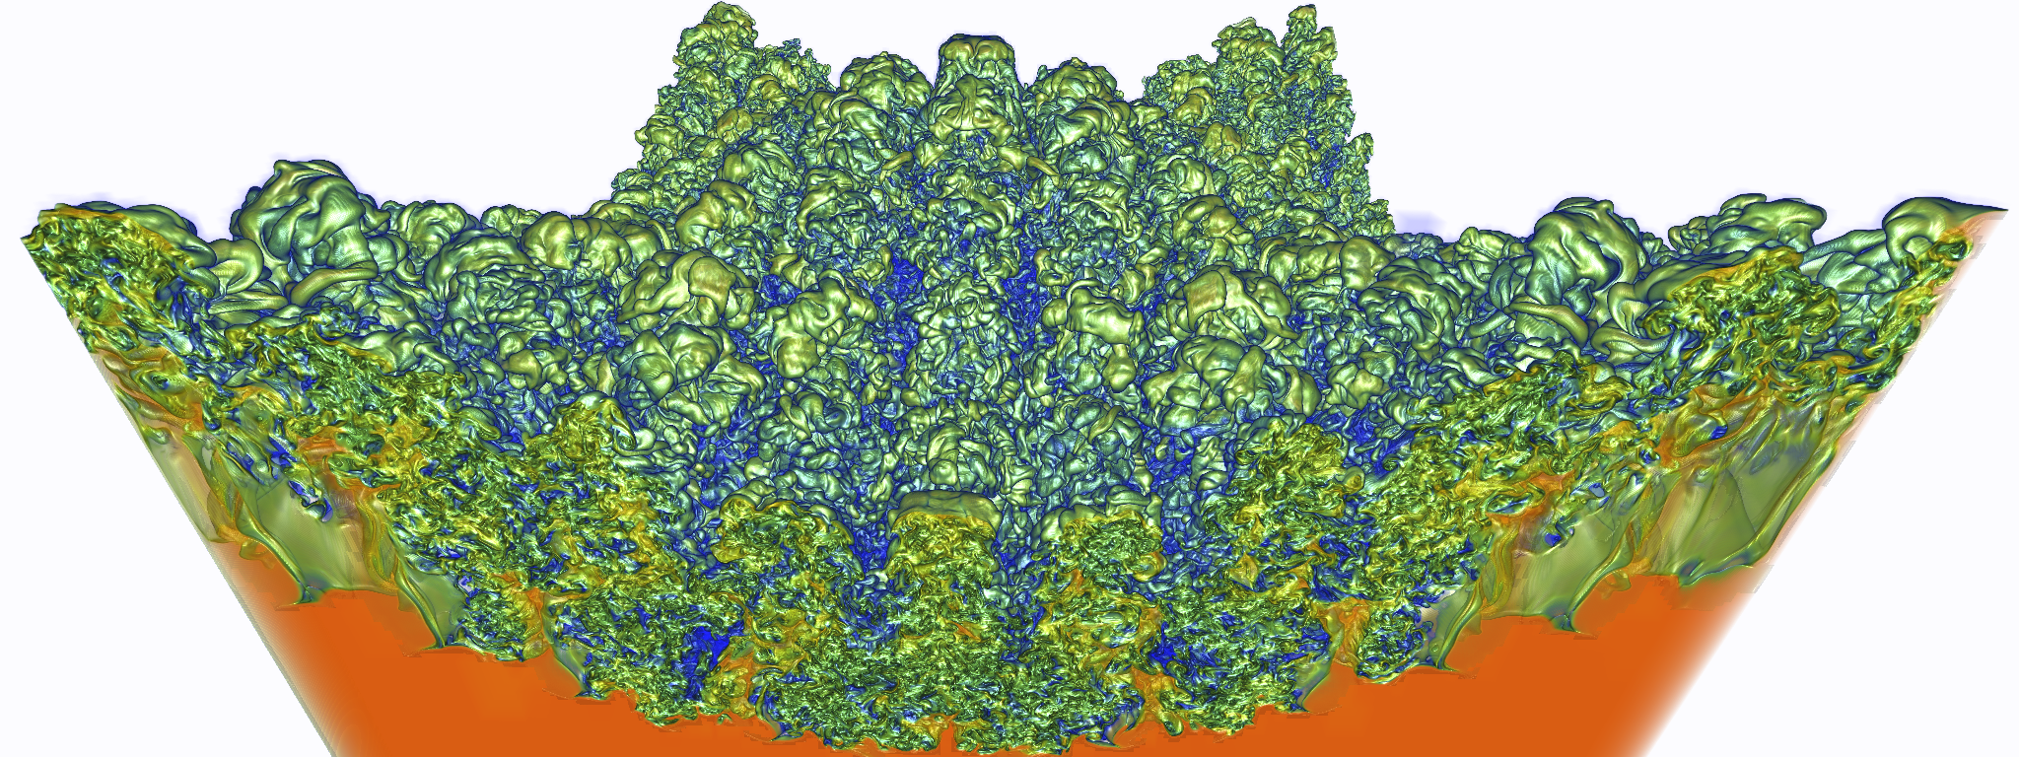
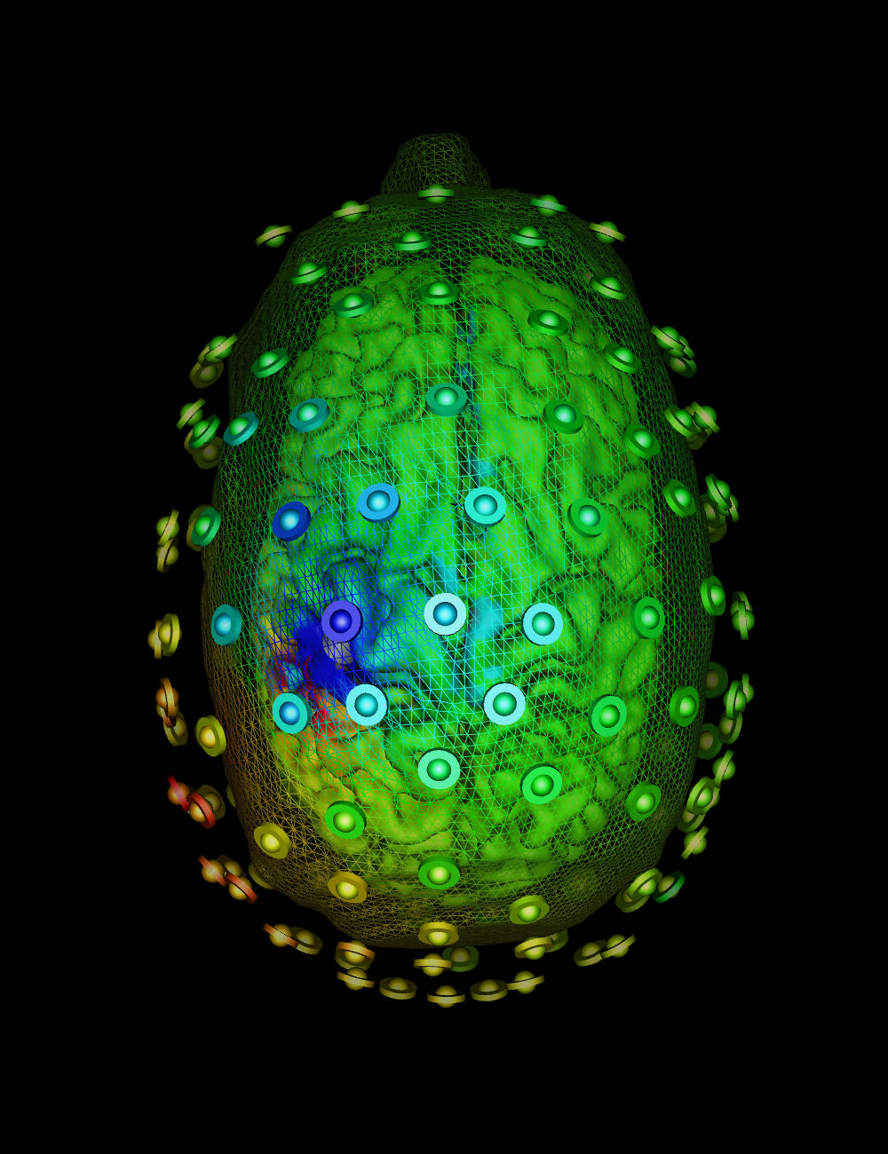
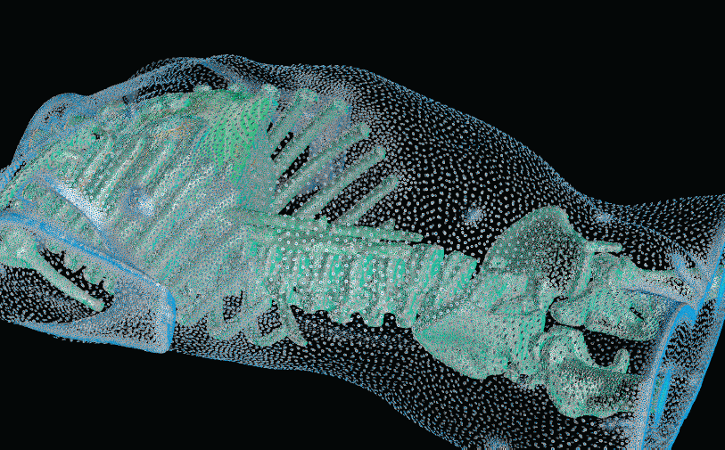
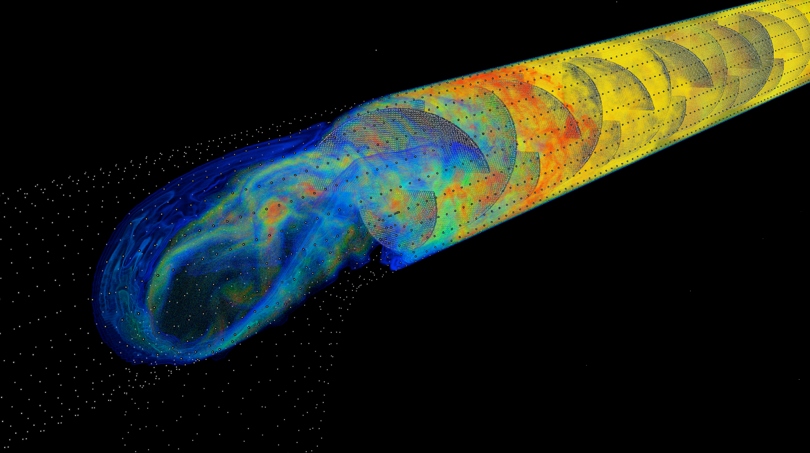
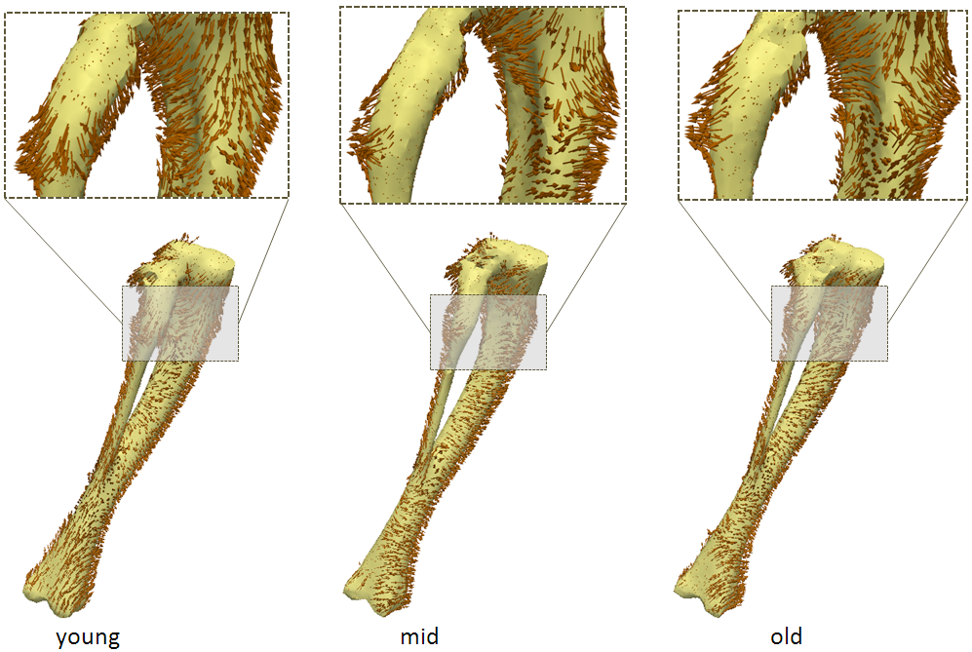
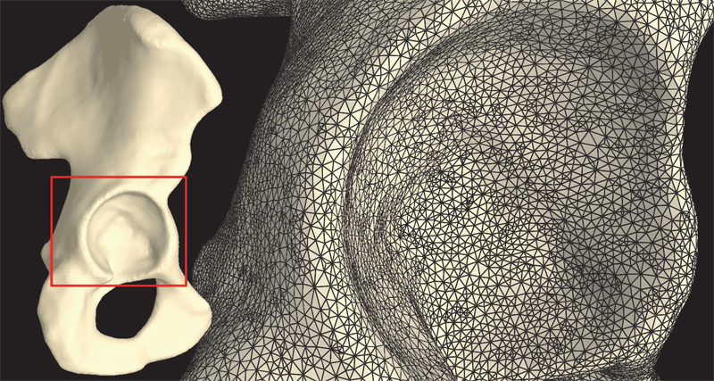
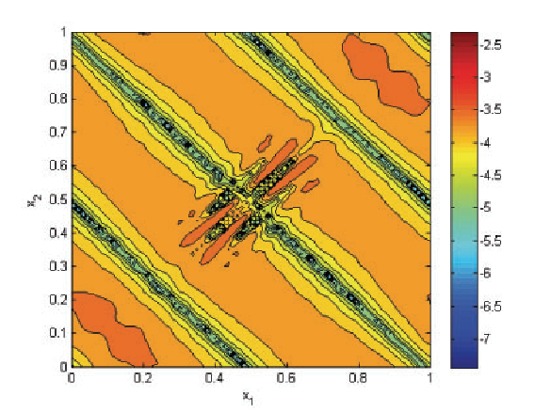
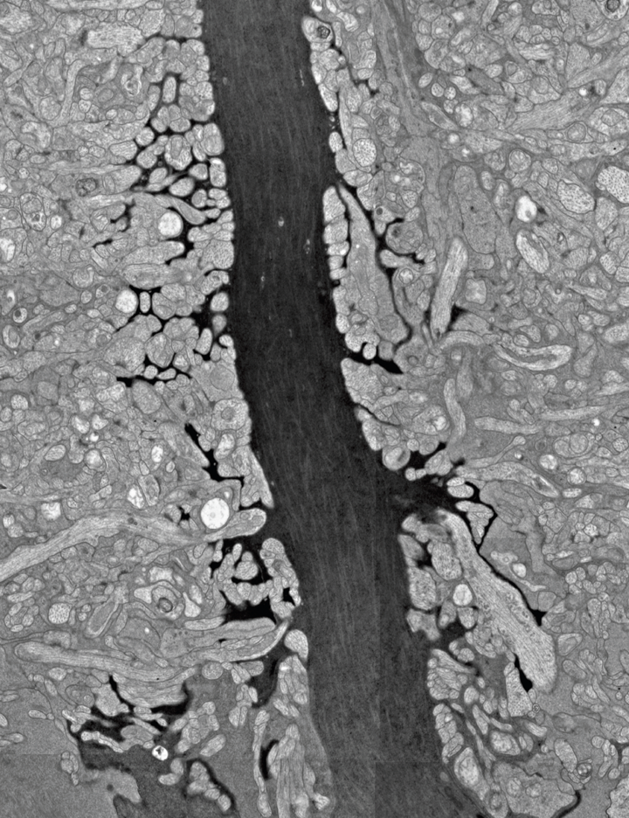
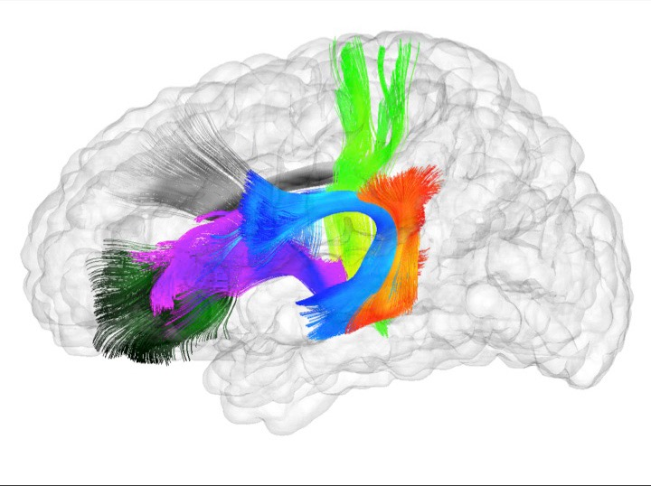
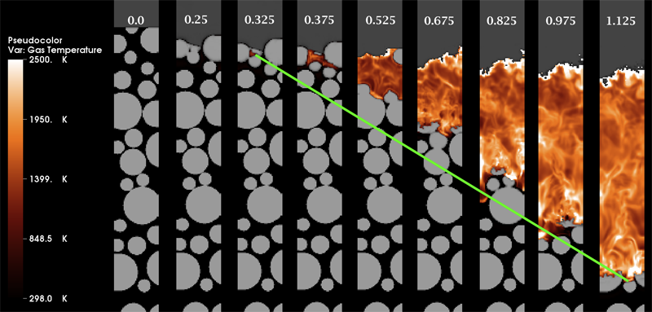
Research Cores
Visualization
Scientific Data
Management
Computing
Image
Analysis

Slide 6
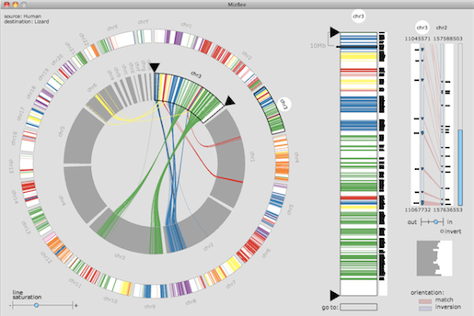
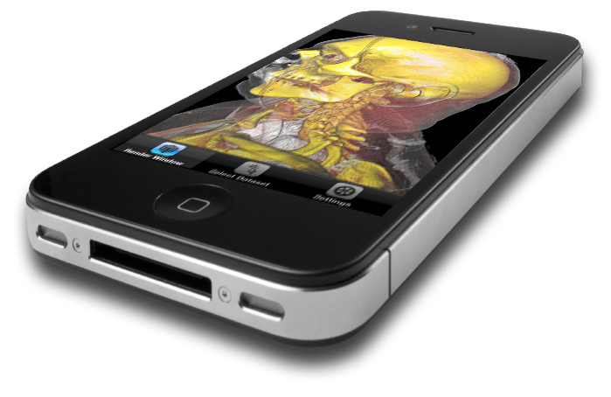
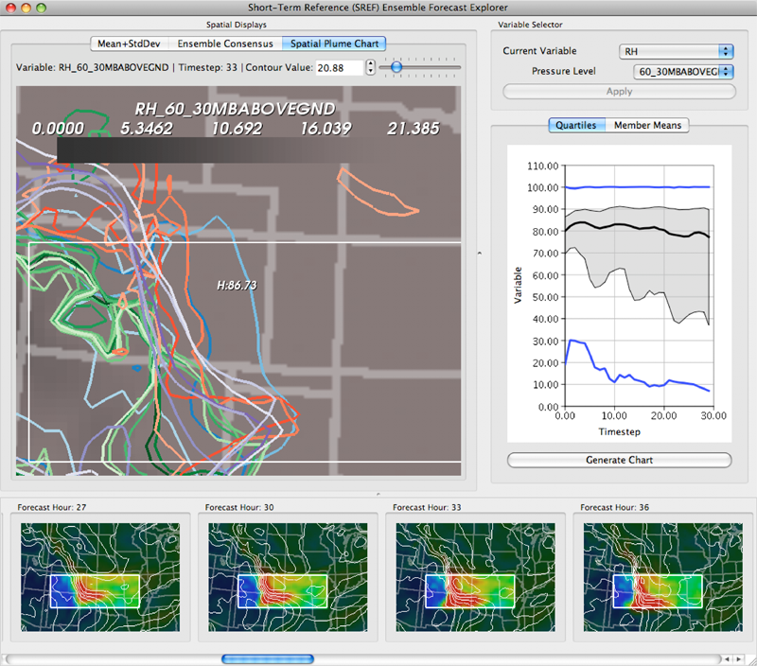
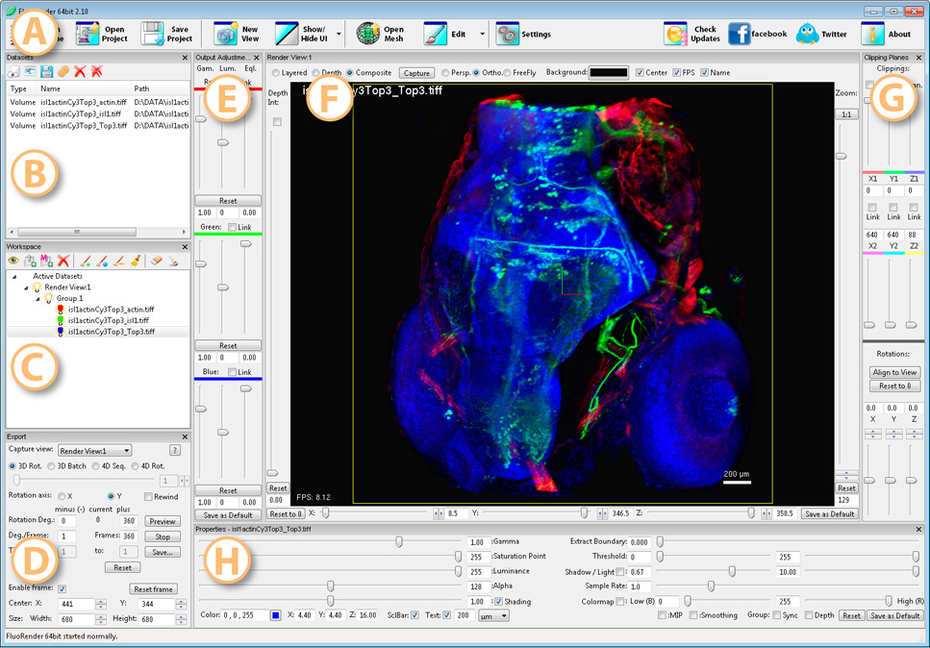
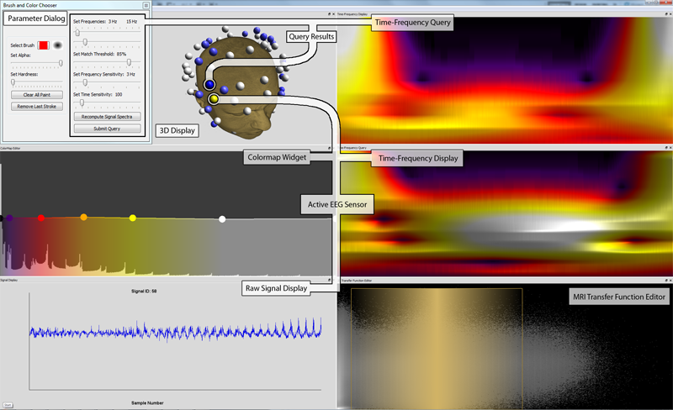
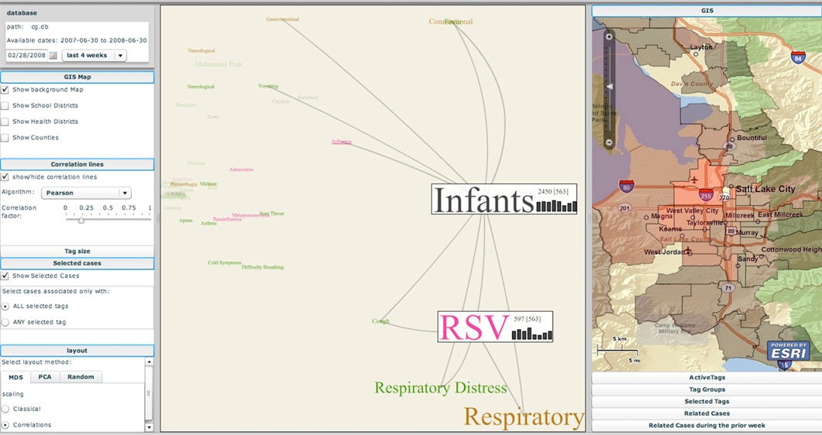
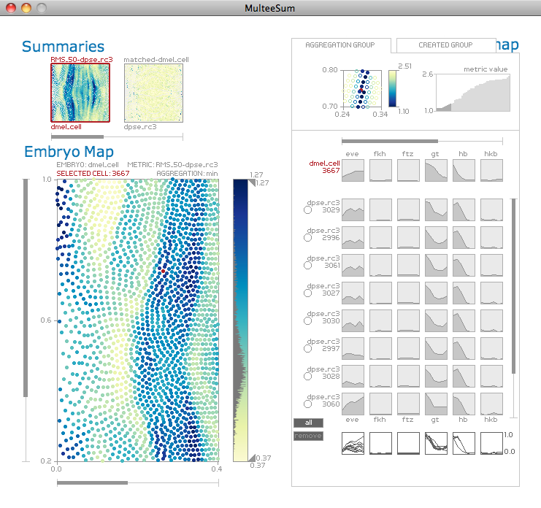
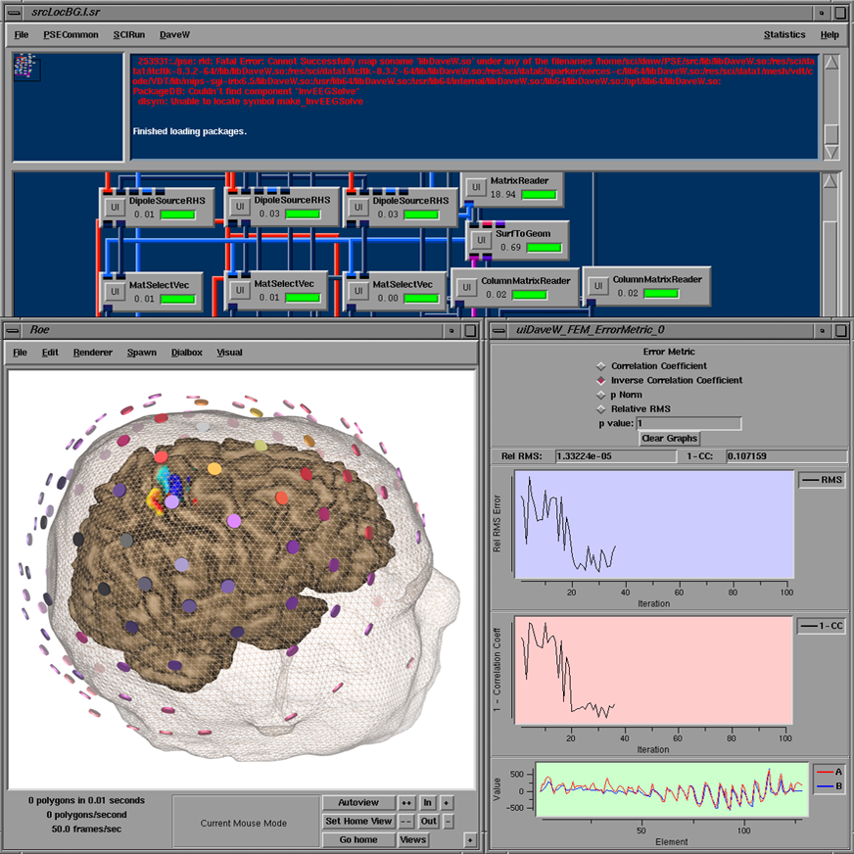
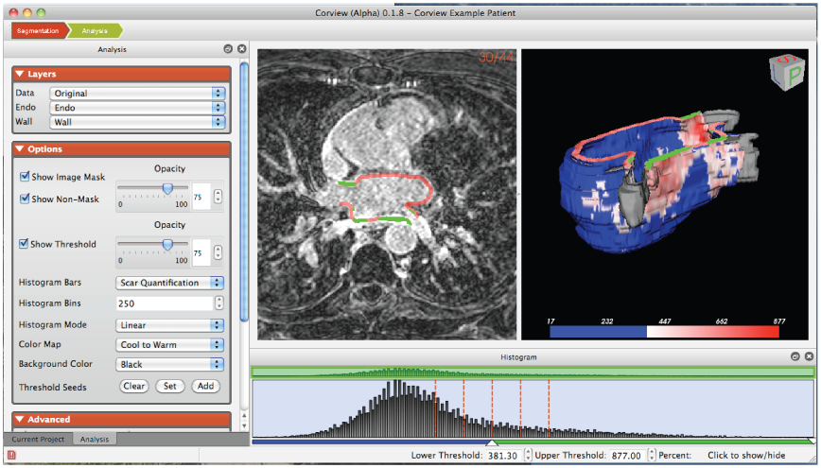
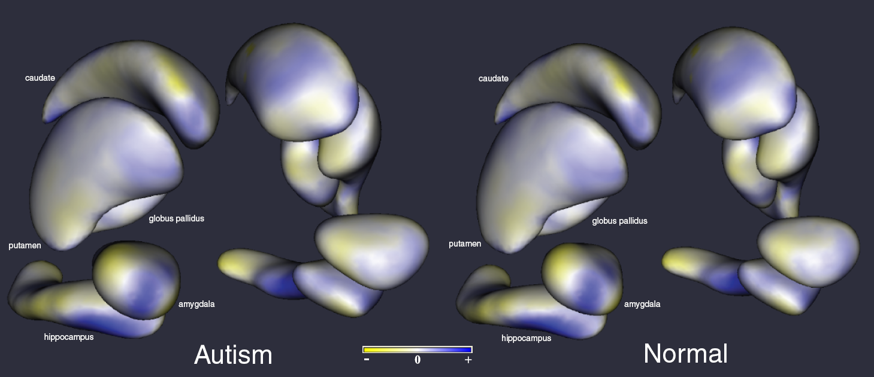
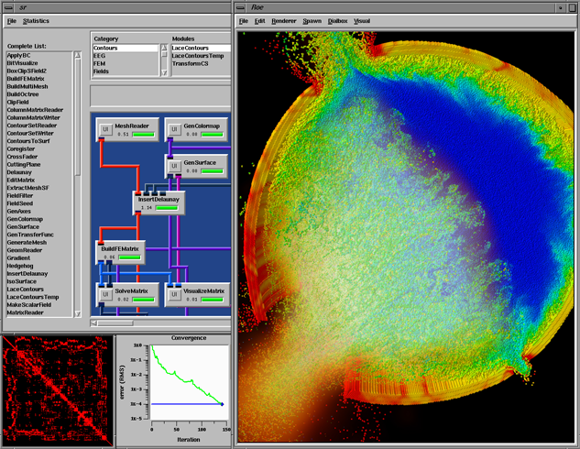
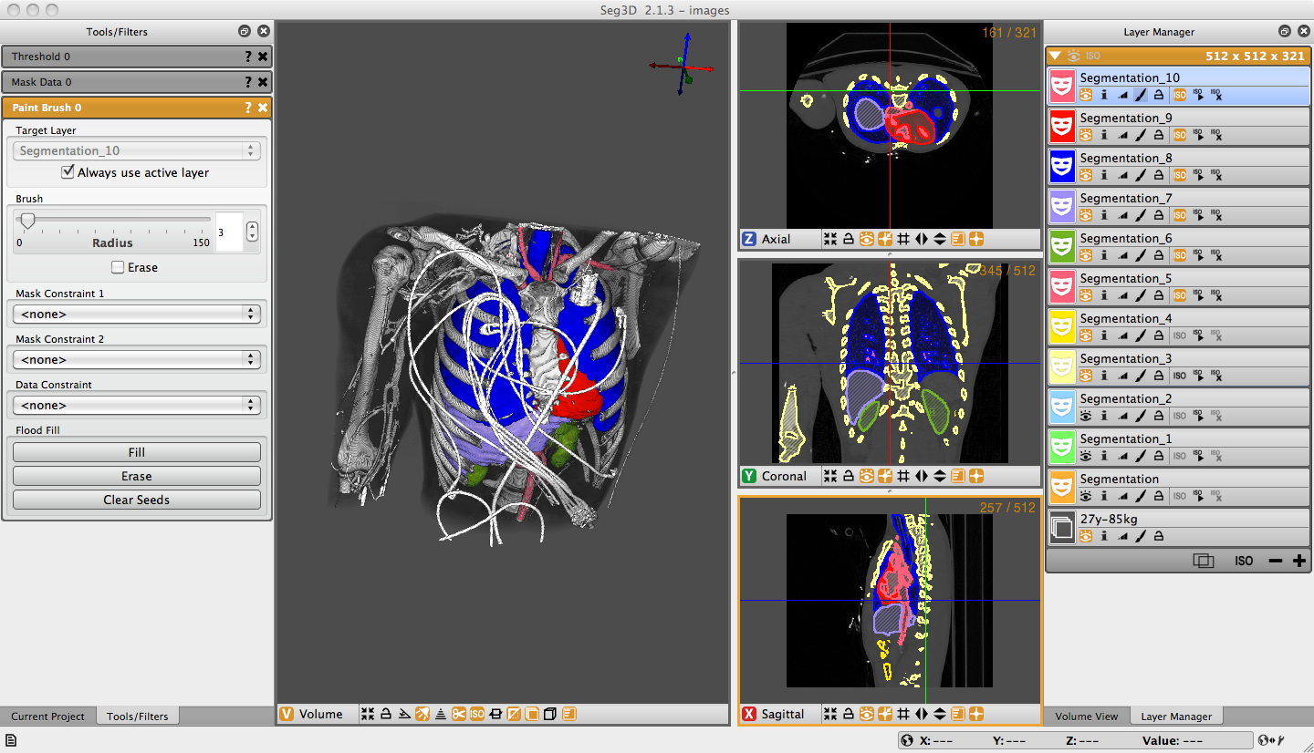
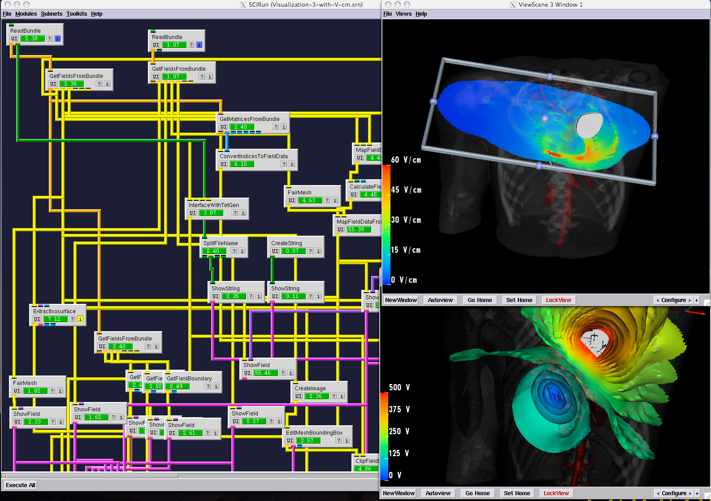
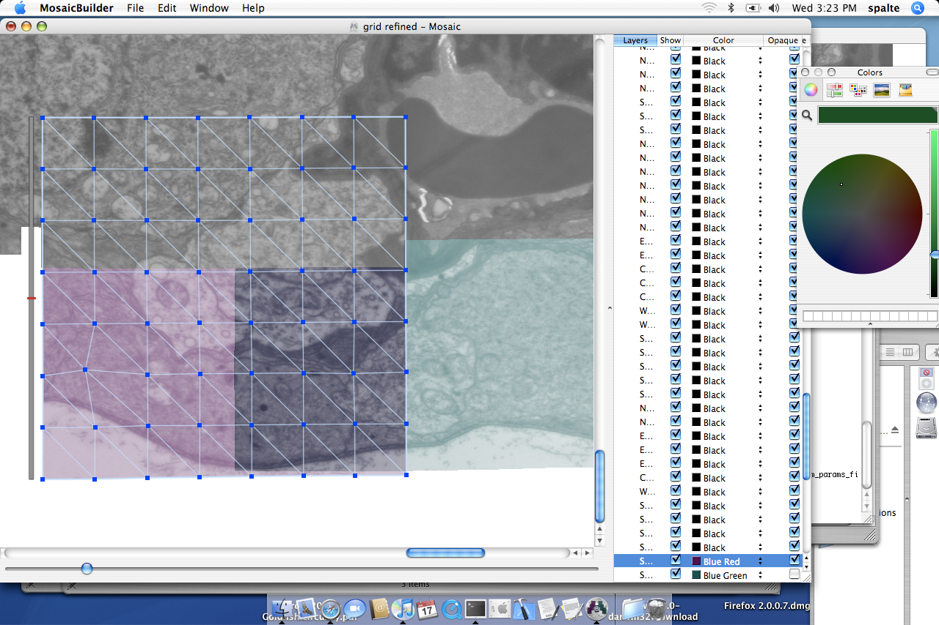
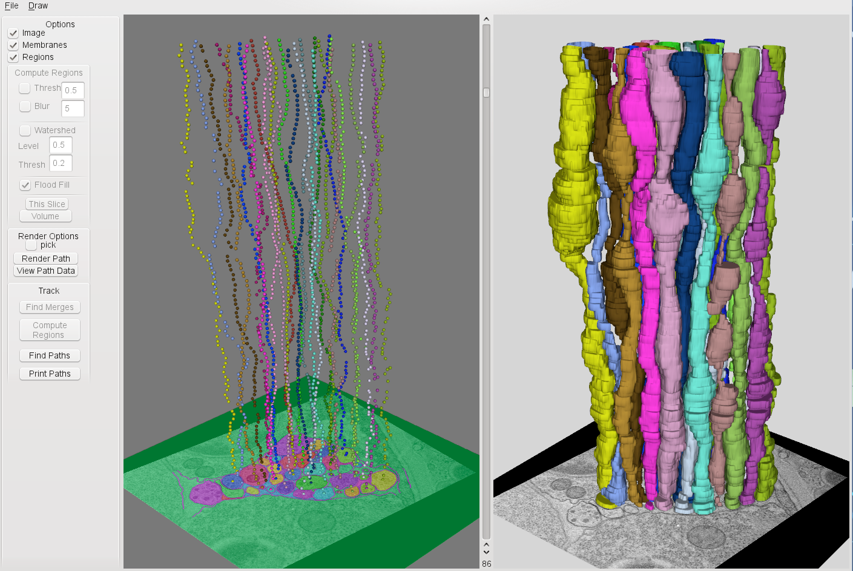
Visualization
Software Development
Computing
Image
Analysis

Slide 7
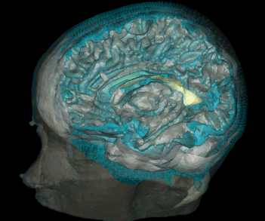
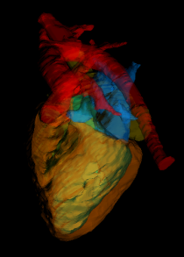
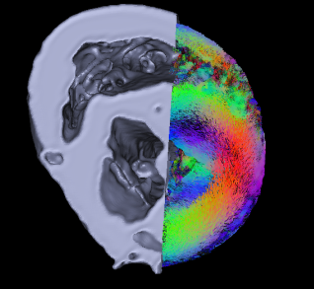
Centers We Direct
NIH/NIGMS Center for Integrative
Biomedical Computing
Center for Extreme Data Management,
Analysis, and Visualization
CEDMAV
Intel Visualization Center

Slide 8
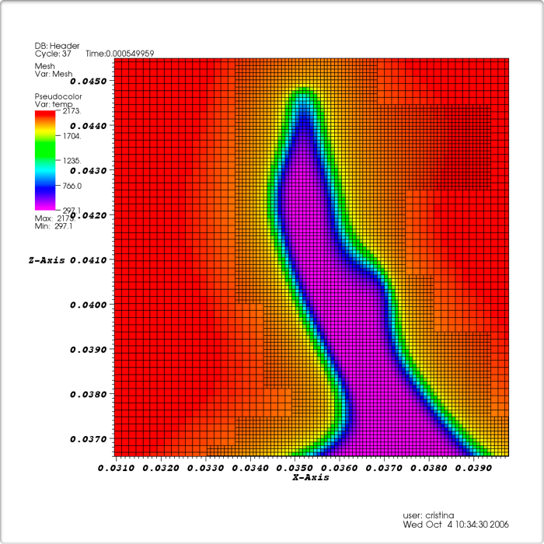
Adaptive Mesh Refinement (AMR)
AMR data is widespread in SCIVIS
Allow mesh to represent computational domains in an adaptive fashion
Use higher resolution compute multi-scale phenomena with specific spatial regions of interest
Block-structured AMR data
LBNL Visualization Group

Slide 9
Motivation
Visualizing the AMR data efficiently for interactive data exploration
Provide a comprehensive solution for directly volume rendering and iso-surface generation of AMR data in the OSPRAY interactive cpu ray tracing framework
Efficiently access and traverse the AMR data
Rendering pipeline of the data
Reconstruction strategy to get a continuous field from discrete data

Slide 10
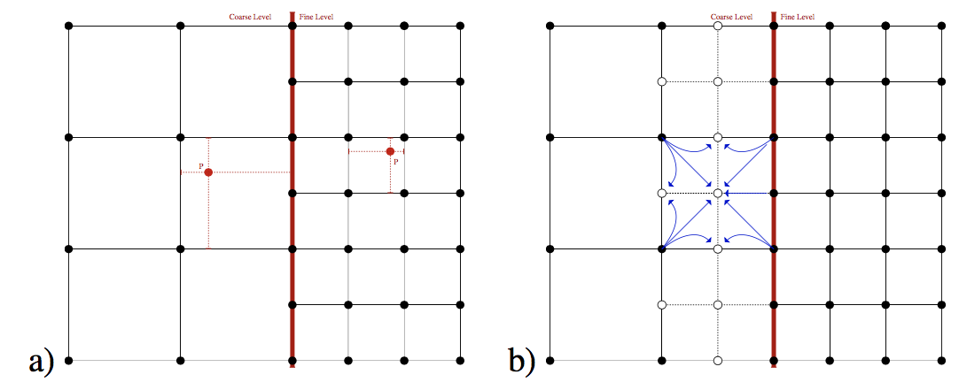
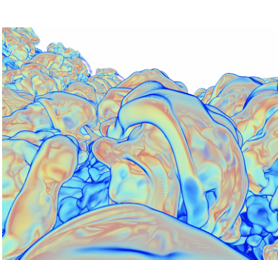
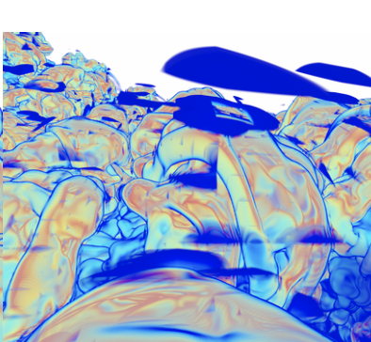
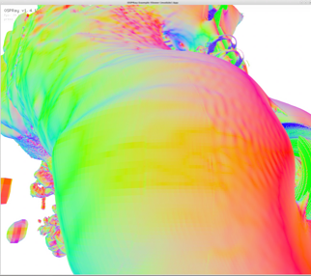
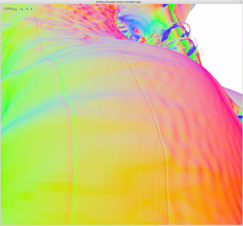
Challenges
How to define a continuous scalar field from the given discrete data point?
(Node-centered AMR data)
(Cell-centered AMR data)
Wald et al. CPU Volume Rendering of Adaptive Mesh Refinement Data

Slide 11
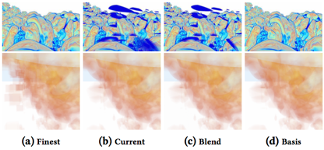
AMR data reconstruction strategy
Previous Work:
AMR data DVR module
A general method for representing and traversing AMR data using a K-D tree
Four data reconstruction strategies
Wald, Ingo & Brownlee, Carson & Usher, Will & Knoll, Aaron. (2017). CPU volume rendering of adaptive mesh refinement data. 1-8. 10.1145/3139295.3139305.
Follow up:
Octant Method for reconstruction
AMR data kernel visualization tools (2D)
AMR data implicit iso-surface module
Reconstruction quality for the four different methods, an AMR representation of the well-known Richtmyer-Meshkov data set (top), and the Landing Gear (bottom). The current and blend methods can in some cases lead to artifacts we refer to as “ghosting”. basis , does not use inner nodes, and thus never exhibits this artifact. (Wald et al. 2017)

Slide 12
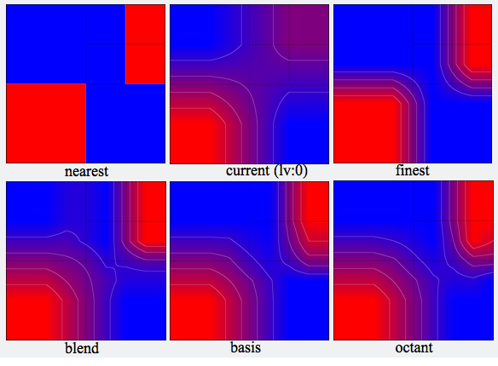
AMR data kernel visualization tools
Desired Property:
Continuity
Accuracy
Adaptive frequency
Interpolate
Cubic region
Speed
2D demonstration of different reconstruction strategies (Red value is 1, Blue is 0 )

Slide 13
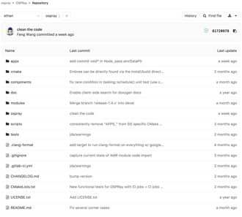
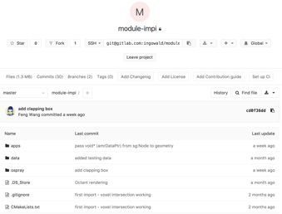
AMR Implicit iso-surface module
Regular Iso-surface Module:
Low performance (sampler number)
Less capability (Couldn’t filter voxel)
New Module:
OSPRAY v1.4.1 AMR Module
Implicit Iso-surface Module

Slide 14
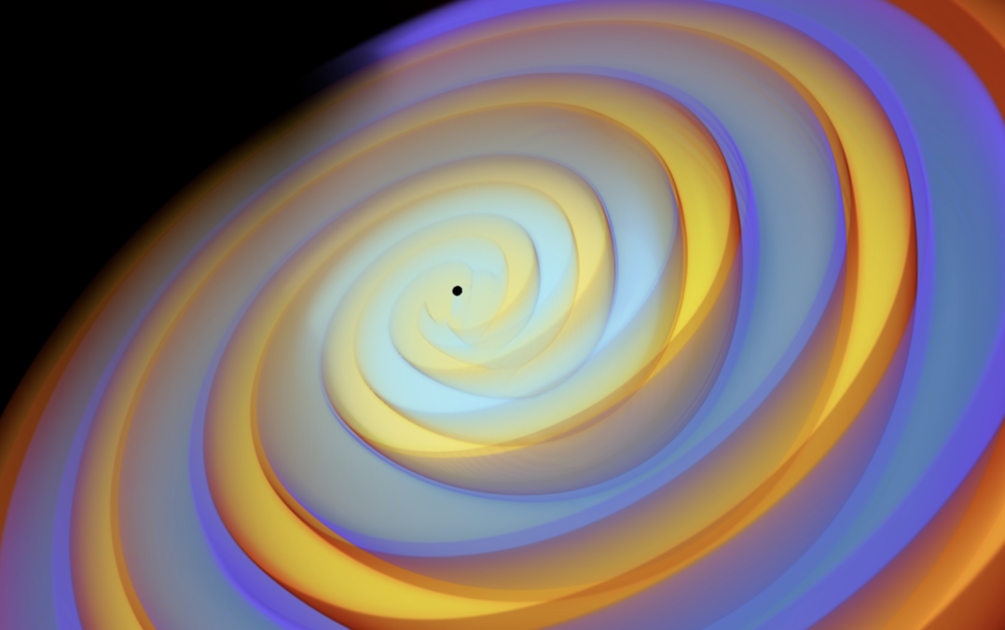
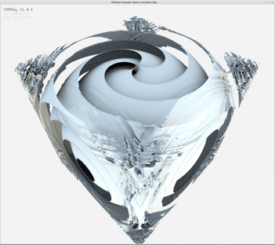
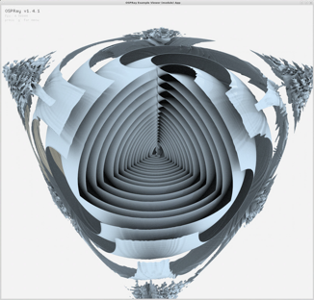
AMR Implicit iso-surface
Volume rendering of Cosmology data
Cosmology data
Size: 28 G
Octants: 1,075,241,728
Frame rate: ~5fps
 | lv0 | lv1 | lv2 | lv3
cells | 4096 | 4098 | 4106 | 4144
Iso-surface of Cosmology data

Slide 15
AMR Implicit iso-surface
Iso-surface of Cosmology data

Slide 16
AMR Implicit iso-surface
NASA LandingGear
Size: 57 G
Octants: 2,096,556,032
Frame rate: ~7fps
 | lv0 | lv1 | lv2 | lv3 | lv4
cells | 4 | 8 | 52 | 560 | 2056
Volume rendering of LandingGear
Iso-surface of LandingGear

Slide 17
Future work
Compare the Octant method with existing reconstruction method
Color mapping on the generated Iso-surface
Performance & Memory optimization
Run this demo on Stampede 2
Publish a paper about Implicit iso-surface generation for large-scale AMR Data

Slide 18
OSPRay Tube Module
Support varying radius line primitives
Support general acyclic graph structures with bifurcations, such as Neurons
Neuron Example from http://neuromorpho.org

Slide 19
Data Structure
vertex | data array of all vertex position
index | data array of indices to the first vertex of a link
vertex.color | data array of corresponding vertex colors (RGBA)
vertex.radius | data array of corresponding vertex colors (RGBA)
OSPRay Streamlines
node | data array of nodes struct (vertex position and radius)
link | data array of link struct(current and predecessor index)
OSPRay Tubes

Slide 20
Methods
Node
Spheres
Component
Cylinders
Link
Cones

Slide 21
OSPRay Tubes Results
Streamlines Under Heart
1,832,126 nodes
16 ~ 35 FPS
30 secs with SCIRun

Slide 22
OSPRay Tubes Results
Simulated Neuron System
40525 nodes
3061 cones
37400 cylinders
140 ~ 150 FPS

Slide 23
OSPRay Tubes Results
Brain White Matter
36,374,153 nodes
355,115,984 cylinders
35 ~ 42 FPS

Slide 24
OSPRay Tubes Results
Simulated Neuron System
15,300,464 nodes
14,155,012 cylinders
1,158,452 cones
11 ~ 14 FPS

Slide 25
Outreach
o Chris Johnson gave an invited presentation on Big Data Visual Analysis at the American Museum of Natural History, New York, December 2017.
o Chris Johnson will give an invited presentation on Big Data Visual Analysis, at Supercomputing 2017, Denver, November 2017.
o Chris Johnson gave a Keynote Presentation on Scientific Visualization: A Bridge to Knowledge at the Scientific Visualization Conference, New York, October 2017.
o Chris Johnson gave an invited presentation on Image-Based Biomedical Modeling, Simulation and Visualization at the International Conference on Computational Science and Engineering, Oslo, October 2017.
o Chris Johnson gave an invited presentation on Visual Learning at the Future in Review Conference 2017, Park City, October 2017.
o Chris Johnson gave an invited presentation on Science at Extreme Scales: Where Big Data Meets Large Scale Computing at the NSF Modern Math Workshop, Salt Lake City, October 2017.
o Chris Johnson gave an invited presentation on Big Data Visual Analysis at Arizona State University, Phoenix, October 2017.
o Chris Johnson gave a Plenary Presentation on Big Data Visual Analysis at the Swedish Royal Academy of Sciences Symposium on Technology for a Digital Future, Norkoping, Sweden, September 2017.
o Chris Johnson gave a Keynote Presentation on Image-Based Biomedical Modeling, Simulation, and Visualization, Imaging at the Elevated Symposium, Salt Lake City, September 2017.
o Chris Johnson gave a Keynote Presentation on DDDAS: Image-Based Modeling, Simulation, and Visualization at the DDDAS 2017 Conference, Cambridge, MA, August 2017.
o Chris Johnson organized a session on High Performance Visualization at the International Supercomputing Conference 2017 in Frankfurt, July 2017.
o Chris Johnson gave an invited presentation on Computing and Visualizing the Future: Applications in Science, Engineering and Medicine at Caltech, March, 2017.
o Chris Johnson gave an invited presentation on Computing and Visualizing the Future: Applications in Science, Engineering and Medicine at Stanford University, March, 2017.
o Chris Johnson gave an invited presentation on Big Data Visual Analysis at Aberdeen Proving Ground, February, 2017.
o Chris Johnson gave an invited presentation on Computing and Visualizing the Future: Applications in Science, Engineering and Medicine at the Carnegie Institution for Science, D.C., February, 2017.

Slide 26
Future Work
Papers are in progress
Rendering combines with volume data
Add transparent line feature
Add color corresponding to each node
Compare performance with other techniques

