Slide 1
Nonnegative Matrix Factorization
CS6962 Fall 2023
Timbwaoga Ouermi (TAJO)
Chris Johnson
Nicolas Gillis
Tamara Kolda
Christos Faloutsos
Evrim Acar
Charles Van Loan

Slide 2
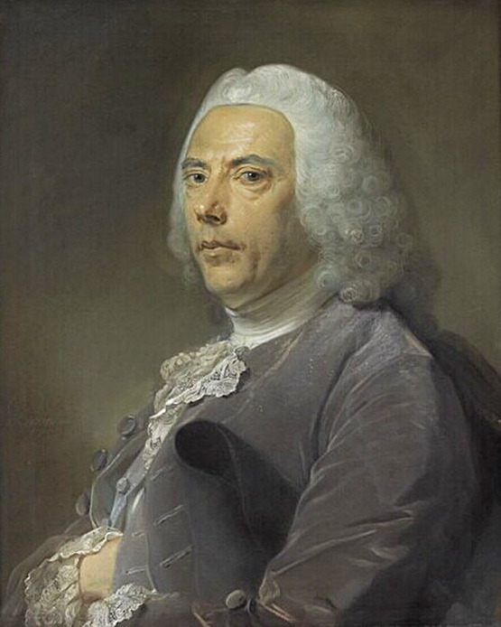
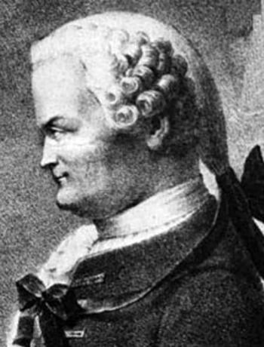
History
Analytical Chemistry
Pierre Bouguer (1698 - 1758)
Johann Heinrich Lambert (1728-1777)
August Beer (1825-1863)
Chemical reaction Spectra samples
Pure components spectral signature
Notes:
Pierre, Johann, and August’s experimental and theoretical work contributed to the formulation and discovery of the Lambert-B$ℝ_{+}^{m×n}$eer Law that relates nonnegative spectra samples to (spectral signature) to pure component spectra and their concentration.
Richard was the first to describe the model as self-modeling curve resolution (SMCR) which is a NMF problem.
Hendrik and John were the first to use blind HU to analyze the mixture of heavy mineral data

Slide 3
History
Analytical Chemistry
Pierre Bouguer (1698 - 1758)
Johann Heinrich Lambert (1728-1777)
August Beer (1825-1863)
Richard M. Wallace
“Analysis of Absorption Spectra of Multicomponent Systems” (1960)
Self-modeling curve resolution (a form of NMF)
Notes:
Pierre, Johann, and August’s experimental and theoretical work contributed to the formulation and discovery of the Lambert-B$ℝ_{+}^{m×n}$eer Law that relates nonnegative spectra samples to (spectral signature) to pure component spectra and their concentration.
Richard was the first to describe the model as self-modeling curve resolution (SMCR) which is a NMF problem.
Hendrik and John were the first to use blind HU to analyze the mixture of heavy mineral data

Slide 4
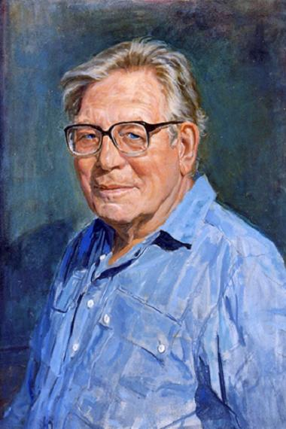
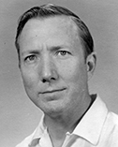
History
Analytical Chemistry
Pierre Bouguer (1698 - 1758)
Johann Heinrich Lambert (1728-1777)
August Beer (1825-1863)
Richard M. Wallace
“Analysis of Absorption Spectra of Multicomponent Systems” (1960)
Geoscience and Remote Sensing
Tjeerd Hendrik van Andel (1923-2010)
John Imbrie (1925 -2016)
“Vector Analysis of Heavy-Mineral Data” (1964)
Use blind Hyperspectral Unmixing to analyze the mixture of heavy mineral data
Notes:
Pierre, Johann, and August’s experimental and theoretical work contributed to the formulation and discovery of the Lambert-B$ℝ_{+}^{m×n}$eer Law that relates nonnegative spectra samples to (spectral signature) to pure component spectra and their concentration.
Richard was the first to describe the model as self-modeling curve resolution (SMCR) which is a NMF problem.
Hendrik and John were the first to use blind HU to analyze the mixture of heavy mineral data

Slide 5
SVD Interpretation Weakness
The SVD is easy to compute but does not provide users with any interpretation of its mathematical factors or why it works so well.
A common complaint from users is: do the SVD factors reveal anything about the data collection? (No)

Slide 6
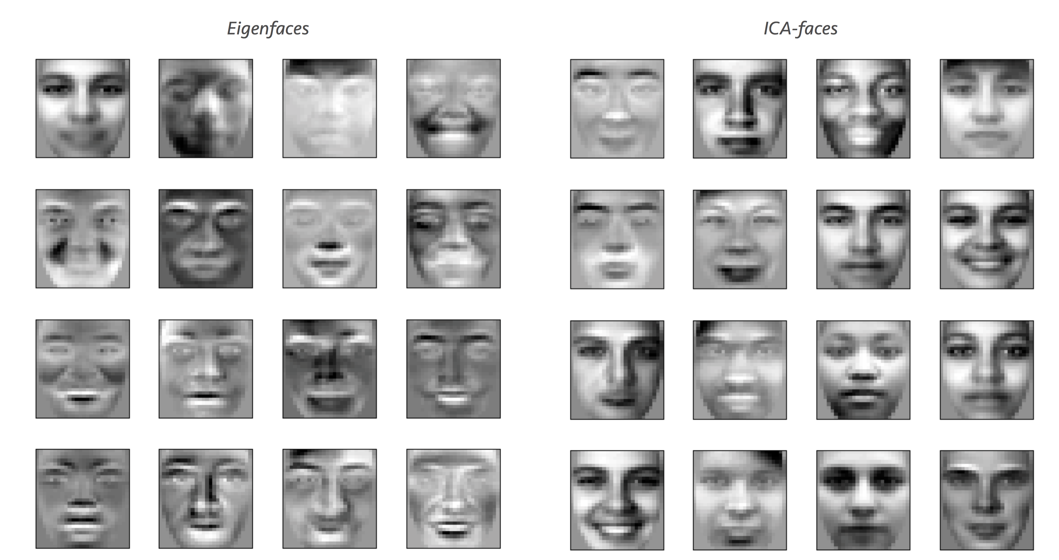
Eigenfaces and ICA-faces

Slide 7
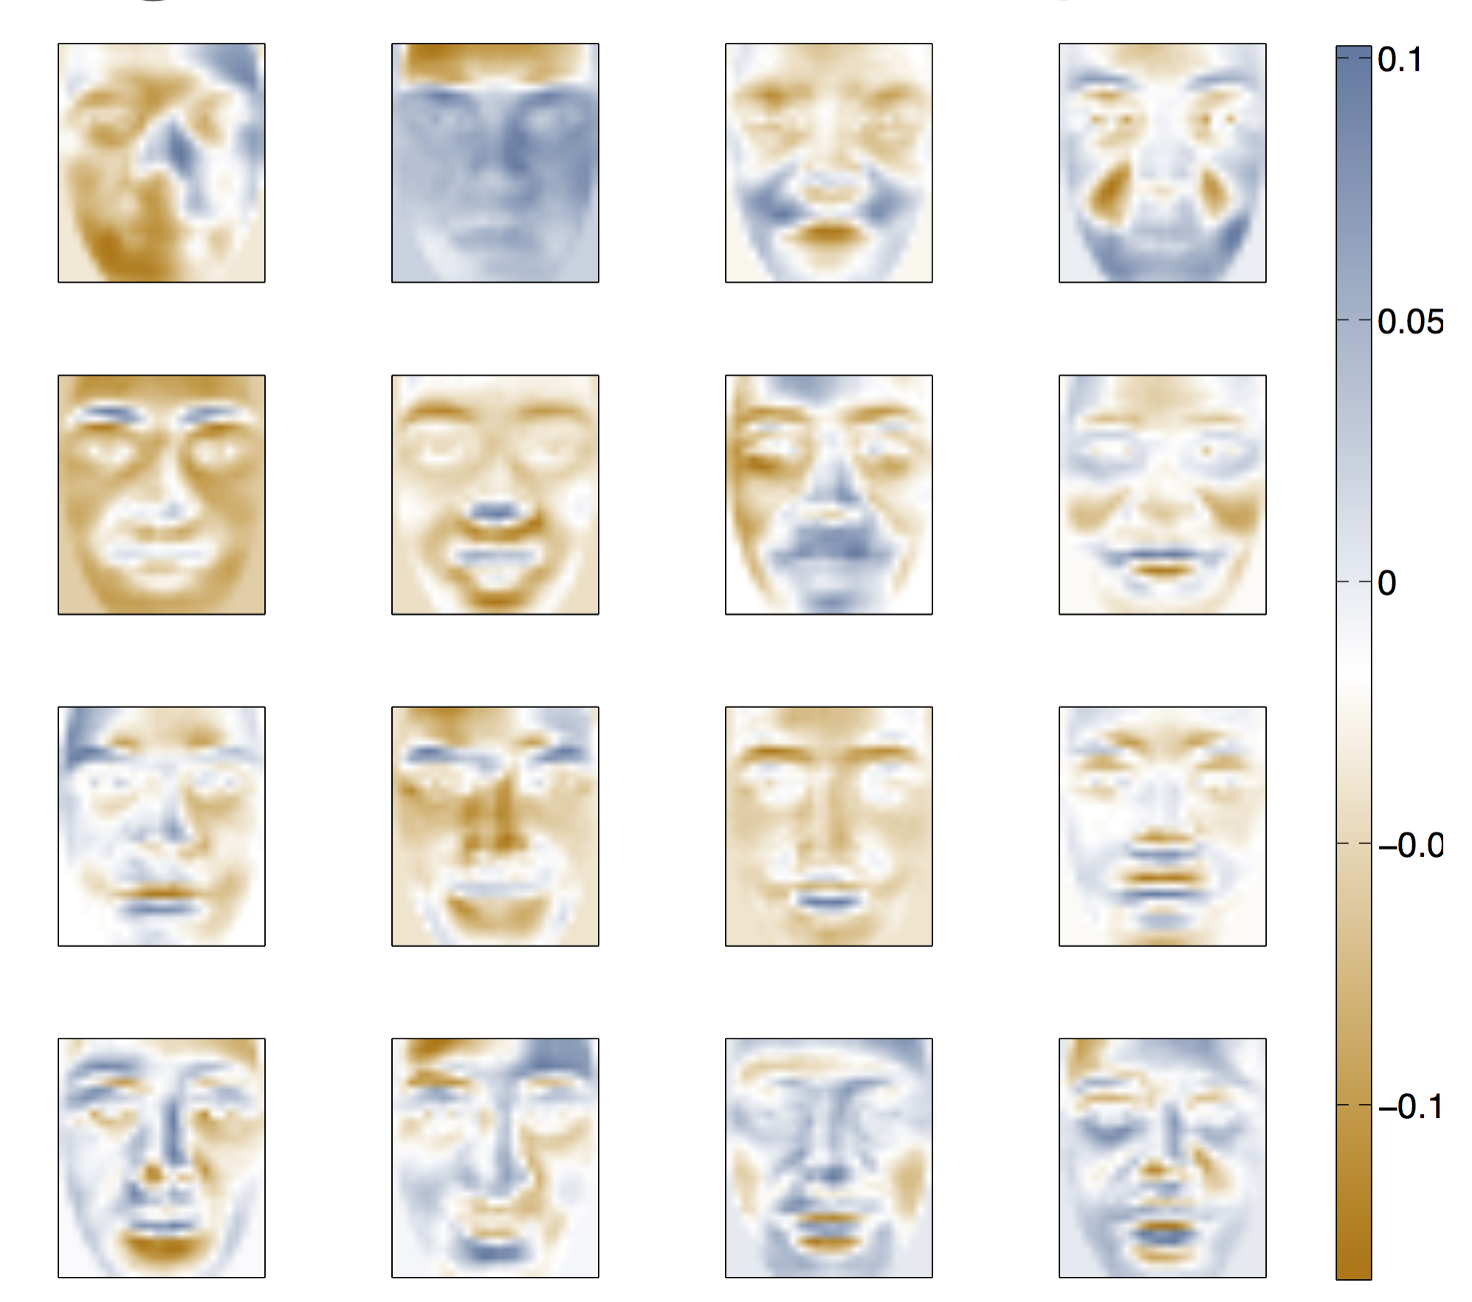
Eigenfaces have negative components – Why?

Slide 8
Nonnegative data are pervasive
In collections of documents, each document is stored as vectors. Each element of a document vector is a count (possibly weighted) of the number of times a corresponding term appears in that document.
Stacking document vectors one after the other creates a nonnegative term-by-document matrix that represents the entire document collection numerically.

Slide 9
Nonnegative data are pervasive

Slide 10
Nonnegative data are pervasive
In image libraries or collections, each image is represented by a vector, and each element of the vector corresponds to a pixel.
The intensity and color of the pixel is given by a nonnegative number, which creates a nonnegative pixel-by-image matrix.
Power spectra data are nonnegative and one may have to process multiple spectra simultaneously (time-space- frequency analysis)
For recommendation systems (Amazon, Netflix) or item sets, the information for a purchase history of customers or ratings on a subset of items is stored in a non-negative sparse matrix.
In gene expression analysis, gene-by-experiment matrices are formed from observing the gene sequences produced under various experimental conditions.

Slide 12
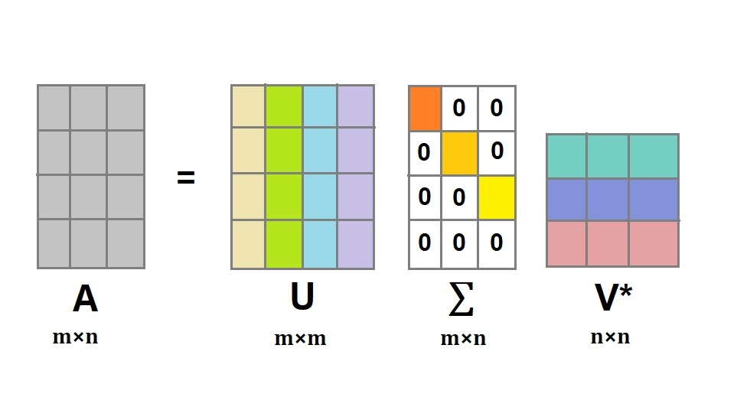
SVD

Slide 13
Summary of Truncated SVD
Strengths:
Using A_{k} in place of A gives improved performance
Noise reduction isolates essential components of matrix
Best rank-k approximation
A_{k} is unique
Weaknesses:
Storage—U_{k} and V_{k} are usually completely dense
Good truncation point k is hard to determine
Interpretation of basis vectors is difficult due to mixed signs.
Negative elements make interpretation difficult.

Slide 14
Nonnegative Matrix Factorization (NMF)
nonnegative
nonnegative
nonnegative
Problem (Nonnegative Matrix factorization). Given a nonnegative matrix $A∈ℝ_{+}^{m×n}$, a factorization rank $r$, and a distance measure $D(.,.)$ between two matrices, compute two nonnegative matrices $W∈ℝ_{+}^{m×r}$ and $H∈ℝ_{+}^{r×n}$ such that $D(A, WH)$ is minimized, that is solve
$$\min_{W∈ℝ_{+}^{m×r} H∈ℝ_{+}^{r×n}}{D\left(A, WH\right).}$$

Slide 15
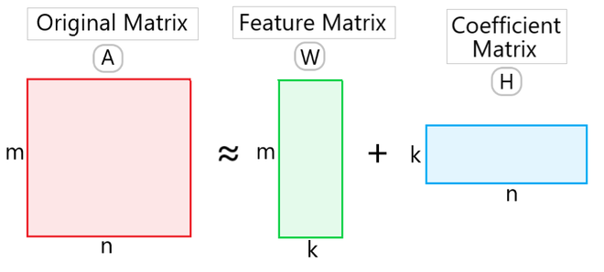
NMF and Low-rank Modeling
nonnegative
nonnegative
nonnegative
Given a set of multivariate m-dimensional data vectors, the vectors are placed in the columns of an mxn matrix A where n is the number of examples in the data set.
This matrix is then approximately factorized into a mxk matrix W and a kxn matrix H.
Usually k is chosen to be smaller than n or m, so that W and H are smaller than the original matrix A.
This results in a compressed version of the original data matrix

Slide 16
Nonnegative Matrix Factorization (NMF)
Idea: use low-rank approximation with nonnegative factors to improve weaknesses of truncated-SVD
SVD: A_{k} = U_{k} Σ_{k} V^{T}_{k}
NMF: A_{k} = W_{k} H_{k}
mixed
nonnegative
mixed
nonnegative
nonnegative
nonnegative

Slide 17
NMF
Low rank approximation A_{k} = W_{k} H_{k} where all matrices are non-negative
The factor matrices may have significantly lower rank than product matrix A or it can be well approximated by A_{k} (rank-k approximation of A)
Each column of A can be computed as linear combination of column vectors in W and the coefficients are given by elements of H.

Slide 18
Interpretation NMF
Columns of W are the underlying basis vectors, i.e., each of the n columns of A can be built from k columns of W.
Columns of H give the weights associated with each basis vector.

Slide 19
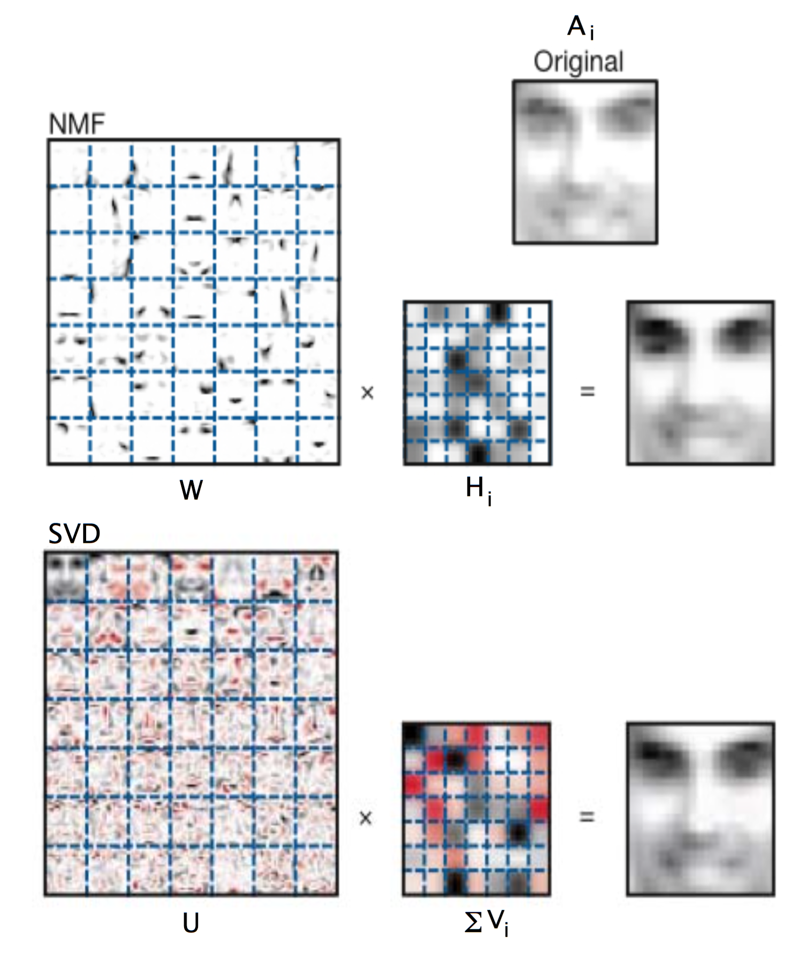
NMF Faces
Notes:
NMF – decompose A into additive parts that are easy to interpret
SVD – factors are not easy or intuitive

Slide 20
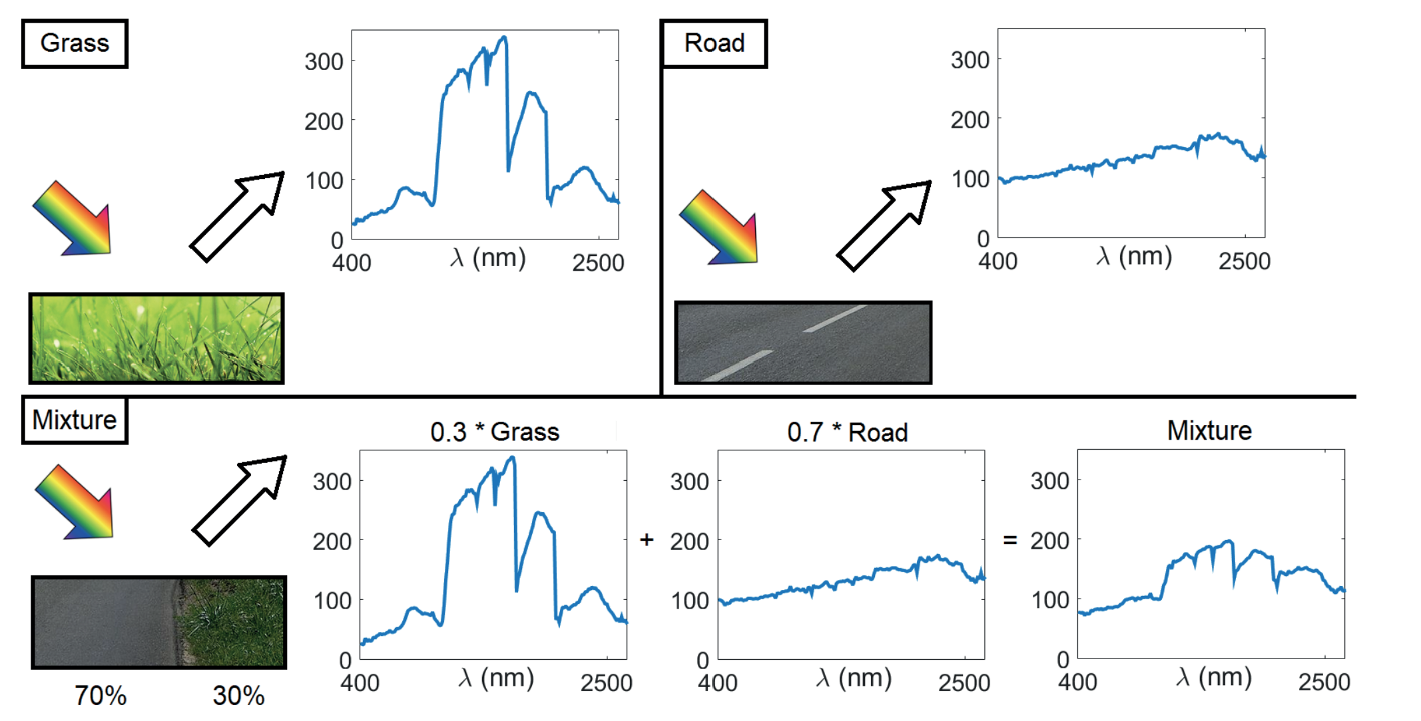
NMF for Hyperspectral imaging
Notes:
Hyperspectral image measures the intensity of the light within a scene for many different wavelengths typically between 100 and 200. each pixel is a vector of intensities that is equal to the fraction of light reflected depending on the wavelength

Slide 21
NMF
Since relatively few basis vectors are used to represent many data vectors, good approximation can only be achieved if the basis vectors discover structure that is latent (underlying/hidden) in the data.

Slide 22
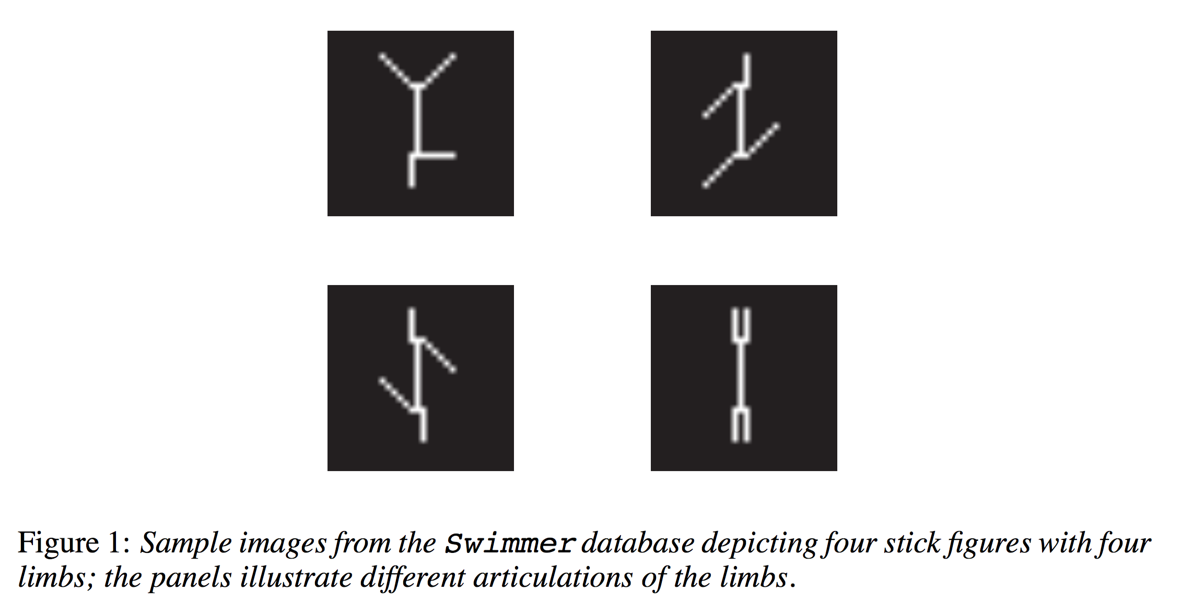
When Does Non-Negative Matrix Factorization Give a Correct Decomposition into Parts? Donoho, David L., and Victoria Stodden, NIPS 2003.

Slide 23
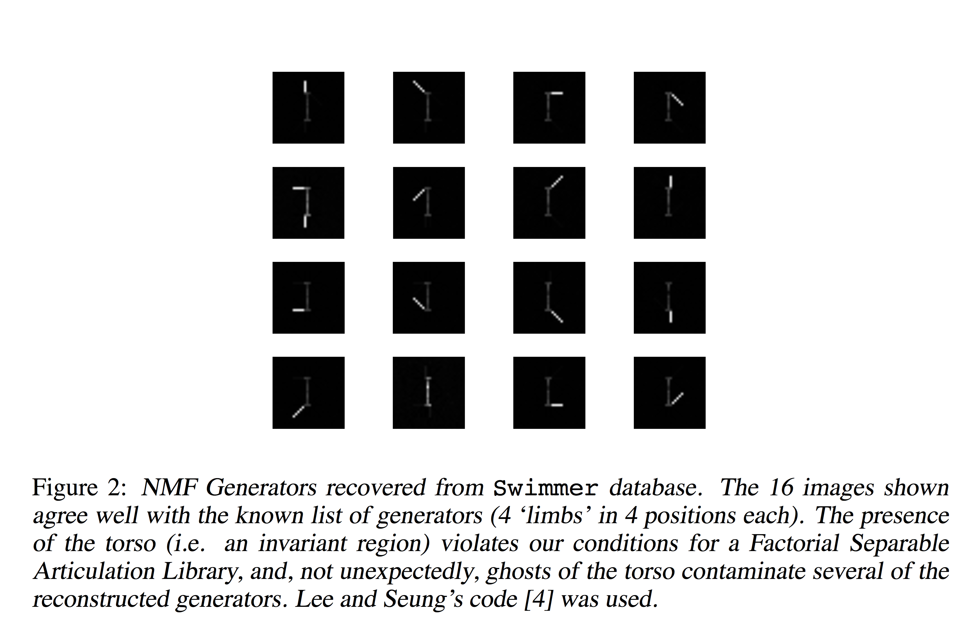

Slide 24
NMF Factor Interpretation Example
Non-negative factors give benefits in interpretation
– In text processing requiring factorization of term by document matrix A_{mxn}, k can be considered the number of topics present in the document collection
– Element i,j of A tells how many times ith word in vocabulary appears in document j
– W is a term by topic matrix whose columns are the basis vectors – The nonzero elements of column 1 of W correspond to particular terms.
Considering the highest weighted terms in this vector, one can assign label or topic to the basis vector

Slide 25
NMF Factor Interpretation Example
In image processing, blocks in W matrix are sparse and weights represented by blocks in H are sparse as well.
– For example, in facial image database, each face image (obtained by stacking image into column vector) is a column in A
– W contains basis images and H their weights – Basis images correspond to parts of a face such as eyes, nose, lips, hence additive representation
SVD basis does not create additive parts representation and factors are dense

Slide 26
Properties of NMF
Basis vectors w_{i} are not ⊥ ⇒ can have overlap of topics
Can restrict W, H to be sparse Wk, Hk ≥ 0 ⇒ immediate interpretation (additive parts-based representation)
Example: Large w_{ij}’s ⇒ basis vector w_{i} is mostly about terms j
Example: h_{i1} how much doc₁ is pointing in the “direction” of topic vector w_{i}

Slide 27
Nonnegative Matrix Factorization (NMF)
nonnegative
nonnegative
nonnegative
Problem (Nonnegative Matrix factorization). Given a nonnegative matrix $A∈ℝ_{+}^{m×n}$, a factorization rank $r$, and a distance measure $D(.,.)$ between two matrices, compute two nonnegative matrices $W∈ℝ_{+}^{m×r}$ and $H∈ℝ_{+}^{r×n}$ such that $D(A, WH)$ is minimized, that is solve
$$\min_{W∈ℝ_{+}^{m×r} H∈ℝ_{+}^{r×n}}{D\left(A, WH\right).}$$

Slide 28
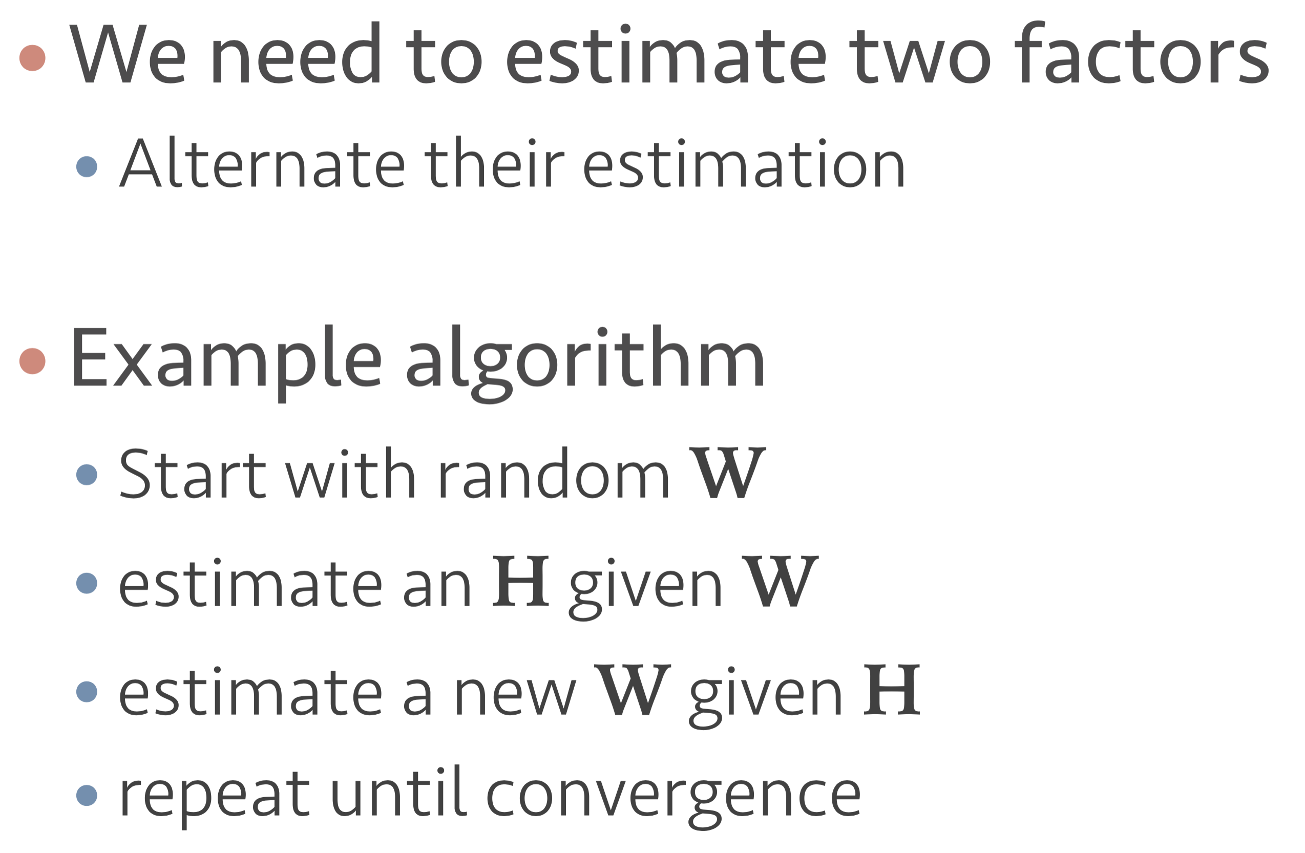
NMF Algorithms

Slide 29
NMF Algorithms
Two-Block Coordinate Descent
Input: nonnegative matrix $A∈ℝ^{m×n}$ and factorization rank $r$
Output: $\left(W, H\right)≥0$
Generate some initial matrices $W^{(0)}≥0$ and ${ H}^{(0)}≥0$
for t=1, 2, … do
$W^{(t)}=update\left(A,{ H}^{(t−1)},W^{(t−1)}\right).$
${{ H}^{(t)}}^{T}=update\left({ A}^{T},{W^{(t)}}^{T},{{ H}^{(t−1)}}^{T}\right).$
end for
Stopping criteria are often based on evolution of objective function, and difference between consecutive iterations.

Slide 30
Multiplicative Update
Forbenius norm
${\left\|A−WH\right\|}_{F}^{2}= \sum_{i}{\sum_{j}{{\left(A−WH\right)}_{ij}^{2}}}$

Slide 31
Multiplicative Update
Forbenius norm
${\left\|A−WH\right\|}_{F}^{2}= \sum_{i}{\sum_{j}{{\left(A−WH\right)}_{ij}^{2}}}$
Kullback-Leibler (KL) Divergence or Relative entropy
$D_{KL}\left(A, WH\right)= \sum_{i}{\sum_{j}{A_{ij}log\frac{A_{ij}}{{\left(WH\right)}_{ij}}−A_{ij}+{\left(WH\right)}_{ij}}}$

Slide 32
Multiplicative Update
Forbenius norm
$W_{ij}←W_{ij} \frac{{\left(AH^{T}\right)}_{ij}}{{\left(WHH^{T}\right)}_{ij}} H_{jk}←H_{jk} \frac{{\left(W^{T}A\right)}_{jk}}{{\left(W^{T}WH\right)}_{jk}}$

Slide 33
Multiplicative Update
Forbenius norm
$W_{ij}←W_{ij} \frac{{\left(AH^{T}\right)}_{ij}}{{\left(WHH^{T}\right)}_{ij}} H_{jk}←H_{jk} \frac{{\left(W^{T}A\right)}_{jk}}{{\left(W^{T}WH\right)}_{jk}}$
Kullback-Leibler (KL) Divergence or Relative entropy
$W_{ij}←W_{ij}\frac{\sum_{k}{H_{jk}A_{ik}/{\left(WH\right)}_{ik}}}{\sum_{p}{H_{jp}}} H_{jk}←H_{jk}\frac{\sum_{i}{W_{ij}A_{ik}/{\left(WH\right)}_{ik}}}{\sum_{q}{H_{jq}}}$

Slide 34
Other NMF Algorithms
Alternating Nonnegative Least Squares (ANLS)
$W←{argmin}_{W≥0}{\left\|A−WH\right\|}_{F}$

Slide 35
Other NMF Algorithms
Alternating Nonnegative Least Squares (ANLS)
$W←{argmin}_{W≥0}{\left\|A−WH\right\|}_{F}$
Alternating Least Squares (ALS)
$W←max\left({argmin}_{Z∈ℝ^{m×r}}{\left\|A−ZH\right\|}_{F}, 0\right)$

Slide 36
Other NMF Algorithms
Alternating Nonnegative Least Squares (ANLS)
$W←{argmin}_{W≥0}{\left\|A−WH\right\|}_{F}$
Alternating Least Squares (ALS)
$W←max\left({argmin}_{Z∈ℝ^{m×r}}{\left\|A−ZH\right\|}_{F}, 0\right)$
Hierarchical ALS (HALS)
$W(:,l)←{argmin}_{W(:,l)≥0}{\left\|A−\sum_{k≠l}{W(:,l)H(:,k)}\right\|}_{F}$

Slide 37
Other NMF Algorithms
Alternating Nonnegative Least Squares (ANLS)
$W←{argmin}_{W≥0}{\left\|A−WH\right\|}_{F}$
Alternating Least Squares (ALS)
$W←max\left({argmin}_{Z∈ℝ^{m×r}}{\left\|A−ZH\right\|}_{F}, 0\right)$
Hierarchical ALS (HALS)
$W(:,l)←{argmin}_{W(:,l)≥0}{\left\|A−\sum_{k≠l}{W(:,l)H(:,k)}\right\|}_{F}$
$←max\left(0, \frac{A{H(l,:)}^{T}− \sum_{k≠l}{W(k,:)\left(H\left(k,:\right){H(l,:)}^{T}\right)}}{{\left\|H(l,:)\right\|}_{2}^{2}}\right)$

Slide 38
Other NMF Algorithms
Multiplicative Update (MU)
Accelerated Multiplicative Update (A-MU)
Alternating Least Squares (ALS)
Alternating Nonnegative Least Squares (ANLS)
Hierarchical Alternating Least Squares (HALS)
Accelerated HALS (A-HALS)
Adding momentum to A-HALS → E-A-HALS
Fast Projected Gradient Methods (FPGM)
2-BCD + Alternating Direction Method of Multipliers (AO-ADMM)
Many more (See NMFLab Guidebook pages 24-28)

Slide 39
Calculating NMF
A
A

Slide 40
Rank r Selection
Expert Insight
Analytical Chemistry
Hyperspectral unmixing
Cross Validation
Facial features extraction, text mining, recommender systems
Statistical Approaches

Slide 41
Regularization of NMF
$$\min_{W∈ℝ_{+}^{m×r} H∈ℝ_{+}^{r×n}}{D\left(A, WH\right)+α_{W}f_{W}\left(W\right)+α_{H}f_{H}\left(H\right).}$$
Minimum-volume
$f_{W}\left(W\right)=det(W^{T}W)$, other forms
Sparsity
$f_{H}\left(H\right)={\left\|H\right\|}_{1}$, $f_{W}\left(W\right)={\left\|W\right\|}_{1}$
Orthogonality
${f_{H}\left(H\right)=\left\|H^{T}H −I\right\|}_{F}^{2}$, or ${f_{H}\left(H\right)=\left\|{HH}^{T} −I\right\|}_{F}^{2}$

Slide 42
SymNMF (Zachary’s Karate club)

Slide 43
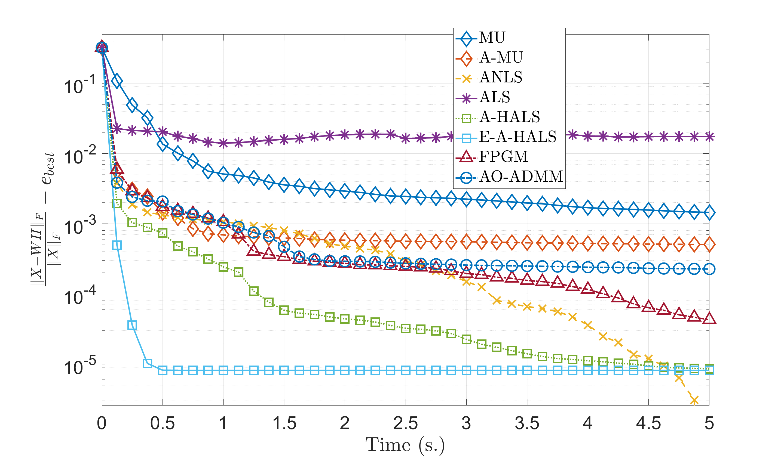
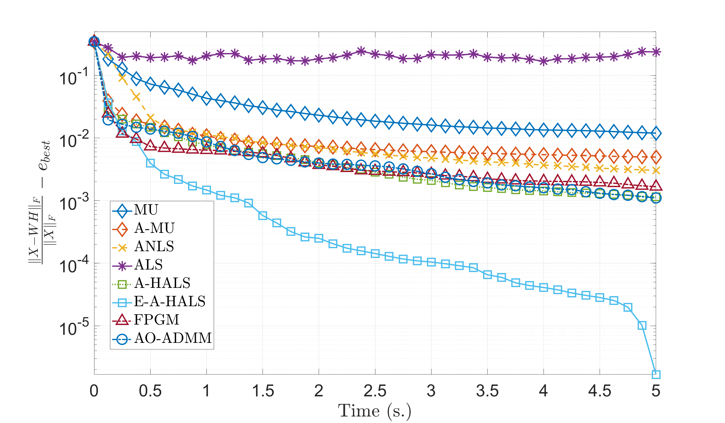
Algorithms Performance

Slide 44
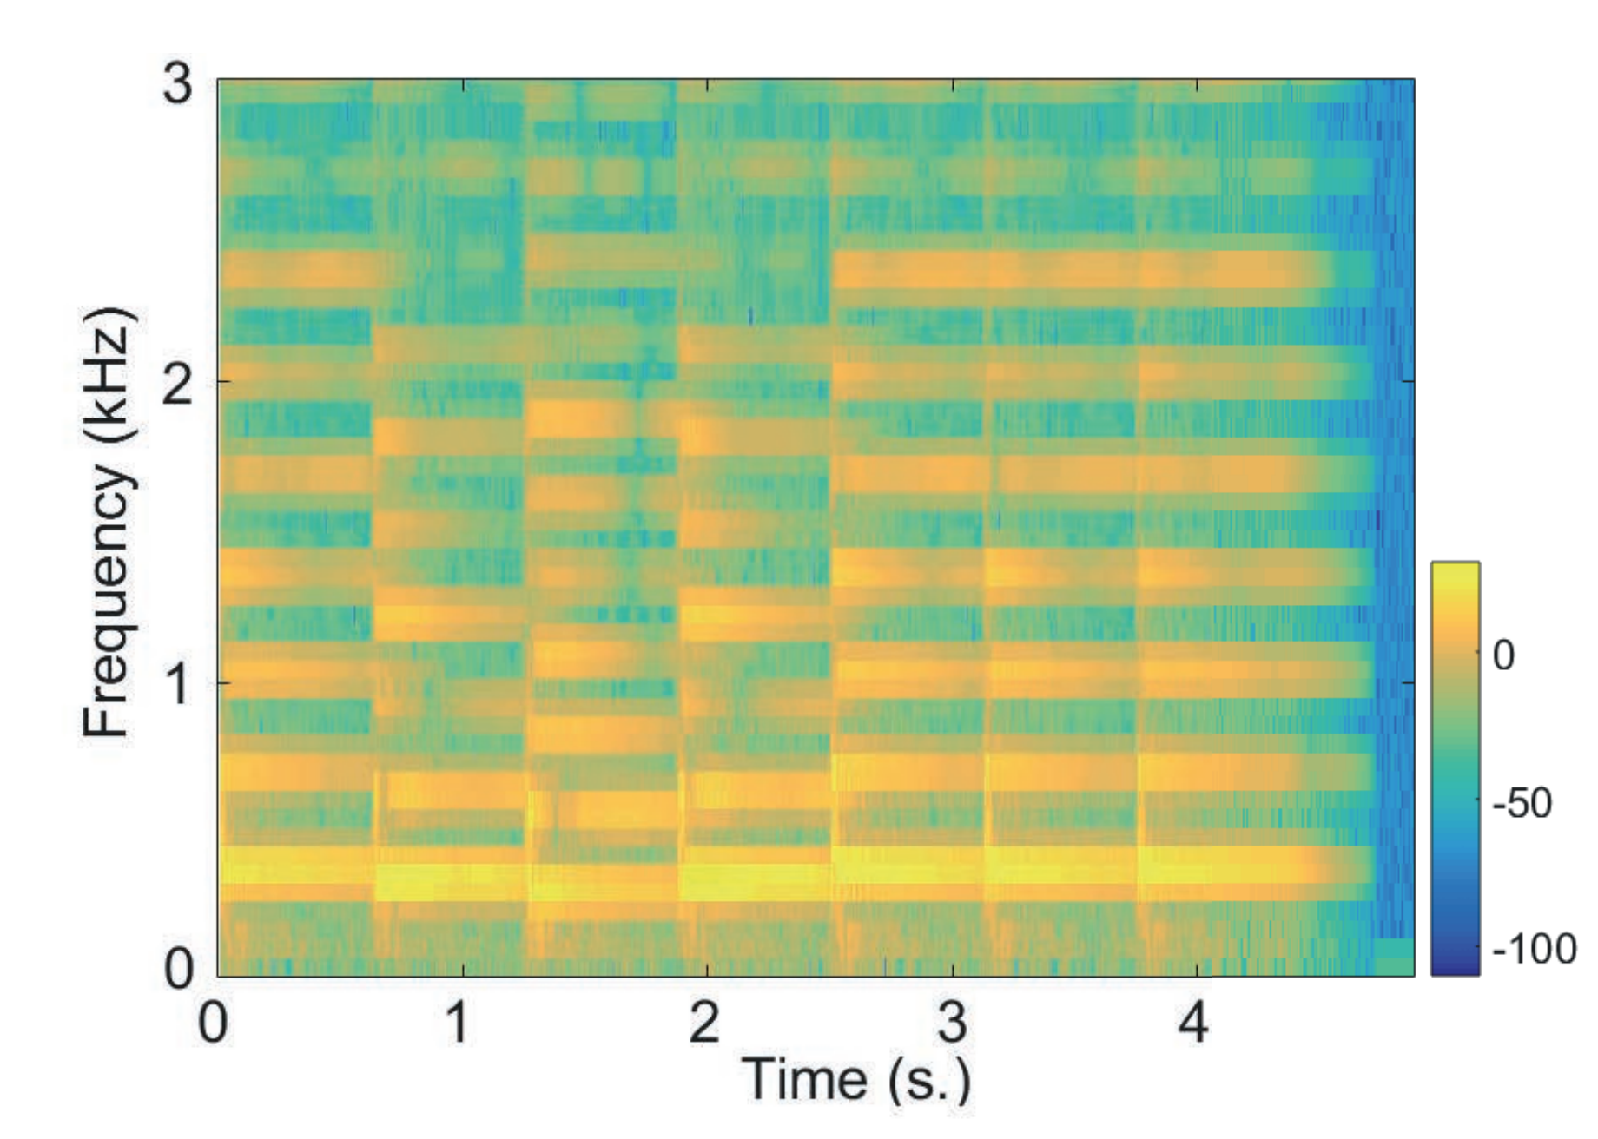
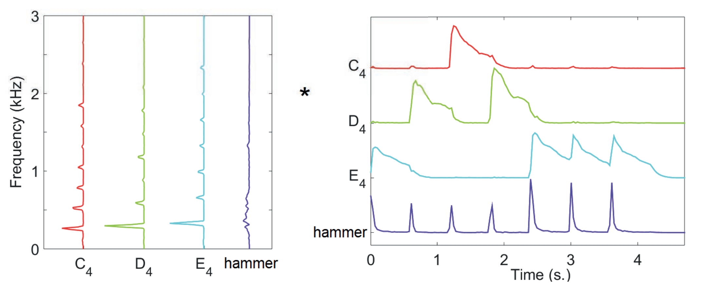
Music Example

Slide 45
Music Example

Slide 46
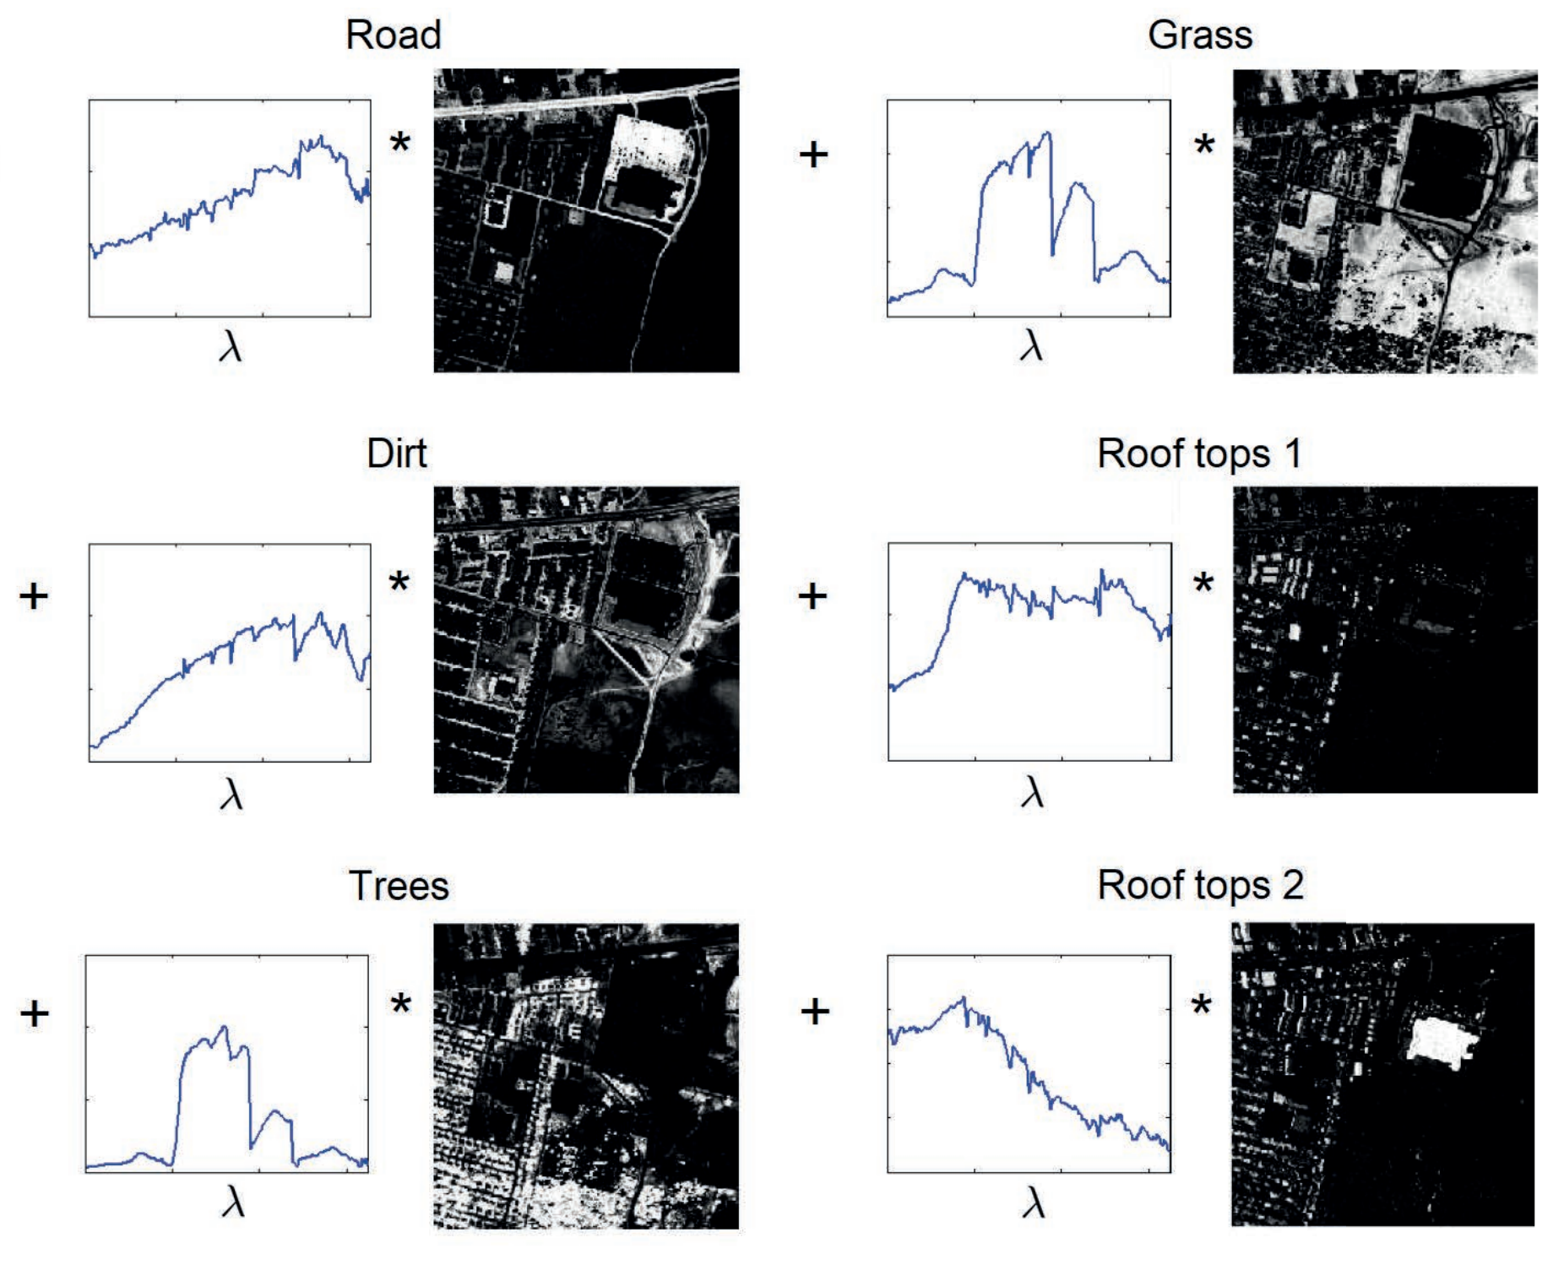
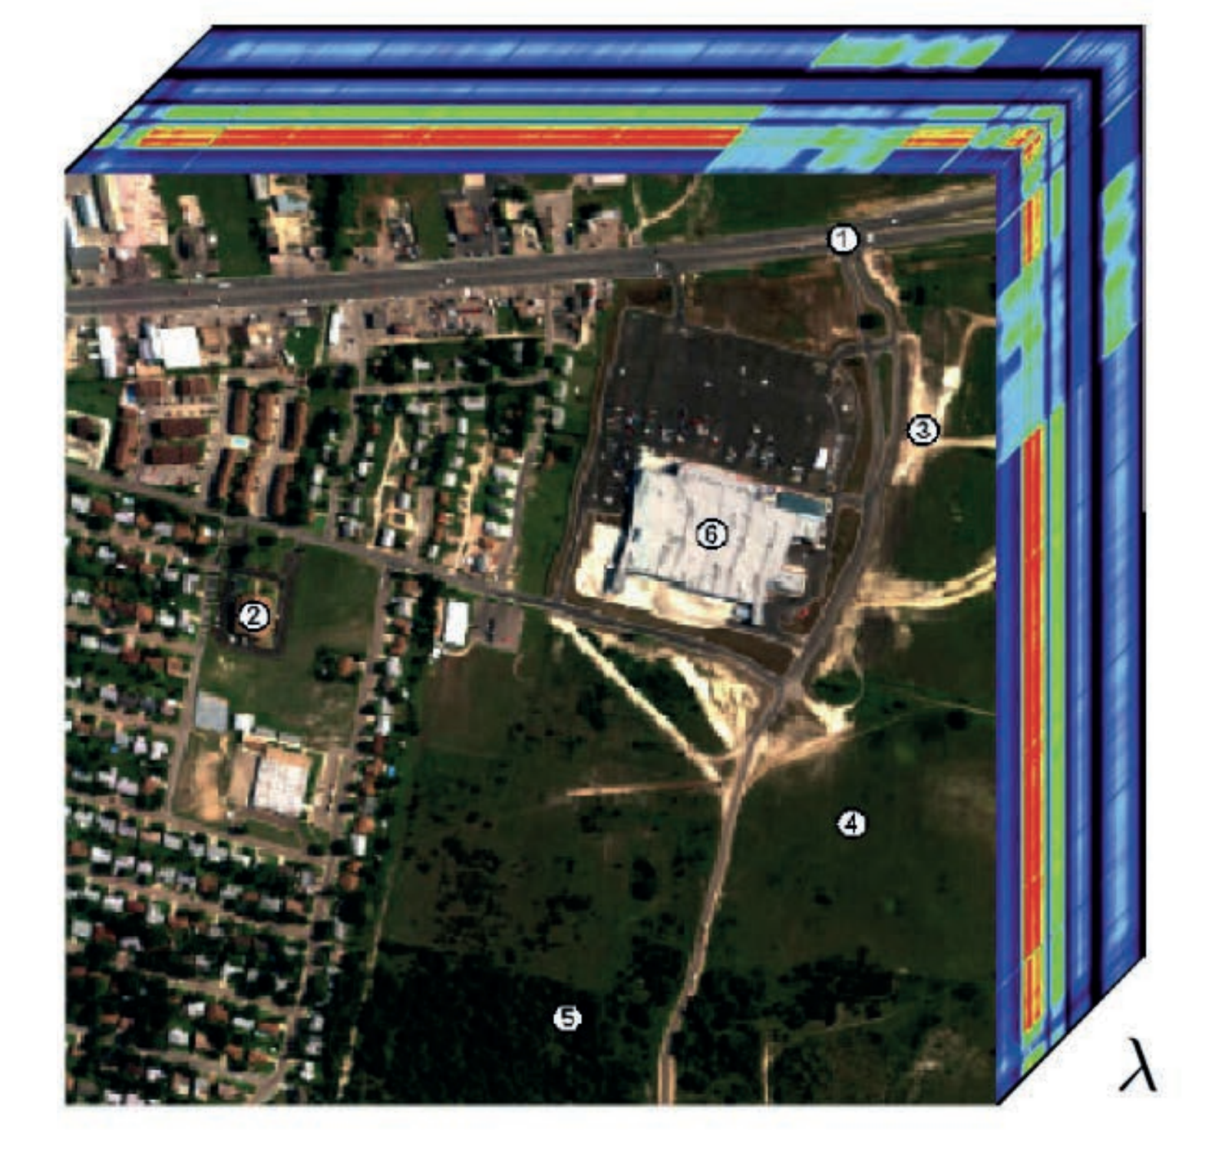
Hyperspectral Unmixing

Slide 47
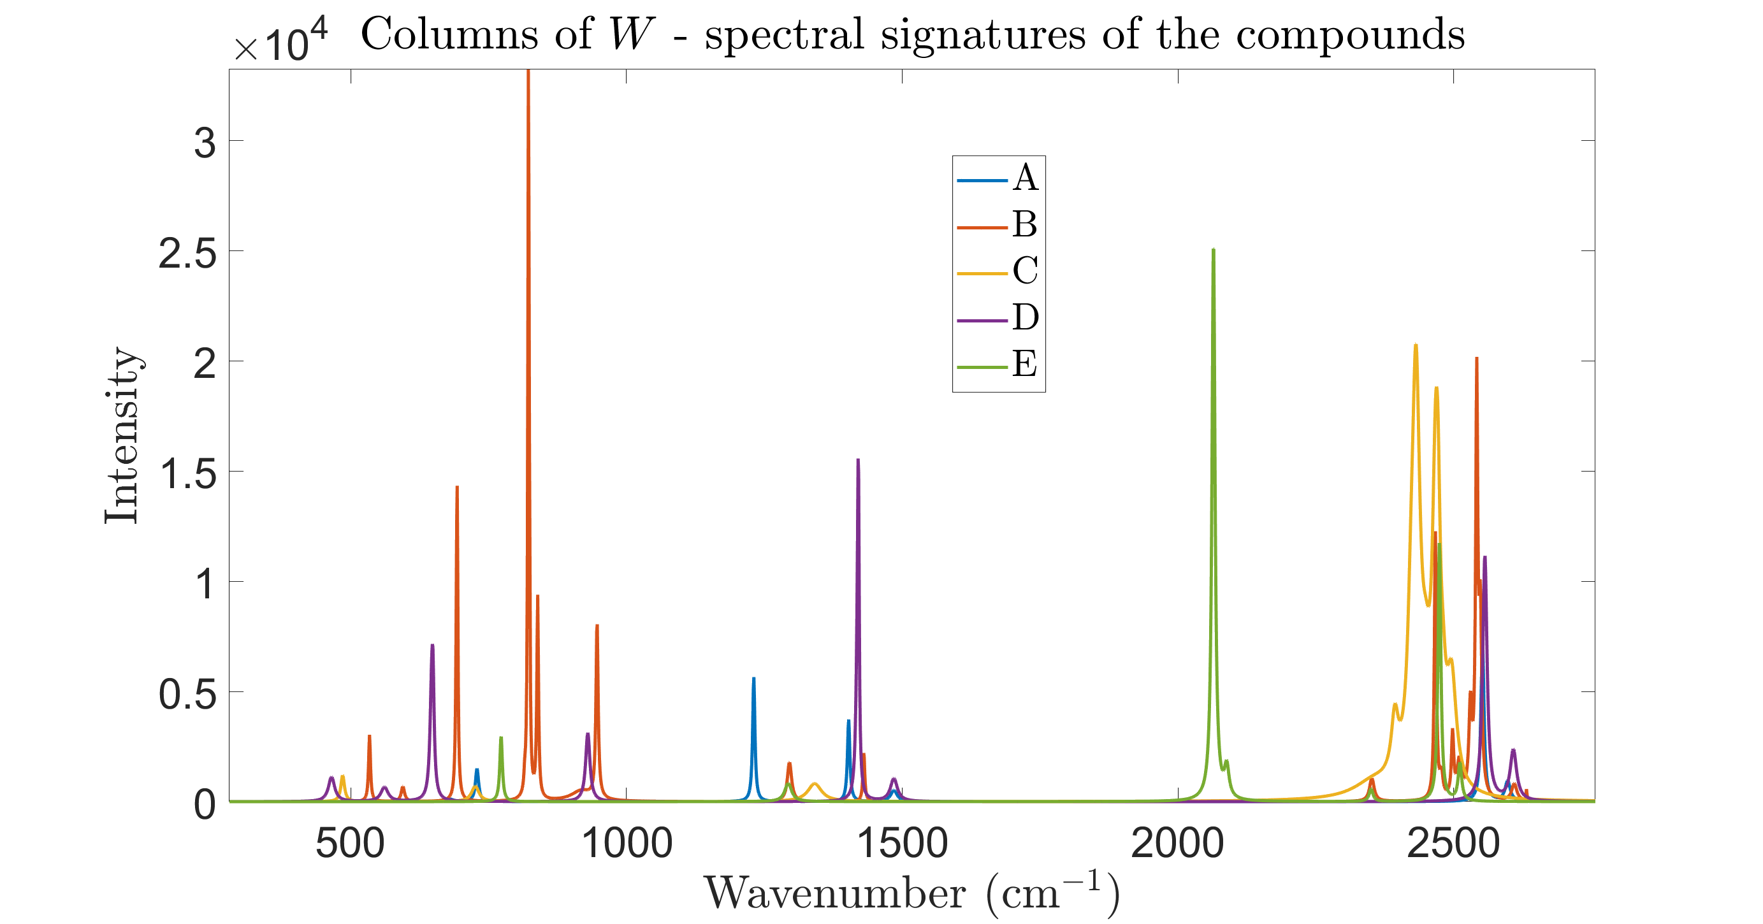
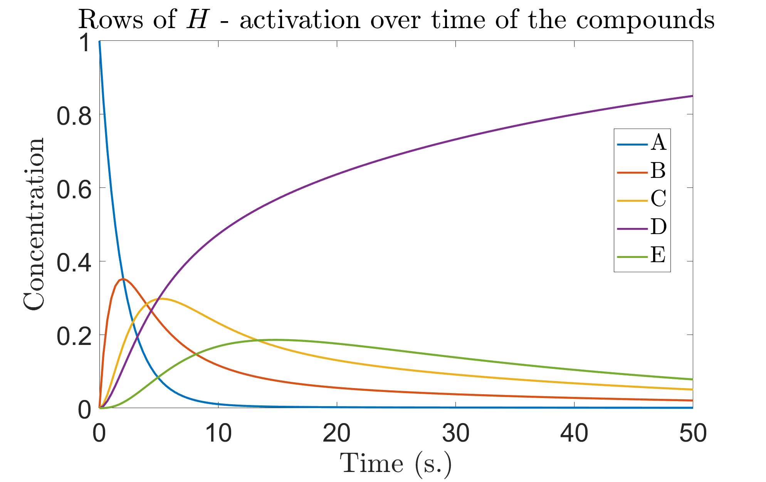
Hyperspectral Unmixing
Notes:
- each row of input matrix X corresponds to wavelengths where intensity is recorded
- each column corresponds to spectra sample

Slide 48
NMF Applications
Text mining: (Xu et al., 2003; Berry and Browne, 2006; Kim and Park, 2008)
Images:
unsupervised object discovery (Sivic et al., 2005)
object and face recognition (Soukup and Bajla, 2008)
tagging (Kalayeh et al., 2014)
denoising and inpainting (Mairal et al., 2010)
texture classification (Sandler and Lindenbaum, 2011)
spectral data (Berry et al.)
hashing (Monga and Mihcak, 2007)
watermarking (Lu et al., 2009)
Electroencephalography (EEG) data:
feature extraction (Cichocki and Rutkowski, 2006; Lee et al., 2009)
artifact rejection (Damon et al., 2013a,b)

Slide 49
NMF Applications (cont.)
Bioinformatics:
gene expression analysis (Brunet et al., 2004; Gao and Church, 2005)
protein interaction clustering (Greene et al., 2008) • Other:
collaborative filtering (Melville and Sindhwai, 2010)
community discovery (Wang et al., 2010)
portfolio diversification (Drakakis et al., 2007)
food consumption analysis (Zetlaoui et al., 2010)
industrial source apportionment (Limem et al., 2013)

Slide 50
NMF Applications (cont.)
Source separation (NMF is state-of-the art):
speech: separating voices in speech mixtures or voice from background (Virtanen, 2007; Virtanen and Cemgil, 2009; Mohammadiha et al., 2013)
music: separating singing voice/melody from accompaniment or musical instruments in polyphonic mixtures (Durrieu et al., 2009; Ozerov and Fevotte, 2010; Hennequin et al., 2011; Ozerov et al., 2013; Rafii et al., 2013)
Signal enhancement/denoising: (Wilson et al., 2008; Schmidt et al., 2007; Sun and Mazumder, 2013)
Audio inpainting (Roux et al., 2011; Yilmaz et al., 2011)

Slide 51
NMF Softwares
Nicolas Gillis / NMFbook · GitLab
The Non-Negative Matrix Factorization Toolbox in MATLAB (google.com)
CRAN - Package NMF (r-project.org)
Welcome to Nimfa — Nimfa 1.3.1 documentation (biolab.si)
GitHub - hiroyuki-kasai/NMFLibrary: NMFLibrary: Non-negative Matrix Factorization (NMF) Library: Version 2.1
GitHub - satwik77/libnmf: Optimization and Regularization variants of Non-negative Matrix Factorization (NMF)

Slide 52
Summary of SVD versus NMF

Slide 53
SVD, PCA, ICA or NMF?
Depends on what you want to do
PCA does a fantastic job in dimensionality reduction
ICA provides a clean output
And is perceptually more relevant
NMF provides interpretable outputs
But only for non-negative data
As usual there is no right answer
When in doubt try them all!

Slide 54
